Slide 1
AUTOMATIC CONTROL OF TWO WHEELER USING SMART HELMET
K. Rohith

Slide 2
INTRODUCTION OF HELMET
A smart helmet is the special idea which makes bike driving safety then before . An helmet can reduce shock from the impact and may save a life. The main purpose of the smart helmet is to provide safety for rider. This implementation by using advance features like alcohol detection, accident identification . This makes not only smart helmet but also feature of smart bike.
FOLLOW THE RULES BUT ,NEVER FORGET TRAFFIC RULES.......

Slide 3
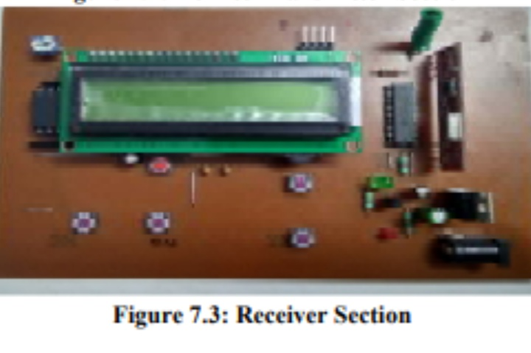
RECEIVER
The HT12D converts the serial input into outputs . It decodes the serial addresses and data received b an RF receiver , to the parallel data and sends them to output data pins.

Slide 4
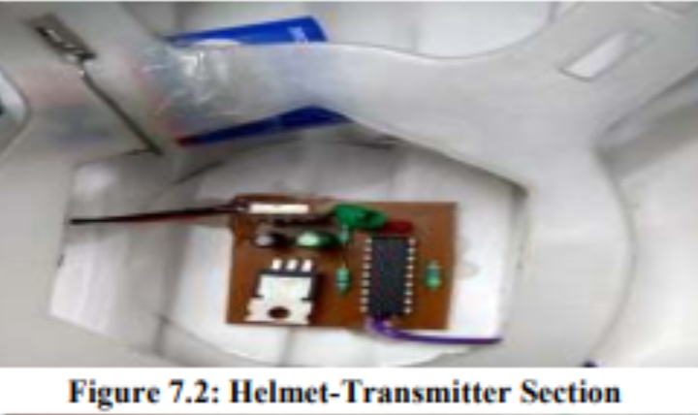
TRANSMITTER
The transmitter combines the information signal to be carried with the radio frequency signal which generates the radio waves, which is called as carrier signal....In a frequency modulation .

Slide 5
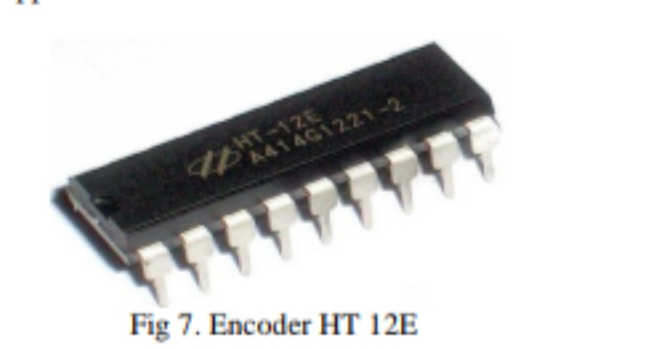
ENCODER
Encoder are used to translate rotary or linear motion into a digital signal. Usually this is for the purpose of monitoring or controlling motion parameters such as speed , distance or position.

Slide 6
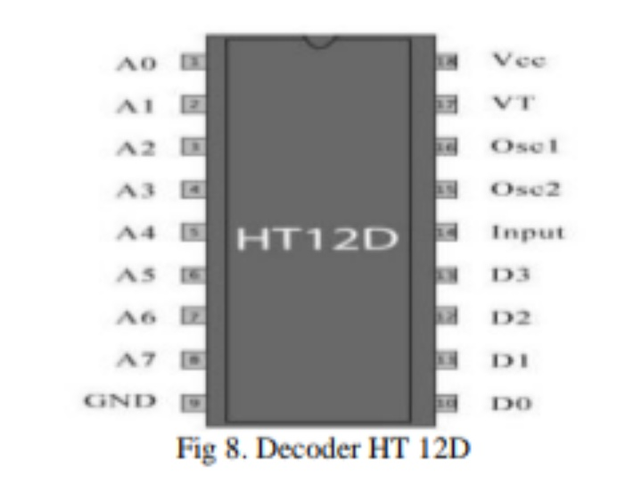
DECODER
A Decoder is a circuit that changes a code into set of signals . It is called a decoder because it does the reverse of encoding.

Slide 7
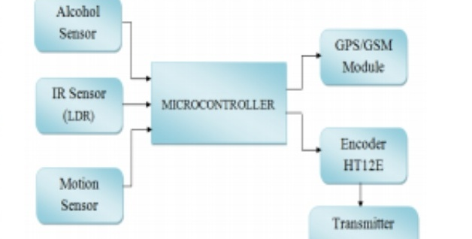
THE TRANSMITTER SECTION
A Micro controller is a small computer on a single integrated circuit.

Slide 8
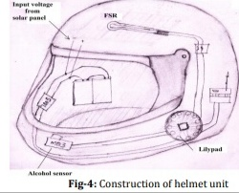
We already mentioned that we divide a project in two units namely helmet and bike . Here is the construction of the helmet unit

Slide 9
FUTURE SCOPE OF THE PROJECT
In this project we are using IR sensor which detects any obstacle .
We can completely take control of signalling into our finger tips.
This technology can also be used for cars to put the seat belt also.

Slide 10
CONCLUSION OF THE PROJECT
The main aim of this project is to protect the life of the rider.
Reduce the death rate.

Slide 11
THANK YOU

