Slide 1
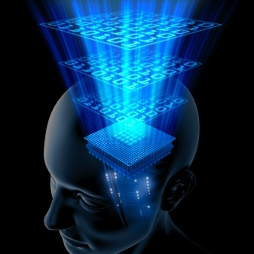
Brain Chips

Slide 2
Overview of brain chip
Introduction
Evolution towards implantable brain chips
Achievements
Challenges
Benefits of brain chips
Drawbacks of brain chips
Conclusion

Slide 3
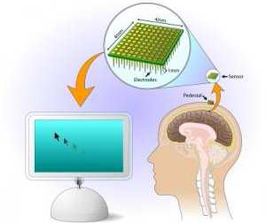
Introduction
WHAT IS BRAIN CHIP?
ELECTRODE
SENSOR

Slide 4
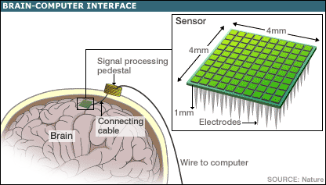
HOW TO IMLEMENT BRAIN CHIP?

Slide 5

WORK OF BRAIN CHIP
Brain chips records brain signals and transmits them to muscles.
Brain chips can enhance memory of human beings, help paralyzed patients and are intended for military purposes.
It develop direct interface between brain and computers.

Slide 6

Evolution towards brain chips
Jose Delgado’s experiments.
Jose Delgado controlling a bull with stimoceiver

Slide 7
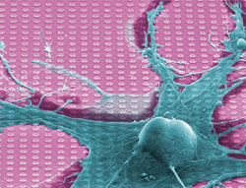
Brain cells and silicon chips linked electronically
Tiny Electrode arrays
Fromherz researches led to the growth of three or four neurons on a 180x180 transistor array
Max Planck Institute grew snail neuron on a CMOS chip with 128x128 Transistors

Slide 8
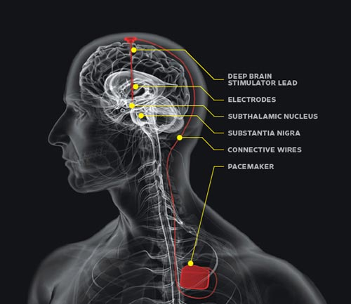
Achievements In This Field
Brain “pace makers”
They are implantable silicon neurons that would perform the function of a part of brain that has been damaged by stroke or epilepsy.

Slide 9
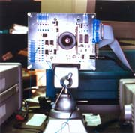
Retinomorphic chip
Retinomorphic chip is a silicon device similar to the human eye, picks out the kinds of features and facial patterns that we use to recognize people and read their emotional state.
It contains nearly 6000 photoreceptors and 4000 synthetic nerve connections .The chip is only 1/8 th the size of retina .It uses only 0.06 watts.

Slide 10
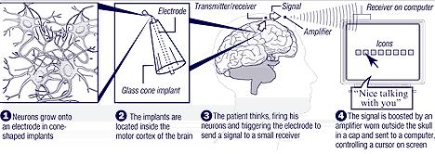
Invisible mouse
It helps the user to transmit the signals picked up from the brain and translate them into cursor commands on the computer

Slide 11

Remote controlled Rat
Movement signals are transmitted from computer to the brain of rat through a radio receiver strapped to its back.
Military purposes and human rescue operations

Slide 12
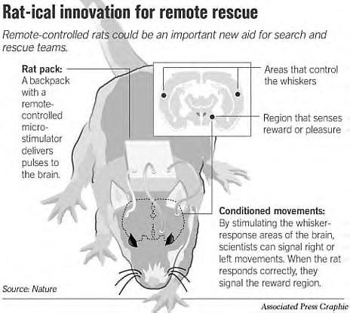

Slide 13
Challenges Faced by
Scientists
Interface between biology and technology.
Giving a paralyzed person complete control over robotic arms.
Decreasing the size of chip.

Slide 14
Benefits Of Brain Chips
It will increase the dynamic ranging of senses and enabling. Brain cells enable users to see IR,UV and chemical spectra.
It will enhance memory.
It will enable “cyberthink”.
It will enable consistent and constant access to information where and when it is needed
The advantage of implants is that they take the decision making power away from the addict. Chips take away one's free will. It enables a person to make a better choice not to take drugs at all.

Slide 15
Drawbacks of brain chip technology
It cannot reliably predict all the effects.
Safety
Individual needs are not realized.
It may create social inequality.

Slide 16

Brain chips could help paralyses
patients

Slide 17
Conclusion
Brain chips enhance capability of human organs and senses.
It has a significant role to play in future genetic engineering fields and neuroscience.
Let’s hope this technology will be used for restoring peace of world and not giving the world a devastating end.

