Slide 1







Technology Trends Analysis Report
Niha Fathima Abdul Babu
08-May-2022

Slide 2



OUTLINE
Executive Summary
Introduction
Methodology
Results
Visualization – Charts
Dashboard
Discussion
Findings & Implications
Conclusion
Appendix

Slide 3

EXECUTIVE SUMMARY
Current Technology
Language
Database
Platform
Webframe
Future Technology
Language
Database
Platform
Webframe
Demographic Analysis
Country & Gender

Slide 4

INTRODUCTION
Analyze technological trends to identify the emerging skills across the IT Industry
Purpose of the presentation
Identify the top emerging programming skills in order to train the IT resources to compete in the market.
Identify the commonly used databases
Identify the trending platforms used for IT projects
Identify the trending web frames used for developing projects
Target Audience
IT Organizations
Recent IT/Computer Science Graduates
Freelance Programmers

Slide 5

METHODOLOGY
Data Collection
Data Wrangling Techniques
Data Exploration
Data Cleaning
Data Visualization
IBM Cognos
Presentation

Slide 6
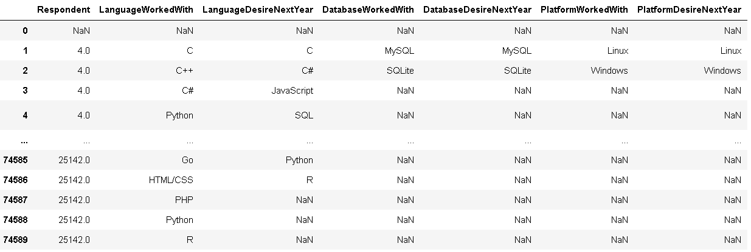
RESULTS

Slide 7
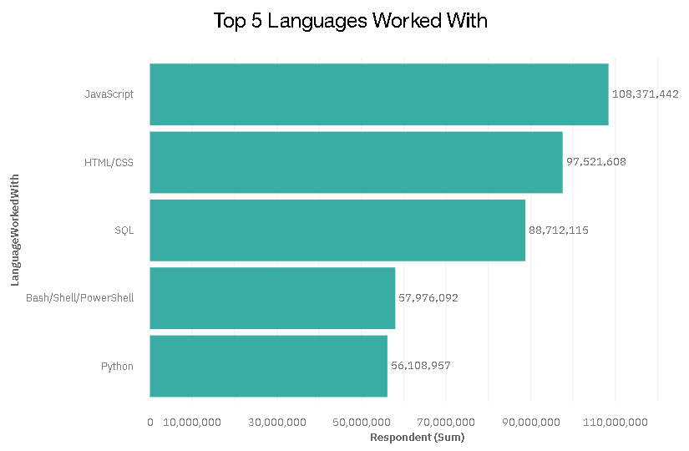
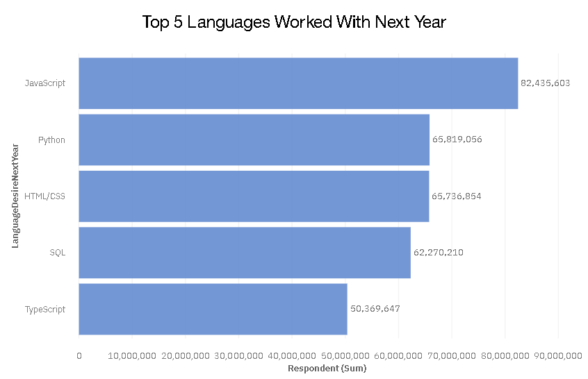
PROGRAMMING LANGUAGE TRENDS
Current Year
Next Year

Slide 8
PROGRAMMING LANGUAGE TRENDS - FINDINGS & IMPLICATIONS
Findings
Java Script is the top trending language in the world
Python and Typescript are becoming more and more popular
HTML/CSS and SQL still have a great portion in the language usage trend
Implications
Client-side Security is a major concern in JavaScript as code is viewable to the user, others may use it for malicious purposes.
Python is the go-to language these days due to its simplicity however they are not ideal for mobile app development due to the consumption of more memory and its slow processing speed

Slide 9
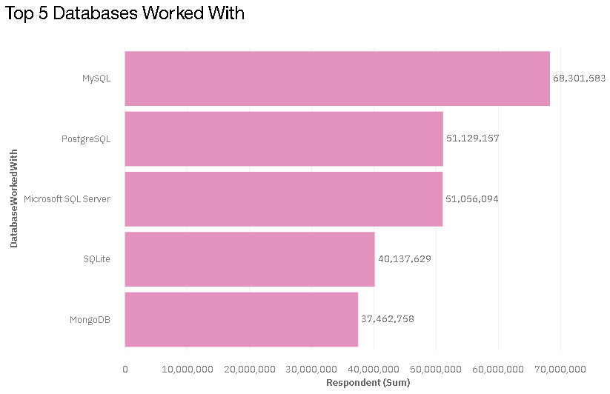
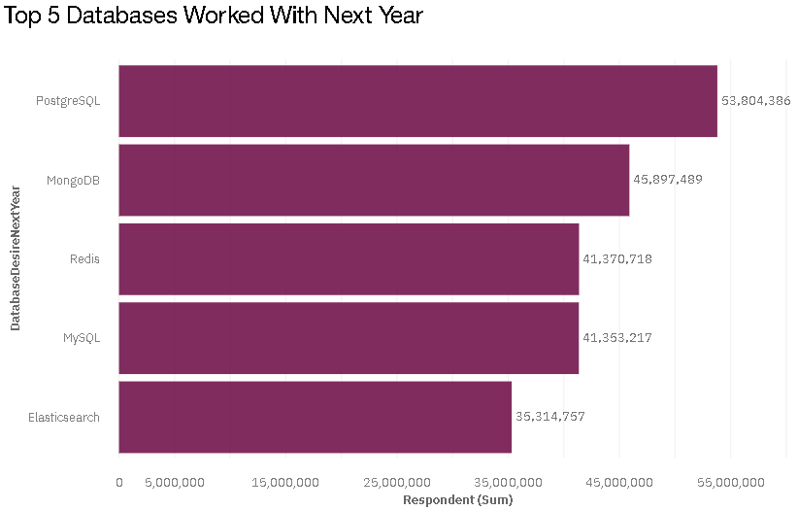
DATABASE TRENDS
Current Year
Next Year

Slide 10
DATABASE TRENDS - FINDINGS & IMPLICATIONS
Findings
MySQL is the most popular database
There are still a lot more companies using Microsoft SQL server
MongoDB and Redis are the most favorable NoSQL database
Implications
Open source DBs are the new trend however the key implication around that is a lack of usability.
Similarly, NoSQL despite being successful does not always promise the ACID properties, which is Atomicity, Consistency, Isolation, Durability, of the transactions.

Slide 11

DASHBOARD
The Permanent link to the Cognos Dashboard is as follows:
https://eu-gb.dataplatform.cloud.ibm.com/dashboards/2e5761e2-b98e-47c9-a462-80409dd98278/view/6218ab0c239112c96feee2e407cf2b527966240cb3bb8751d4d67b490b367197f06d12c7c8281d5dda12046af1e91758c8

Slide 12
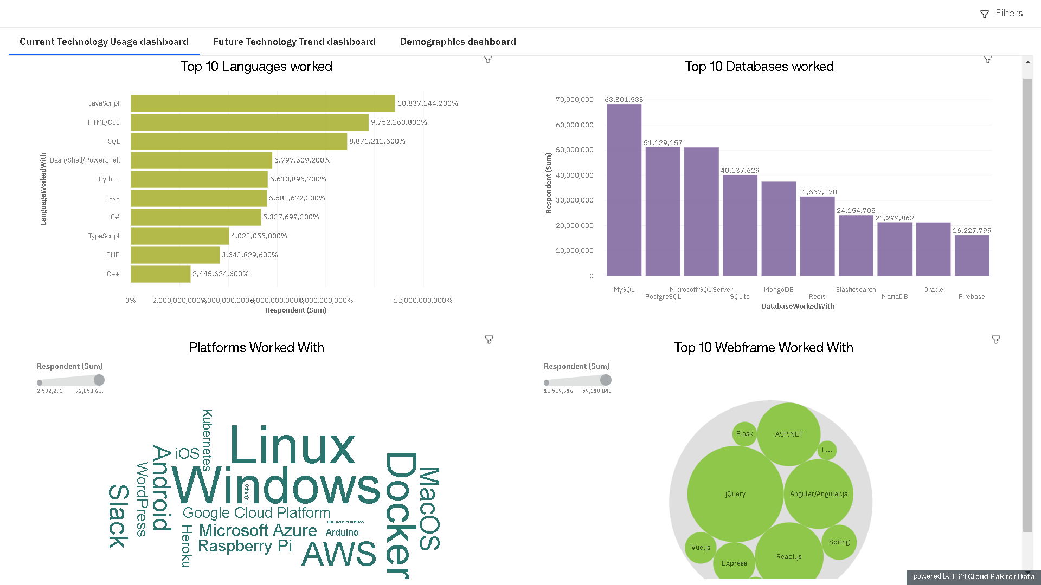
CURRENT TECHNOLOGY USAGE

Slide 13
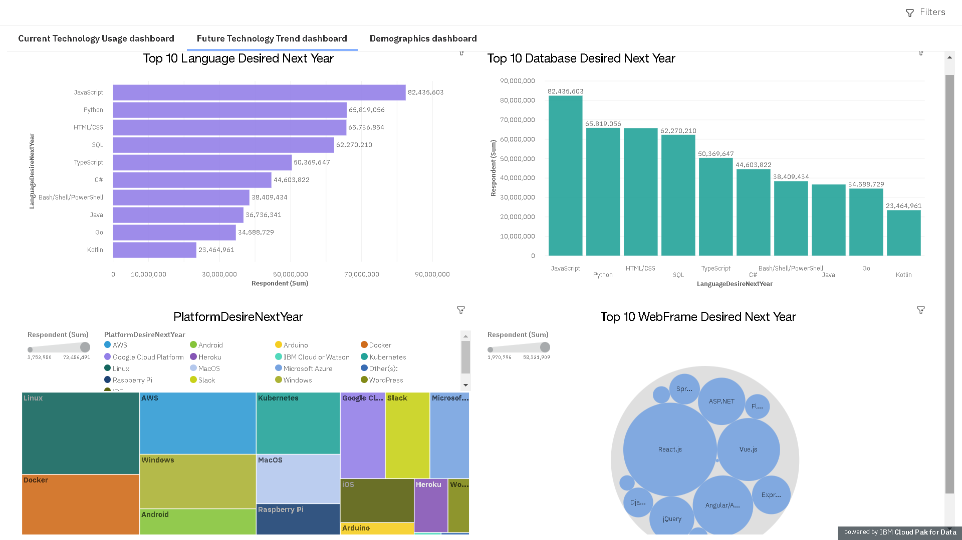
FUTURE TECHNOLOGY TREND

Slide 14
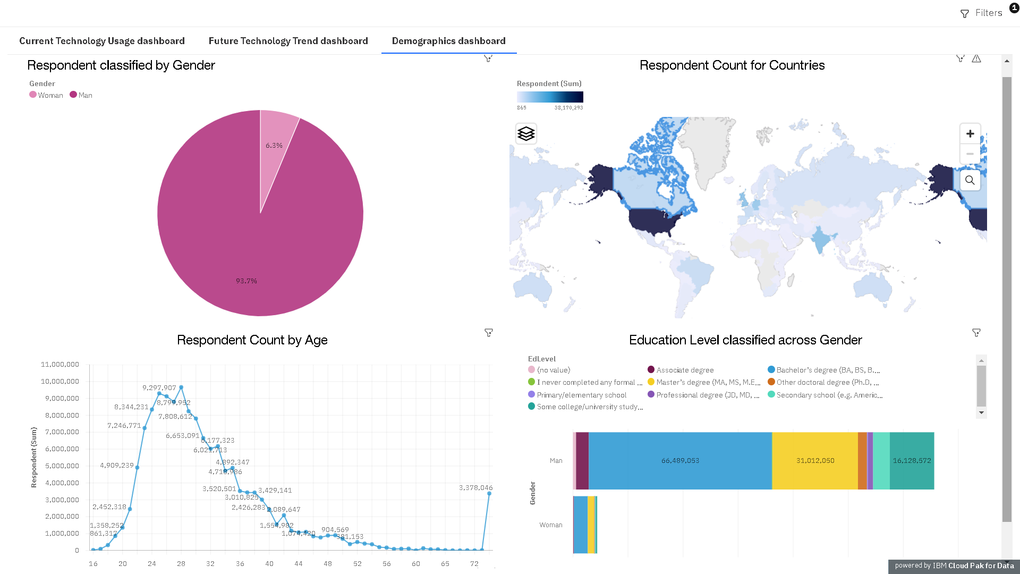
DEMOGRAPHICS

Slide 15
DISCUSSION
A lot of countries are still deprived of this wonderful technical enhancement. Does education play a role in this?
Education level between gender is causing major concerns and rising more questions as to when will be dawn to this global issue.

Slide 16
OVERALL FINDINGS & IMPLICATIONS
Findings
Technology trends change every year
USA is the top technology country
There are extreme gender and age discrimination
Docker and AWS are the most popular platform
Implications
Based on the continuous technological improvements, programmers have to keep themselves updated with the latest trends
Gender and Age discrimination continues to be a major concern due to a lack of resources and exposure

Slide 17

CONCLUSION
Technologies are continuing to thrive with trends are changing year on year
We are seeing the boom of new technologies, databases, and development platforms teasing the IT industries with numerous benefits
Countries have started implementing more technological solutions in their journey toward becoming a developed nation
Education continues to be the major point of discussion when it comes to gender equality

Slide 18

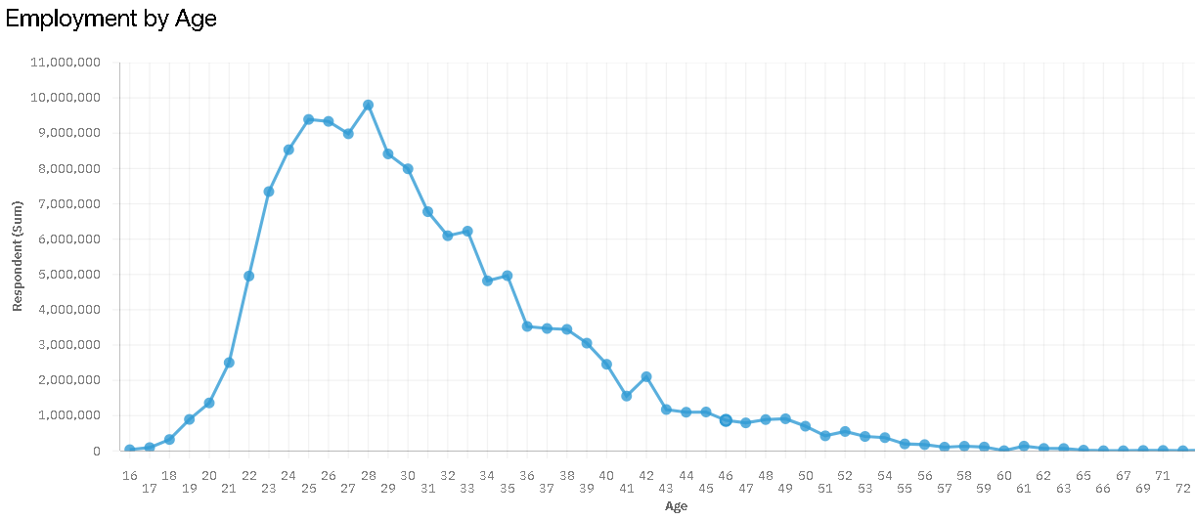
APPENDIX
Another interesting factor determined during the analysis was the average age of a working individual. It roughly spans between 20 – 40, beyond which there is a significant drop in the values.

Slide 19
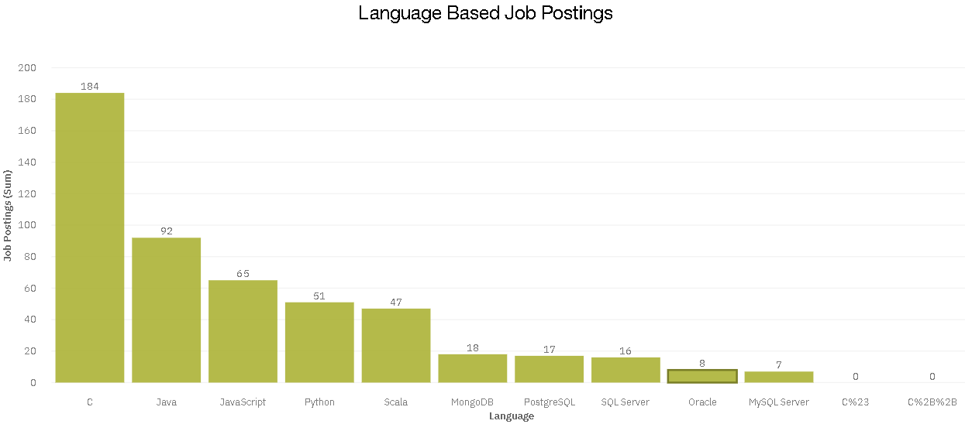
GITHUB JOB POSTINGS

Slide 20
POPULAR LANGUAGES

