Slide 1

Exploratory Data Analysis
Steps
Submitted By: Nihal Singh

Slide 2
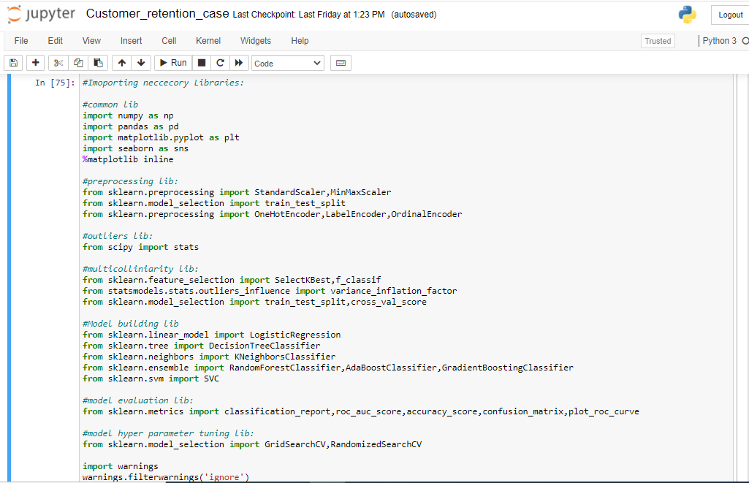
Importing Libraries:
Importing the Libraries used for preprocessing.

Slide 3
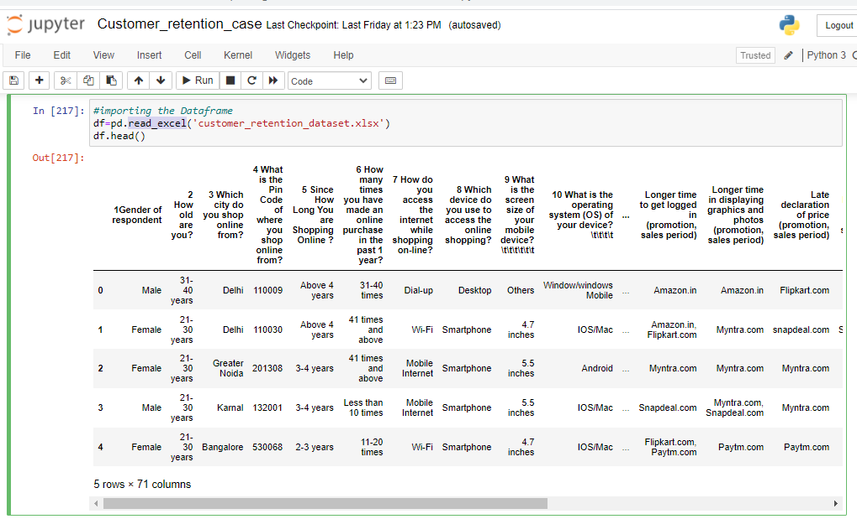
Fetching the Data frame:
Using the pandas library to import the data from excel file to data frame.
The library has been used read_excel.
Using strip in the lambda function to remove the space and unwanted data from
the column of the data frame.

Slide 4
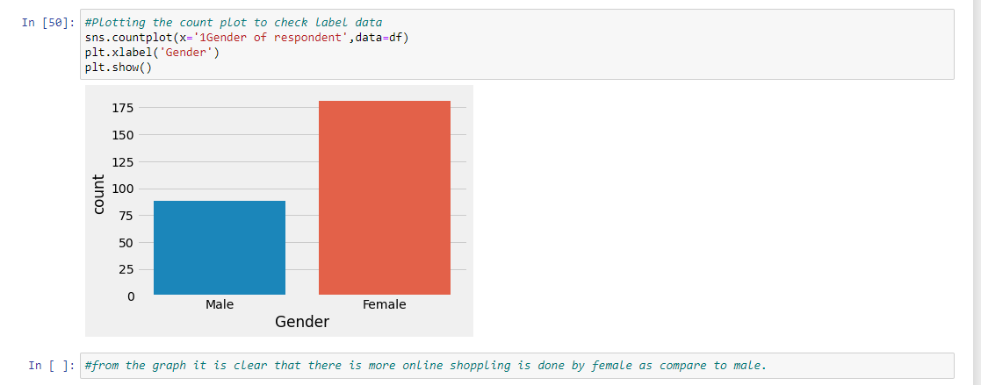
Plotting the Count Plot:
Using the count plot to plot the Count graph for the features in the data frame.
From the graph it is clear that the sopping is more done by female as compare to male.

Slide 5
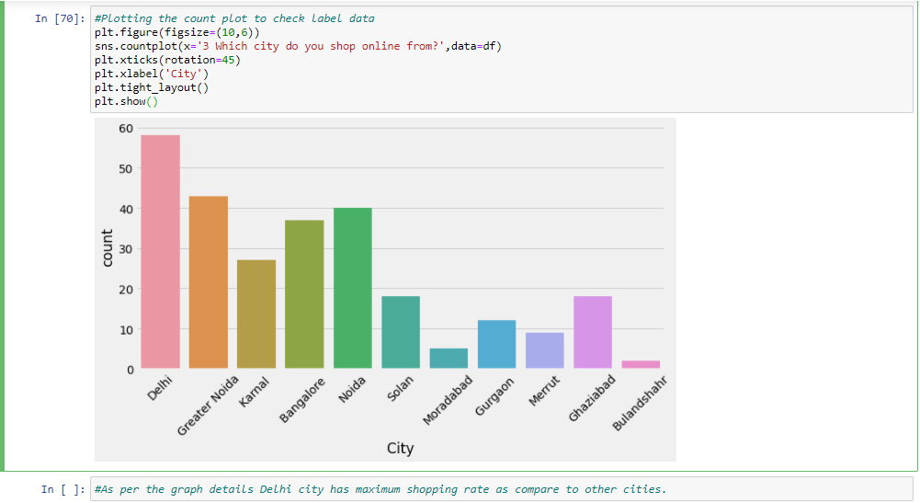
Plotting the Count Plot:
Using the count plot to plot the Count graph for the features in the data frame.
From the graph we can conclude that the metro city delhi has the max e-commerce buyer as compare to other city.

Slide 6
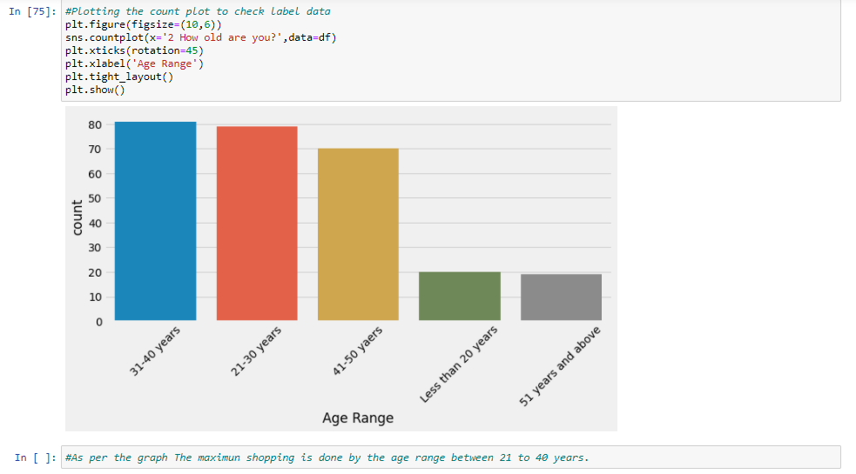
Plotting the Count Plot:
Using the count plot to plot the Count graph for the features in the data frame.
From the graph we can conclude that the age range where the max shopping is done between 21 to 40 years..

Slide 7
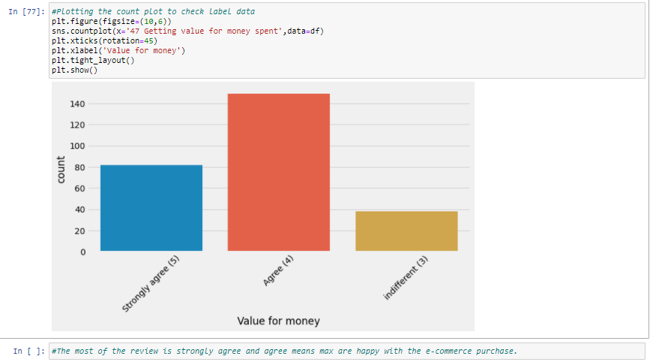
Plotting the Count Plot:
Using the count plot to plot the Count graph for the features in the data frame.
From the Count plot it is clear that most of the customers are strongly agree or agree means most are the happy customers with e-commerce shopping.

Slide 8
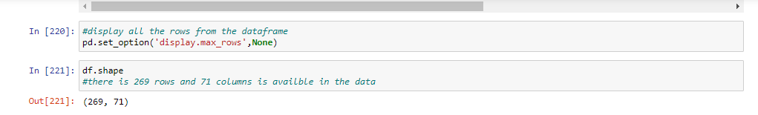
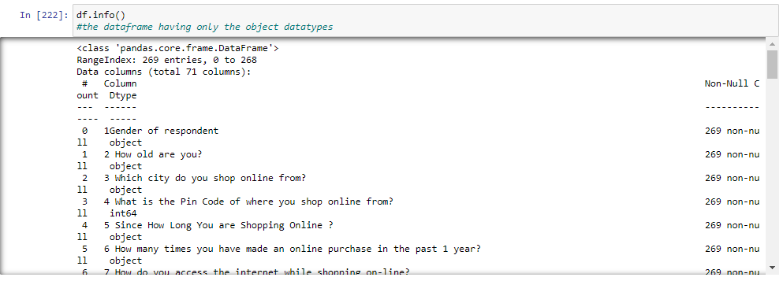
Checking the Shape and info of Data Frame:
Checking the shape of the Data frame using the .shape method.
The shape of the give data frame is (269,71)
Checking the datatype information about the data frame using the info method.

Slide 9
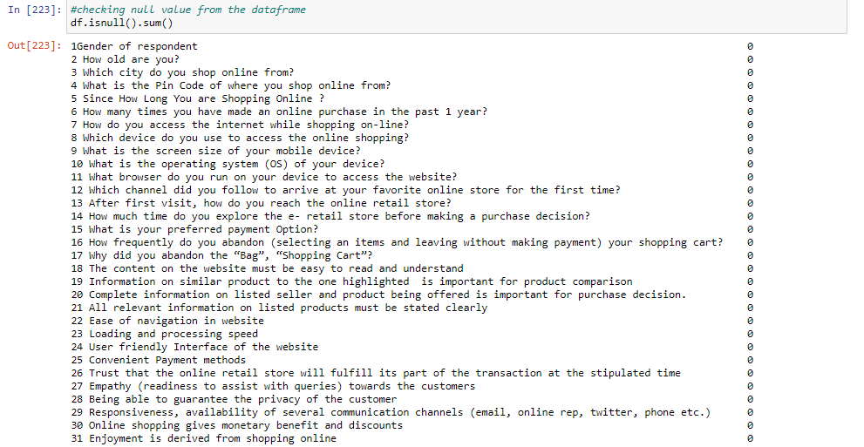
Checking the Null value count in Data frame:
Checking the null value count from every column of data frame.
Using the isnull().sum() method to check the null values. There is no null values in columns.

Slide 10
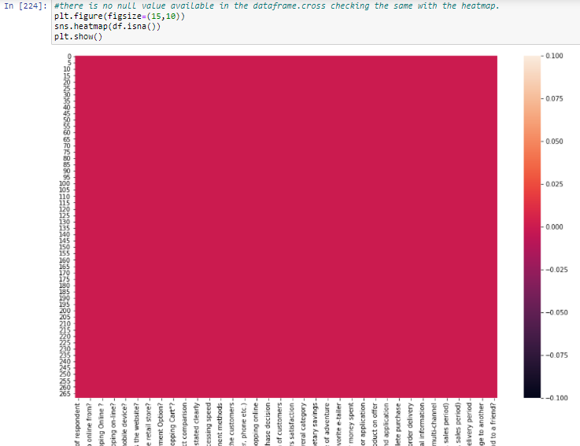
Checking the Null value using Heat map:
Checking the null value count from every column of data frame using the heat map.
Using the seaborn library and using the heat map from the library. There is no null values present in the given data frame.

Slide 11
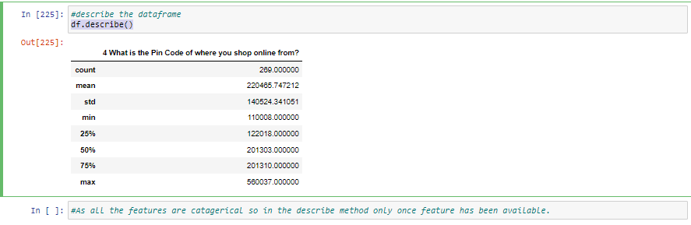
Using Describe Method to describe the data frame:
Using the describe method to describe the numerical columns.Describe method
only work on the numerical data features.
Describe is basically provide the count,mean,standered deviation,min max and quantile details of the columns data.it can be display using df.describe().

Slide 12
Using the Encoding Method to encode the categorical Data:
The Encoding method is used to encode the categorical data into numerical data as the machine learning is not understand the categorical data so using the encoding method to encode the categorical value into numerical values.
Using the label encoding method to encode the categorical value into 0 and 1.
Label encoder is basically used when required only two outputs.
The label encoder is available in the library sklearn.preprocessing.
At first import the Label encoder then use the fit_transform to encode the categorical column value into numerical value.

Slide 13
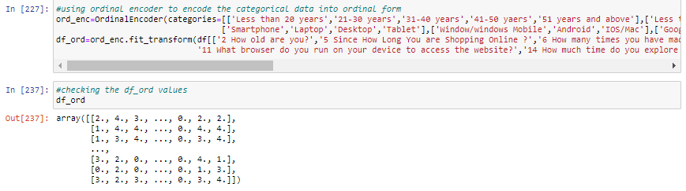
Using the Encoding Method to encode the categorical Data:
The other encoding method used is Ordinal Encoder.
The Ordinal encoder method is used to encode the data in the given order which is provided to it.
It basically encode the categorical data into the numerical order sequence.
Ordinal encoding techniques encode the data and make it to array format.

Slide 14
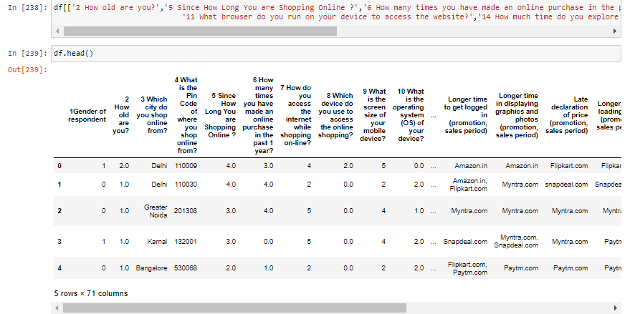
Using the Encoding Method to encode the categorical Data:
After the Ordinal Encoding Assign the encoded value to the data frame features whose categorical data has been encoded.

Slide 15
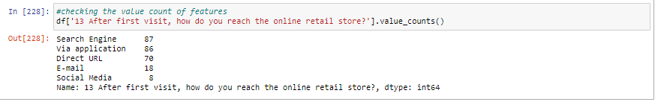
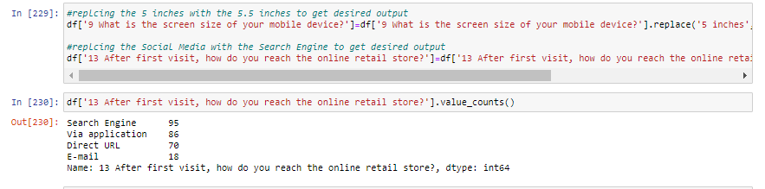
Replace the values from the features:
Checking the values count of the features which data has to replace with the some other data to get the desired output.
Now replacing the data from the features using the .replace method.

Slide 16
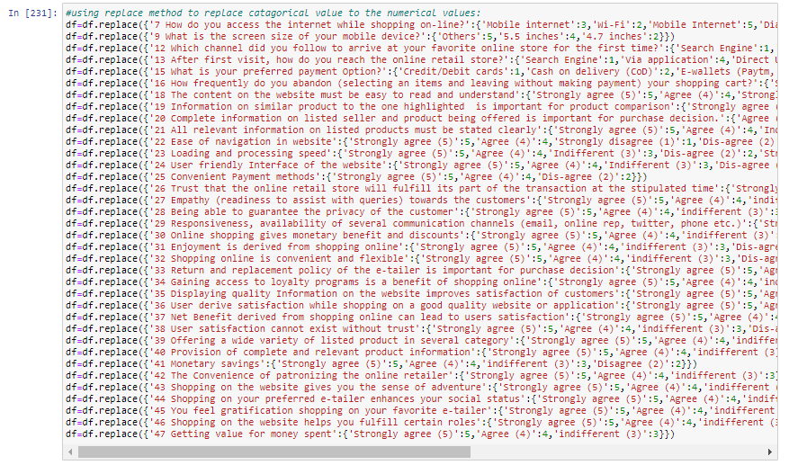
Using the Replace method to replace the data from the features:
Using the replace method to replace the categorical data from feature to numerical values.

Slide 17
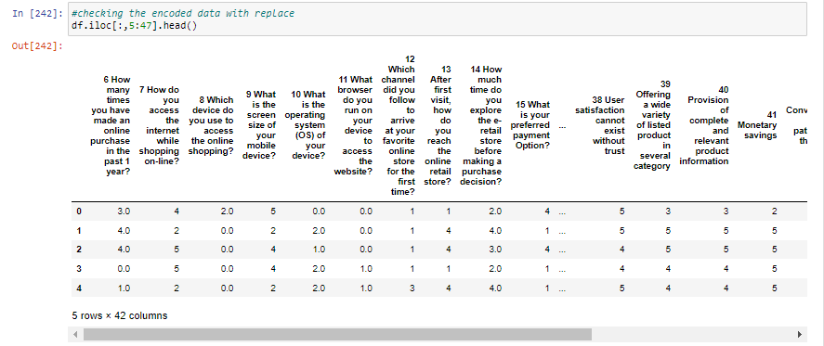
Checking the Data frame value after the replace method:
Checking the data frame values after using the replace to get the desired output.
.

Slide 18
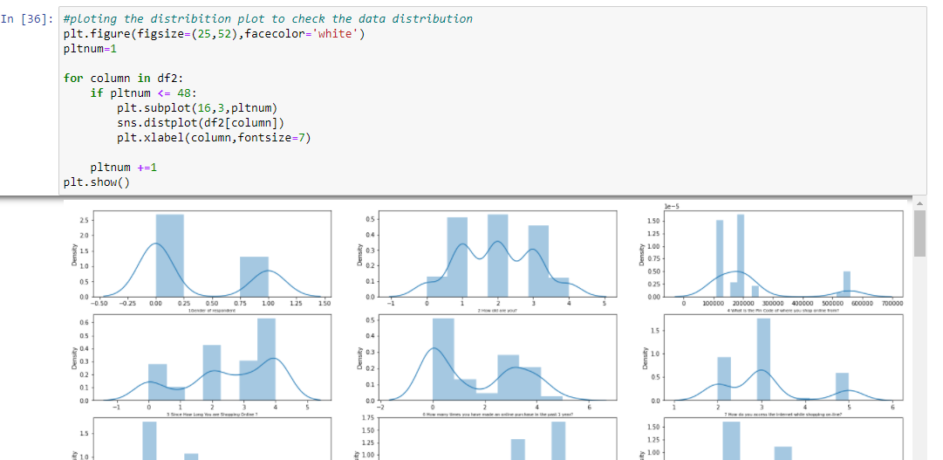
Plotting the Distribution Plot:
Using Distribution plot to plot the distribution graph for the features in the data frame.

Slide 19
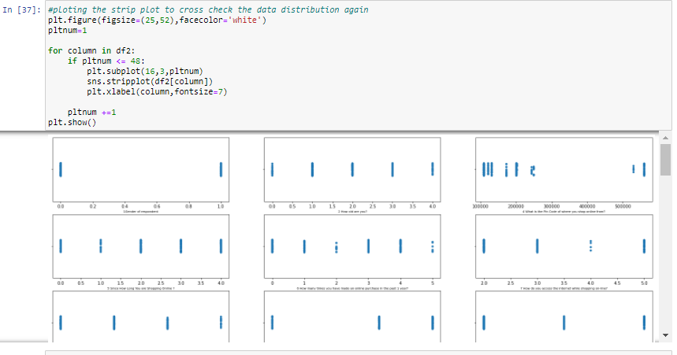
Plotting the Strip Plot:
Using strip plot for the data distribution graph for the features in the data frame.

