Slide 1

WELCOME TO MAN BANK

Slide 2
Project web technology III SEM
MAN BANK WEBPAGE
BY
MANIKANATA R
ABHILASH H
NIHAL S

Slide 3
Introduction:-
Man bank it is a banking web page which consist of some common things what other banking websites have.
Here we tried to use HTML,CSS,JS,PHP to create web pages which are all required.

Slide 4
Web pages are :
HOME
CREATE ACCOUNT
BALANCE
DEPOSIT
WITHDRAW
TRANSFER
CLOSE
ABOUT
FAQ

Slide 5
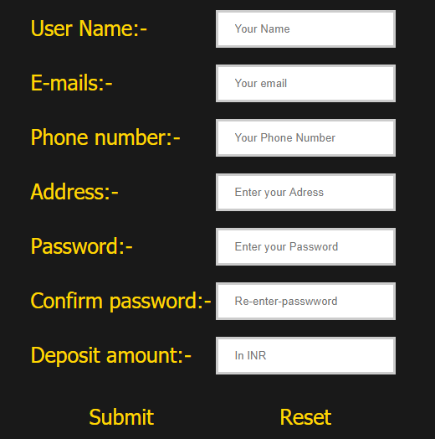
1.CREATE ACOOUNT :
Here in this we are asking user to enter his name ,phone number ,email ID, password,address and his confirmation to create an account in our bank.

Slide 6
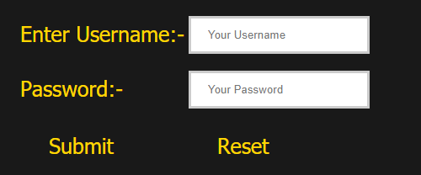
2. BALANCE :
Here user needs to enter his username and password to check the balance of his account.
By clicking submit button he can make sure to check his balance or he can reset it if anything goes wrong.

Slide 7
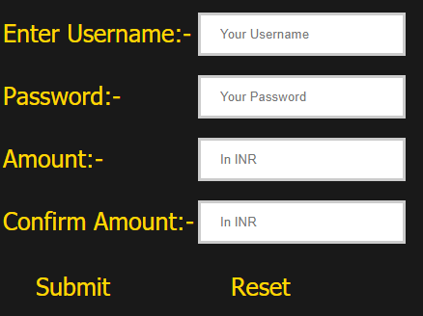
3. DEPOSIT :
In this page user needs to enter his username and password to deposit amount to his account.
Then he needs to enter the amount to be deposited . By clicking submit button he can make sure to check his balance or he can reset it if anything goes wrong.

Slide 8
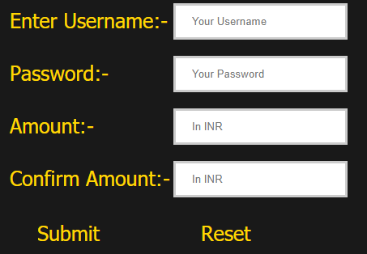
4. WITHDRAW :
Ii is also same as deposit user needs to enter his username and password to deposit amount to his account.
Then he needs to enter the amount to be withdraw . By clicking submit button he can make sure to check his amount is correct or he can reset it if anything goes wrong.

Slide 9
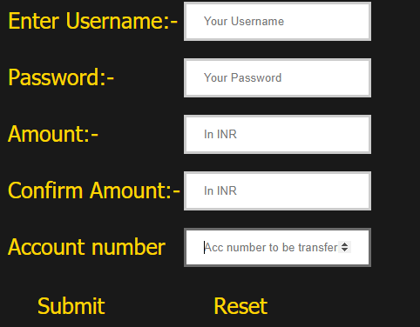
5.TRANSFER :
Here user needs to enter his username and password to enter his account.
And need to give the account number to where money to be transfer.

Slide 10
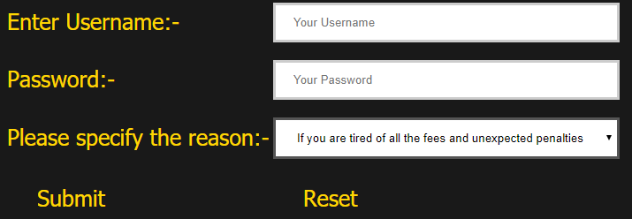
5.Close :
If costumer wants to close his account he needs to enter his name , password and specify the reason to close account.
By submitting he can close his account.

Slide 11
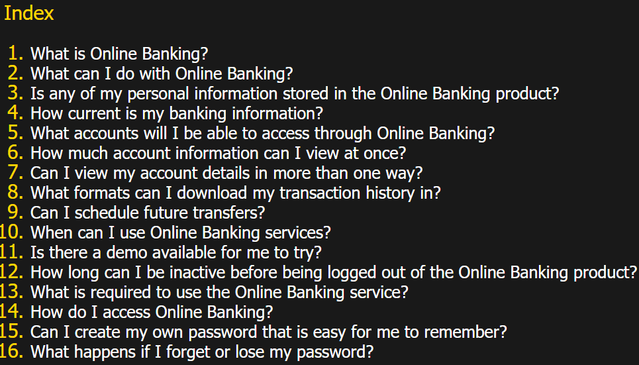
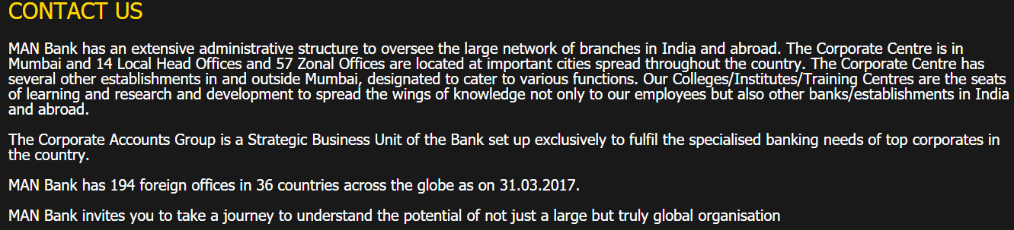
6. FAQ : 7.ABOUT :
This is section is for any queries and doubts user need to clarify he can refer this page.

Slide 12
THANK YOU

