Slide 1
What is Android?
Android is a software package and Linux based operating system for mobile devices such as tablet computers and smartphones.
It is developed by Google and later the OHA (Open Handset Alliance). Java language is mainly used to write the android code even though other languages can be used.

Slide 2
Open Handset Alliance
It's a consortium of 84 companies such as google, Samsung, AKM, synaptics, KDDI, Garmin, Teleca, Ebay, Intel etc.
It was established on 5th November, 2007, led by Google. It is committed to advance open standards, provide services and deploy handsets using the Android Platform.

Slide 3
Features
1) It is open-source.
2) Anyone can customize the Android Platform.
3) There are a lot of mobile applications that can be chosen by the consumer.
4) It provides many interesting features like weather details, opening screen, live RSS (Really Simple Syndication) feeds etc.

Slide 4
Android Architecture
linux kernel
native libraries (middleware),
Android Runtime
Application Framework
Applications

Slide 5
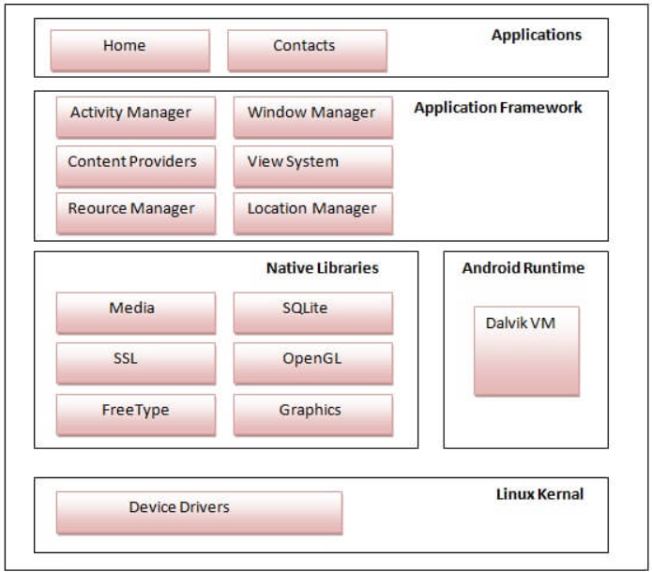

Slide 6
Linux Kernel
It is the heart of android architecture that exists at the root of android architecture. Linux kernel is responsible for device drivers, power management, memory management, device management and resource access.
Native Libraries
On the top of linux kernel, their are Native libraries such as WebKit, OpenGL, FreeType, SQLite, Media, C runtime library (libc) etc.

Slide 7
Android Runtime
In android runtime, there are core libraries and DVM (Dalvik Virtual Machine) which is responsible to run android application. DVM is like JVM but it is optimized for mobile devices. It consumes less memory and provides fast performance.
Android Framework
On the top of Native libraries and android runtime, there is android framework. Android framework includes Android API's such as UI (User Interface), telephony, resources, locations, Content Providers (data) and package managers. It provides a lot of classes and interfaces for android application development.

Slide 8
Applications
On the top of android framework, there are applications. All applications such as home, contact, settings, games, browsers are using android framework that uses android runtime and libraries. Android runtime and native libraries are using linux kernal.

Slide 9
Data Structures and File Systems
AndroidManifest.xml:
Every project in Android includes a manifest file, which is AndroidManifest.xml, stored in the root directory of its project hierarchy. The manifest file is an important part of our app because it defines the structure and metadata of our application, its components, and its requirements.
This file includes nodes for each of the Activities, Services, Content Providers and Broadcast Receiver that make the application and using Intent Filters and Permissions, determines how they co-ordinate with each other and other applications.

Slide 10
Java:
The Java folder contains the Java source code files. These files are used as a controller for controlled UI (Layout file). It gets the data from the Layout file and after processing that data output will be shown in the UI layout. It works on the backend of an Android application.
Drawable:
A Drawable folder contains resource type file (something that can be drawn). Drawables may take a variety of file like Bitmap (PNG, JPEG), Nine Patch, Vector (XML), Shape, Layers, States, Levels, and Scale.

Slide 11
layout:
A layout defines the visual structure for a user interface, such as the UI for an Android application. This folder stores Layout files that are written in XML language. You can add additional layout objects or widgets as child elements to gradually build a View hierarchy that defines your layout file.
mipmap:
Mipmap folder contains the Image Asset file that can be used in Android Studio application. You can generate the following icon types like Launcher icons, Action bar and tab icons, and Notification icons.

Slide 12
colors.xml:
colors.xml file contains color resources of the Android application. Different color values are identified by a unique name that can be used in the Android application program.
strings.xml:
The strings.xml file contains string resources of the Android application. The different string value is identified by a unique name that can be used in the Android application program. This file also stores string array by using XML language.

Slide 13
styles.xml:
The styles.xml file contains resources of the theme style in the Android application. This file is written in XML language.
build.gradle(Module: app):
This defines the module-specific build configurations. Here you can add dependencies what you need in your Android application.

Slide 14
Rooting/Jailbreaking
Rooting, cracking, or jailbreaking a mobile device, in practice, is essentially the same thing. Essentially, rooting is the term used for modifying Androids while jailbreaking is the term used for iPhones.
Fundamentally, rooting is obtaining root access to the underlying Linux system, in order to perform operations such as mounting/unmounting filesystems; running SSH, HTTP, DHCP, DNS or proxy daemons; killing system processes; and so on.
Being able to run commands as the root user allows us to do anything on Linux and thus, by extension, on an Android system.
Jailbreaking is the process of privilege escalation, by which we can remove the hardware level restrictions imposed by Apple on iOS devices. Jailbreaking permits root access to the iOS filesystem and manager, allowing the downloading of additional applications, extensions, and themes that are unavailable through the official Apple App Store.

Slide 15
BusyBox
BusyBox is an open source (GPL) project providing simple implementations of nearly 400 common commands, including ls , mv , ln , mkdir , more , ps , gzip , bzip2 , tar , and grep .07-Sept-2021

