Slide 1
Identify Interface & Cable Issues
In the context of networking, collisions refer to a situation where two or more devices on a shared network segment transmit data at the same time, causing the data to collide and become corrupted
Use this command to view collisions:
show interfaces

Slide 2
IPv6 Address Types
Global Unicast – similar to IPv4 public IP addresses. These addresses are assigned by the IANA and used on public networks. They have a prefix of 2000::/3, (all the addresses that begin with binary 001).
unique local – similar to IPv4 private addresses. They are used in private networks and aren’t routable on the Internet. These addresses have a prefix of FD00::/8.
link local – these addresses are used for sending packets over the local subnet. Routers do not forward packets with this addresses to other subnets. IPv6 requires a link-local address to be assigned to every network interface on which the IPv6 protocol is enabled. These addresses have a prefix of FE80::/10.

Slide 3
Anycast – identifies one or more interfaces. For example, servers that support the same function can use the same unicast IP address. Packets sent to that IP address are forwarded to the nearest server. Anycast addresses are used for load-balancing. Known as “one-to-nearest” address.
Multicast – represents a dynamic group of hosts. Packets sent to this address are delivered to many interfaces. Multicast addresses in IPv6 have a similar purpose as their counterparts in IPv4.
EUI-64 (Extended Unique Identifier) is a method we can use to automatically configure IPv6 host addresses. An IPv6 device will use the MAC address of its interface to generate a unique 64-bit interface ID. However, a MAC address is 48 bit and the interface ID is 64 bit. What are we going to do with the missing bits

Slide 4
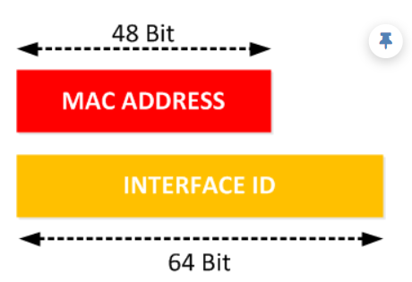

Slide 5
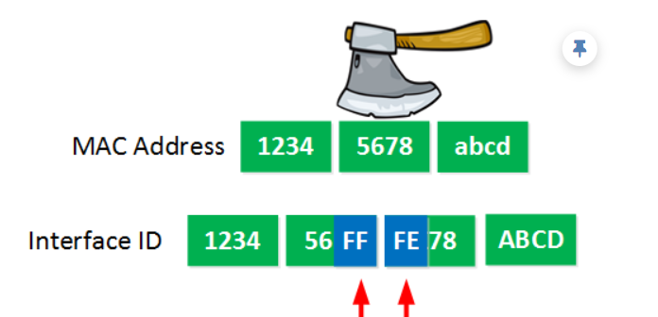
Here’s what we will do to fill the missing bits:
We take the MAC address and split it into two pieces.
We insert “FFFE” in between the two pieces so that we have a 64 bit value.
So if my MAC address would be 1234.5678.ABCD then this is what the interface ID will become:

Slide 6
Non-Overlapping Wi-Fi channels:
Data is typically sent between two devices during a wireless connection. More devices can join in sharing the medium for data exchanges on a wireless LAN. To transfer data from one device to another, a wireless LAN needs to emit a signal using radio frequencies (RF). In addition to being mobile and free to roam about, transmitters and receivers can also be fixed in specific areas. Our wireless network’s ability to transmit and receive data across a Wi-Fi channel. While the 5 GHz frequency contains 45 channels, the 2.4 GHz band only has 11. Your Wi-Fi coverage and performance can be greatly enhanced by choosing the appropriate Wi-Fi channel. The only non-overlapping channels in the 2.4 GHz frequency are channels 1, 6, and 11. A crucial step in successfully configuring your network is deciding on one or more of these channels.

Slide 7
SSID:
Service Set Identifier is referred to as SSID. The name of the Wi-Fi network is SSID. An SSID is a 32-character unique ID that is used to identify wireless networks. SSIDs ensure that data is routed to the proper spot when several wireless networks coexist in the same area. The network is connected to a MAC address on the AP. A service set identifier is what your clients use to connect to this network or workgroup (SSID). Therefore, the SSID on the AP is a mashup of the MAC address and network name. This MAC address may be a different MAC address created on the AP or wireless radio. A Basic Service Set Identifier is used to describe an AP that only provides service to one network (BSSID). The option to use multiple SSIDs is provided by APS. This will enable you to use the same AP while providing both a Guest Network and a Corporate Network. Multiple Basic Service Set Identifiers are used when an AP has multiple networks (MBSSID). Despite serving a number of networks, it is the same hardware. Users on one network share with users on another because the hardware and frequency range are the same, and if they communicate at the same time, they may clash.

Slide 8
RF (Radio Frequency):
Transmission of data is carried out using radio frequencies (RF) in wireless communications. The electromagnetic spectrum contains different radio frequency bands dedicated to different services. Digital cordless phones, personal digital assistants, laptops, pagers, Personal Computer Memory Card International Association (PCMCIA), and other devices operate in the 800 MHz to 2.5 GHz portion of the electromagnetic spectrum. Radiofrequency (RF) signals are used in transmission from one device (transmitter) to another (receiver) through open space. As long as both devices are set to the same frequency (or channel) and communicate using the same protocol, the transmitter, and receiver can always be in communication with one another. An electrical signal is applied at one end and carried to the other end of a wired link to transmit data across it. The signal can spread quite easily because the wire is continuous and conductive. There are no physical cables or other means of signal transmission in a wireless link.

Slide 9
Encryption:
Applying a certain algorithm to data in order to change how it appears and render it confusing to others without access. Datagram Transport Layer Security (DTLS) keeps packets secure when data encryption is enabled for an AP. Various authentication mechanisms are used during the identification procedure. Security features like frame authentication and encryption are used to protect wireless data. The data must be encrypted on a wireless network to ensure data privacy. This is achieved by encrypting the payload of the data in each wireless frame right before transmission and decrypting it upon reception. The goal is to successfully encrypt and decrypt the data by employing an encryption technique that both the transmitter and receiver can use. All clients must associate using the same encryption method because each WLAN in wireless networks may only allow one authentication and encryption methodology. In order for the AP and a client to interpret each other’s data, they should be the only two devices that share the encryption keys. No device should be aware of the keys or be able to use them to intercept and decode the data.

Slide 10
Virtualization is the process of operating a virtual computer. Software used in virtualization enables you to run virtual systems, hardware, and applications on a single machine. Most frequently, it is utilized to run various operating systems, including Windows and Linux, on a single device. To make the most of the hardware, virtualization allows you to divide up huge systems into numerous smaller ones. Think of servers, for instance. The usage of virtualization enables you to divide a single server for several purposes rather than using many servers to perform distinct activities. As a result, one of the servers can be divided to manage both mail and apps rather than having servers for networking, email, and apps that aren’t being used to their full potential. The effectiveness of the server is maximized by doing this. By utilizing the hardware of the server, such as the processor, RAM, and storage memory, virtualization can turn a single physical server into a number of virtual PCs (virtual machines) that serve as digital computers. Each virtual machine operates independently, just like an actual computer would. Therefore, virtualization is the ideal way to utilize a single machine.

