Slide 1

Code Refactoring and Bug Fixing
Submitted by
Nihal Sayed
IN1240813

Slide 2
About me
I am Nihal Sayed from Karnataka Pursuing final semester of my MCA at Birla Institute of Technology
Python has always been a great tool for me to explore tech and also create tech , while I do keep researching about various applications or things to do with python , I found data Science very interesting and loved spending time in finding valuable insights from the data and hence choose this to be my career path as it has wide scope as well as good professional development.
I have total 4 months of experience . I have worked as Python Development Intern for 3 Months at Centre of Excellence in Visual Intelligence (CEVI) where in I was responsible for developing annotation software used for data labelling and curation for AI/ML . I Have 1 month of Experience as Core Java Intern at Uniconverge Technologies where in I have worked on a console based HRMS and developed Smal Java modules as Learning-aids
Github : https://github.com/Nihal-sayed
linkedin : https://www.linkedin.com/in/nihal-sayed-2a1758199

Slide 3
Project Objective :
The primary objective of the project is to create an web application using Python Flask which can create and store the notes that a user can create . The basic functionality of app includes
Take notes from user
Save them in the order with newest at top
Ease of usage and practicality
Tech Stack
Python
Flask
HTML

Slide 4
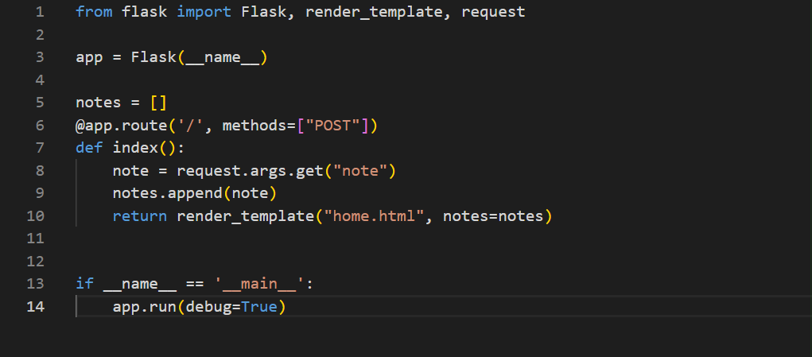
Code and bugs
App.py

Slide 5
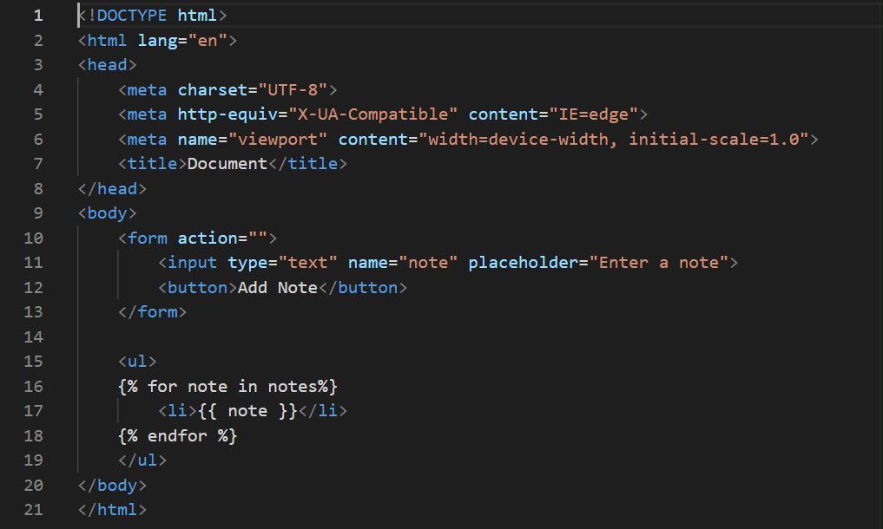
Home.html

Slide 6
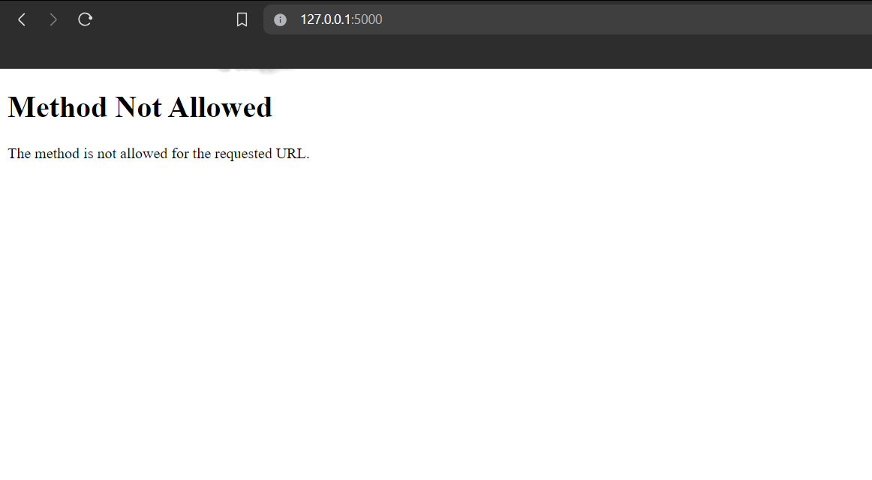
http://127.0.0.1:5000

Slide 7
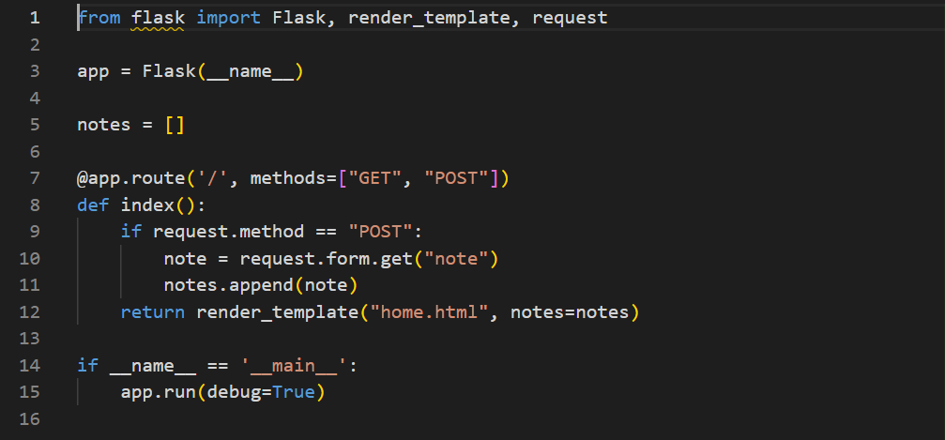
Bug identified in app.py
The POST method is used to submit notes, but we are trying to access the note using request.args.get() which is appropriate for GET requests. For POST requests, we should use request.form.get() to access form data. Below is the correct code

Slide 8
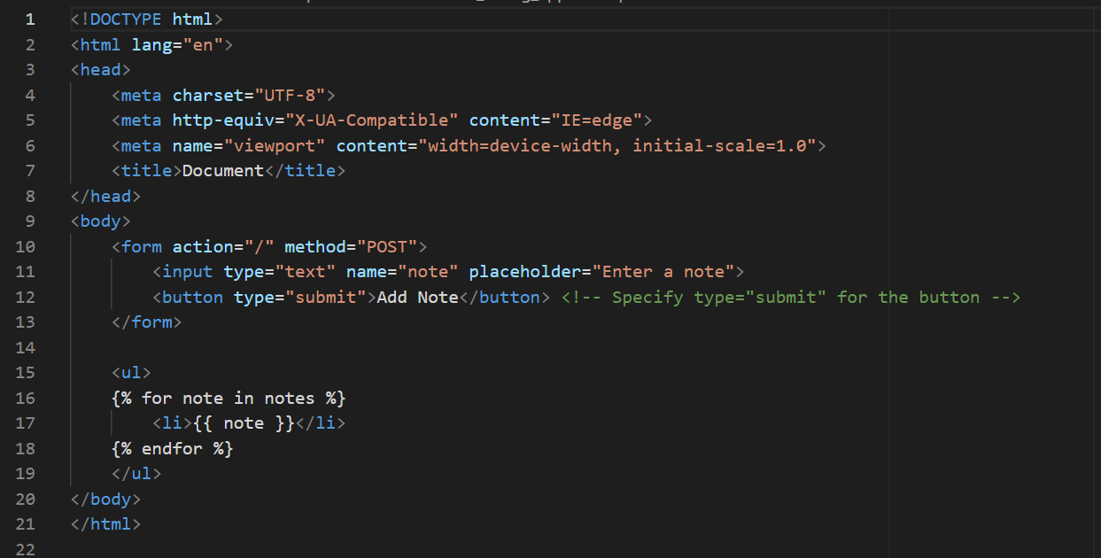
Bug identified in home.html
Since we want to send data via a POST request, we need to specify the method attribute of the form as "post". Additionally, we need to include the action attribute to indicate where the form data should be sent. Below is the corrected code

Slide 9
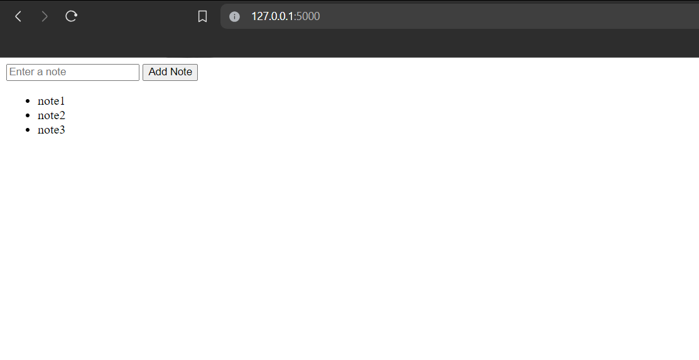
Fixed and deployed at http://127.0.0.1:5000

Slide 10

THANK YOU

