Slide 1

FINAL WORKFLOW PRESENTATION
StockSense
System Requirements, Design & Workflow — Consolidated Review
Nihal Jain (IU2341230543) • Tanay Jain (IU2341230541) • Hikash Kumar Maheshwari (IU2341230522)
Project Guide: Prof. Anjali Chopra

Slide 2





Agenda
1
2
3
4
5
Requirement Analysis
Literature Review
System Architecture
Use Case Diagram
Roadmap Ahead
Functional & non-functional requirements
Existing approaches & research gap
Layered workflow of the system
Actors & key interactions
Next steps & milestones

Slide 3

Requirement Analysis — Snapshot
User & Access Management
Key Non-Functional Requirements
Secure login, role-based access for Owner & Admin
Fast, near real-time predictions
Simple, intuitive dashboard UI
Secure authentication & data storage
Scalable to more products/users
Modular, maintainable codebase
Cross-browser accessibility
Data Management
Upload sales/stock data, manage product catalog
Prediction & Alerts
ML-based shortage prediction, configurable alerts
Dashboard & Reporting
Visual stock status, trend charts, exportable reports

Slide 4
Literature Review — Key Findings
Approach
Strengths
Limitations
Traditional / Rule-Based
Simple, low resource use
No adaptability to demand shifts
Statistical (ARIMA, etc.)
Interpretable, moderate data need
Struggles with sparse/irregular data
Classical ML (RF, GB)
Multi-feature, good accuracy
Needs feature engineering effort
Deep Learning (LSTM)
High accuracy at scale
Needs large data & compute — impractical here
Commercial Apps
Ready-to-use interfaces
Threshold-based, not predictive
Research Gap: Small businesses need lightweight, data-efficient prediction — not just static threshold alerts.

Slide 5





System Workflow
Collect Data
Preprocess
Predict (ML)
Alert Owner
Dashboard View
End-to-end loop: data flows from the store through preprocessing and the ML model to generate alerts, which the owner acts on — restocking updates the data for the next cycle.

Slide 6
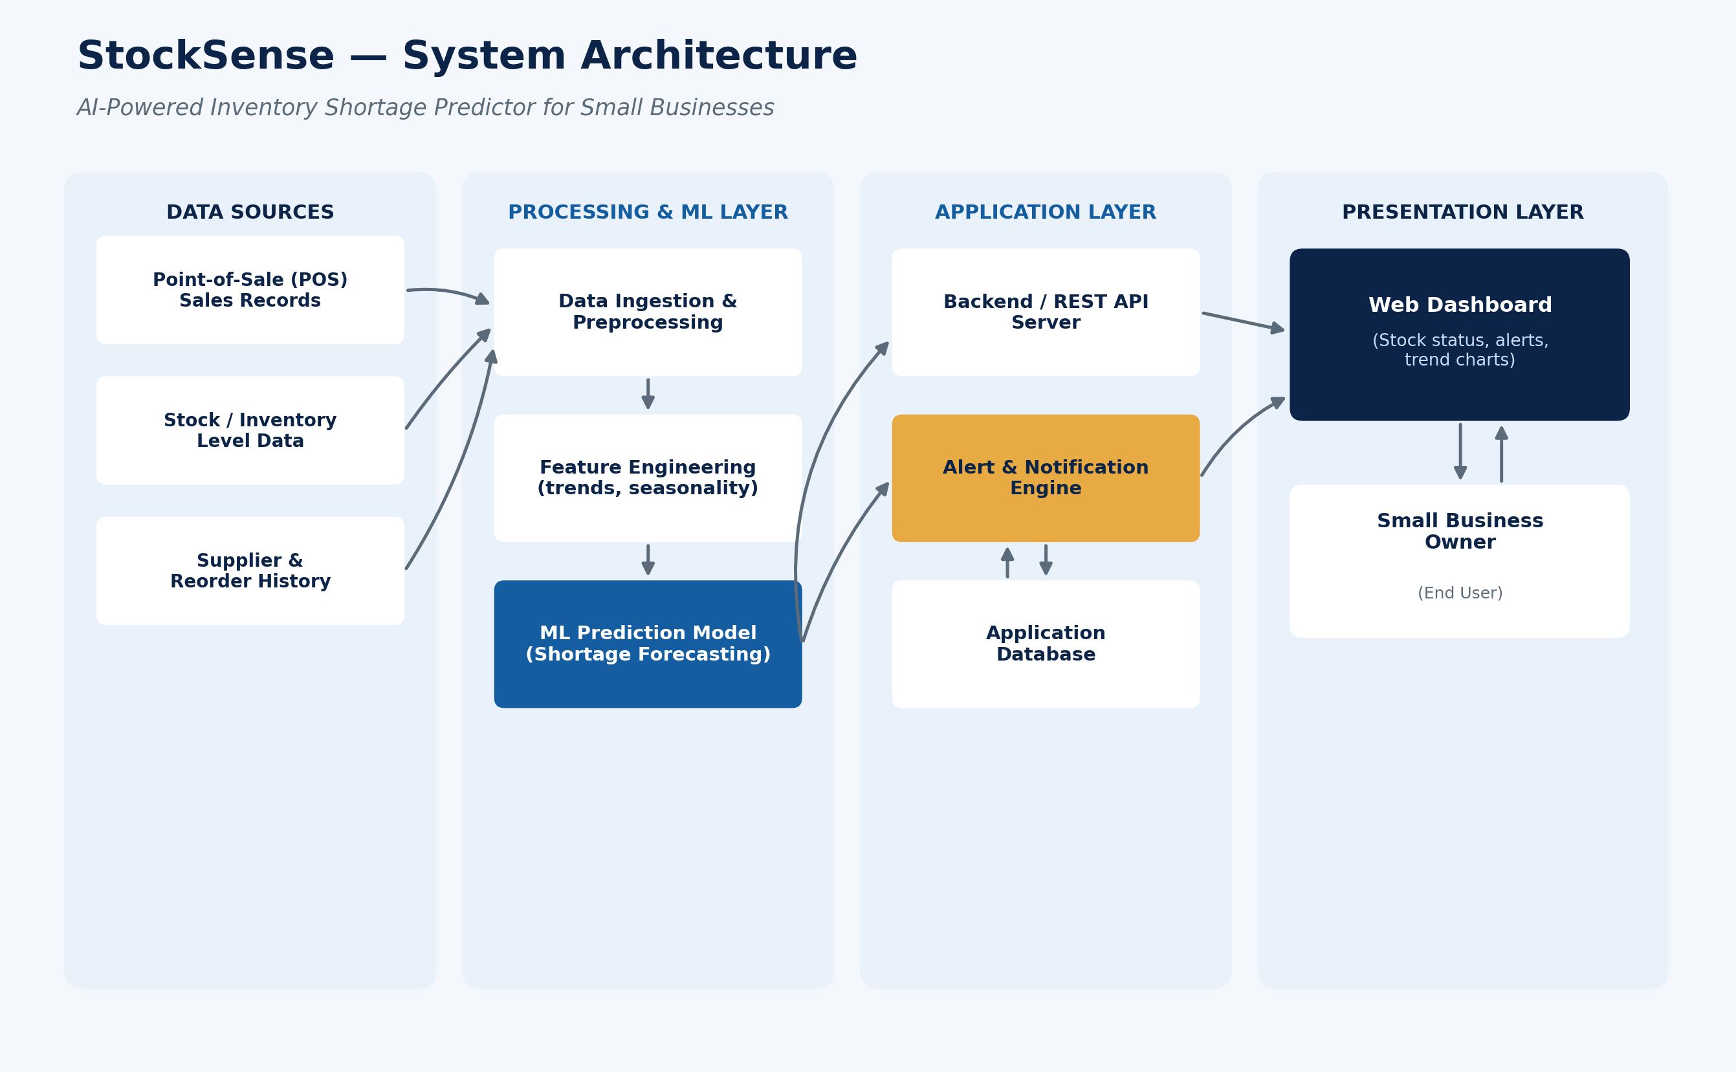
System Architecture

Slide 7
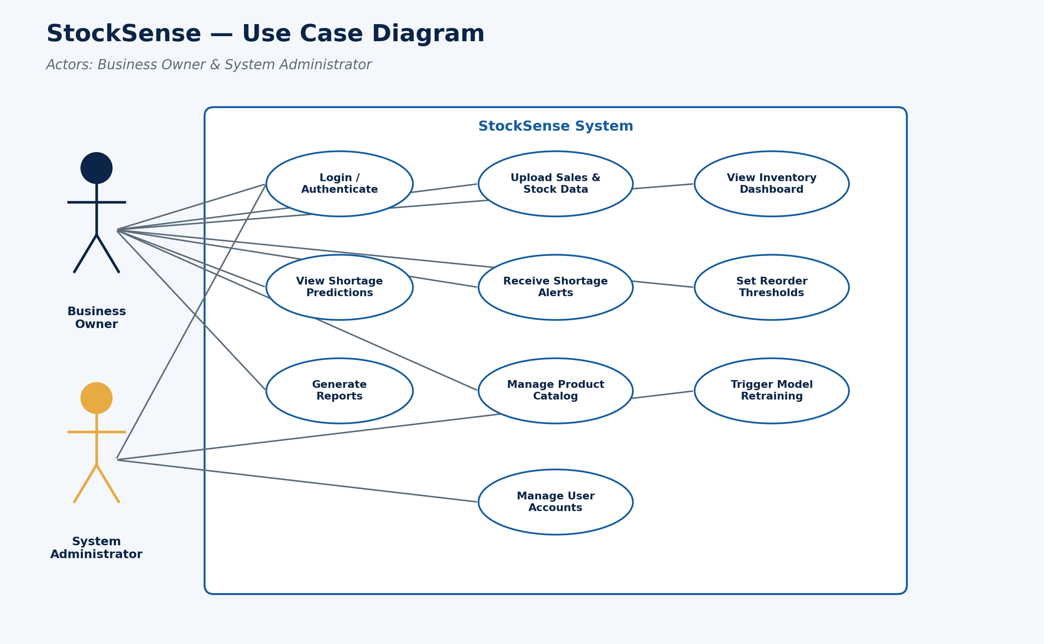
Use Case Diagram

Slide 8
Roadmap Ahead
1
2
3
4
5
Requirement Study
Data Preparation
Model Development
Web Integration
Testing & Final Review
Requirement analysis, literature review, and system design are complete. Next: data collection, model development, and full system integration.

Slide 9
Thank You
StockSense — AI-Powered Inventory Shortage Predictor for Small Businesses
Nihal Jain (IU2341230543) • Tanay Jain (IU2341230541) • Hikash Kumar Maheshwari (IU2341230522)
Project Guide: Prof. Anjali Chopra

