Slide 1
Empowering Financial Security: Detecting Fraudulent Transactions using Advanced Machine Learning Techniques and Predictive Analytics
Date:04th June 2024

Slide 2
Problem Statement
Develop a machine learning model to detect potentially fraudulent transactions based on the provided features.
The dataset contains information about various transactions, including account age, payment method, time of transaction, and category.
The goal is to build a classification model that can accurately classify transactions as either legitimate or potentially fraudulent.

Slide 3
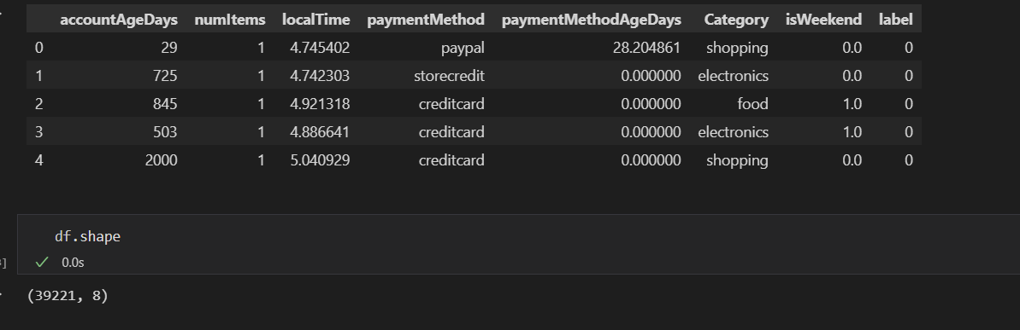
Preprocessing
There are 39221 rows and 8 columns in the given dataset- “Payment_Data.csv”.
Columns “paymentMethod” and “Category” have nominal data which needs to be converted to numerical values to apply classification machine learning algorithms.

Slide 4
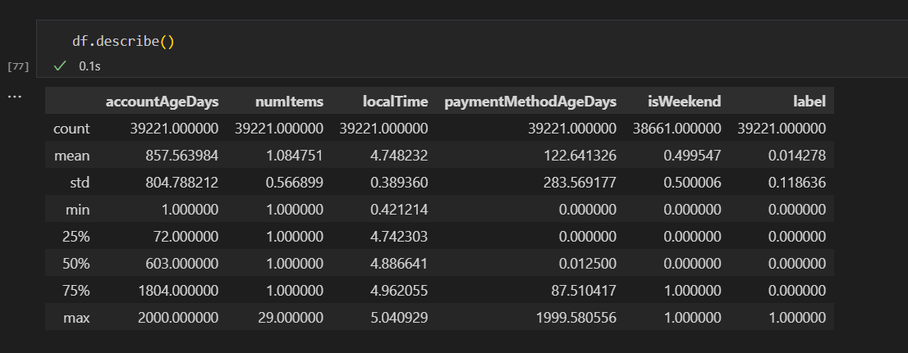
Preprocessing
“paymentMethodAgeDays” had outlier values which were far away from the mean value. But upon removing the outliers using IQR method all the potential fraudulent transactions were eliminated from the dataset. Hence, Outlier removal was not done.

Slide 5
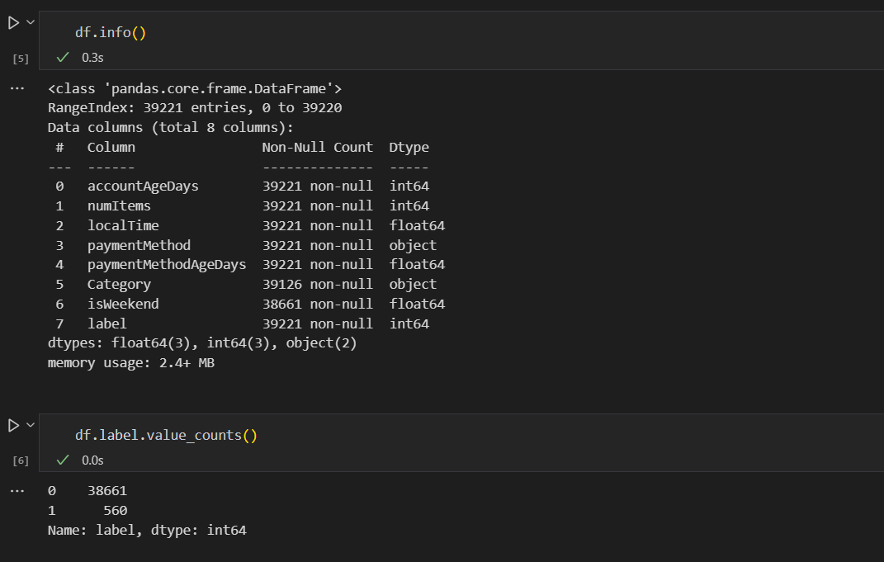
Preprocessing
The dataset is imbalanced as in the target column the number of fraudulent transactions is only 1.43%.
The columns “Category” and “isWeekend” have null values.
Category-Null Values:95
IsWeekend-Null Values:560
Intersection-Null Values:8
Union Null Values:647

Slide 6
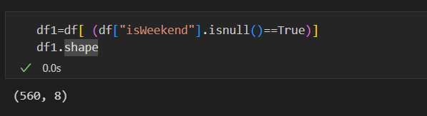
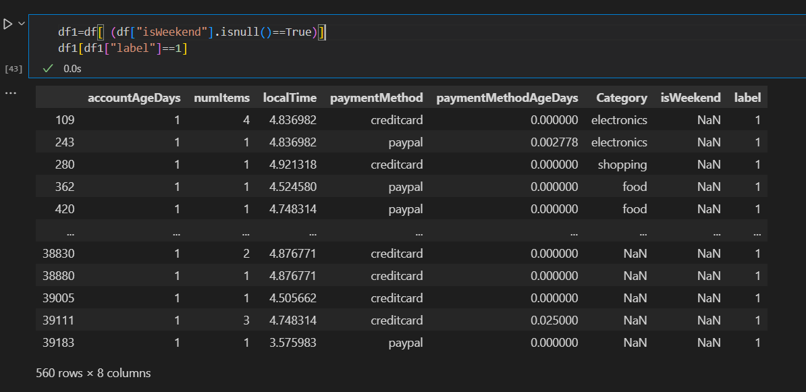
Preprocessing
All the transactions having null value for the column “isWeekend” are potentially fraudulent. Thus eliminating all the rows with null values will make the data biased without any sample of legitimate transaction. Thus the model will not be able to learn for legitimate transactions.
Thus, the column “isWeekend” was dropped.

Slide 7
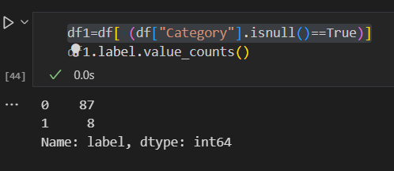
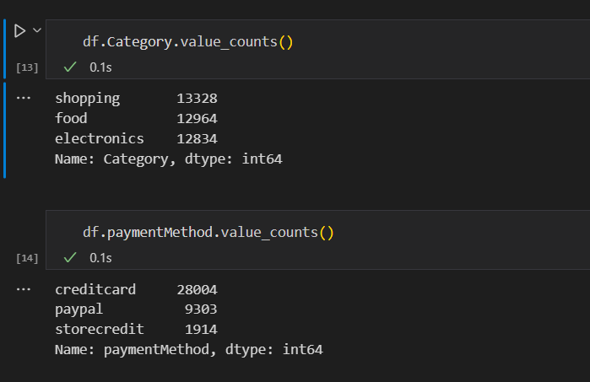
Preprocessing
Only 8 transactions having null values for the column “Category” were potentially fraudulent. Hence, these rows were dropped as it would not significantly affect the model predictions.
To handle nominal data One-hot encoding was used.

Slide 8
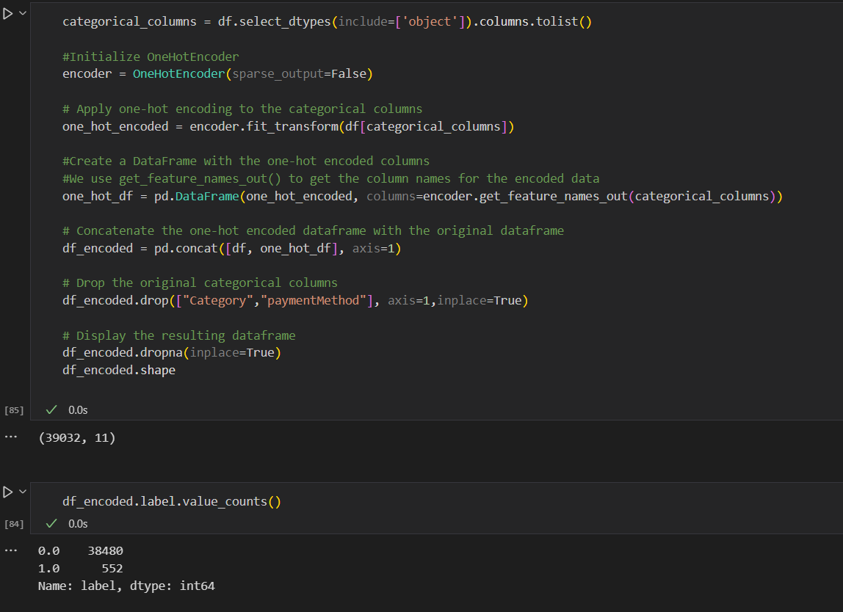
Preprocessing
Using One hot encoder the nominal data was converted to numerical data and the original columns were dropped.
The dataset now had 39032 rows and 11 columns.

Slide 9
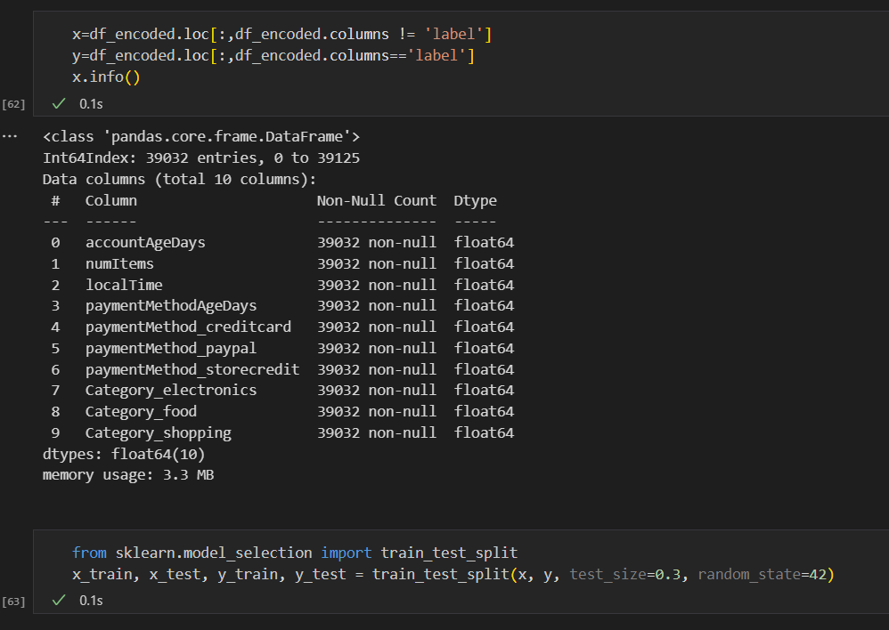
Preprocessing
After separating the data into features matrix (x) and target vector(y), the data was split into training and testing set using train_test_split method in 70:30 ratio.

Slide 10
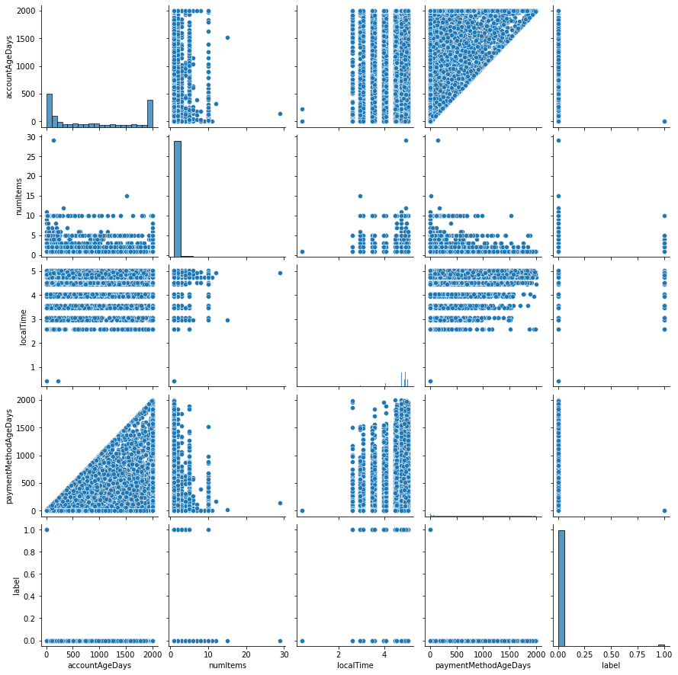
Preprocessing-Pairplot
No conclusive observation was made from the pairplot

Slide 11
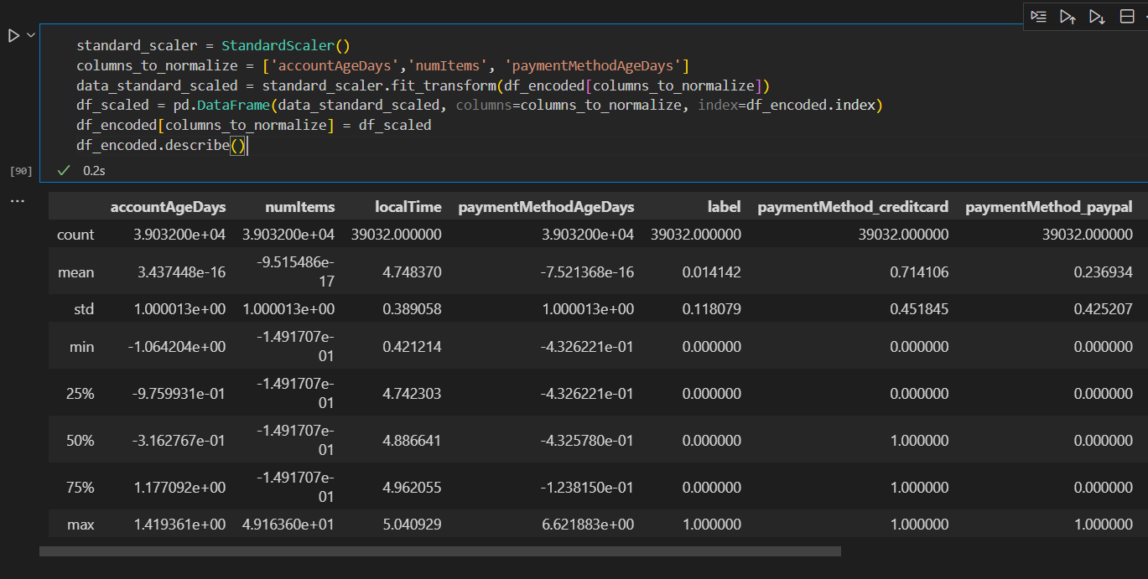
Preprocessing
StandardScaler was used to normalise the data for the columns-'accountAgeDays','numItems', 'paymentMethodAgeDays as StandardScaler() is less sensitive to outliers compared to MinMaxScaler but can still be influenced by extreme values and also useful for algorithms that assume normally distributed data (e.g., logistic regression)

Slide 12
Modelling
Logistic Regression algorithm was selected for following advantages:
Interpretability: Logistic regression provides interpretable coefficients, making it easier to understand the impact of features on the likelihood of fraud.
Efficiency: Logistic regression is computationally efficient and can handle large datasets.
Probabilistic Output: Logistic regression outputs probabilities, which can be useful for setting decision thresholds

Slide 13
Modelling
SMOTE
The Synthetic Minority Oversampling Technique (SMOTE) addresses imbalanced datasets by synthetically generating new instances for the minority class. Unlike simply duplicating records, SMOTE enhances diversity by creating artificial instances. In simpler terms, SMOTE examines instances in the minority class, selects a random nearest neighbour using k-nearest neighbors, and generates a synthetic instance randomly within the feature space

Slide 14
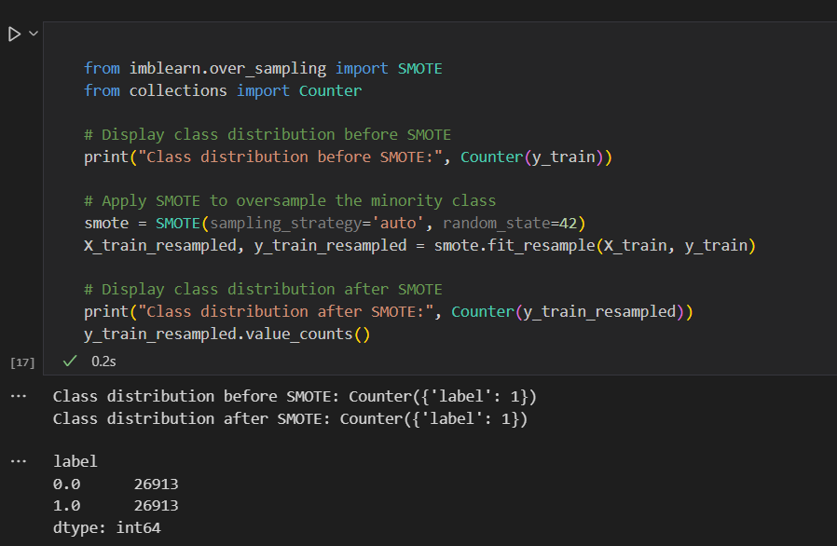
Modelling
SMOTE

Slide 15
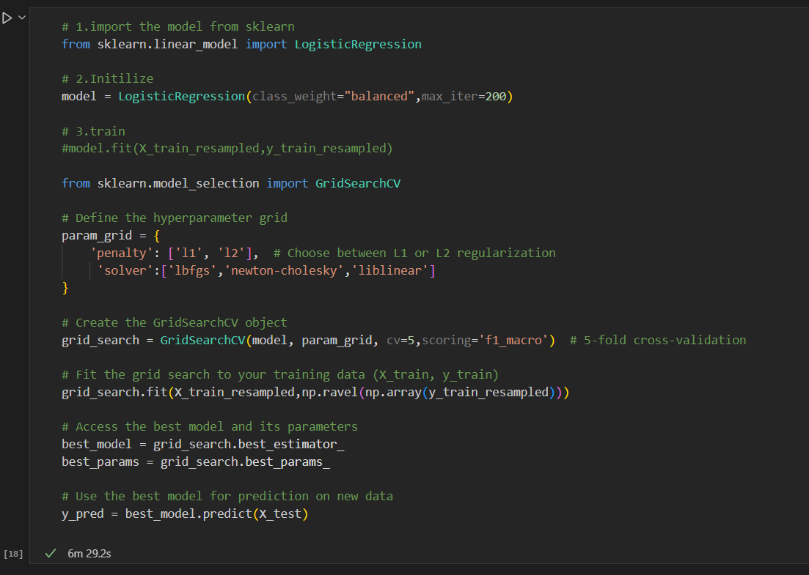
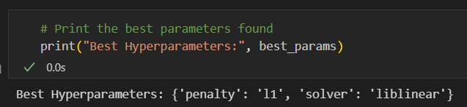
Modelling
Hyperparameter Tuning-GridsearchCV()
Optimum ‘penalty’ and ‘solver’ parameters were selected for the logistic regression model after the tuning.
Best Hyperparameters:
penalty-l1
solver-liblinear

Slide 16
Model Evaluation
In fraud detection, it's often more critical to correctly identify the fraudulent cases (true positives) even at the expense of misclassifying some non-fraudulent cases (false positives).
Thus, for an imbalanced dataset in fraud detection it is advised to aim for a higher F1 score for the positive class (fraudulent transactions) while ensuring reasonable performance on the negative class (non-fraudulent transactions).

Slide 17
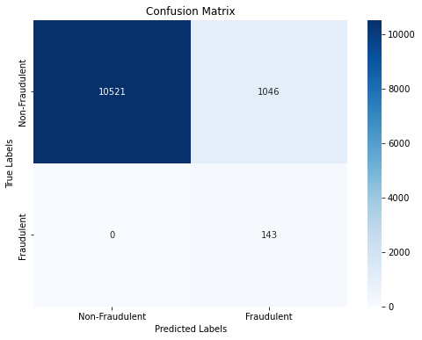
Model Evaluation
Logistic Regression Model with SMOTE correctly classified all the fraudulent transactions.

Slide 18
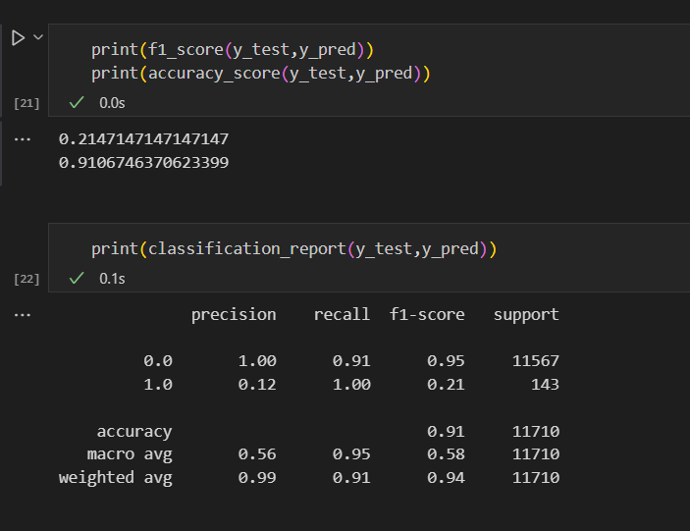
Model Evaluation
Although the F1 score of the model is low, the model correctly classified all the fraudulent transactions which is the desired goal.

