Slide 1

Lifeline
Let’s take the responsibility to Change The World
-By Nihal Gajbhiye

Slide 2
Lifeline
Introduction
Proposed Solution
Application

Slide 3
Cardiovascular diseases are number one cause of death in developed countries
% of all deaths
Developed countries
 | Ischemic heart disease | 16.4
 | Cerebrovascular | 9.3
 | Lung cancer | 5.9
 | Respiratory infections | 3.8
 | COPD | 3.5
 | Dementia | 3.4
 | Colon cancer | 3.3
 | Diabetes | 2.7
 | Breast cancer | 2.0
 | Stomach cancer | 1.8
SOURCE: World Health Organization, 2008
2

Slide 4
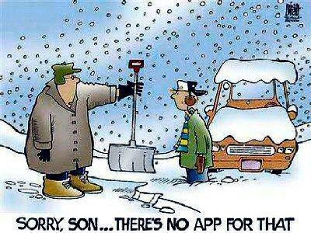
Problem Statement
People who suffered a recent cardiac arrest have difficulty doing physical activities
Most people find it difficult doing physically intensive tasks around their house
With the additional payments for medical bills and other expenses they cannot afford to hire help to get through these daily tasks

Slide 5
Lifeline
Introduction
Proposed Solution
Application

Slide 6
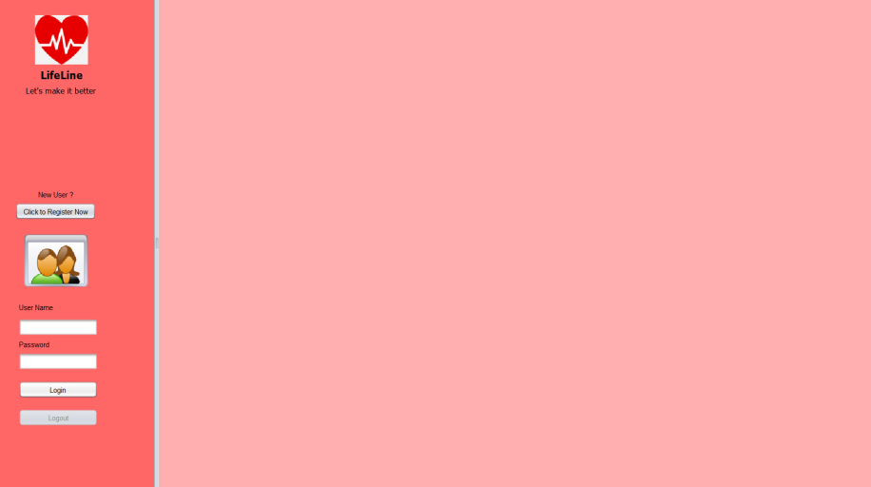
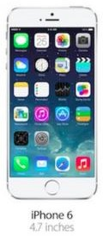
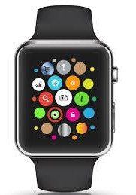
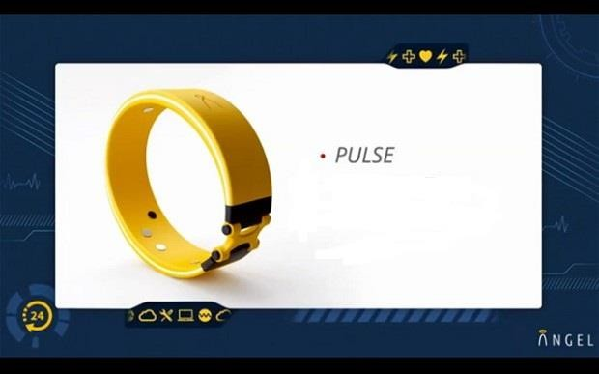
Proposed Solution
LifeLine application is a user friendly application that connects heart patients, volunteers, doctors and donors
Volunteers are local high school students who will help the heart patients do the physically intensive tasks like snow shoveling
Monitor the heart patients data using a sensor device to send him alerts
Advising doctor can monitor the patients data through the application and suggest medication changes
Donors can use the application to make donations

Slide 7
Lifeline
Introduction
Proposed Solution
Application

Slide 8
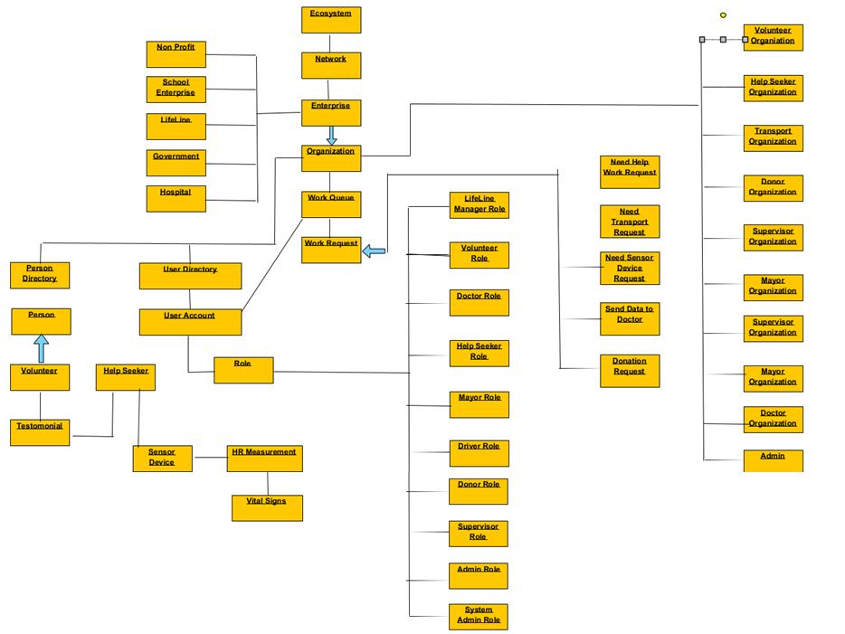
Object Model

Slide 9
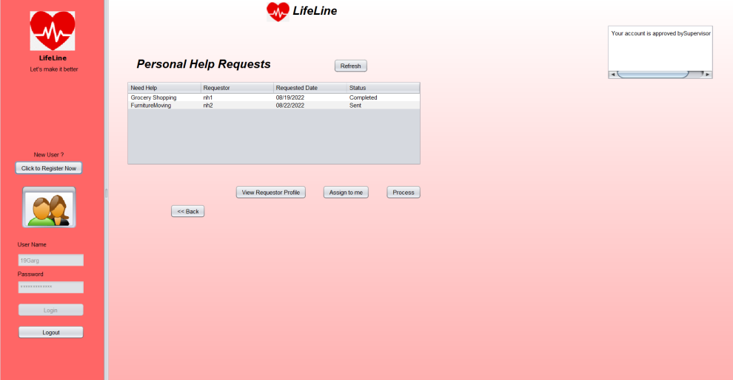
Use Case
Request for Help from Help Seekers to Volunteers
1) Select a particular volunteer
from a network and send a request.
2) Send a request for help to the
volunteers in the network, which is fulfilled by anonymous volunteer.
Volunteers can request for transport service to go the help seeker location to fulfill the help request
Help Seekers can raise a request to donors if they cannot afford sensor device and are suffering from heart problems

Slide 10
Use Case contd.
Application Monitors vital data and proactively send alerts to the help seekers if their past two vital signs are not in normal condition.
Help Seekers can send vital data to doctor for analysis and seek suggestions or new medication if no examination is required.
Donors can make donation by fulfilling the senor device request from a help seeker or by donating money to the LifeLine enterprise

Slide 11
Key Roles
Volunteer Role: The responsibility of the volunteer role is to fulfill
request from Help Seeker with the help of Transport Organization
Help Seeker Role: The Help Seeker role raises various requests like request to Volunteer for help, request to donor for a sensor device, request to doctor to seek suggestions or new medication
Supervisor Role: The supervisor is responsible to approve the volunteer, help Seeker and Doctor sign up request

Slide 12
Key Roles Contd.
Doctor Role: Vital Data tracked using sensor device is sent by help seeker for analysis. The doctor can reply with suggestions or new medication.
Donor Role: The donor role is to make donations by processing the sensor device request or donating money directly to the heart help enterprise account.
LifeLine Manager Role: The responsibility of the manager is to enforce the system is working by and identifying the need by analyzing the data through Business Intelligence technique.

Slide 13
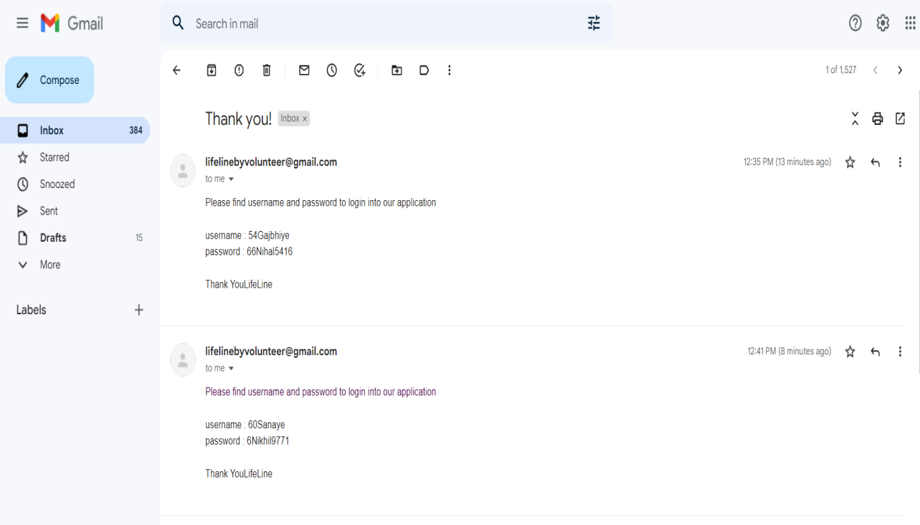
Key Features
Help Seeker, Volunteer or a Doctor sign up the application via registration page
When a volunteer sign up the application an email is sent to the registered email address with the user name and password
An email is sent to Volunteer, Help Seeker, Doctor when the account is enable or approved by the supervisor

Slide 14
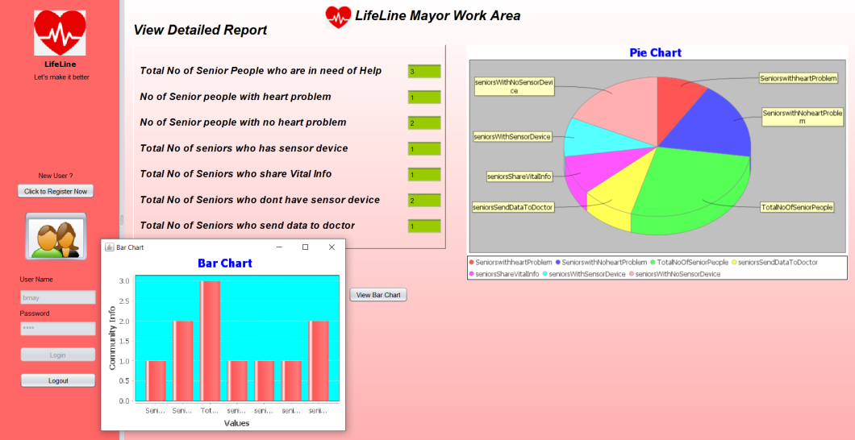
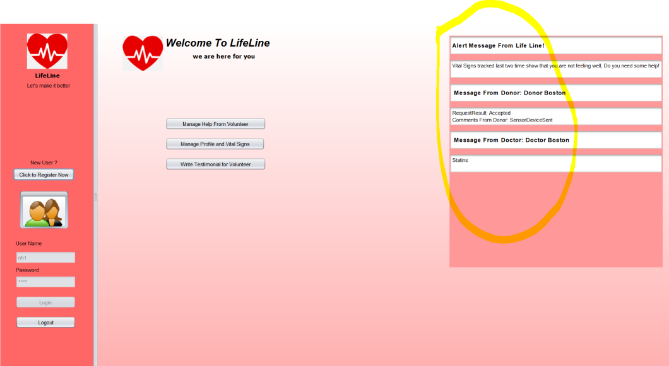
Extra Features
Email is sent to users appropriately when required
Alerts are sent when required
Help Seeker can write a testimonial for Volunteer
Graphs, Chart Diagrams are displayed to Mayor, Manager and Help Seeker when required

