Slide 1
CRM
CUSTOMER & LEAD
MANAGEMENT SYSTEM
Full-Stack Web Application
Python • Flask • HTML • CSS • JavaScript • SQLite
SKYBRISK — MONTH 4

Slide 2
    Project Overview
    Purpose and expected outcome
A practical CRM application
CORE
Manage customer records from one interface.
Create, view, update and delete sales leads.
Track lead status and customer/lead interactions.
Provide a dashboard for quick CRM visibility.
Keep application data in a lightweight SQLite database.
Customers
+
Leads
+
Interactions
One workflow for day-to-day CRM operations

Slide 3
    Functional Requirements
    What the application is designed to do
AUTHENTICATION
CUSTOMERS
LEADS
Sign Up • Login • Session
Create • View • Update • Delete
Create • Track • Update • Search
INTERACTIONS
DASHBOARD
EXPORT
Record and review activity
Summary and CRM visibility
Download CRM data as CSV

Slide 4
        Technology Stack
    Technologies used in the implementation
HTML
CSS
JavaScript
Page Structure
Responsive Styling.
Client-side behaviour.
Python
Flask
SQLite
Backend Language
Web framework
Data Storage.
3

Slide 5
    System Architecture
    End-to-end application flow
USER
→
FRONTEND
→
FLASK
→
SQLITE
→
CRM UI
Browser
HTML • CSS • JS
Routes & Logic
Persistent Data
Dashboard
User → Web Interface → Flask Backend → SQLite → CRM Dashboard

Slide 6
    Authentication Module
    Secure entry point to the CRM
01
SIGN UP
Create a user account with required credentials.
02
LOGIN
Validate credentials and establish an authenticated session.
03
CRM ACCESS
Authenticated users continue to the CRM dashboard and modules.

Slide 7
    Customer Management
    Maintain a central customer record
CUSTOMER RECORD
Create
View
Add a new customer with relevant details.
Review stored customer information.
Update
Delete
Modify customer details when information changes.
Remove records when they are no longer required.

Slide 8
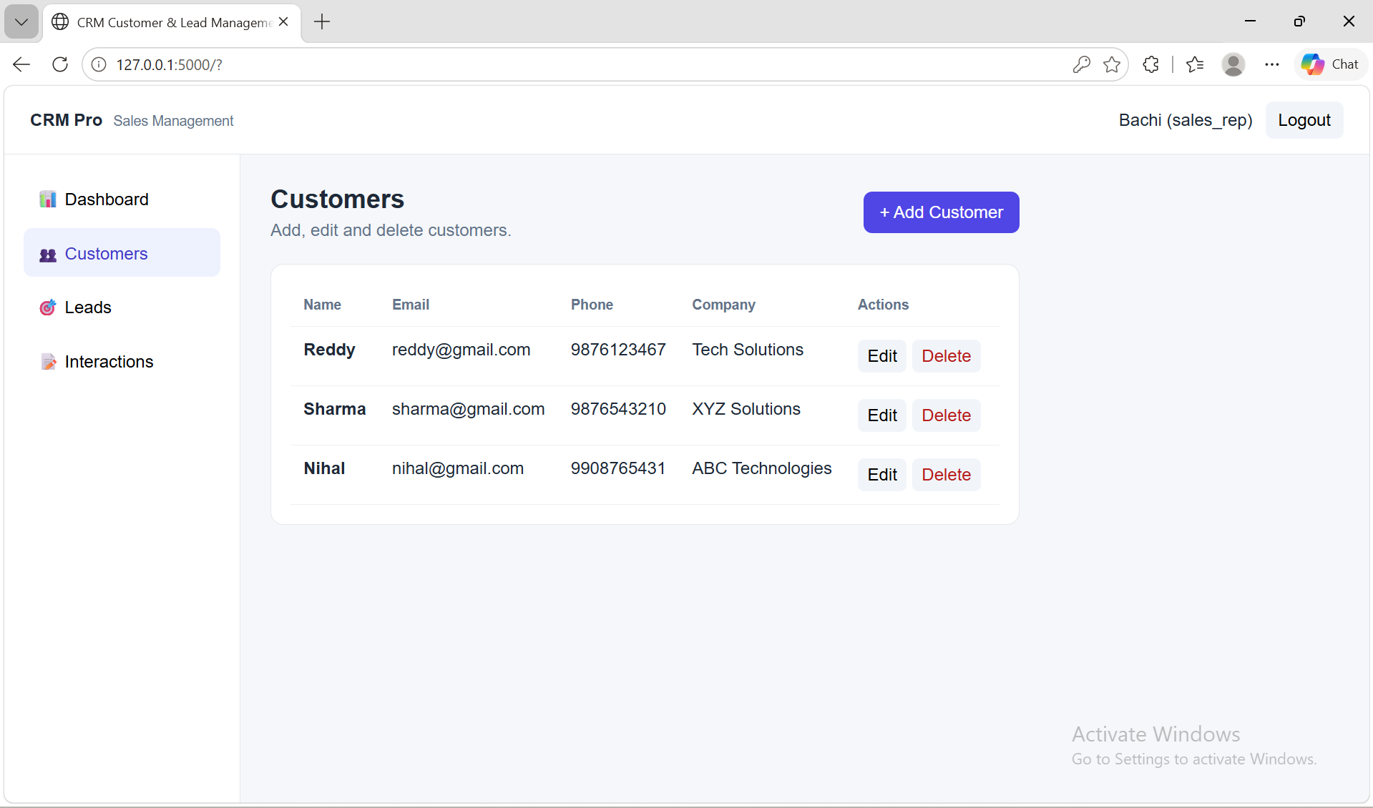

Slide 9
    Lead Management
    Track prospects through the sales process
LEAD LIFECYCLE
NEW
→
CONTACTED
→
QUALIFIED
→
CLOSED
Lead created
Initial communication
Potential opportunity
Outcome recorded
Key operations
Create and update lead records
Track status changes
Search/filter leads for easier follow-up

Slide 10
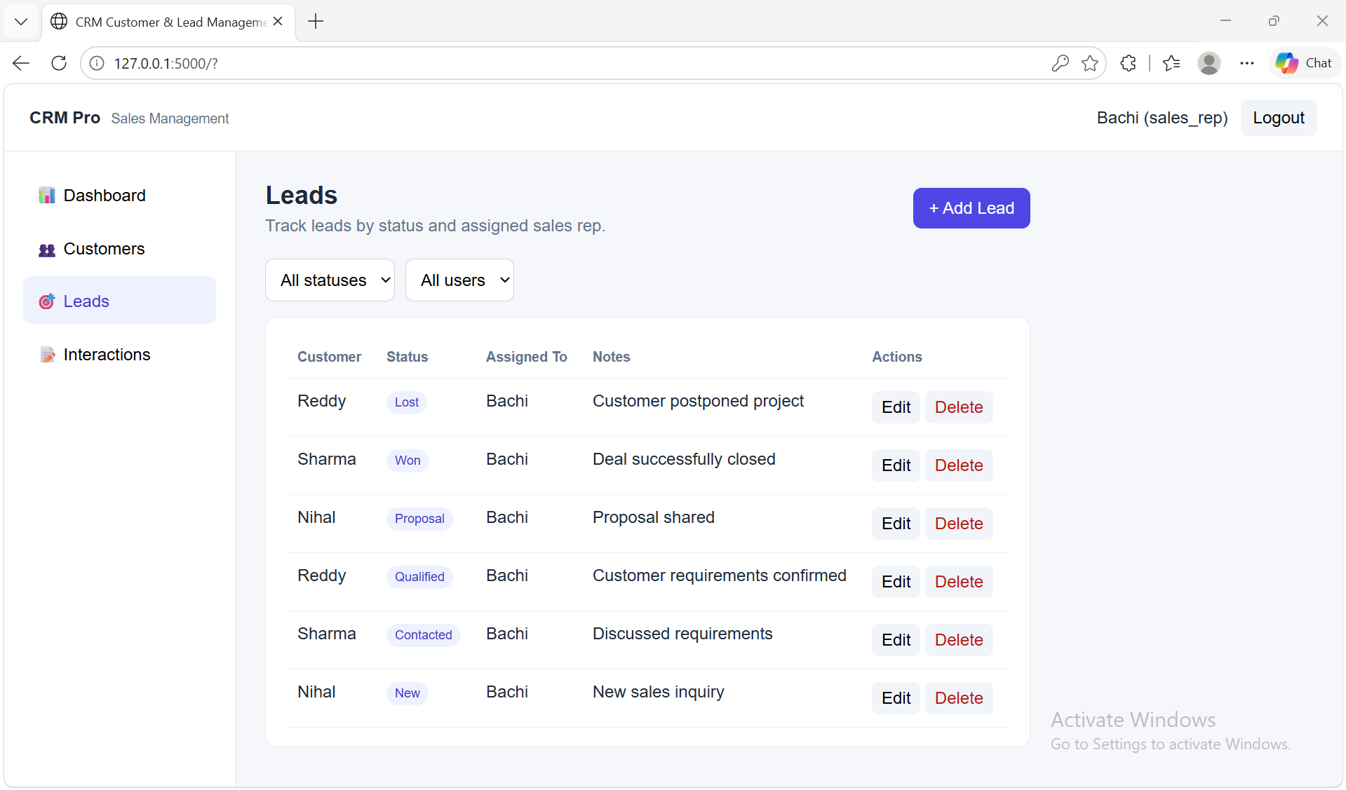

Slide 11
    Interaction Management
    Keep a history of customer and lead activity
INTERACTION HISTORY
Why it matters
01
Record an interaction
A consistent activity trail makes customer and lead follow-up easier.
02
Associate it with the relevant CRM record
03
Review activity later for context

Slide 12
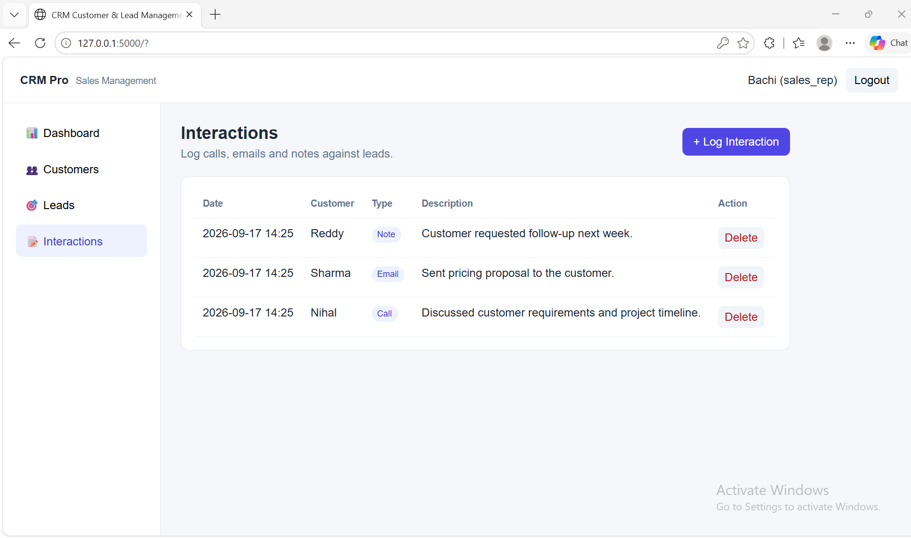

Slide 13
    Dashboard
    Quick view of CRM activity
CUSTOMERS
LEADS
ACTIVITY
Lead & customer records
Pipeline visibility
Interaction tracking
The dashboard brings the main CRM functions together so the user can quickly move from overview to action.

Slide 14
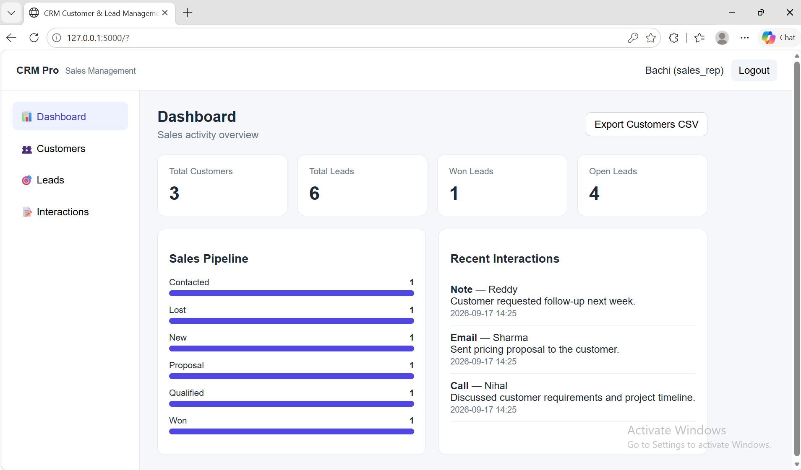

Slide 15
    Data & CSV Export
    Simple persistence and practical data access
SQLite
CSV EXPORT
Stores application records locally and provides persistent data between sessions.
CRM data can be exported for reporting, offline analysis or sharing.
CRM DATA → EXPORT → CSV FILE → EXCEL / ANALYSIS

Slide 16
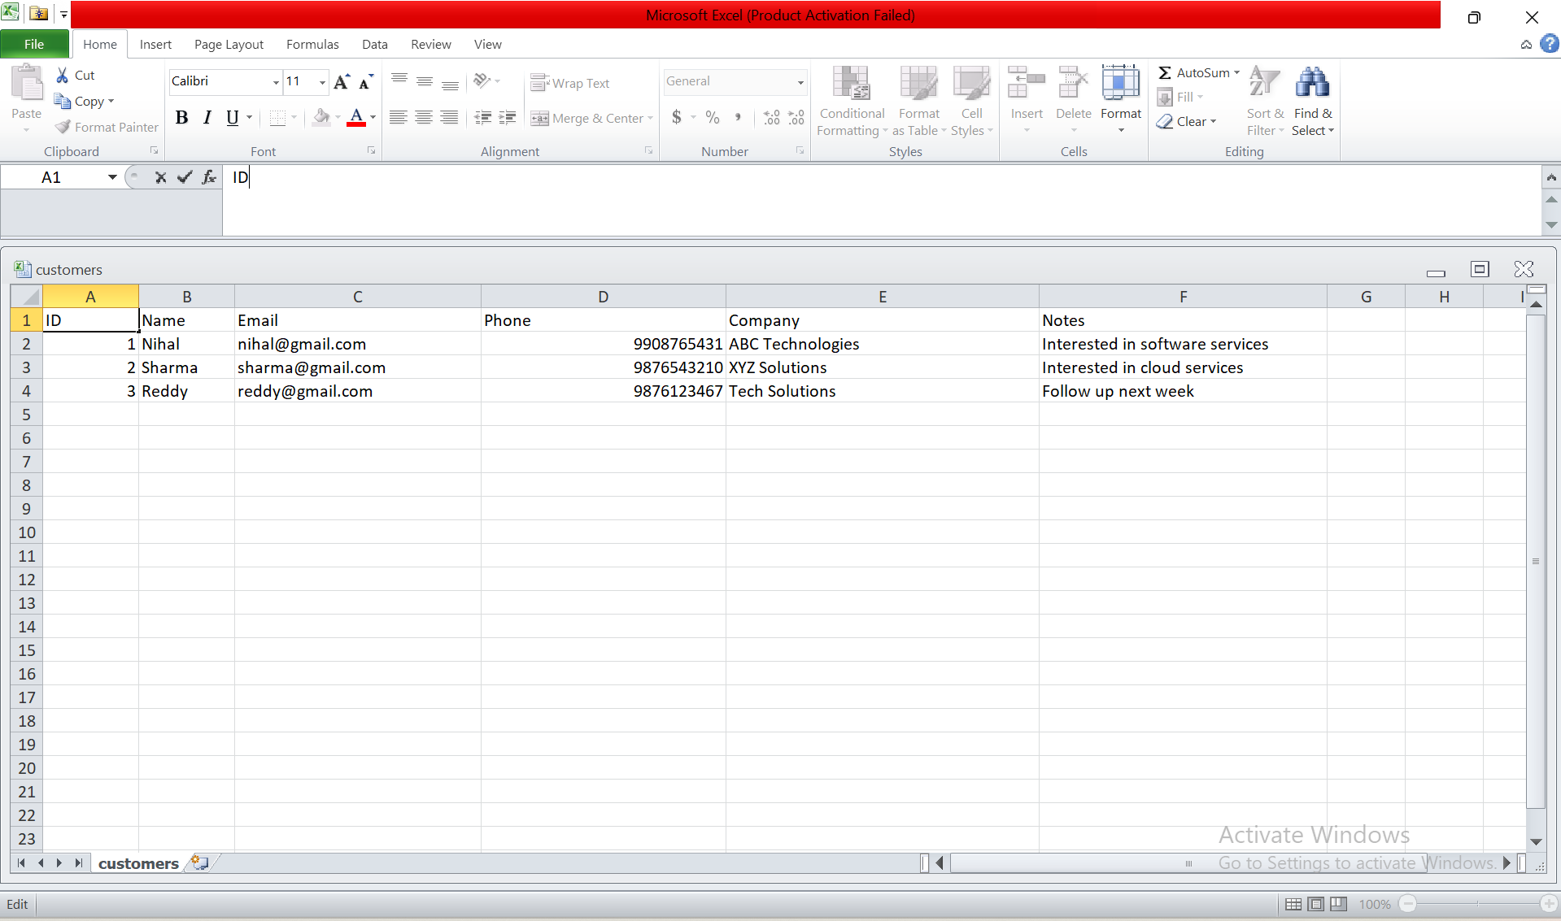

Slide 17
    Project Workflow
    From login to CRM operations
01
02
03
04
05
06
Open App
→
Sign Up / Login
→
Dashboard
→
Customers / Leads
→
Interactions
→
Export
The workflow is designed to keep common CRM actions simple and connected.

Slide 18
    Testing & Demonstration
    Checks to perform before submission
Verify the Flask application starts without errors.
Test Sign Up and Login with valid and invalid input.
Create, view, update and delete customer records.
Create leads and verify status changes.
Record and review customer/lead interactions.
Verify dashboard information updates from stored data.
Test CSV export and confirm the downloaded file opens correctly.

Slide 19
    Skills Demonstrated
    Learning outcomes from the project
Frontend
Backend
HTML structure, CSS styling and JavaScript behavior
Python Flask routing, requests and application logic
Database
Web Integration
SQLite storage and CRUD operations
Frontend-to-backend communication
CRM Concepts
Data Handling
Customers, leads, statuses and interactions
CSV export and practical reporting

Slide 20
    Project Structure
    Suggested organization for the CRM application
CRMProject/
├── backend/
│ ├── app.py
│ ├── database / SQLite files
│ └── requirements.txt
└── frontend/
├── index.html
├── app.js
└── style.css
Separation of frontend and backend keeps the project easier to run, test and maintain.
Note: use the actual filenames from your submitted project if they differ.

Slide 21
    Future Enhancements
    Possible next steps
Role-based access for administrators and regular users.
Advanced search, filtering and pagination.
Email notifications for lead follow-up.
Charts and richer CRM analytics.
Cloud database and deployment.
Improved authentication and security controls.

Slide 22
      CONCLUSION
A Simple and Effective CRM Workflow
The project connects the frontend, Flask backend, and SQLite database to provide a complete workflow for managing customers, leads, interactions, and reports.
THANK YOU

