Slide 1
A LOW-POWER AND HIGH-ACCURACY APPROXIMATE MULTIPLIER WITH RECONFIGURABLE TRUNCATION

Slide 2
Contents
Abstract
Literature Review
Existing System
Disadvantages
Proposed System
Advantages
Application
Tools Used
Results
Conclusion
Future scope
Reference

Slide 3
Abstract
In this project, we are going to design approximate multiplier by designing an approximate compressor with high accuracy compared to existing approximate compressors. Multipliers are among the most critical arithmetic functional units in many applications, and those applications commonly require many multiplications which result in significant power consumption. For applications that have error tolerance, employing an approximate multiplier is an emerging method to reduce critical path delay and power consumption. An approximate multiplier can trade off accuracy for lower energy and higher performance.

Slide 4
In this paper, we not only propose an approximate 4-2 compressor with high accuracy, but also an adjustable approximate multiplier that can dynamically truncate partial products to achieve variable accuracy requirements. In addition, we also propose a simple error compensation circuit to reduce error distance. The proposed approximate multiplier can adjust the accuracy and power required for multiplications at run-time based on the users’ requirement. Experimental results show that the compared to existing accurate Wallace multiplier, the proposed adjustable approximate multiplier can be reduced in parameter values.

Slide 5
INTRODUCTION
Compressors are the fundamental blocks in Multipliers which are fundamental subsystems for microprocessors, digital signal processors, and embedded systems with applications ranging from filtering to convolutional neural networks. Unfortunately, multipliers are characterized by complex logic design and constitute one of the most energy-hungry digital blocks. Therefore, approximate multiplier design has become an important research subject in recent years.

Slide 6
Approximate computing is an emerging trend in digital design that trades off the requirement of exact computation for improved speed and power performance. The approximate arithmetic blocks are utilized in them to optimize performance of these circuits. Multiplier is basic in computer arithmetic blocks. Moreover, the 4-2 compressors are widely employed in the parallel multipliers to accelerate the compression process of partial products.

Slide 7
LITERATURE REVIEW
S. NO | Journal Type with year | Authors | Title | Outcomes
1 | IEEE Embedded Systems .(2018). | Ha, M., & Lee, S. | Multipliers With Approximate 4–2 Compressors and Error Recovery Modules. | Hardware efficiency is less
2 | IEEE Asia Pacific Conference on Circuits and Systems | Yi Guo, | Low-Cost Approximate Multiplier Design using Probability-Driven Inexact Compressors | Area and power dissipation is more

Slide 8
S. NO | Journal Type with year | Authors | Title | Outcomes
3 | IEEE Int. Symp. Circuits and Syst. (ISCAS)- (2019) | X. Yi, H. Pei, Z. Zhang, H.Zhou, and Y. He. | Design of an Energy-Efficient Approximate Compressor for Error-Resilient Multiplications | It achieves 26.7% reduction on energy-delay product (EDP) when compared with the exact multiplication.
4 | IEEE Transactions – (2018) | D. Esposito, A. G. M. Strollo, E. Napoli, D. De. Caro, and N. Petra. | Approximate Multipliers Based on New Approximate Compressors | the proposed circuits provide better power or speed for a target precision

Slide 9
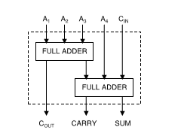
Existing Method
The block diagram of an exact 4 : 2 compressor is shown in Figure 1. It comprises of ﬁve inputs, three outputs and two cascaded full adders. A1, A2, A3, A4 and CIN are the inputs and COUT, CARRY and SUM are the outputs of the exact 4:2 compressor. COUT, CARRY and SUM are given as
COUT = A3(A1⊕A2)+A1(A1⊕A2) …(1)
CARRY=CIN(A1⊕A2⊕A3⊕A4)+A4(A1⊕A2⊕A3⊕A4) … (2)
SUM = CIN ⊕A1⊕A2⊕A3⊕A4 …(3)
Fig.1 Exact compressor

Slide 10
Disadvantages
Power consumption is more .
Area efficiency is less.
Delay is more

Slide 11
Proposed Method
For multiplication that generates accurate results. First, accurate partial products are produced using 2-input AND gates, and later compressed by the accurate compressors. Finally, accurate adders sum the compressed partial products to generate the result.
The main differences between traditional multiplication and the proposed multiplication are the steps of generating partial products and compressing the partial products. In the step of generating partial products, we use the dynamic input truncation that will be introduced
A high-accuracy and low-power approximate 4-2 compressor is proposed. The proposed 4-2 approximate compressor is shown in Fig below

Slide 12
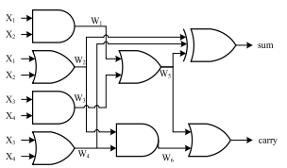
Fig Gate-level implementation of proposed 4-2 compressor
An incorrectly computed carry bit has a higher error distance than the sum bit, i.e., an incorrect carry bit produces two times ED of that produced by an incorrect sum bit, the carry bit in the proposed compressor is designed always to be correctly generated

Slide 13
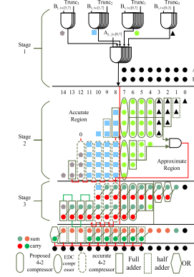
Fig 2. Proposed approximate multiplier

Slide 14
Advantages
Power consumption is less.
Area efficiency is high.
Delay is less

Slide 15
Application
DIP
DSP applications
In MAC Unit
Image smoothening

Slide 16
Hardware & Software Requirements
Xilinx Vivado Tool
HDL: Verilog

Slide 17
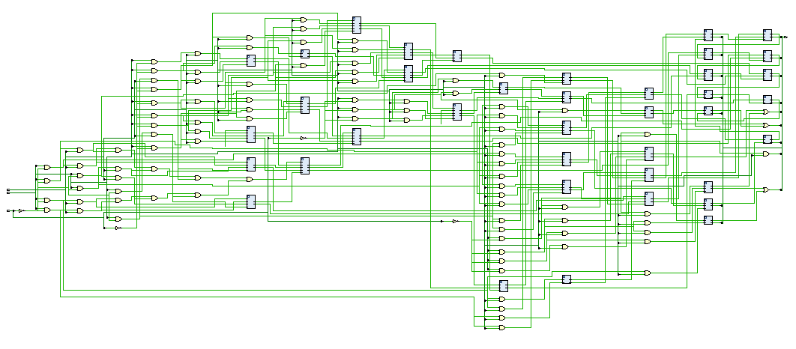
Results
RTL schematic

Slide 18
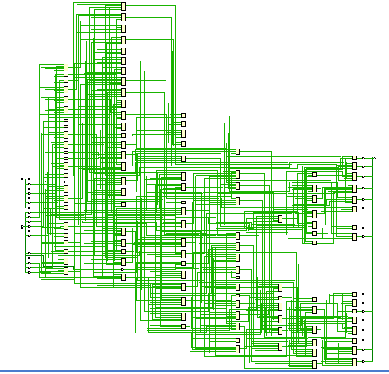
Technology schematic

Slide 19
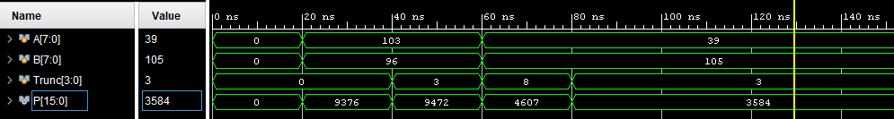
Simulation method:
 | Area (in LUT’s) | Delay (in ns) | Power (in Watts)
Proposed | 86 | 8.563 | 10.437
Evaluation method:

Slide 20
Conclusion
In this paper, a high accuracy approximate 4-2 compressor that can be used to construct an approximate multiplier is proposed. The proposed approximate multiplier dynamically truncates partial products to adjust the accuracy and a simple error compensation circuit is used to reduce the error distance. The delay and the average power consumption of the proposed adjustable approximate multiplier is reduced, compared to the Wallace tree multiplier. Compared to other approximate multipliers, our proposed multiplier has the lowest mean error distance and lowest average power consumption

Slide 21
Future scope
In the multiplier structure the delay and power can be further optimized by simply applying the pipelining concept to the existing multiplier architecture. We can further enhance the design by using some other efficient multiplier architecture can also be a further modification that is possible.

Slide 22
Reference
[1] M. de la Guia Solaz, W. Han, and R. Conway, ‘‘A flexible low power DSP with a programmable truncated multiplier,’’ IEEE Trans. Circuits Syst., vol. 59, no. 11, pp. 2555–2568, Nov. 2012.
[2] R. Zendegani, M. Kamal, M. Bahadori, A. Afzali-Kusha, and M. Pedram, ‘‘RoBa multiplier: A rounding-based approximate multiplier for highspeed yet energy-efficient digital signal processing,’’ IEEE Trans. Very Large Scale Integr. (VLSI) Syst., vol. 25, no. 2, pp. 393–401, Feb. 2017.
[3] C. S. Wallace, ‘‘A suggestion for a fast multiplier,’’ IEEE Trans. Electron. Comput., vol. EC-13, no. 1, pp. 14–17, Feb. 1964.
4] A. Weinberger, ‘‘4:2 carry-save adder module,’’ IBM Tech. Discl. Bull., vol. 23, no. 8, pp. 3811–3814, 1981.

