Slide 1
Title: IT Ticket Analysis and Improvement Recommendations Subtitle: Data-Driven Insights to Optimize IT Support Operations
Date: 16-12-2024
Presented By Nihali Jawariya

Slide 2
Objective:
The objective is to analyze the IT support ticket management system to understand the performance of IT agents.
Assessing the efficiency of ticket resolution, and the satisfaction levels of employees.
Identify high and low performers among IT agents.
The ultimate goal is to make informed staffing decisions, including hiring, firing, and training, to enhance overall service quality and team performance
Key objectives:
Evaluate ticket volumes, resolution times, agent performance, and improvement opportunities.

Slide 3
Methodology:
Tool: Excel
Data sources: IT tickets, agent performance records.
Approach: Data cleaning and Preprocessing, Exploratory Data Analysis (EDA), correlation studies, and trend analysis, some aggregate function, some string function, lookup, date function, cost-benefit analysis, Segment analysis, what-if analysis.

Slide 4
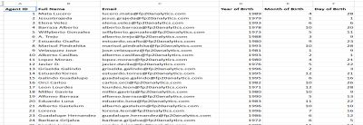
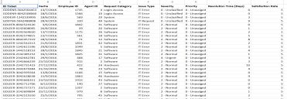
Data overview:
Total sheets:- 2 ( Tickets and IT Agents sheet).
Total number of tickets raised:- 97498
Total no of IT agents:- 50
Time Span of data:- 2016 to 2020
Categorical columns:- 16

Slide 5
Data Cleaning and Preparation
There were no missing values in the data.
Some cell in IT Agent sheet column B Full Name not contain the full name of agent we write full name of agent from their agent email.
To Agent name in Tickets Sheet by using VLOOKUP.
By using =DATE(D2,E2,F2) function combine birth year, month and date.
Find current age of agent by using =DATEDIF(G2,TODAY(),"y").
Use VLOOKUP to add age of agent column in Tickets sheet.
To extract severity value from severity using =IF(G3="0 - Unclasified",0, IF(G3="1 - Minor",1 , IF(G3="2 - Normal",2, IF(G3="3 - Mayor", 3, IF(G3="4 - Urgent", 4,"")))))
Used ‘Find and Replace’ feature to correct the spelling mistakes.

Slide 6
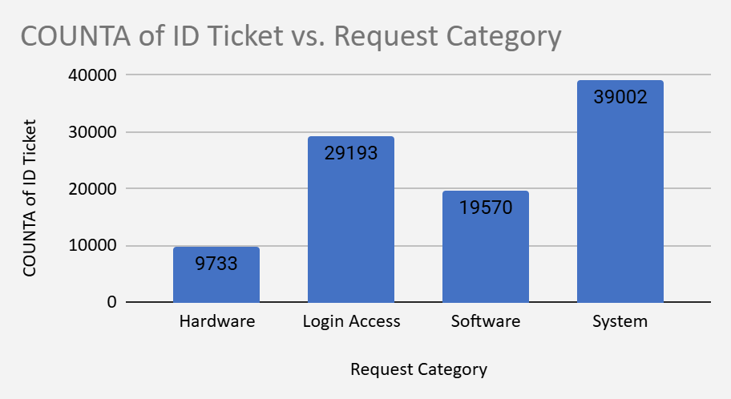
Analysis based on Count of Ticket vs. Request Category:
The system category has received maximum tickets among all categories, it received total 39002 tickets.
The least amount of tickets has been received from Hardware category which is 9733.
It is very important to understand distribution of ticket categories so that we can decide that which category need more improvement
.

Slide 7
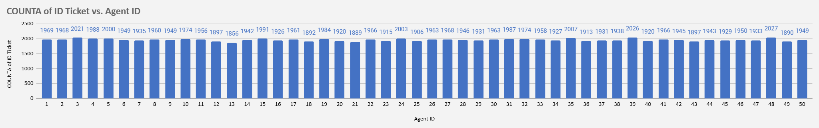
Analysis based on Count of Ticket vs. Agent ID:
Maximum no of tickets were held by agent id 48 which is 2027 tickets.
Minimum no of tickets were held by agent id 13 which is 1856 tickets.
Understanding of ticket distribution among IT agents is necessary to measure the performance of IT agents.

Slide 8
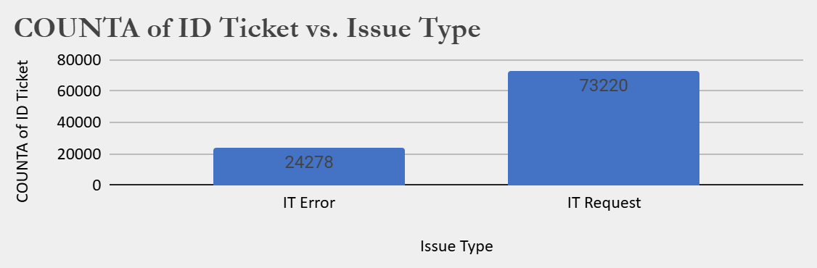
Analysis based on Count of Ticket vs. Issue Type:
The 73220 tickets are raised from IT Request.
The 24278 tickets are raised from IT Error.
It is very important to understand which Issue Type raised more tickets.

Slide 9
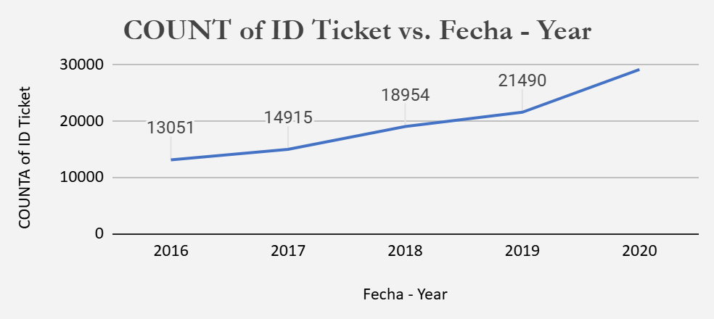
Analysis based on Count of Ticket vs. Fecha-Year:
The graph shows no. of tickets raised from 2016 to 2020.
Maximum no of tickets raised on 2020 which is 21490.
Minimum no of tickets raised on 2016 which are 13051.

Slide 10
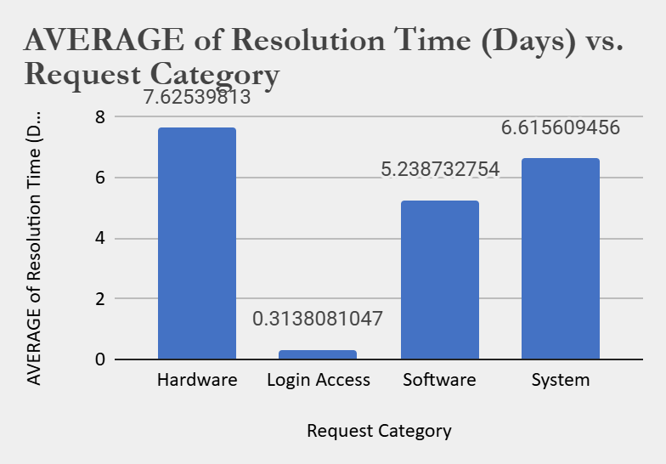
Analysis based on Average Resolution Time (Days) vs. Request Category:
Tickets raised from Hardware category takes the most to resolve.
Ticket raised from Login Access category gets resolved in just 0.3 days.
Understanding of resolution time of different request category is necessary to understand which request category is taking more time to get resolved.

Slide 11
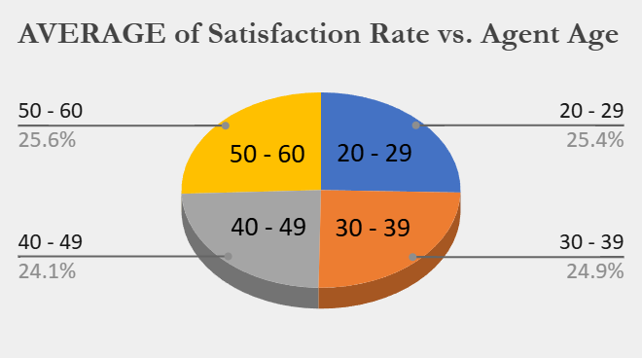
Analysis based on Average Satisfaction Rate vs Agent Age:
Consistently High Satisfaction (Ages 28-38): The satisfaction rate remains relatively stable and high in the age range of 28-38.
Slight Dip in Mid-Age Group (Ages 39-43): There is a noticeable dip in satisfaction levels around ages 39-43.
Satisfaction Rebounds (Ages 44-52): The satisfaction rate recovers and stays consistent towards the upper age bracket (44-52).

Slide 12
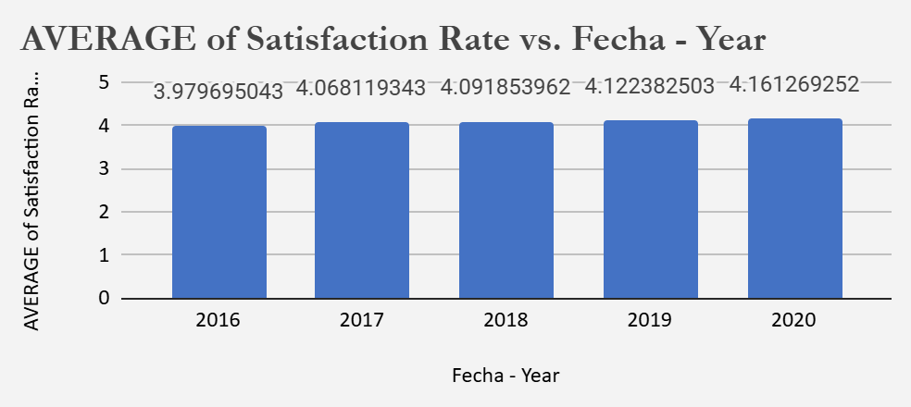
Analysis based on Count of Average Satisfaction Rate vs. Fecha-Year:
Steady Improvement: The satisfaction rate has consistently increased year over year from 2016 to 2020.
Significant Jump: The most noticeable rise in satisfaction occurred between 2016 and 2017.
Peak in 2020: 2020 recorded the highest satisfaction rate, suggesting successful efforts to boost employee morale.

Slide 13
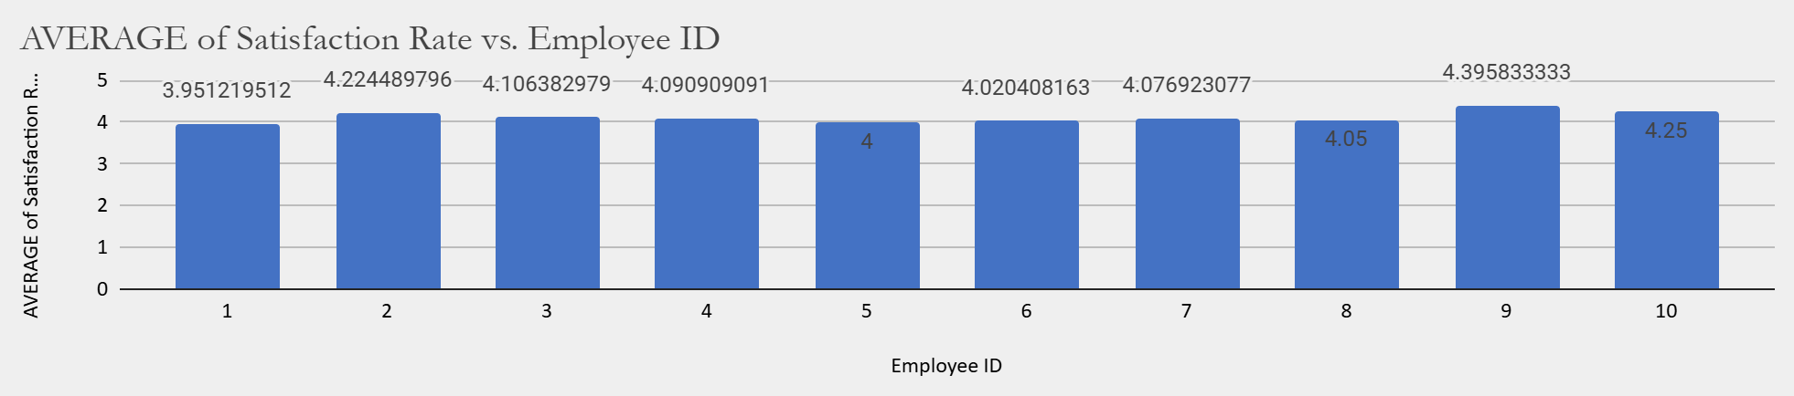
Analysis based on Analysis based on Satisfaction Rate vs. Employee ID:
The data has a total of 2000 employees, but we are only analysing performance of 10 employees.
The peak satisfaction rate is given by the employee no 9 which is close to 4.4.
The lowest satisfaction rate is given by no. 1 which is close to 3.9.
The satisfaction rate of the whole data ranges from 3.9 to 4.5.

Slide 14
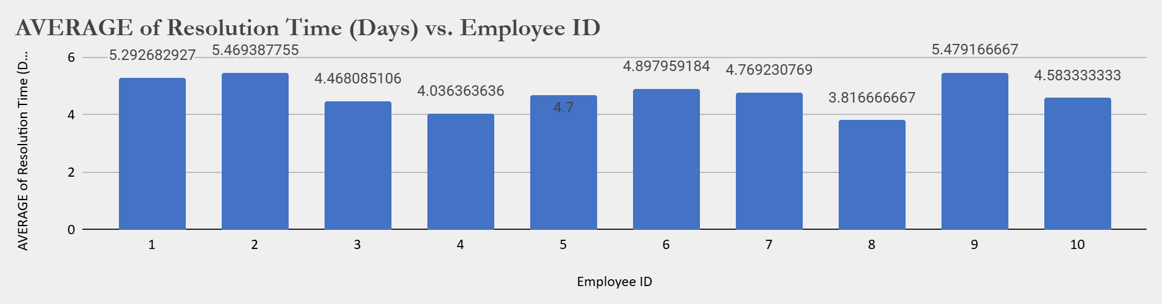
Analysis based on Count of Average Resolution Time (Days) vs. Employee ID:
Issues of employee no. 4 got resolved on just less than 4 days on an average.
While for Id no. 2 and 9 , it took more than 5 days.

Slide 15
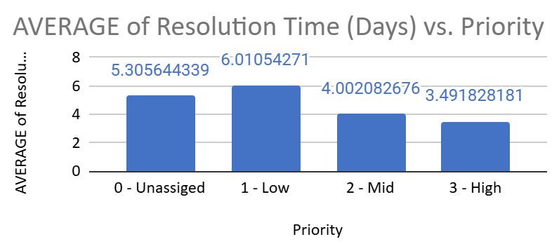
Analysis based on Count of Average Resoltion Time(Days) vs. Priority:
This graph shows the resolution time of different priorities.
Unassigned priority tickets are taking less time to resolve than low priority tickets.
High Priority tickets get resolved in just 3.49 days.
It is crucial to understand that whether tickets are being resolved according to priorities or not.

Slide 16
Analysis based on Count of Ticket vs. Request Category:
System-related requests dominate the ticket count with 39,002 tickets.
Login Access issues are the second highest, with 29,193 tickets.
Software requests are substantial but lower than System and Login Access.
Hardware requests are the least frequent, with only 9,733 tickets.

Slide 17
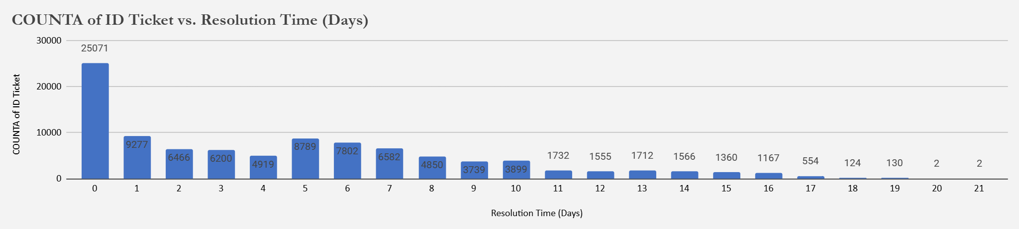
Analysis based on Count of Ticket vs. Resolution Time:
Most tickets (25,071) are resolved within 0 days.
Resolution times of 1 to 7 days also show a high ticket count, with a gradual decline.
Resolution times beyond 10 days are minimal.
Resolution efficiency decreases as time increases.

Slide 18
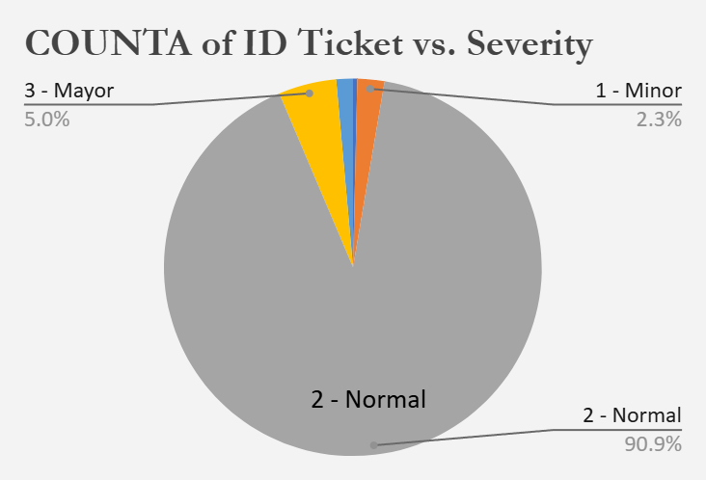
Analysis based on Count of Ticket vs. Severity:
Normal severity tickets are the most common, with 88,656 tickets.
Major severity tickets are relatively few, with only 4,836.
Minor, Unclassified, and Urgent tickets have very low counts, with only 2,258 Minor, 356 Unclassified, and 1,392 Urgent tickets.

Slide 19
Strategic Recommendations:
Hiring more agents can be one option.
The current agent-to-ticket ratio is approx 1912 tickets per agent over four years from 2016-2020.
It seems that the resolution time is high due to agent overload, so hiring more agents can be the solution.
Hiring more agents incurs salary costs, benefits, and overhead expenses.
This could reduce the workload for existing agents, leading to faster ticket resolution times and more satisfaction rate as resolution time has increased.

Slide 20
Strategic Recommendations:
Another option might be to improve training programs.
We should focus on agents with high resolution times and low satisfaction scores.
We found an insight in the analytics section(9th slide) that agents 19,22,25,28,3,22, 7 have resolution time>=5 days and satisfaction rate<=4.
If their performance is due to a lack of training then improving training could be a cost-effective solution.
Better-trained agents can resolve tickets faster and more accurately, improving satisfaction scores and lowering resolution times.

Slide 21
Strategic Recommendations:
Upgrading ticket management software system is another good alternative.
Slow resolution times that are caused by inefficiencies in the current system can be improved by upgrading the system.
Software upgrades can be expensive (licensing, implementation, training on new software).
New software might automate certain tasks, track issues better, and improve the overall efficiency of ticket handling.

Slide 22
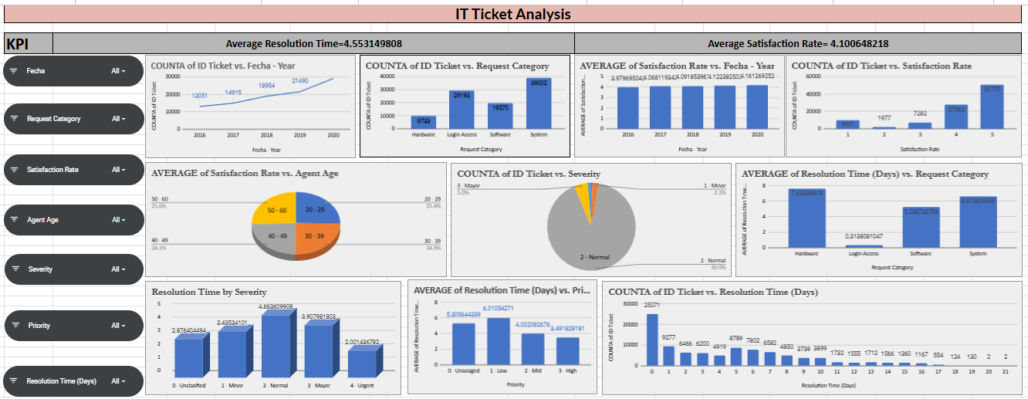
Dashboard:

Slide 23
Conclusion:
We analyse that if we add additional software and also some agent need training so that our tickets are resolve very less time and employ satisfaction rate also increases.
We want to hire more IT agent and so that our agent workload decreases and agent can resolve tickets as much as fast and with employ satisfaction.
As we seen that every year no. of tickets are increases with increasing satisfaction rate and decreasing resolution time so that here there is no need to fire any agent.

