Slide 1
Password generator

Slide 2
1) Aim of the project:• The aim of this project is to create a simple random password generator using Python to enhance security by generating strong and unpredictable passwords.
2) Objectives of the project:• Generate random passwords with a specified length.• Include a variety of characters (uppercase, lowercase, numbers, symbols) in the passwords.• Allow customization of password length.• Provide a user-friendly interface for generating passwords.

Slide 3
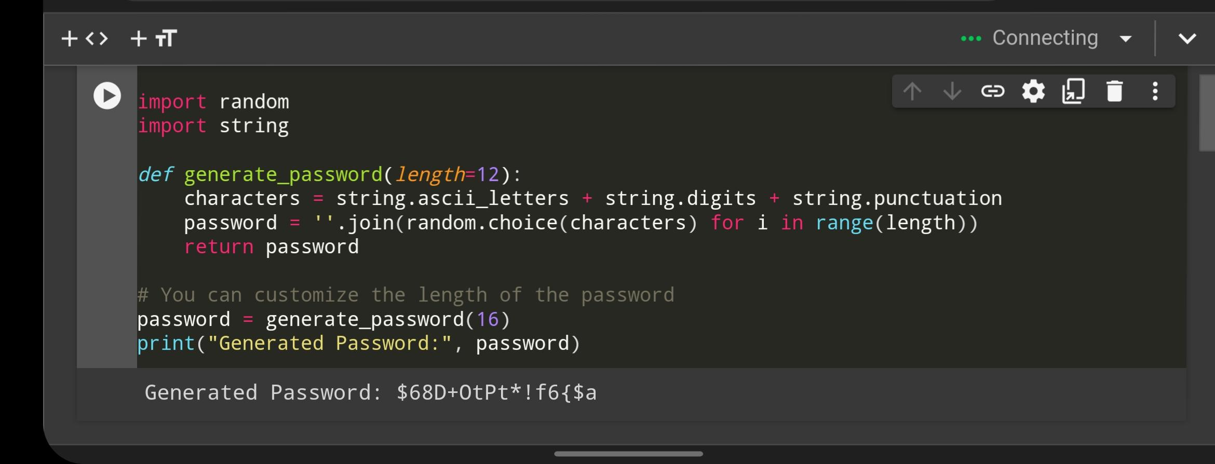
3) Source code:

Slide 4
5) Conclusion:• This project demonstrates a simple yet effective way to generate secure passwords programmatically. By incorporating various character types, the generated passwords are resistant to common attacks, enhancing overall security for users. Additionally, this project serves as a foundation management serve advanced password management system

