Slide 1

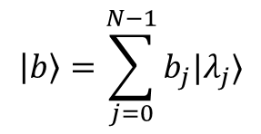
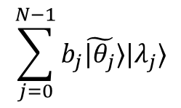


$$n_{l}$$
QPE
$$\left|0^{n_{l}}\right\rangle$$
$$\sum_{j=0}^{N−1}{b_{j}\tilde{|θ_{j}}⟩|λ_{j}⟩}$$
$$\left|b\right\rangle =\sum_{j=0}^{N−1}{b_{j}|λ_{j}⟩}$$
$$n_{b}$$

