Slide 1
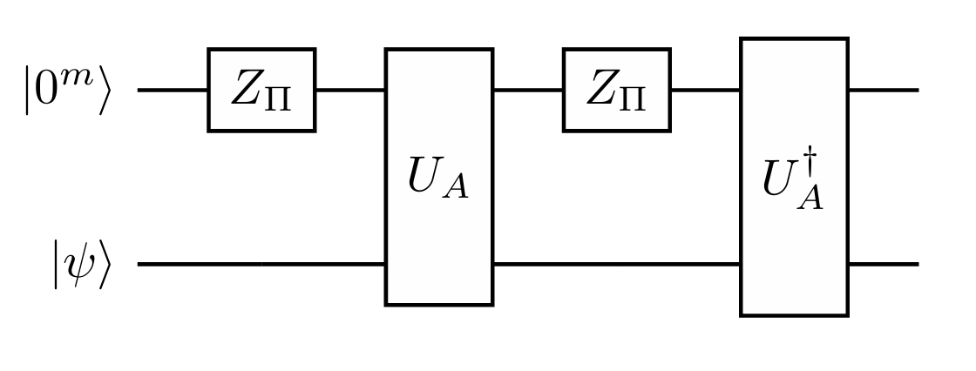



$$|0^{m+4}⟩$$
$$H$$
$$H$$

Slide 3
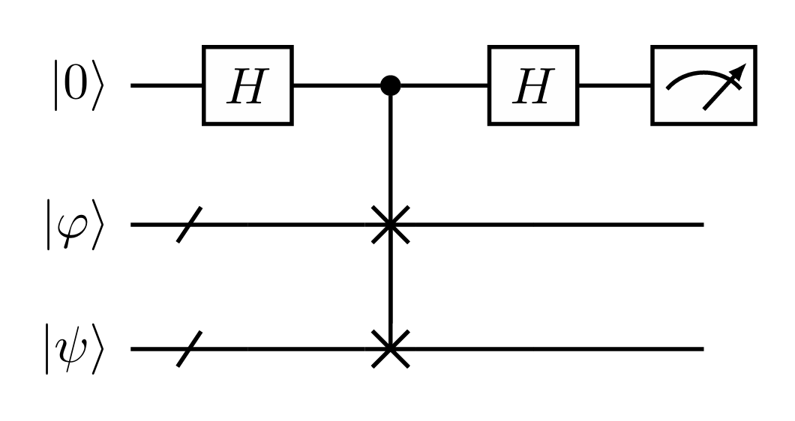





$$|ψ_{0}⟩$$
$$U_{Ω_{i}^{\left(t\right)}}$$
$$U_{T_{r}(H)}$$
$$|ψ_{0}⟩$$
$$U_{Ω_{j}^{\left(t\right)}}$$

