Slide 1

Hybrid quantum-classical algorithms for large sparse eigenvalue problems
Nihar Shah
(M.Tech 2nd Year)
Dissertation Advisor: Prof. Phani Motamarri
Notes:
Good after noon sirs, we will be discussing my Mtech dissertation proposal. Welcome to the September review. The topic for the discussion is on Quantum Computing based algorithms for Solving large Scale, sparse Eigenvalue problem.s

Slide 2
Flow of the Presentation
Quantum Computing
Principles of Quantum Computing
Notable Applications
Grover’s Algorithm
Shor’s Algorithm
HHL Algorithm
Classical vs Quantum Computing
The Challenges
Problem Definition
Classical Methods
Quantum Methods
Quantum Phase Estimation
Variation Quantum Eigensolver
Quantum Chebyshev Filtered Subspace Iteration Algorithm

Slide 3
Quantum Computing
A summary of the intersection of Linear Algebra Concepts, and Quantum Computing.

Slide 4
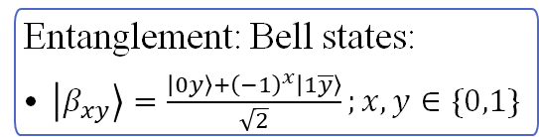
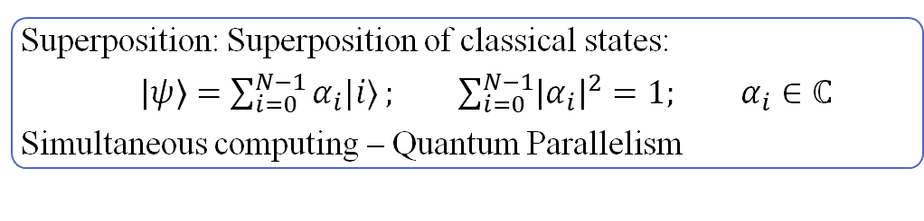

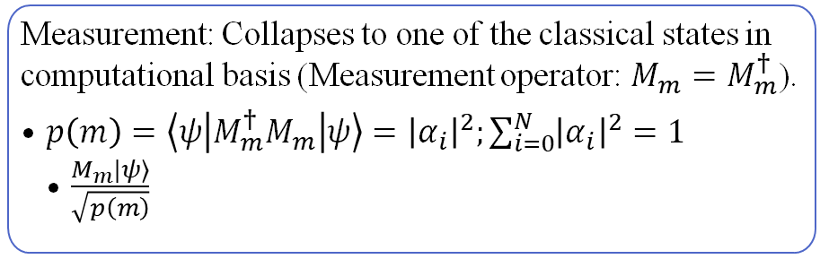
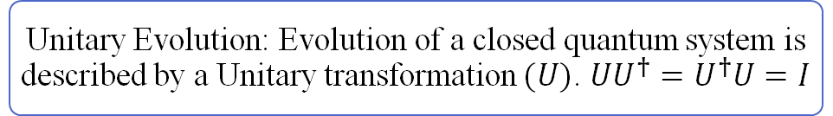
Principles of Quantum Computing
Superposition: Superposition of classical states:
$\left|ψ\right\rangle =\sum_{i=0}^{N−1}{α_{i}|i⟩}; \sum_{i=0}^{N−1}{{\left|α_{i}\right|}^{2}}=1; α_{i}∈ℂ$
Simultaneous computing – Quantum Parallelism
Example, For a qubit:
$$α\left|0\right\rangle +β\left|1\right\rangle ;{\left|α\right|}^{2}+{\left|β\right|}^{2}=1$$
State space of a Multi-qubit system is tensor product of the state spaces of the individual qubit systems
Entanglement: Bell states:
$\left|β_{xy}\right\rangle =\frac{{\left|0y\right\rangle +\left(−1\right)}^{x}\left|1\overline{y}\right\rangle }{\sqrt{2}};x,y∈\{0,1\}$
Unitary Evolution: Evolution of a closed quantum system is described by a Unitary transformation $(U)$. $UU^{†}=U^{†}U=I$
Measurement: Collapses to one of the classical states in computational basis (Measurement operator: $M_{m}=M_{m}^{†}$).
$p\left(m\right)=\left\langle ψ\left|M_{m}^{†}M_{m}\right|ψ\right\rangle ={\left|α_{i}\right|}^{2};\sum_{i=0}^{N}{{\left|α_{i}\right|}^{2}}=1$
$\frac{M_{m}|ψ⟩}{\sqrt{p\left(m\right)}}$

Slide 5
Notable Applications
Grover, Shor, HHL algorithms

Slide 6
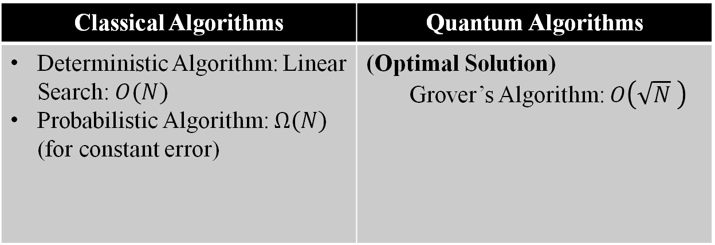
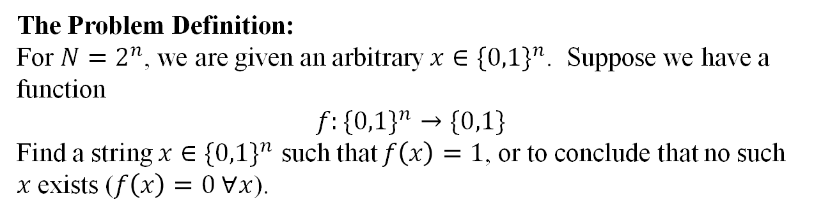


Grover’s Algorithm: Unstructured Search
The Problem Definition:
For $N=2^{n}$, we are given an arbitrary $x∈\{0,1\}^{n}$. Suppose we have a function
$$f:\{0,1\}^{n}→\{0,1\}$$
Find a string $x∈\{0,1\}^{n}$ such that $f\left(x\right)=1$, or to conclude that no such $x$ exists ($f\left(x\right)=0 ∀x$).
Classical Algorithms | Quantum Algorithms
Deterministic Algorithm: Linear Search: $O(N)$ Probabilistic Algorithm: $Ω(N)$ (for constant error) | (Optimal Solution) Grover’s Algorithm: $O\left(\sqrt{N} \right)$
$${|α}_{i}|$$
Quadratic Speedup!!
$$i$$
Grover, L. K. (1998, May). A framework for fast quantum mechanical algorithms. In Proceedings of the thirtieth annual ACM symposium on Theory of computing (pp. 53-62).https://doi.org/10.1145/237814.237866

Slide 7
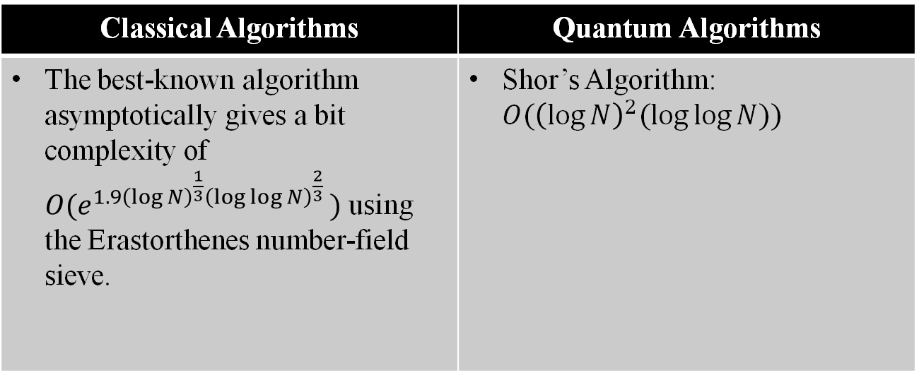
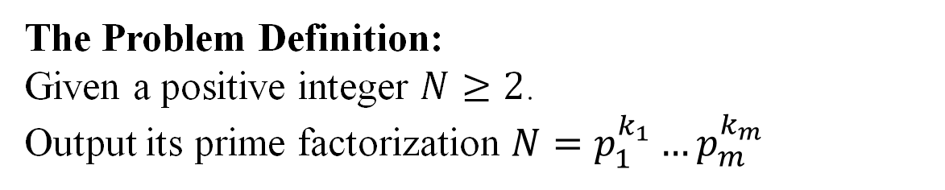
Shor’s Algorithm
The Problem Definition:
Given a positive integer $N≥2$.
Output its prime factorization $N=p_{1}^{k_{1}}…p_{m}^{k_{m}}$
Classical Algorithms | Quantum Algorithms
The best-known algorithm asymptotically gives a bit complexity of ${O(e}^{1.9{\left(\log{N}\right)}^{\frac{1}{3}}{\left(\log{\log{N}}\right)}^{\frac{2}{3}} })$ using the Erastorthenes number-field sieve. | Shor’s Algorithm: $O({\left(\log{N}\right)}^{2}(\log{\log{N})})$
Exponential Speedup!!
Shor, P. W. (1997). Polynomial-Time Algorithms for Prime Factorization and Discrete Logarithms on a Quantum Computer. SIAM Journal on Computing, 26(5), 1484–1509. https://doi.org/10.1137/s0097539795293172

Slide 8
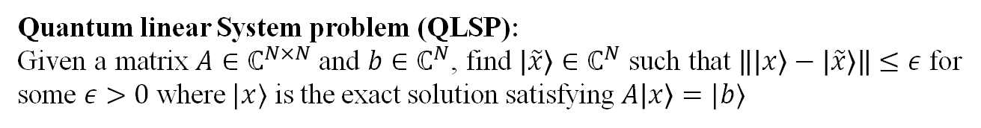

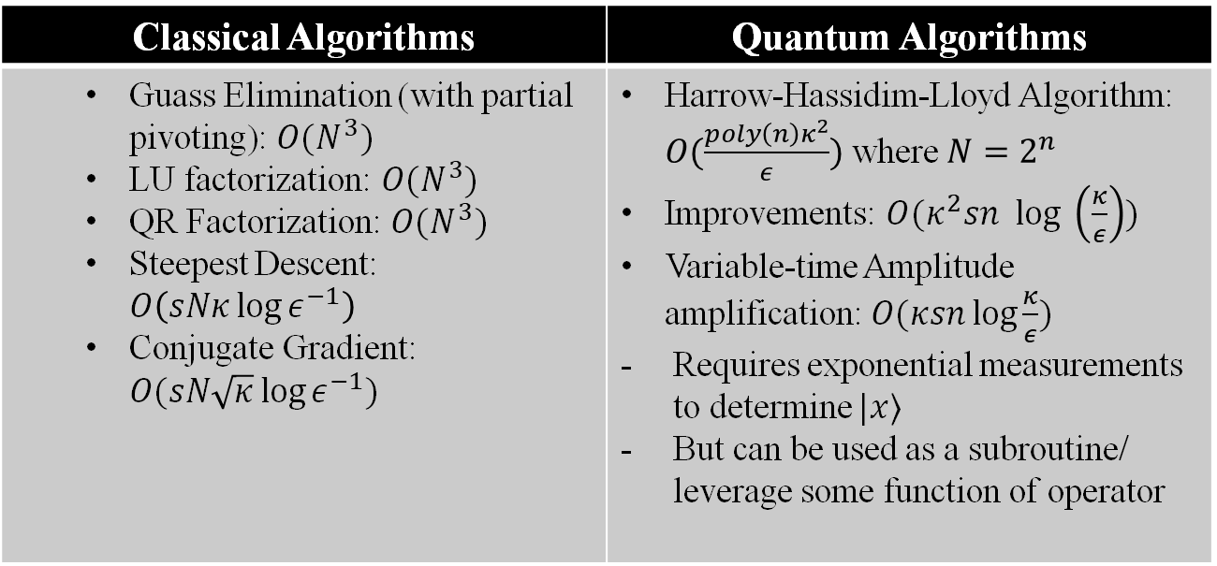
HHL Algorithm
Quantum linear System problem (QLSP):
Given a matrix $A∈ℂ^{N×N}$ and $b∈ℂ^{N}$, find $\left|\tilde{x}\right\rangle ∈ℂ^{N}$ such that $\left\|\left|x\right\rangle −\left|\tilde{x}\right\rangle \right\|≤ε$ for some $ε>0$ where $|x⟩$ is the exact solution satisfying $A\left|x\right\rangle =|b⟩$
Classical Algorithms | Quantum Algorithms
Guass Elimination (with partial pivoting): $O(N^{3})$ LU factorization: $O(N^{3})$ QR Factorization: $O(N^{3})$ Steepest Descent: $O\left(sNκ\log{ε^{−1}}\right)$ Conjugate Gradient: $O(sN\sqrt{κ}\log{ε^{−1}})$ | Harrow-Hassidim-Lloyd Algorithm: $O(\frac{{poly\left(n\right)κ}^{2}}{ε})$ where $N=2^{n}$ Improvements: $O(κ^{2}sn log \left(\frac{κ}{ε}\right))$ Variable-time Amplitude amplification: $O(κsn\log{\frac{κ}{ε}})$ Requires exponential measurements to determine $|x⟩$ But can be used as a subroutine/ leverage some function of operator
*$N=2^{n}$
Harrow, A. W., Hassidim, A., & Lloyd, S. (2009). Quantum algorithm for linear systems of equations. Physical review letters, 103(15), 150502.https://doi.org/10.1103/PhysRevLett.103.150502

Slide 9
Classical vs Quantum Computing
Pros and Cons

Slide 10
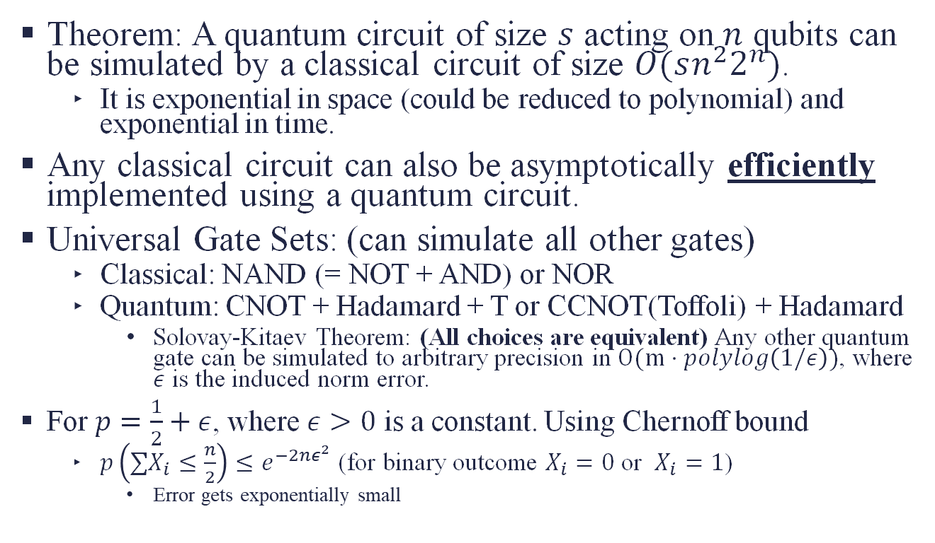
Classical vs Quantum Computing
Theorem: A quantum circuit of size $s$ acting on $n$ qubits can be simulated by a classical circuit of size $O(sn^{2}2^{n})$.
It is exponential in space (could be reduced to polynomial) and exponential in time.
Any classical circuit can also be asymptotically efficiently implemented using a quantum circuit.
Universal Gate Sets: (can simulate all other gates)
Classical: NAND (= NOT + AND) or NOR
Quantum: CNOT + Hadamard + T or CCNOT(Toffoli) + Hadamard
Solovay-Kitaev Theorem: (All choices are equivalent) Any other quantum gate can be simulated to arbitrary precision in $O(m⋅polylog\left(1/ε\right))$, where $ε$ is the induced norm error.
For $p=\frac{1}{2}+ε$, where $ε>0$ is a constant. Using Chernoff bound
$p\left(∑X_{i}≤\frac{n}{2}\right)≤e^{−2nε^{2}}$ (for binary outcome $X_{i}=0$ or $X_{i}=1$)
Error gets exponentially small

Slide 11
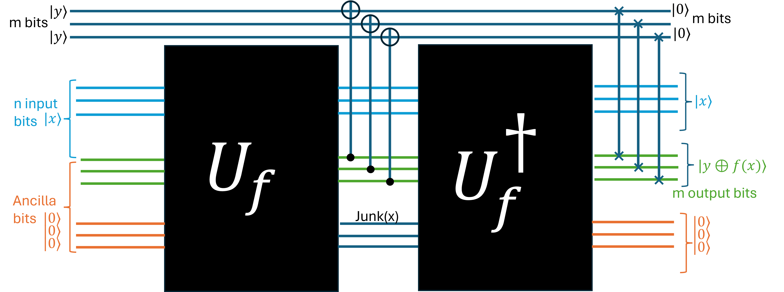

The Challenges: All is not well!!
Too many gates is not desirable
Linear Growth and Duhamel’s Principle
Given Unitaries $U_{i}∈ℂ^{N×N}, \tilde{U_{i}}∈ℂ^{N×N} ∀i∈\left\{0,…,k\right\}$, such that
$\left\|U_{i}−\tilde{U_{i}}\right\|≤ε⇒\left\|\prod_{i=0}^{k}{U_{i}}−\prod_{\left(i=0\right\}}^{k}{\tilde{U_{i}}}\right\|≤kε$
Fault-Tolerant Computation:
All Errors
Approximation Errors at Mathematical Level
Monte-Carlo errors due to Probabilistic nature of measurements.
Reversible Computation (necessity):
$\left|x\right\rangle \left|y\right\rangle \left|0_{an}\right\rangle \underset{→}{U}\left|x\right\rangle \left|y⊕f\left(x\right)\right\rangle |0_{an}⟩$
No Cloning Theorem
Distinguishability of Non-Orthogonal States
Non-Orthogonal states cannot be perfectly distinguished
Notes:
Output must be of same dimension as inpt

Slide 12
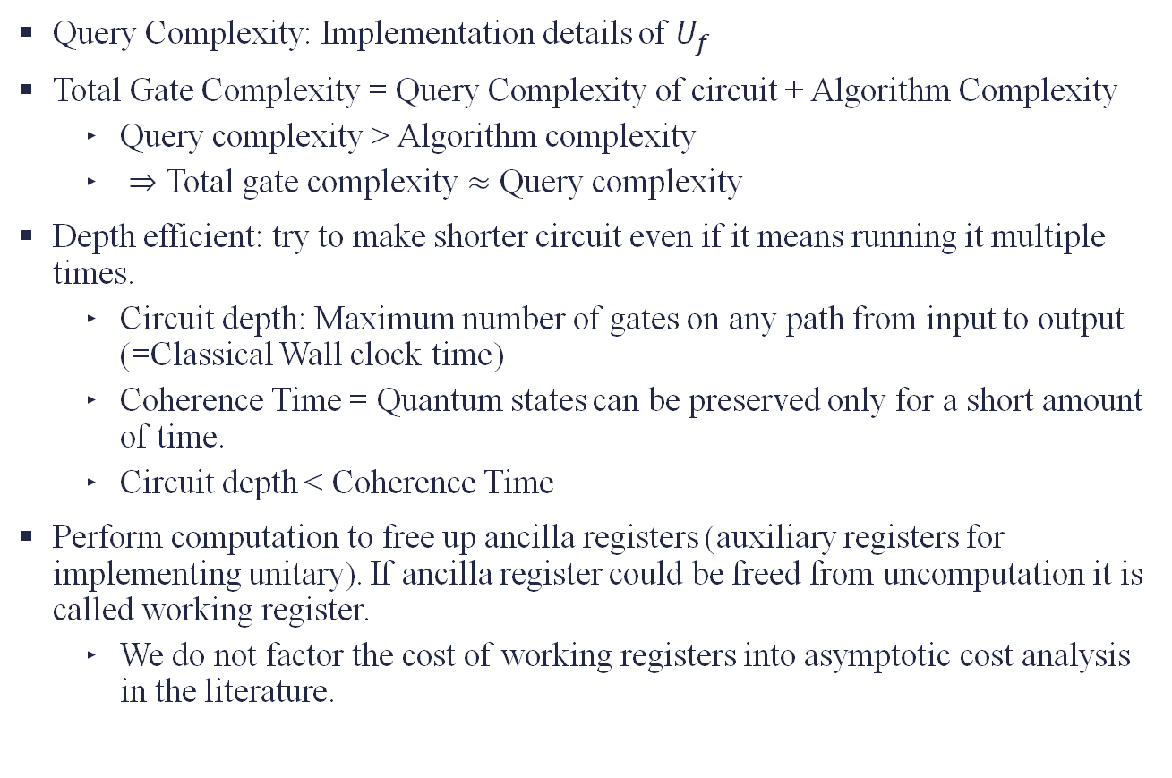
Challenges continued…
Query Complexity: Implementation details of $U_{f}$
Total Gate Complexity = Query Complexity of circuit + Algorithm Complexity
Query complexity > Algorithm complexity
$⇒$ Total gate complexity $≈$ Query complexity
Depth efficient: try to make shorter circuit even if it means running it multiple times.
Circuit depth: Maximum number of gates on any path from input to output (=Classical Wall clock time)
Coherence Time = Quantum states can be preserved only for a short amount of time.
Circuit depth < Coherence Time
Perform computation to free up ancilla registers (auxiliary registers for implementing unitary). If ancilla register could be freed from uncomputation it is called working register.
We do not factor the cost of working registers into asymptotic cost analysis in the literature.

Slide 13
Solving Eigenvalue Problems
Classical and Quantum Methods

Slide 14


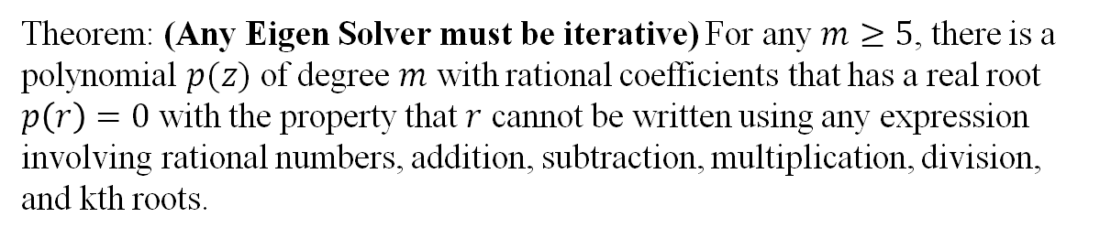
Problem definition
Let be $A∈ℂ^{m×m}$ a square matrix . A nonzero vector $x∈ℂ^{m}$ is an eigenvector of $A$, and $λ∈ℂ$ is its corresponding eigenvalue if
$$Ax=λx$$
Theorem: (Any Eigen Solver must be iterative) For any $m≥5$, there is a polynomial $p(z)$ of degree $m$ with rational coefficients that has a real root $p\left(r\right)=0$ with the property that $r$ cannot be written using any expression involving rational numbers, addition, subtraction, multiplication, division, and kth roots.
Trefethen, L. N., & Bau, D. (2022). Numerical linear algebra. Society for Industrial and Applied Mathematics.

Slide 15
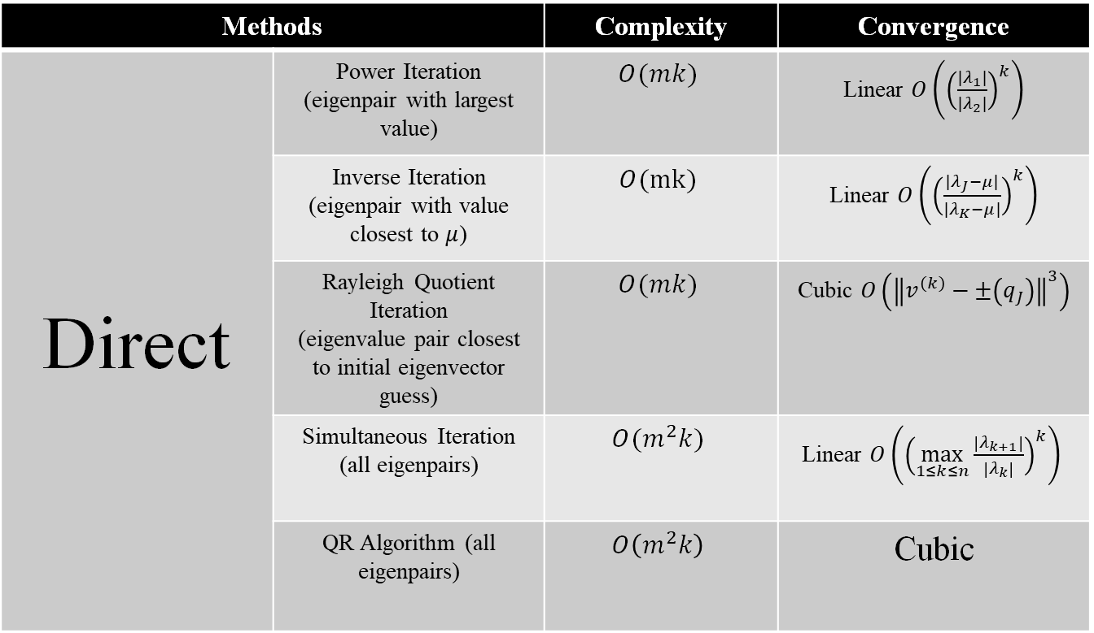
Classical Methods*
If $‖x−q_{J}‖_{2}=ε⇒\left|r\left(x\right)−λ_{J}\right|=O\left(ε^{2}\right)$ where $r\left(x\right)=\frac{x^{T}Ax}{ x^{T}x}$ (Rayleigh Quotient)
Methods |  | Complexity | Convergence
Direct | Power Iteration (eigenpair with largest value) | $$O(mk)$$ | Linear $O\left({\left(\frac{{|λ}_{1}|}{{|λ}_{2}|}\right)}^{k}\right)$
 | Inverse Iteration (eigenpair with value closest to $μ$) | $$O(mk)$$ | Linear $O\left({\left(\frac{{|λ}_{J}−μ|}{{|λ}_{K}−μ|}\right)}^{k}\right)$
 | Rayleigh Quotient Iteration (eigenvalue pair closest to initial eigenvector guess) | $$O(mk)$$ | Cubic $O\left({\left\|v^{\left(k\right)}−±\left(q_{J}\right)\right\|}^{3}\right)$
 | Simultaneous Iteration (all eigenpairs) | $$O(m^{2}k)$$ | Linear $O\left({\left(\max_{1≤k≤n}{\frac{\left|λ_{k+1}\right|}{\left|λ_{k}\right|}}\right)}^{k}\right)$
 | QR Algorithm (all eigenpairs) | $$O\left(m^{2}k\right)$$ | Cubic
* For Real+ Symmetric + Tridiagonal matrices
Notes:
Theorem: No formula exists for Polynomials with degree>=5. Thus, no finite steps algorithm for exact roots of a polynomial and thus the Eigenvalue problem’s characteristic polynomial and vice versa.
Characteristic Polynomial – Evaluation of Determinant is n! and Ill conditioned problem even when EVP is well conditioned
Power Iteration – depends on initial overlap with the required eigenvector
Linear Convergence
Largest Eigenvalue Significantly larger than others
Convergence is Proportional to difference between two eigenvalues
Inverse Iteration – nonzero initial overlap
Linear Convergence, Rate of linear convergence depends on quality of mu
Closer the mu to the eigenvalue of A faster the convergence to the corresponding eigenvalue and eigenvector
Standard model for calculating one or more eigenvectors of a matrix if the eigenvalues are already known.
Rayleigh Quotient Iteration
Estimate evalue from Rayleigh Quotient in Power Iteration use it in inverse iteration
Estimate Evec from inverse iteration
Idea: to use continually improving eigenvalue estimates to increase the rate of convergence of inverse iteration at every step.
Rate of convergence: Each iteration triples the digit of accuracy

Slide 16
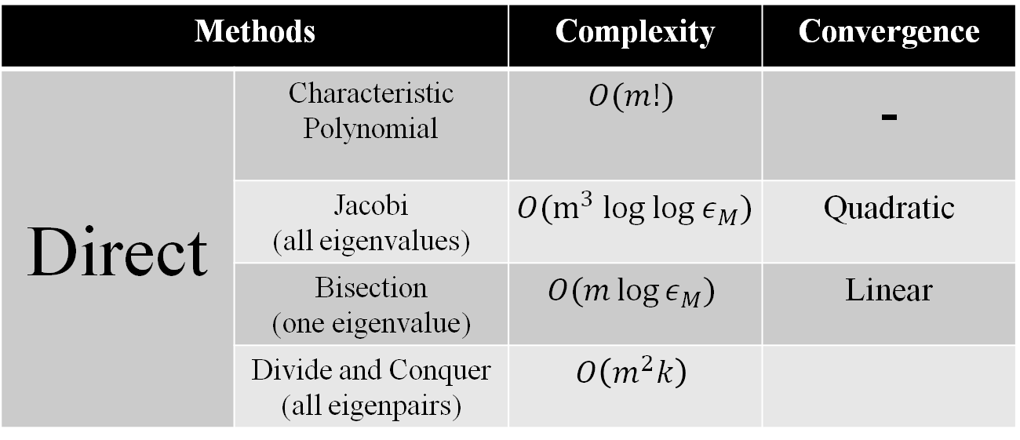
Methods |  | Complexity | Convergence
Direct | Characteristic Polynomial | $$O(m!)$$ | -
 | Jacobi (all eigenvalues) | $$O(m^{3} log log ε_{M})$$ | Quadratic
 | Bisection (one eigenvalue) | $$O(m\log{ε_{M}})$$ | Linear
 | Divide and Conquer (all eigenpairs) | $$O\left(m^{2}k\right)$$
* For Real+ Symmetric + Tridiagonal matrices
Notes:
In these methods we solve the problem in two phases. Phase 1 begin converting to upper Hessenberg form using something similar to Householder reflection.
NOTE that all these methods are used for small scale Eigenvalue problems and cannot be used for largescale eigenvalue problems because they do not take advantage of the sparsity of the matrix.

Slide 17
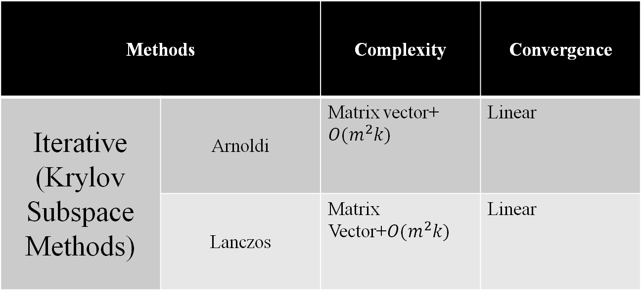
We are interested in the extreme eigenvalues (near the edge of the spectrum of A)
Methods |  | Complexity | Convergence
Iterative (Krylov Subspace Methods) | Arnoldi | Matrix vector+ $O(m^{2}k)$ | Linear
 | Lanczos | Matrix Vector+$O(m^{2}k)$ | Linear
Notes:
What about Large Scale problem where we wish to take advantage of the Sparsity as well!!

Slide 18
Go Quantum
Why Go Quantum?:
All is not Lost

Slide 19
Quantum Methods
Small Scale Eigenvalue Problems
Quantum Phase Estimation
Variational Quantum Eigen solver
Large Scale Eigenvalue Problems
Time Evolution (Imaginary and Real)
Quantum Subspace Methods (hybrid quantum-classical methods)
Hamiltonian Quantum Krylov
Gaussian-power Quantum Krylov
Time Evolution Methods
Quantum Filter Diagonalization
Quantum lanczos based on imaginary-time evolution
Subspace-based variational quantum simulations
Motta, M., Kirby, W., Liepuoniute, I., Sung, K. J., Cohn, J., Mezzacapo, A., ... & Rice, J. E. (2024). Subspace methods for electronic structure simulations on quantum computers. Electronic Structure, 6(1), 013001.

Slide 20
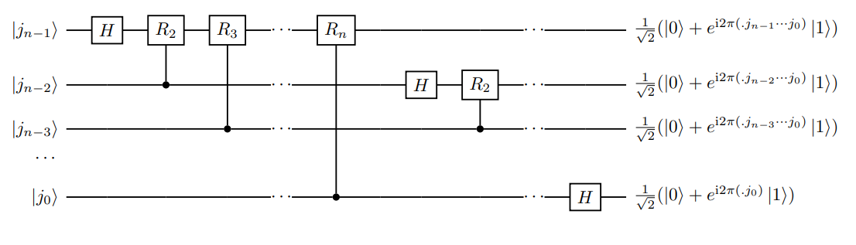
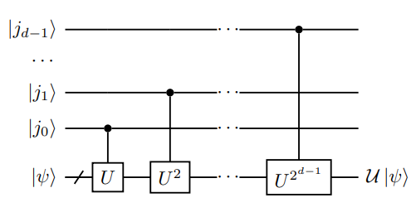
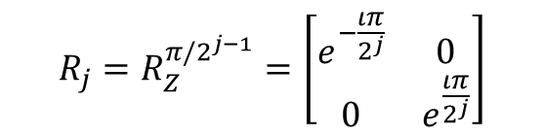



Quantum Phase Estimation
The Problem Definition:
Given a quantum circuit that performs the unitary operation $U$, we are required to find it’s eigenvalue $\left(θ\right)$ and its corresponding eigenvector $|ψ⟩$.
$U\left|ψ\right\rangle =e^{2πιθ}\left|ψ\right\rangle ;θ∈[0,1)$
$${R_{j}=R}_{Z}^{π/2^{j−1}}=\left[\begin{matrix}e^{−\frac{ιπ}{2^{j}}} & 0 \\ 0 & e^{\frac{ιπ}{2^{j}}}\end{matrix}\right]$$
d-ancilla bits
Step 1:
$O\left(d\right)$ gate complexity
$O\left(n^{2}\right)$ gate complexity
Step 2:
Controlled – U operation (C-U)
Quantum Fourier Transform (before applying SWAP) gate

Slide 21
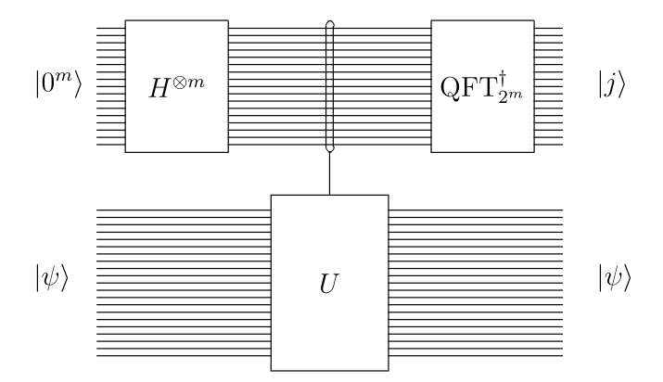
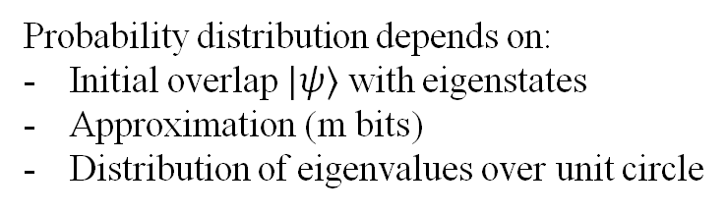
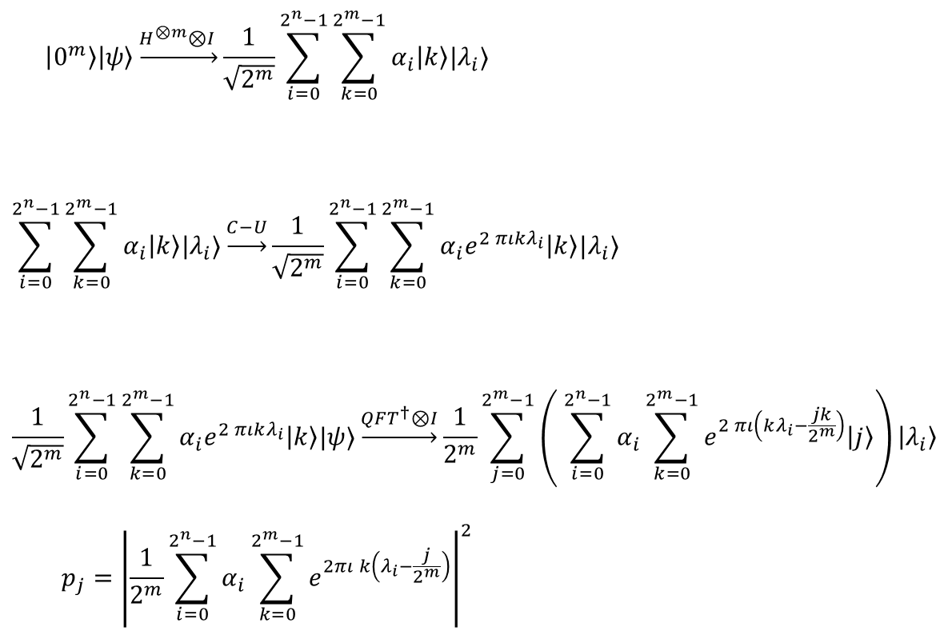
Quantum Phase Estimation
$$\left|0^{m}\right\rangle \left|ψ\right\rangle \underset{→}{H^{⊗m}⊗I }\frac{1}{\sqrt{2^{m}}}\sum_{i=0}^{2^{n}−1}{\sum_{k=0}^{2^{m}−1}{α_{i}\left|k\right\rangle |λ_{i}⟩}}$$
$$\sum_{i=0}^{2^{n}−1}{\sum_{k=0}^{2^{m}−1}{α_{i}\left|k\right\rangle |λ_{i}⟩}}\underset{→}{C−U}\frac{1}{\sqrt{2^{m}}}\sum_{i=0}^{2^{n}−1}{\sum_{k=0}^{2^{m}−1}{α_{i}e^{2 πιkλ_{i}}\left|k\right\rangle |λ_{i}⟩}}$$
$$\frac{1}{\sqrt{2^{m}}}\sum_{i=0}^{2^{n}−1}{\sum_{k=0}^{2^{m}−1}{{α_{i}e}^{2 πιkλ_{i}}\left|k\right\rangle |ψ⟩}}\underset{→}{QFT^{†}⊗I}\frac{1}{2^{m}}\sum_{j=0}^{2^{m}−1}{\left( \sum_{i=0}^{2^{n}−1}{α_{i}\sum_{k=0}^{2^{m}−1}{e^{2 πι\left(kλ_{i}−\frac{jk}{2^{m}}\right)}\left|j\right\rangle }}\right)}\left|λ_{i}\right\rangle$$
$$p_{j}={\left|\frac{1}{2^{m}}\sum_{i=0}^{2^{n}−1}{α_{i}\sum_{k=0}^{2^{m}−1}{e^{2πι k\left(λ_{i}−\frac{j}{2^{m}}\right)}}}\right|}^{2}$$
Probability distribution depends on:
Initial overlap $|ψ⟩$ with eigenstates
Approximation (m bits)
Distribution of eigenvalues over unit circle
Notes:
D=n=m, I have taken m ancilla qubits here

Slide 22
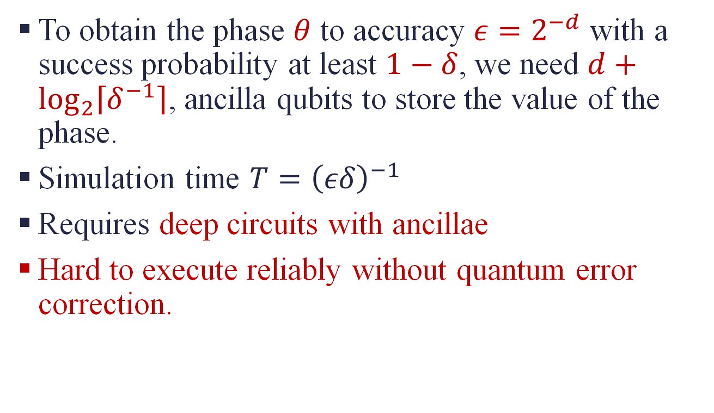
Challenges with QPE
To obtain the phase $θ$ to accuracy $ε=2^{−d}$ with a success probability at least $1−δ$, we need $d+\log_{2}\left\lceil δ^{−1}\right\rceil$, ancilla qubits to store the value of the phase.
Simulation time $T={\left(εδ\right)}^{−1}$
Requires deep circuits with ancillae
Hard to execute reliably without quantum error correction.
Lin Lin. (2022). Lecture Notes on Quantum Algorithms for Scientific Computation. https://doi.org/10.48550/arXiv.2201.08309

Slide 23
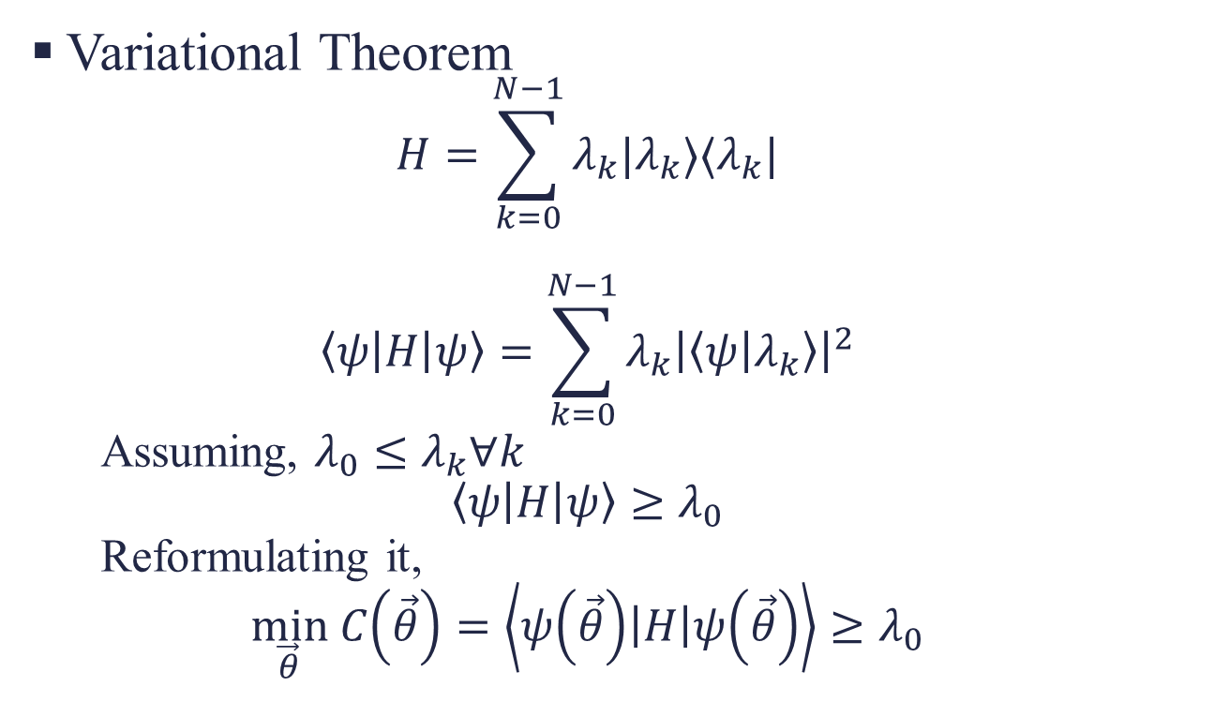
Variational Quantum Eigensolver
Variational Theorem
$$H=\sum_{k=0}^{N−1}{λ_{k}|λ_{k}⟩⟨λ_{k}|}$$
$$\left\langle ψ\left|H\right|ψ\right\rangle =\sum_{k=0}^{N−1}{λ_{k}{\left|\left\langle ψ | λ_{k}\right\rangle \right|}^{2}}$$
Assuming, $λ_{0}≤λ_{k}∀k$
$$\left\langle ψ\left|H\right|ψ\right\rangle ≥λ_{0}$$
Reformulating it,
$$\min_{\vec{θ}} C\left(\vec{θ}\right)=\left\langle ψ\left(\vec{θ}\right)\left|H\right|ψ\left(\vec{θ}\right)\right\rangle ≥λ_{0}$$
Notes:
Hybrid quantum-classical method
For solving the ground state of Hamiltonian–(represented as a linear combination of Pauli terms)
Cost function evaluated using quantum computers and parameters optimized using classical computers
Requires
Hamiltonian and ansatz – No. of parameters = polynomial in no of qubits
Classical Optimizer
Domain Specific Knowledge - Problem specific information to define the structure of ansatz
Cost function

Slide 24
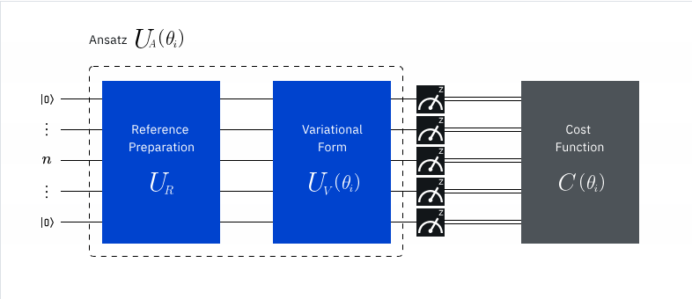
VQEs
Adjust ansatz parameters
Initialize Problem
Prepare Ansatz
Evaluate Cost function
Optimize Parameters

Slide 25
Variational Quantum Eigensolvers
Quantum Subspace Methods
Requires non-linear parameter optimization (NP-hard)
Each update of quantum circuit parameter requires a new call of the quantum computer in just one call.
Does not require non-linear parameter optimization
Can be naturally parallelised
Limitation: eigenstates are not stored on a quantum device, so computing properties after a QSE calculation requires additional measurements.
Limitation: Accuracy and computational cost depends on the choice of basis states spanning subspace.

Slide 26

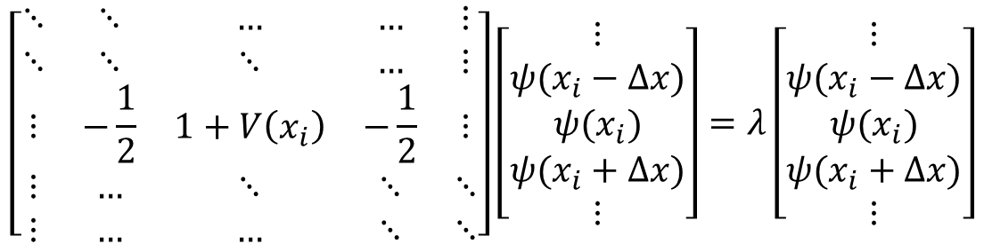
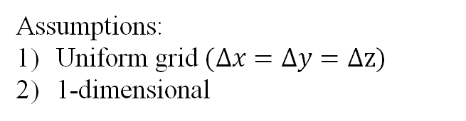
Our Problem (n smallest Eigenvalues)
$$\left(−\frac{1}{2}∇^{2}+V(x)\right) ψ(x)=λψ(x)$$
Assumptions:
Uniform grid $(Δx=Δy=Δz)$
1-dimensional
Finite Difference (FDM)
(using 2nd order accurate CDS for Laplacian)
$$\left[\begin{matrix}⋱ & ⋱ & … & … & ⋮ \\ ⋱ & ⋱ & ⋱ & … & ⋮ \\ ⋮ & −\frac{1}{2} & 1+V\left(x_{i}\right) & −\frac{1}{2} & ⋮ \\ ⋮ & … & ⋱ & ⋱ & ⋱ \\ ⋮ & … & … & ⋱ & ⋱\end{matrix}\right]\left[\begin{matrix}⋮ \\ ψ(x_{i}−Δx) \\ ψ(x_{i}) \\ ψ(x_{i}+Δx) \\ ⋮\end{matrix}\right]=λ\left[\begin{matrix}⋮ \\ ψ(x_{i}−Δx) \\ ψ(x_{i}) \\ ψ(x_{i}+Δx) \\ ⋮\end{matrix}\right]$$
Real + Symmetric + Tridiagonal
Notes:
Because it includes complexities of both Poisson and Helmholtz

Slide 27
Quantum Chebyshev Filter Subspace Iteration Algorithm
The Proposal

Slide 28
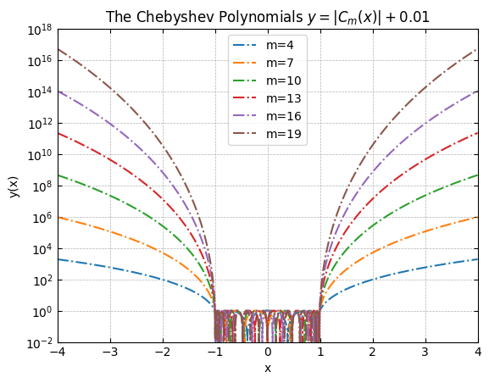
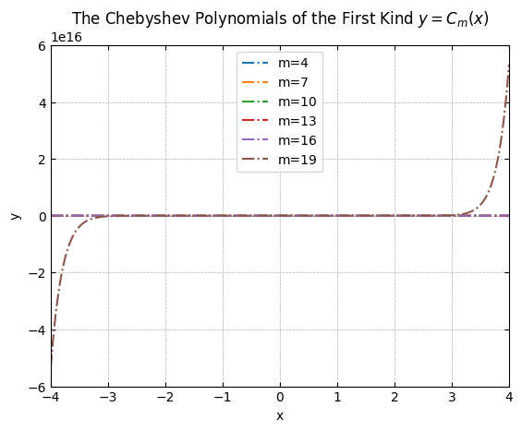

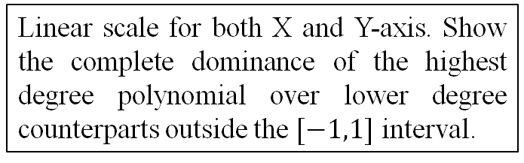

Chebyshev Filtering
Chebyshev Polynomials (of the first kind) as spectrum filters
(introducing favourable gaps among wanted eigenvalues)
$C_{m+1}\left(x\right)= \left\{\begin{aligned}\cos{(m\cos^{−1}{(x))}}, \left|x\right|<1 \\ \cosh{(m\cosh^{−1}\left(x\right))}, x>1 \\ {\left(−1\right)}^{m}\cosh\left(m\cosh^{−1}\left(−x\right)\right), x<−1\end{aligned}\right.$
$C_{m+1}\left(x\right)=2xC_{m}\left(x\right) −C_{m−1}\left(x\right), m=1,2,…,$
$C_{0}\left(x\right)=1 , C_{1}\left(x\right)=x$
Exponential growth of $C_{m}$ outside the $[−1,1]$ interval.
Fastest among all polynomials with degree $≤m$
Denote the eigenbasis of Hermitian $H$ as $ψ_{i}^{′}s$, with corresponding eigen values $λ_{i}^{′}s$ i.e. $Hψ_{i}=λ_{i}ψ_{i}$. Any initial vector $x_{0}$ can be expanded in the eigenbasis as
$x_{0}=α_{1}ψ_{1}+α_{2}ψ_{2}+…+α_{n}ψ_{n}$
Applying Polynomial Filter: $(α_{1}≠0)$
$p\left(H\right)x_{0}=α_{1}p\left(λ_{1}\right)ψ_{1}+α_{2}p\left(λ_{2}\right)ψ_{2}+…+α_{n}p\left(λ_{n}\right)ψ_{n}$
Fast growth of $C_{m}\left(x\right)$ outside the $[−1,1]$ interval. Uses a semilog for the y-axis, for which we take absolute value of $C_{m}(x)$ and add a mall shift $0.01$
$y=\left|C_{m}\left(x\right)\right|+0.01$
Linear scale for both X and Y-axis. Show the complete dominance of the highest degree polynomial over lower degree counterparts outside the $[−1,1]$ interval.

Slide 29

After normalization: $p\left(H\right)x_{0}≈ψ_{1}$.
The convergence rate of an eigen-algorithm depends on the gap-ratio $=\max_{j}\frac{λ_{j}}{λ_{1}}, j≠1$
Apply affine mapping to map unwanted spectrum inside the $[−1,1]$ interval,
Exponential growth property automatically applied to map the wanted spectrum (by better gap-ratio)

Slide 30
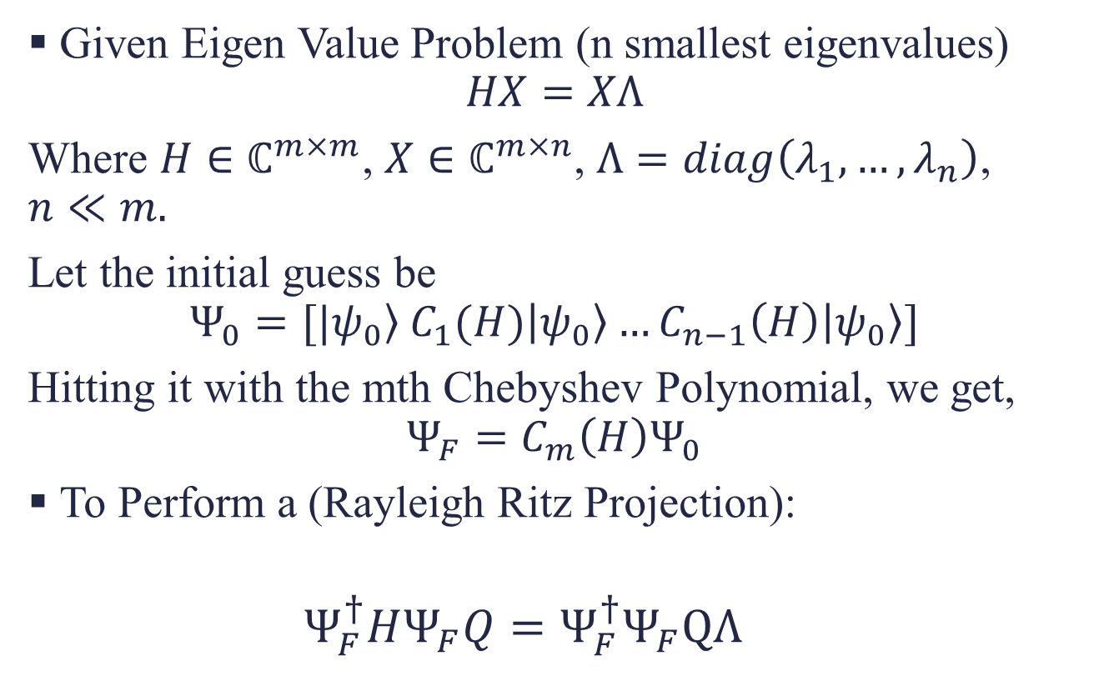
ChFSI
Given Eigen Value Problem (n smallest eigenvalues)
$$HX=XΛ$$
Where $H∈ℂ^{m×m}$, $X∈ℂ^{m×n}$, $Λ=diag\left(λ_{1},…,λ_{n}\right)$, $n≪m.$
Let the initial guess be
$$Ψ_{0}=[|\left.ψ_{0}\right\rangle C_{1}(H)\left|ψ_{0}\right\rangle …C_{n−1}\left(H\right)\left|ψ_{0}\right\rangle ]$$
Hitting it with the mth Chebyshev Polynomial, we get,
$$Ψ_{F}=C_{m}\left(H\right)Ψ_{0}$$
To Perform a (Rayleigh Ritz Projection):
$$Ψ_{F}^{†}HΨ_{F}Q=Ψ_{F}^{†}Ψ_{F}QΛ$$

Slide 31
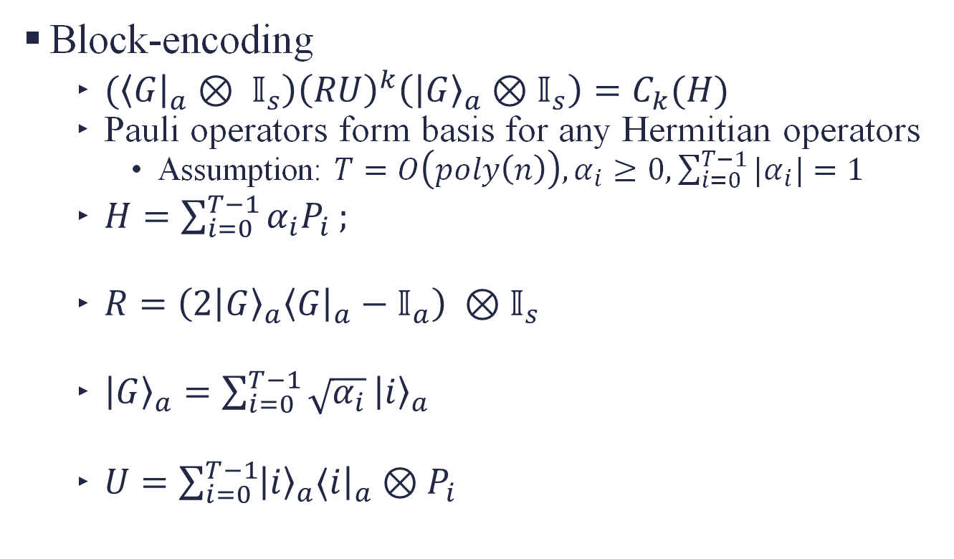
Quantum ChFSI
Block-encoding
$(\left\langle G{\left.​\right|}_{a}⊗ 𝕀_{s}\right){\left(RU\right)}^{k}\left({\left|G\right\rangle }_{a}⊗𝕀_{s}\right)=C_{k}(H)$
Pauli operators form basis for any Hermitian operators
Assumption: $T=O\left(poly\left(n\right)\right),α_{i}≥0, \sum_{i=0}^{T−1}{|α_{i}|}=1$
$H=\sum_{i=0}^{T−1}{α_{i}P_{i}};$
$R={\left(2 | G\right\rangle }_{a}\left\langle G{\left.​\right|}_{a}−𝕀_{a}\right) ⊗𝕀_{s}$
${\left|G\right\rangle }_{a}=\sum_{i=0}^{T−1}{\sqrt{α_{i}}}{\left|i\right\rangle }_{a}$
$U=\sum_{i=0}^{T−1}{{\left|i\right\rangle }_{a}⟨i{\left.​\right|}_{a}}⊗P_{i}$

Slide 32
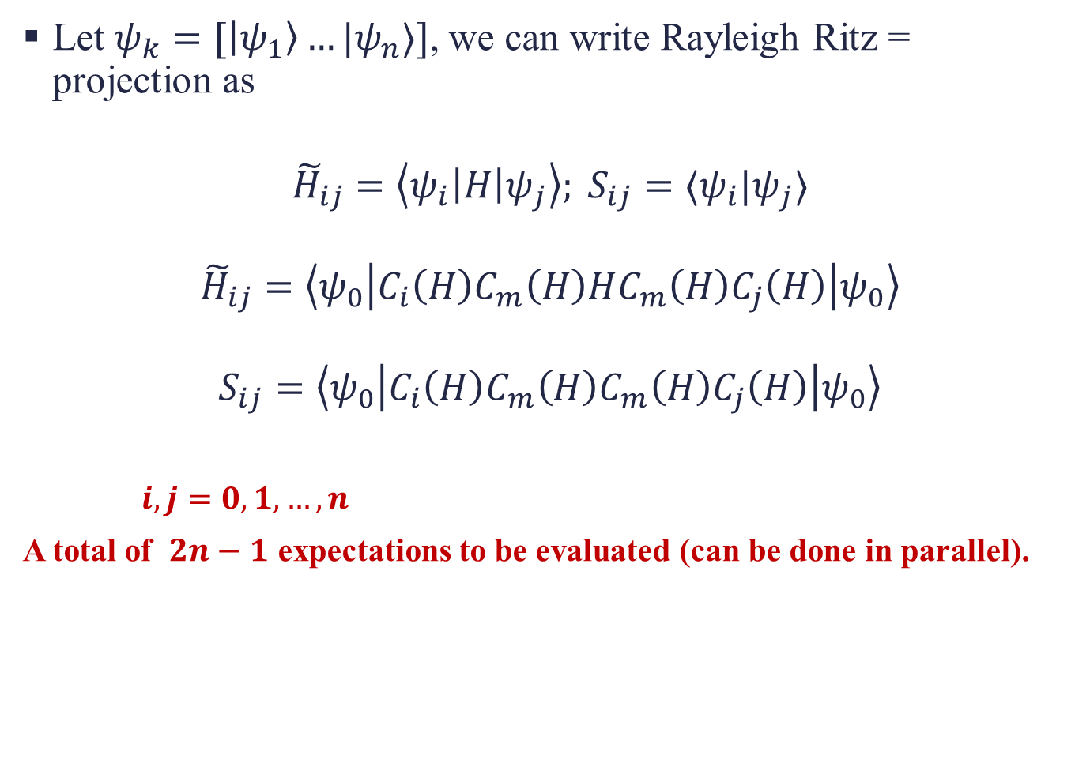
Let$ψ_{k}=[\left|ψ_{1}\right\rangle …|ψ_{n}⟩]$, we can write Rayleigh Ritz = projection as
$${\tilde{H}}_{ij}=\left\langle ψ_{i}\left|H\right|ψ_{j}\right\rangle ; S_{ij}=⟨ψ_{i}|ψ_{j}⟩$$
$${\tilde{H}}_{ij}=\left\langle ψ_{0}\left|C_{i}\left(H\right)C_{m}\left(H\right)HC_{m}\left(H\right)C_{j}\left(H\right)\right|ψ_{0}\right\rangle$$
$$S_{ij}=\left\langle ψ_{0}\left|C_{i}\left(H\right)C_{m}\left(H\right)C_{m}\left(H\right)C_{j}\left(H\right)\right|ψ_{0}\right\rangle$$
$i,j=0,1,…,n$
A total of $2n−1$ expectations to be evaluated (can be done in parallel).

Slide 33
References
Grover, L. K. (1998, May). A framework for fast quantum mechanical algorithms. In Proceedings of the thirtieth annual ACM symposium on Theory of computing (pp. 53-62).https://doi.org/10.1145/237814.237866
Shor, P. W. (1997). Polynomial-Time Algorithms for Prime Factorization and Discrete Logarithms on a Quantum Computer. SIAM Journal on Computing, 26(5), 1484–1509. https://doi.org/10.1137/s0097539795293172
Harrow, A. W., Hassidim, A., & Lloyd, S. (2009). Quantum algorithm for linear systems of equations. Physical review letters, 103(15), 150502.https://doi.org/10.1103/PhysRevLett.103.150502
Motta, M., Kirby, W., Liepuoniute, I., Sung, K. J., Cohn, J., Mezzacapo, A., ... & Rice, J. E. (2024). Subspace methods for electronic structure simulations on quantum computers. Electronic Structure, 6(1), 013001.https://doi.org/10.1088/2516-1075/ad3592
Lin Lin. (2022). Lecture Notes on Quantum Algorithms for Scientific Computation. https://doi.org/10.48550/arXiv.2201.08309

