Slide 1
Gold Standard Memory Buffer
s00 | s01 | s02 | s03 | s04 | .. | .. | .. | .. | s0n
s10 | s11 | s12 | s13 | s14 | .. | .. | .. | .. | s1n
.. | .. | .. | .. | .. | .. | .. | .. | .. | ..
.. | .. | .. | .. | .. | .. | .. | .. | .. | ..
sm0 | sm1 | sm2 | sm3 | sm4 | .. | .. | .. | .. | smn
Random sample
epsilon exploration

Slide 2
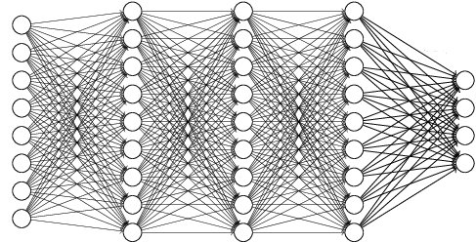
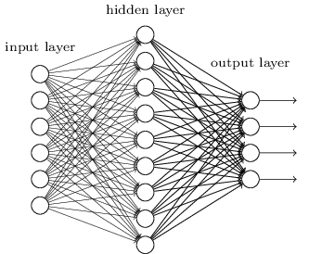
Global Network
Sequential
Updates
Get tongs
Get diamonds
Get jelly beans
Human
Supervision

