Slide 1
Data Visualization for Olympic Dataset
By,
Nihar Sudhanshu Limaye
Email:- niharslims@gmail.com
24th June 2020

Slide 2
Introduction & Motivation
Olympic dataset is rich in value with plenty of information for analysis
Plenty of opportunity to design numerous types of graphs & charts
Used expertise in SQL, data cleaning and data transformation
Huge fan of sports & Olympic world’s biggest sporting event

Slide 3
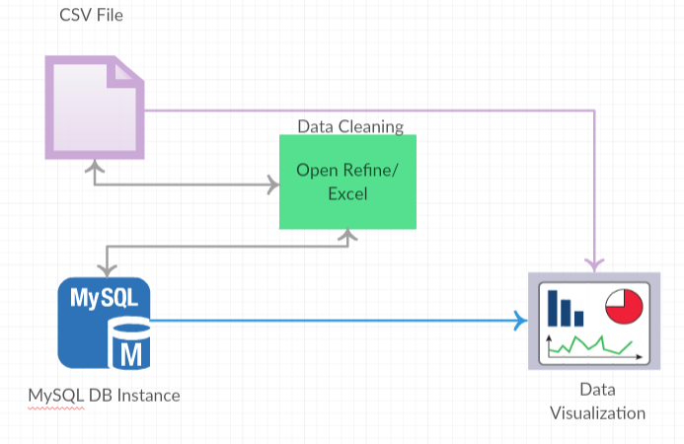
Tools & Process flow
Data Visualization Tools
Tableau Desktop
Power Bi
Ms Excel
Qlikview
Data Storage Tools
MySQL database
CSV file
Fig 1. Process Flow

Slide 4
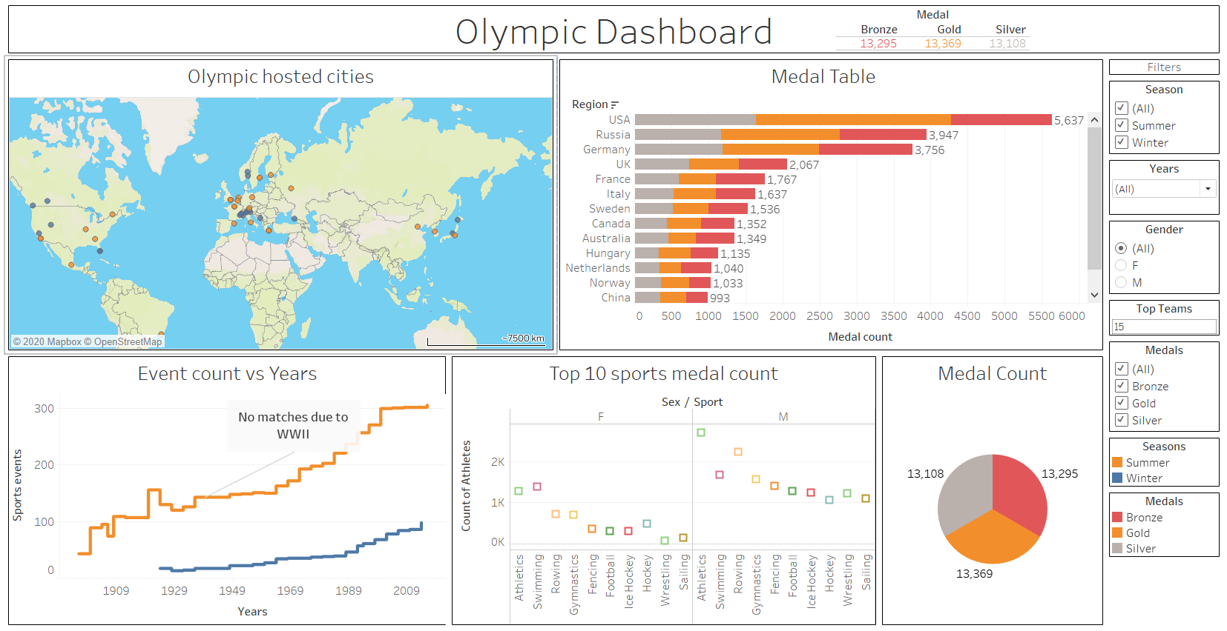
1. Tableau Visualization
Experience in creating & publishing dashboards on cloud *
Click Here

Slide 5
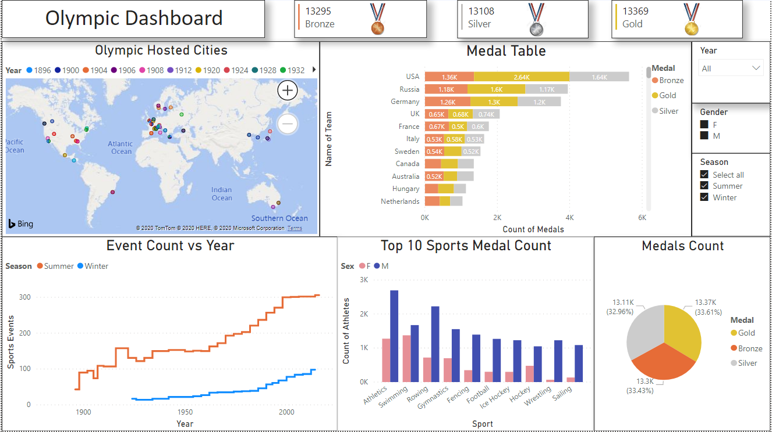
2. PowerBI Visualization

Slide 6
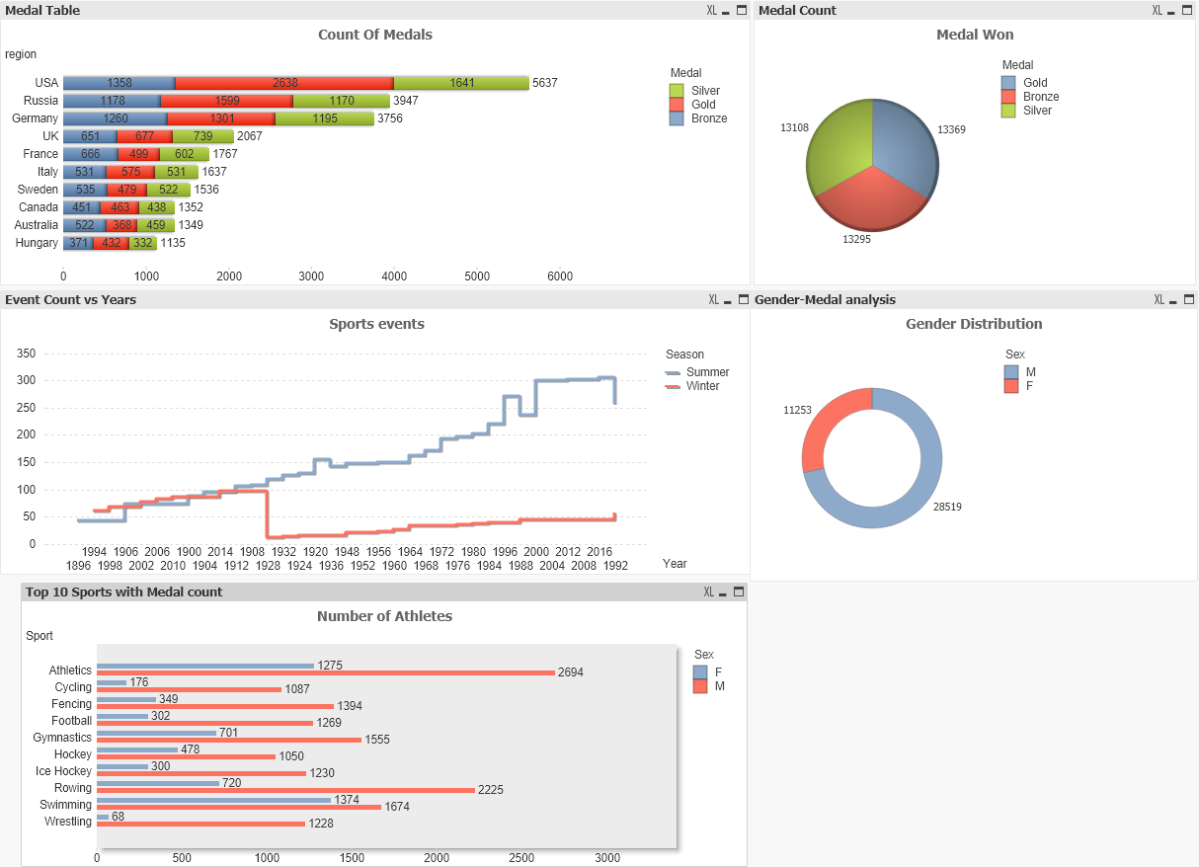
3. Qlikview Visualization

Slide 7
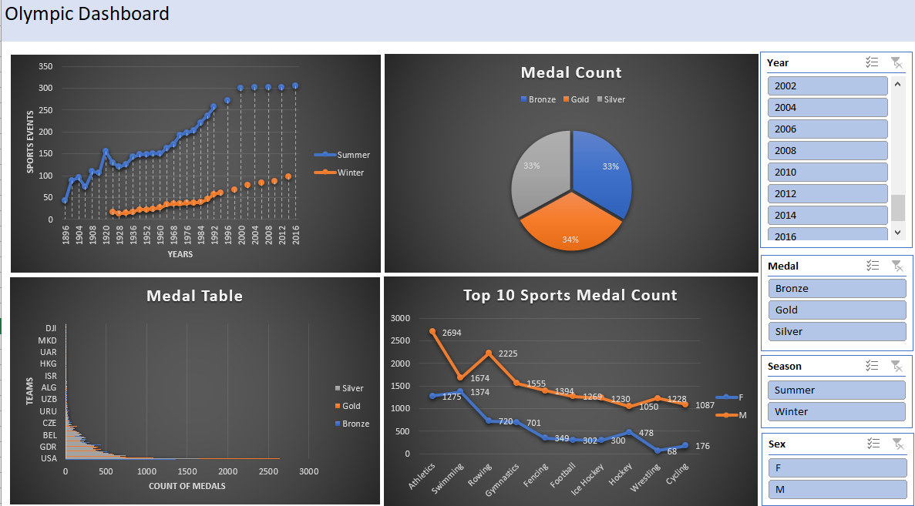
4. MS Excel Visualization

Slide 8
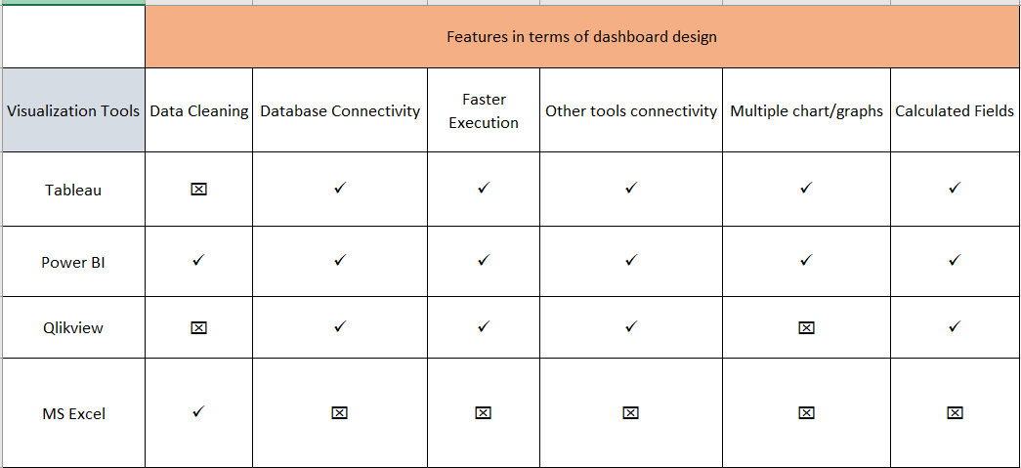
Tools Comparison

Slide 9
Other Skills
Proficient in SQL and published the paper on Relational Databases
Paper Publication : Nihar Limaye
Report writing skills in industry and academic
Academic Report : Nihar Limaye
Other projects and work
GitHub: Nihar Limaye
Updated Resume
Resume: Nihar Limaye

Slide 10
Thank You !!!

