Slide 1
Customer Personality Analysis
Detailed analysis of a company’s ideal customers

Slide 2
Customer Personality Analysis using PCA and K-means Clustering
Objective
Importance:
Expected Outcome
To analyze customer data and segment customers based on their personality traits using PCA (Principal Component Analysis) and K-means clustering.
Understanding customer personalities helps businesses tailor their marketing strategies, improve customer satisfaction, and increase overall sales.
Gain insights into distinct customer segments and their characteristics, enabling targeted marketing and personalized customer experiences.

Slide 3
Methodology
Data Collection and Preprocessing:
Principal Component Analysis (PCA):
K-means Clustering for Customer Segmentation
The dataset from Kaggle, initially with 29 columns capturing demographics and purchasing behavior, was refined to 13 columns after preprocessing, including handling missing values and encoding categorical variables.
PCA was used to reduce the dataset to 2 and 3 principal components, with the 2-component reduction showing clearer distinctions between customer segments, enabling more effective customer segmentation and analysis.
"Utilizing the elbow method, it was determined that 3 clusters should be created using K-means clustering, allowing for effective segmentation of customers based on their personality traits derived from PCA components.

Slide 4
Code Snippets

Slide 5
Libraries used
NumPy-used for data manipulation, mathematical operations, and handling numerical data structures, such as arrays or matrices
Pandas-used for reading and preprocessing data, handling data frames, performing data cleaning, filtering, grouping, and merging operations, and preparing data for analysis or modelling.
Seaborn, matplotlib-used to create various types of charts, plots, and visualizations to explore data, identify patterns, trends, and relationships
Sklearn-Used for implementing machine learning algorithms, such as clustering algorithms (e.g., K-means clustering) and dimensionality reduction techniques (e.g., PCA).

Slide 6
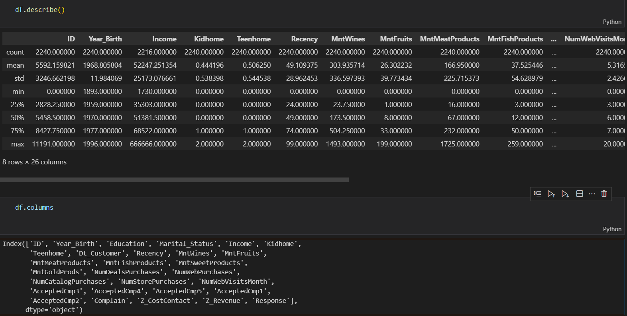
Data Before Preprocessing

Slide 7
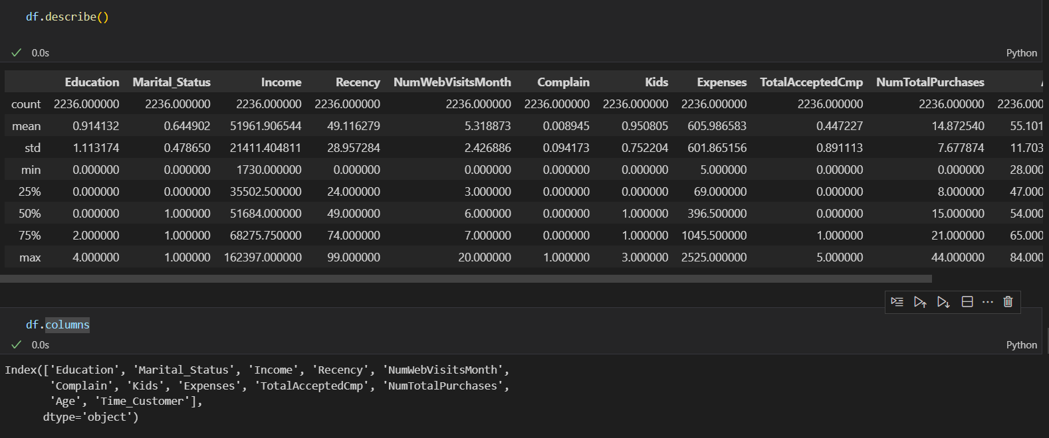
Data After Preprocessing

Slide 8
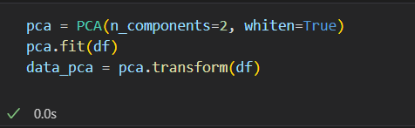
Principal Component Analysis (PCA):

Slide 9
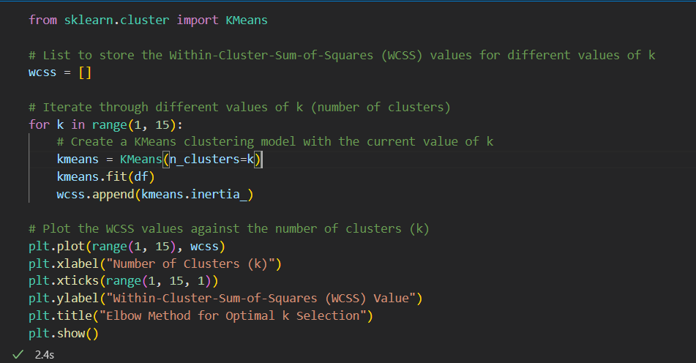
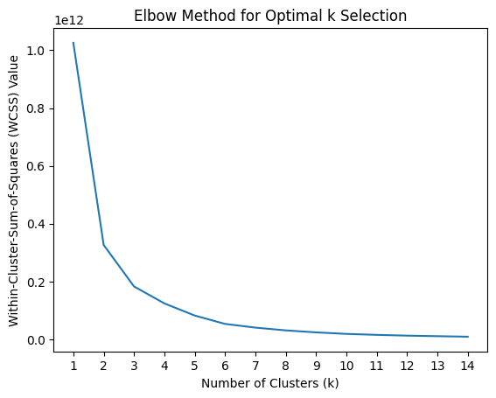
Selecting Number of Clusters To Make

Slide 10
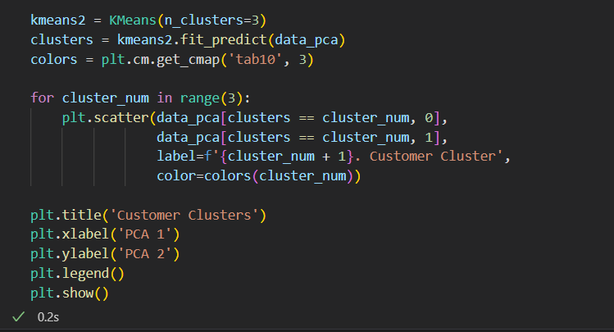
K-means Clustering for Customer Segmentation

Slide 11
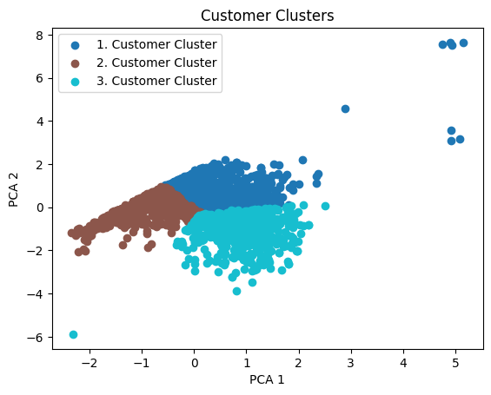
Results and Insights

Slide 12
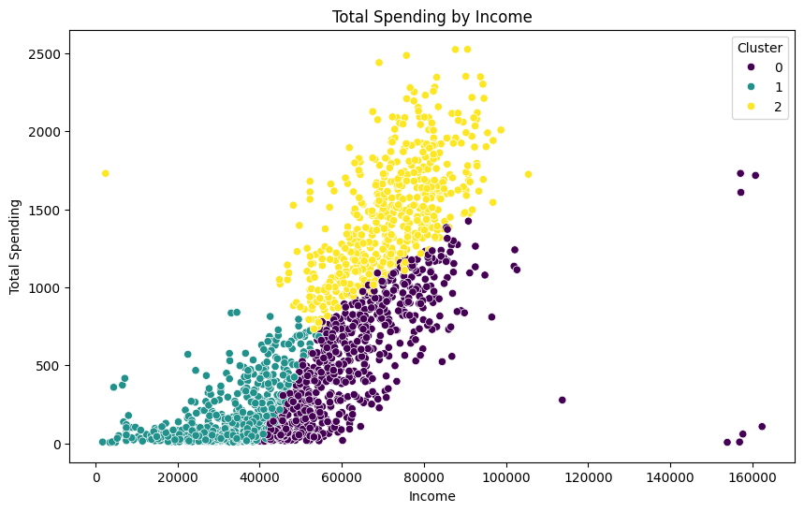
Total Spending by Income
Cluster 0 most likely represents people with a low income and low total spending.
Cluster 1 most likely represents people with a medium income and low total spending.
Cluster 2 most likely represents people with a high income and high total spending

Slide 13
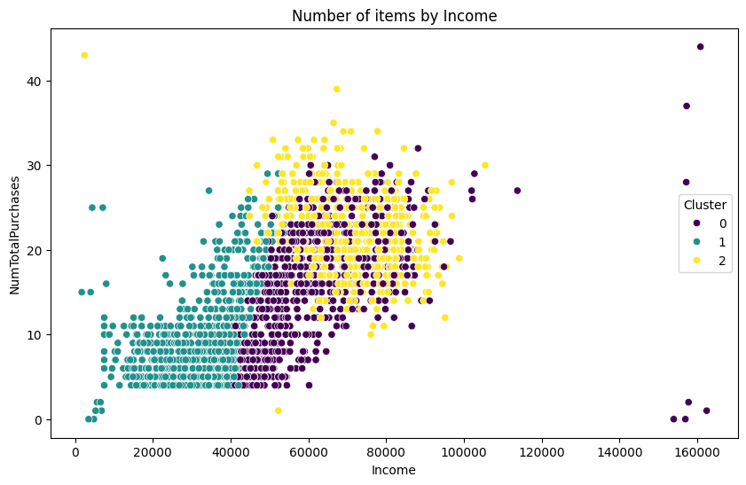
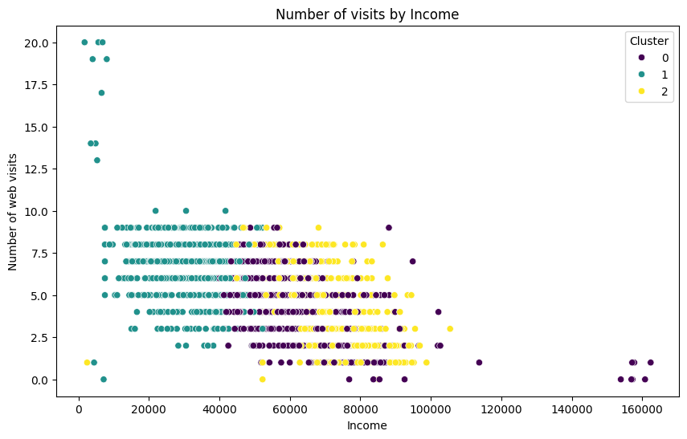
Some more graphs

Slide 14
Conclusion
The customer personality analysis project effectively used unsupervised machine learning to identify three distinct consumer clusters from a dataset of 29 attributes. These findings provide valuable insights for marketing strategies, product development, and enhancing consumer engagement. Adapting solutions to individual client segments can boost customer satisfaction, loyalty, and overall market competitiveness, crucial for sustained success in today's dynamic business environment.

