Slide 1

BANGALORE HOUSE PRICE PREDICTION
Presented By :
Afaque Akhtar(21051484)
Hema Malik(21052156)
Nihar Ranjan Sahoo(21052165)
Sujal Singh(21052927)
Guided by:-Dr. Manas Nayak

Slide 2
1
ABSTRACT
The Bangalore House Price Prediction project aims to develop a predictive model that accurately forecasts residential property prices in Bangalore, India. With the real estate market in Bangalore witnessing dynamic fluctuations and rapid growth, accurate price prediction is crucial for buyers, sellers, and real estate investors to make informed decisions. Leveraging machine learning techniques and datasets comprising various housing features such as location, size, amenities, and proximity to essential facilities, the project seeks to build a robust predictive model.

Slide 3
2
OVERVIEW
Introduction
Future Scope
Tech Used
Conclusion
Approach
Thank You
Implementation

Slide 4

3
INTRODUCTION
The Bangalore House Price Prediction project seeks to leverage the power of machine learning and data analytics to develop predictive models capable of estimating residential property prices with high accuracy. By analyzing diverse datasets encompassing various housing features such as location, size, amenities, construction quality, proximity to essential facilities, and market trends, the project aims to identify the key factors influencing property prices in Bangalore.
Through comprehensive data preprocessing, feature engineering, and model training using advanced regression algorithms, the project endeavors to build robust predictive models capable of capturing the complex relationships between housing attributes and prices.

Slide 5
TECH USED
4
1.Programming Languages:
Python: Python serves as the primary programming language for data preprocessing, model development, and deployment due to its extensive libraries for machine learning, data analysis, and web development.
2.Data Processing and Analysis:
Pandas: Pandas is used for data manipulation, cleaning, and exploratory data analysis (EDA).
NumPy: NumPy provides support for numerical operations and array manipulation required for mathematical computations.
3.Machine Learning and Predictive Modeling:
Scikit-learn: Scikit-learn offers a wide range of machine learning algorithms for regression, including linear regression, decision trees, random forests, gradient boosting, and more. It also provides utilities for model evaluation, hyperparameter tuning, and feature selection.
4.Web Development and Deployment:
Flask :Flask is a lightweight and versatile web framework written in Python. It is designed to be simple, easy to use, and flexible, making it an ideal choice for building web applications, APIs, and microservices.

Slide 6
APPROACH
5
Data Collection:
Gather diverse datasets containing information on residential properties in Bangalore, including attributes such as location, size, amenities, construction year, proximity to transportation, schools, hospitals, and market trends.
Data Preprocessing:
Cleanse the collected data to handle missing values, outliers, and inconsistencies.
Perform data transformations, such as encoding categorical variables, standardizing numerical features, and normalizing data distributions.
Model Selection and Training:
Choose appropriate regression algorithms suitable for predicting housing prices, such as linear regression, decision trees, random forests, gradient boosting, and neural networks.
Split the dataset into training and validation sets using techniques like cross-validation to evaluate model performance.

Slide 7
Model Evaluation and Validation:
Evaluate the trained models on the validation dataset to assess their generalization performance and identify potential overfitting or underfitting issues.
Compare the performance of different models using evaluation metrics and select the best-performing model for deployment.
Model Deployment:
Deploy the trained model into a production environment, either as a standalone application or integrated into a web-based platform.
Develop a user-friendly interface for users to input property details and receive predicted price estimates.
6

Slide 8
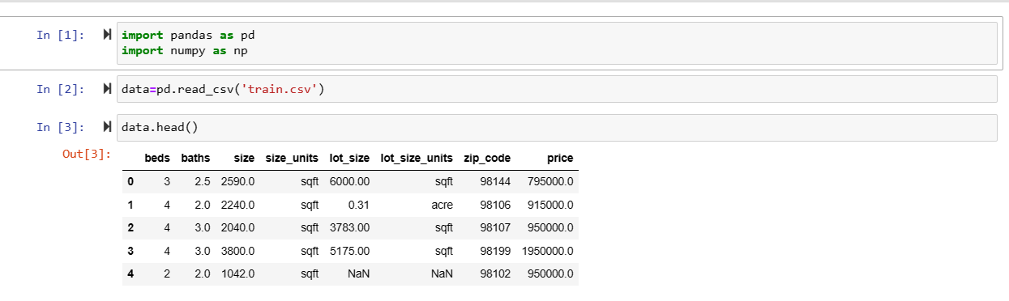
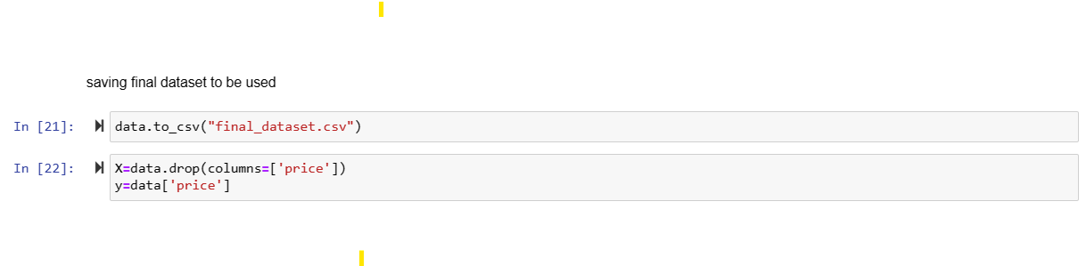
IMPLEMENTATION
7
DATA COLLECTION AND PROCESSING:

Slide 9
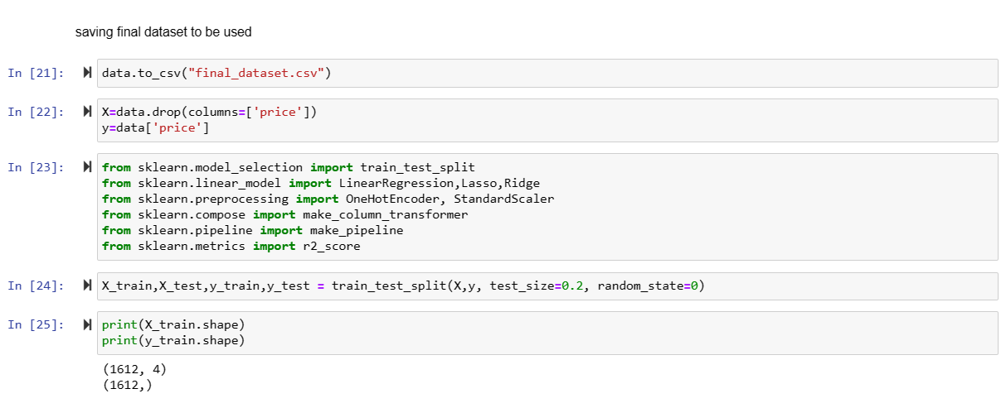
8
MODEL SELECTION AND TRAINING

Slide 10
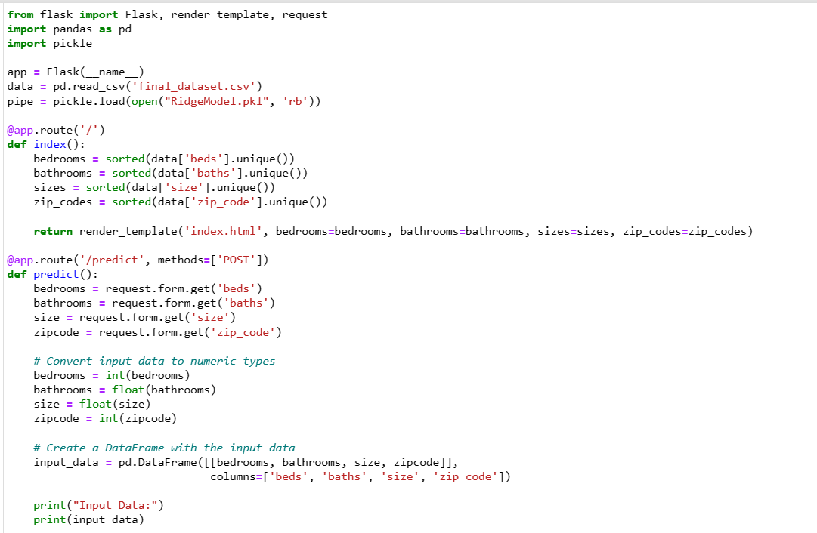
9
MODEL DEPLOYMENT

Slide 11
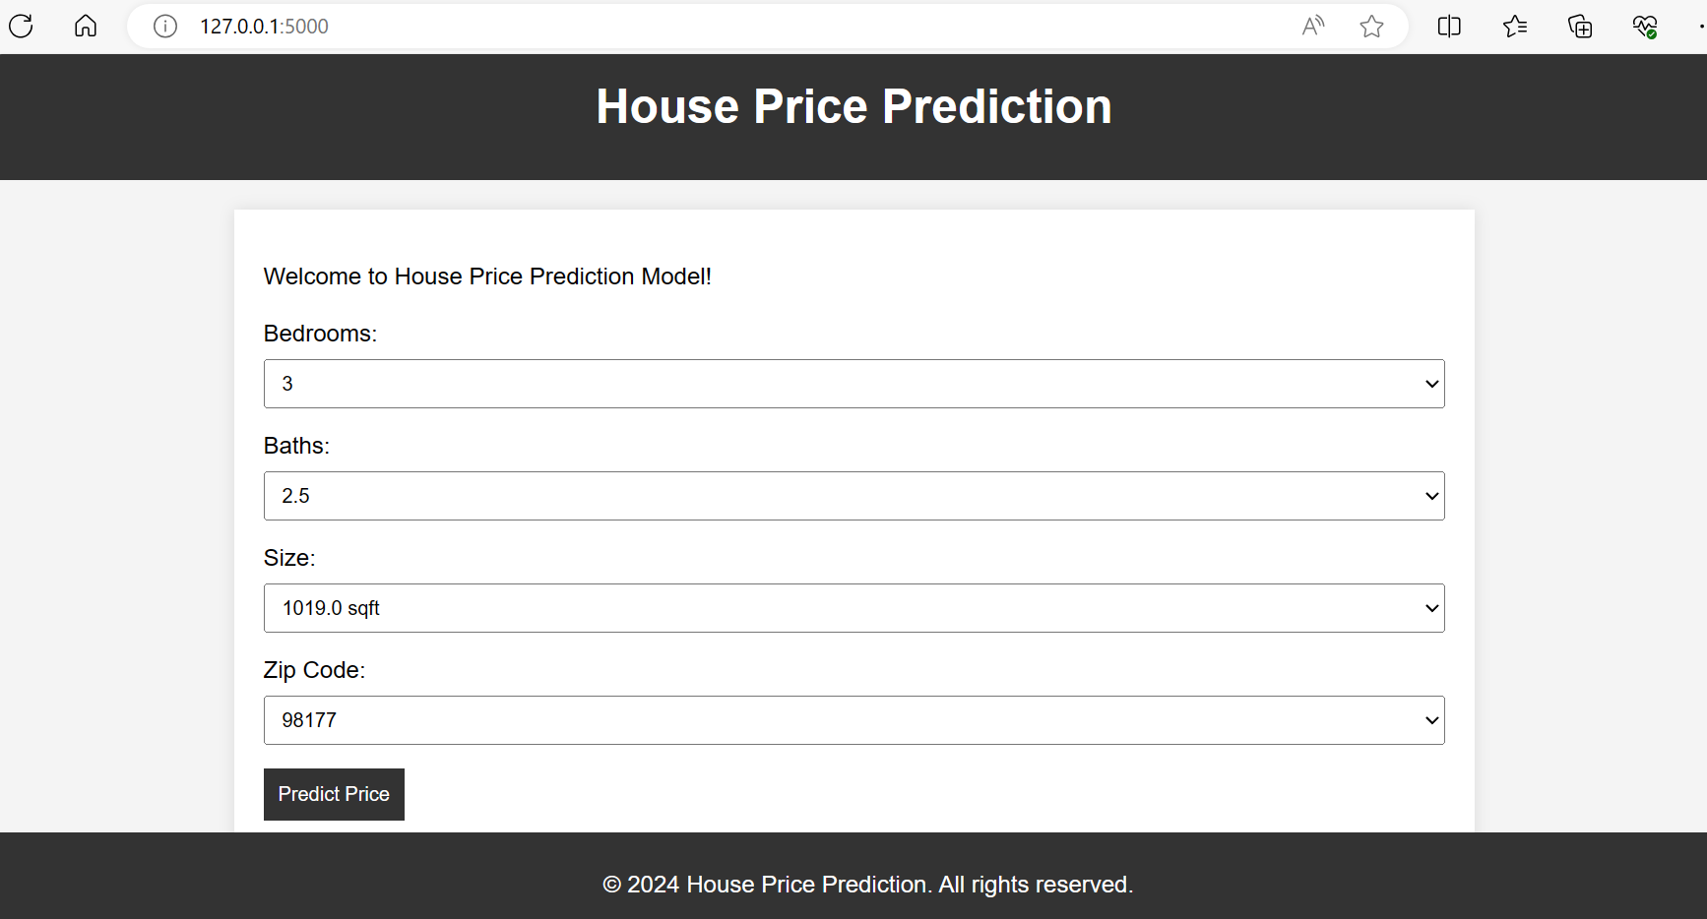
10
FINAL PAGE

Slide 12
FUTURE SCOPE
11
The future scope of house price prediction projects is promising, driven by advancements in technology, data analytics, and machine learning techniques. Here are some key aspects that illustrate the potential future scope of such projects:
Improved Accuracy and Precision:
Future advancements in machine learning algorithms, including deep learning and ensemble methods, will likely enhance the accuracy and precision of house price prediction models.
Integration of more comprehensive datasets and advanced feature engineering techniques can further refine predictions, accounting for nuanced factors that influence property values.
Integration with Emerging Technologies:
Integration of emerging technologies such as blockchain, Internet of Things (IoT), and augmented reality (AR) can revolutionize the way house price prediction models operate.
Blockchain technology can facilitate transparent and secure transactions, while IoT devices can collect real-time data on property conditions and environmental factors, enriching predictive capabilities.
AR applications can enable immersive experiences for users, allowing them to visualize predicted property values and explore virtual representations of potential homes in different scenarios.
Personalization and Customization:
Future house price prediction projects may prioritize personalization and customization, tailoring predictions to individual preferences, lifestyles, and investment goals.
Integration of user feedback mechanisms and AI-driven recommendation systems can refine predictions based on user interactions and evolving needs, fostering a more user-centric approach.

Slide 13
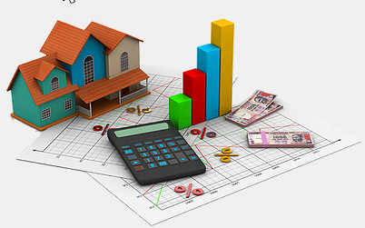
12
CONCLUSION
In conclusion, the house price prediction project has demonstrated the efficacy of data-driven methodologies in forecasting property values. Through comprehensive data collection, preprocessing, and model development, we have constructed predictive models capable of providing valuable insights into the dynamics of housing markets. The project has highlighted the significance of features such as location, property size, amenities, and market trends in determining house prices, underscoring the complexity of real estate valuation

Slide 14
THANK YOU

