Slide 1



ECO_ROUTE
SMART WASTE MANAGEMENT SYSTEM
MICROSERVICES ARCHITECTURE ·NODE.JS + EXPRESS · SWAGGER API

Slide 2
OBJECTS
Design and implement a Microservices Architecture for a real-world business domain
Understand the role an API Gateway plays in connecting microservices under a single port
Gain hands-on experience with REST API development, Swagger documentation, and service isolation
Each member independently develops, documents, and demonstrates one complete microservice

Slide 3
PROBLEM & SOLUTION
The Problem
Overflowing bins cause urban health hazards
Inefficient truck routing wastes fuel & time
Citizens have no incentive to recycle properly
Hazardous waste often ends up in landfills
No real-time visibility into waste collection
EcoRoute Solution
IoT smart bins with real-time fill monitoring
AI-powered route optimization for trucks
Citizen Eco-Points rewards for recycling
Dedicated E-Waste tracking & compliance
Unified API Gateway for seamless access

Slide 4
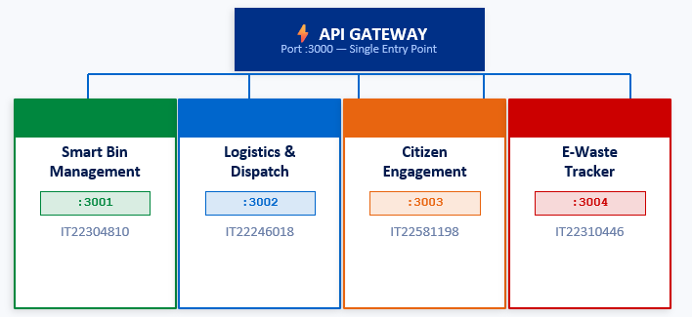
MICROSERVICES ARCHITECTURE

Slide 5
THE NEED FOR AN API GATEWAY
Without Gateway
Client must know 4 different ports
:3001 for Bin Service
:3002 for Dispatch Service
:3003 for Citizen Service
:3004 for E-Waste Service
CORS must be managed per service
No central logging or rate limiting
Tight coupling between client & services
Without Gateway
Single port :3000 for everything
/api/bins → Bin Service :3001
/api/dispatch → Dispatch :3002
/api/citizen → Citizen :3003
/api/ewaste → E-Waste :3004
Centralized CORS & rate limiting
Unified logging & health checks
Loose coupling — scalable architecture

Slide 6
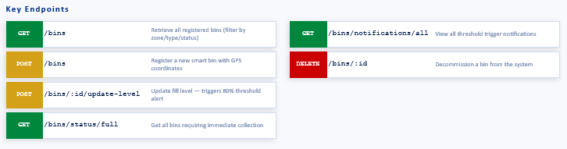
1: SMART BIN MANAGEMENT
SEWWANDI M.P.S.S.S.
Responsibility
Acts as the Digital Twin for physical waste bin infrastructure. Manages registration, geolocation, and real-time status of all smart bins.
Unique Logic
Threshold Trigger: When a bin's fill_level reaches 80%, the system automatically emits a dispatch notification to the Logistics Service — enabling proactive collection.

Slide 7
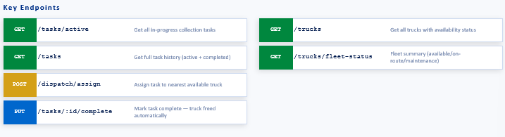
2: LOGISTICS & DISPATCH
HANSIKA J.A.J.
Responsibility
The "Brain" of EcoRoute. Manages the fleet of garbage trucks and assigns collection tasks to drivers based on availability and proximity.
Unique Logic
Route Optimization Engine: Filters full bins from Bin Service and assigns the NEAREST available truck using Euclidean distance calculation — minimizing travel time and fuel consumption.

Slide 8
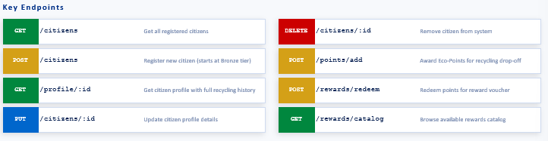
3: CITIZEN ENGAGEMENT & REWARDS
DAYARATHNE S.H.N.R.
Responsibility
Focuses on the User side of the Smart City. Manages citizen profiles and gamifies recycling through an Eco-Points system with tiers and badges.
Unique Logic
Points & Tier Engine: Citizens earn Eco-Points per kg recycled (Plastic=50pts, Metal=60pts, Electronic=100pts). Automatically upgrades Bronze→Silver→Gold tier and awards achievement badges.

Slide 9
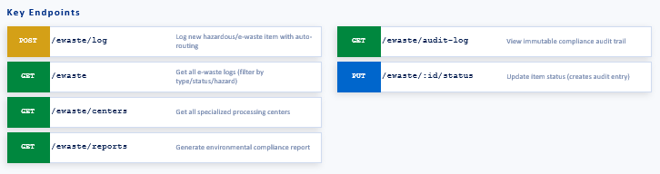
4: HAZARDOUS & E-WASTE TRACKER
GUNARATHNE A.A.D.T.
Responsibility
Specialized service for tracking dangerous materials (batteries, chemicals, medical waste). Ensures compliance with Basel Convention and environmental regulations.
Unique Logic
Auto-Router + Immutable Audit Log: Automatically routes each waste item to the correct specialized processing center. Every status change is permanently logged for environmental compliance.

Slide 10
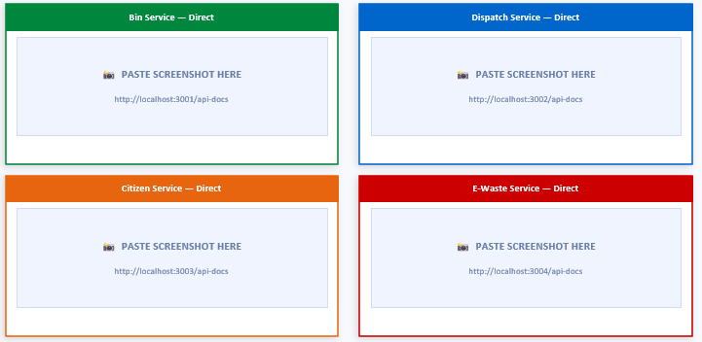
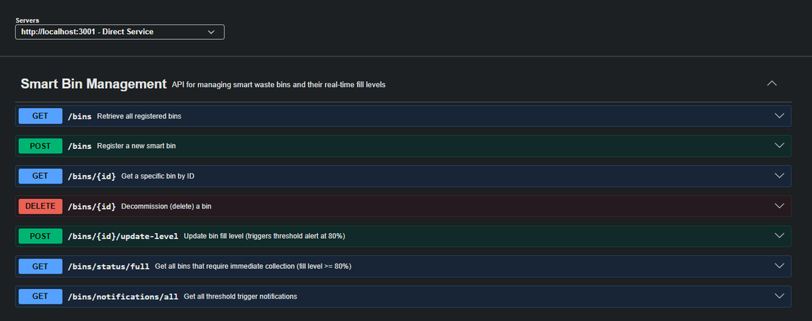
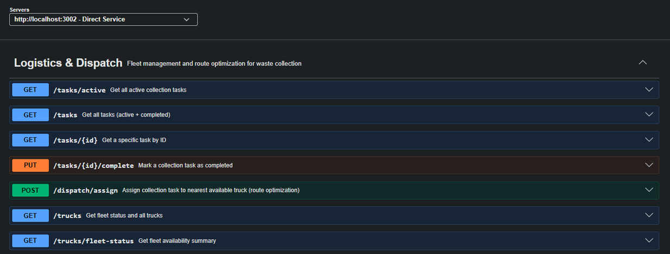
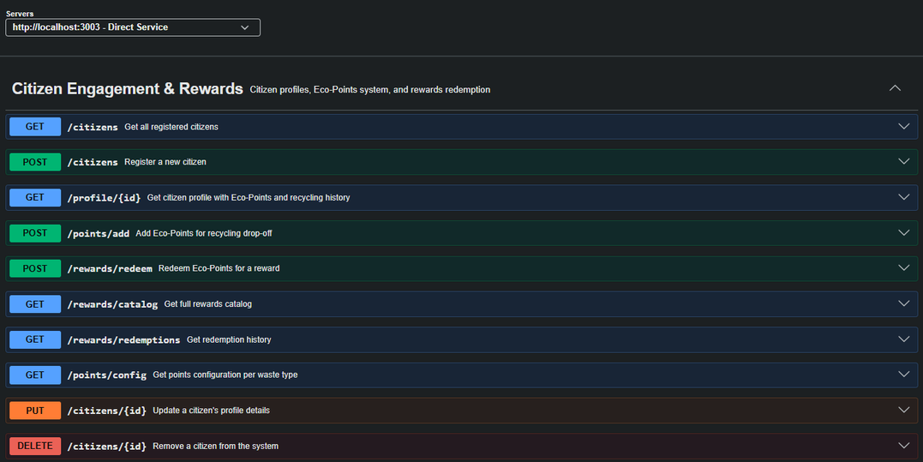
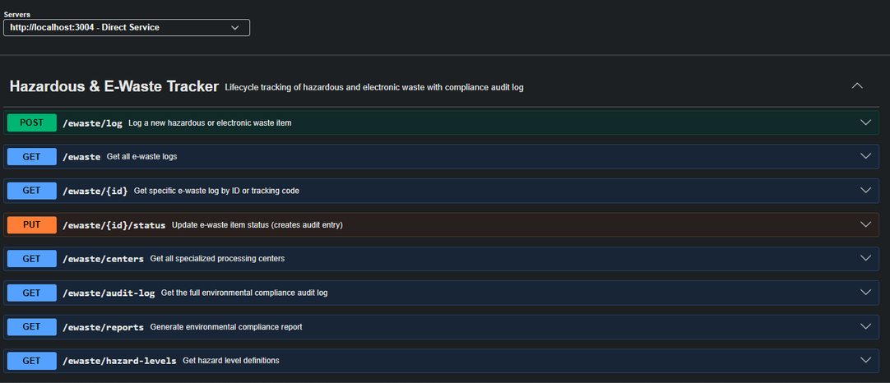
SWAGGER DOCUMENTATION - DIRECT ACCESS

Slide 11
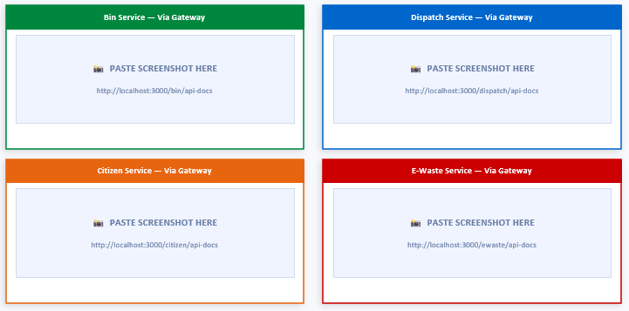
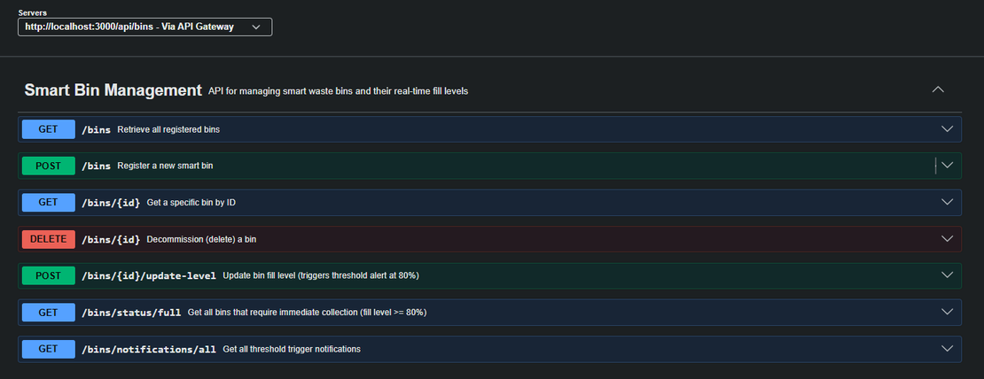
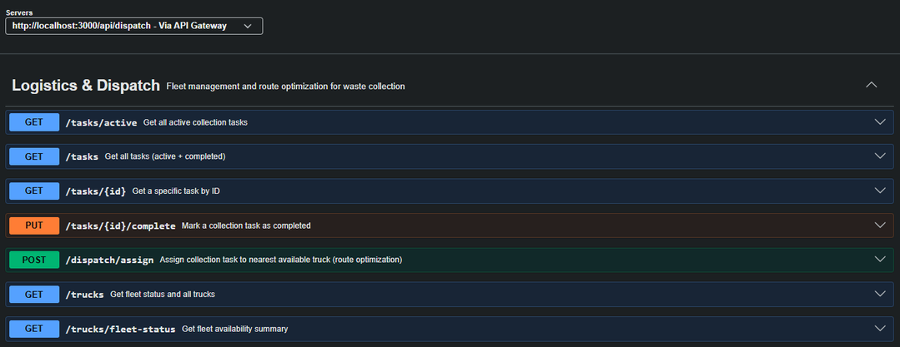
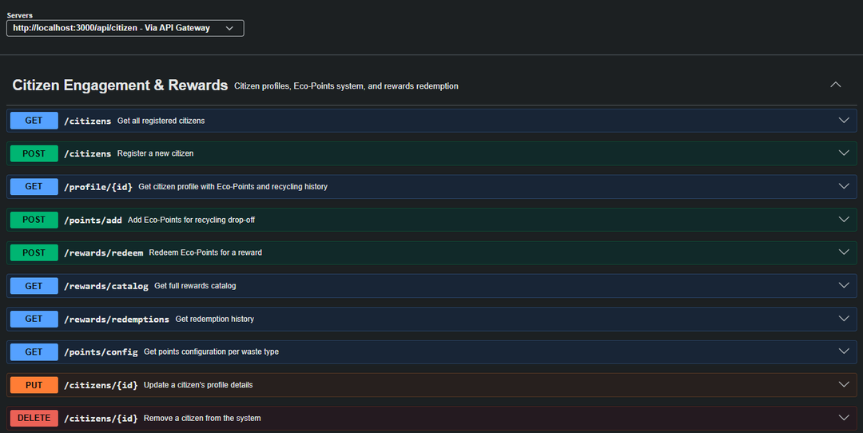
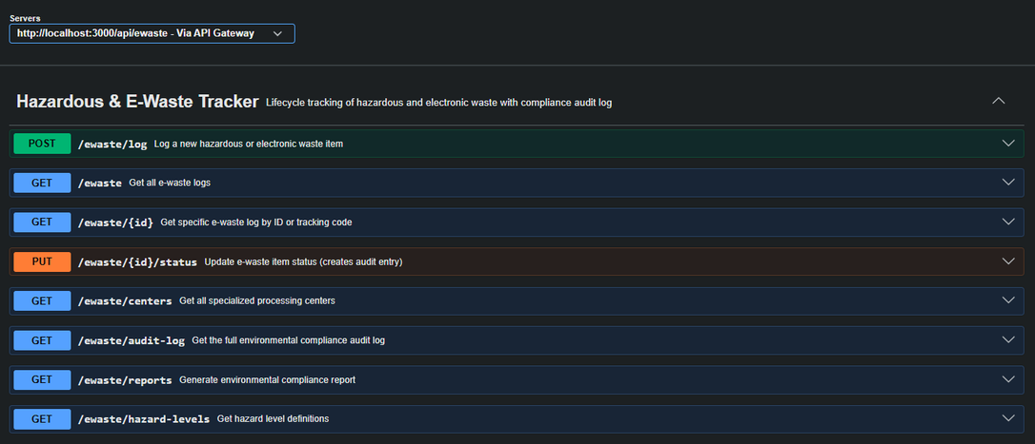
SWAGGER DOCUMENTATION - VIA API GATEWAY

Slide 12
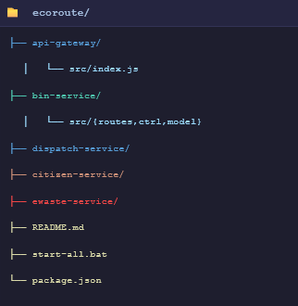
PROJECT STRUCTURE & TECH STACK
Tech Stack
Node.js - Runtime Environment
Express.js - REST API Framework
Swagger / Open AI 3.0 - API Documentation
Swagger-jsdoc - JSDoc annotations - Swagger spec
Swagger-ui-express - Interactive Swagger UI
http-proxy-middleware - Gatewaye request proxying
Express-rate-limit - Gateway rate limiting
uuid - Unique ID generation

Slide 13

THANK YOU

