Slide 1
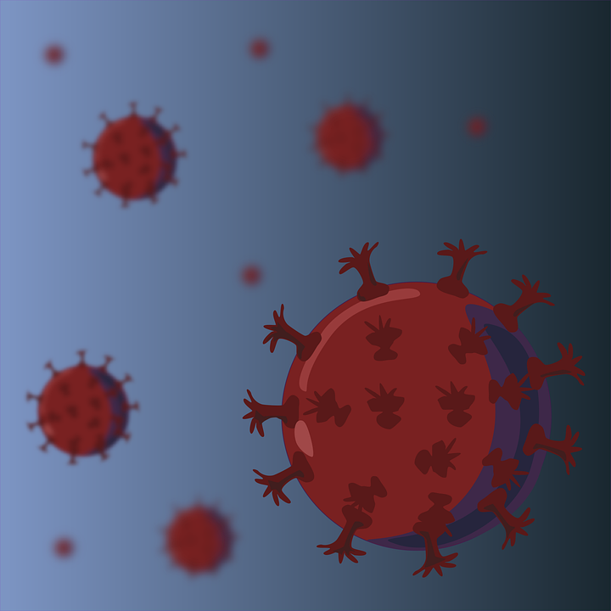
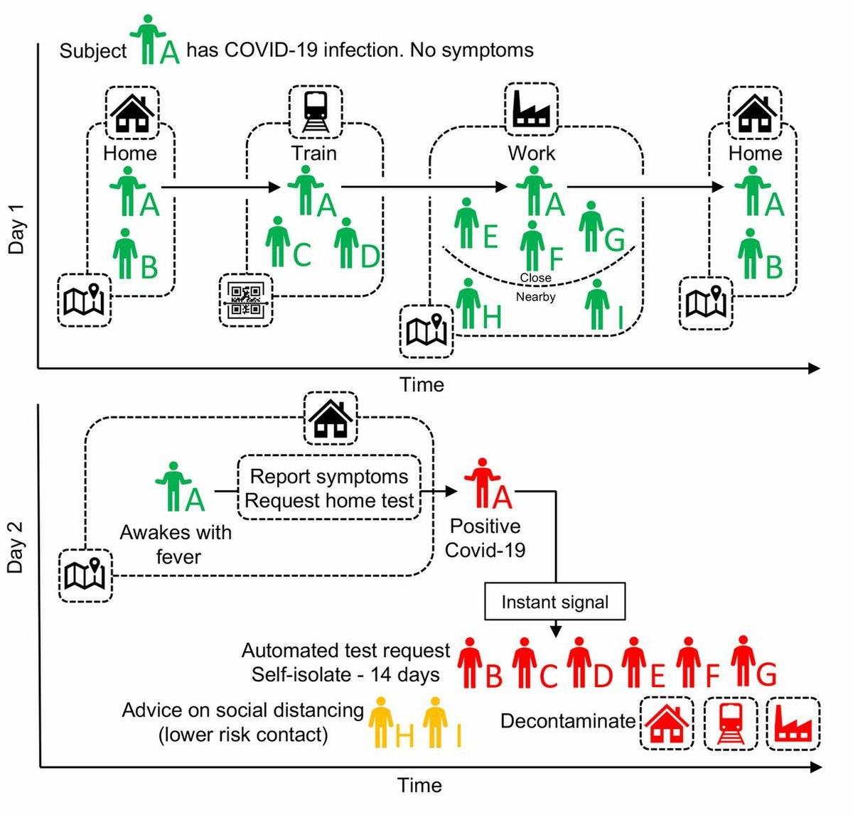
TYL C++ HACKATHON
PROBLEM STATEMENT :- MODELING THE COVID-19 SPREAD AND RECOVERY
TEAM:
CODEBLOODED
-AKANSHA AGARWAL
-ALAJANGI NIHARIKA
-AMAN KAPOOR
-AMAN KUMAR

Slide 2
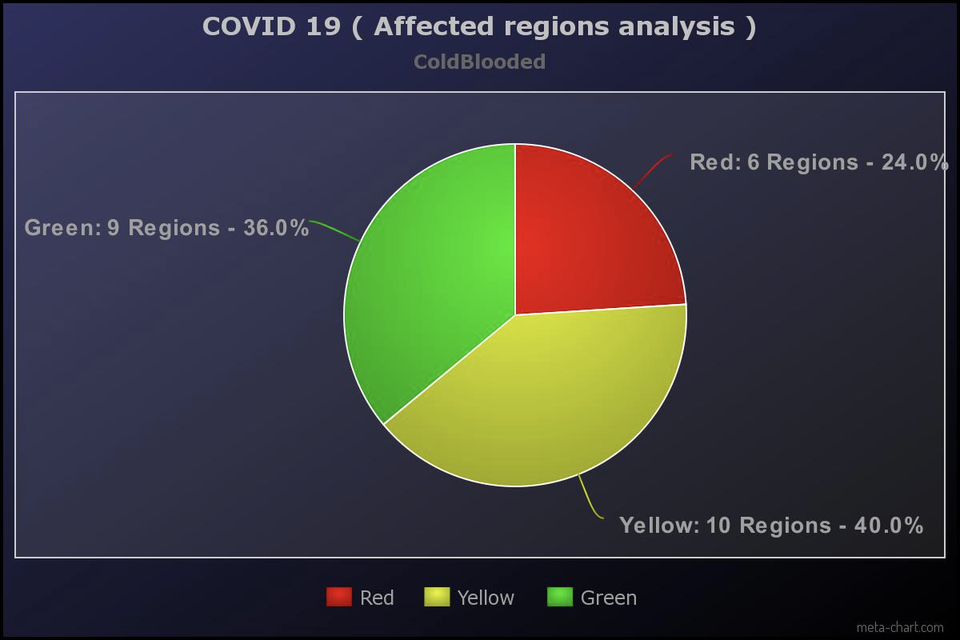
INITIAL STAGE :
➨25 Regions, each represented by a cell in 2-D matrix.
➨Initially we assume 6 regions are declared as red zones, 10 regions as yellow zones and 9 regions as green zones.

Slide 3
WEEK ONE :
If a region has two neighbouring regions as Red zones, this region also moves to Red zone in 1 week.
Bright red indicates the region has been moved to red zone.

Slide 4
2) If a non-Red zone has 2 neighbouring non-Green zones, this moves to the next level in 1 week.
Bright yellow indicates the region has been moved to next level zone i.e yellow zone.
GREY INDICATES THE CELL HAS ALREADY BEEN UPDATED FOR WEEK 1

Slide 5
3) If triangular nodes (3 neighbouring regions) are non-green zones, all nodes move to the next level in 1 week.
INITIAL STAGE
AFTER 3 CONDITIONS
AFTER 1 WEEK
INDICATES THE CELL REMAINS UNCHANGED AFTER 1ST WEEK

Slide 6
4) If a zone stays in the same level (colour) for 4 consecutive weeks, then it moves down one level.
TIME LAPSE:
AFTER 4 WEEKS
Initial stage:
After WEEK four:

Slide 7
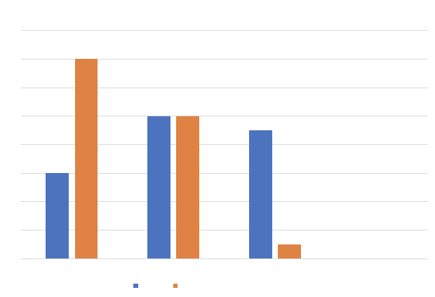
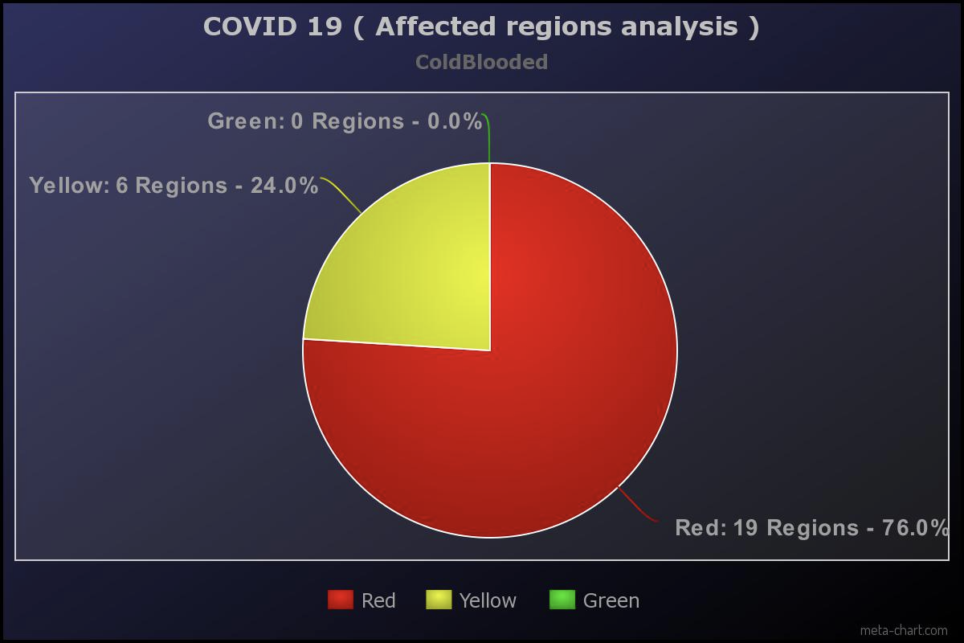
SPREAD AND RECOVERY: (FOR 25 REGIONS)
AFTER WEEK ONE:
AFTER WEEK FOUR:

