Slide 1


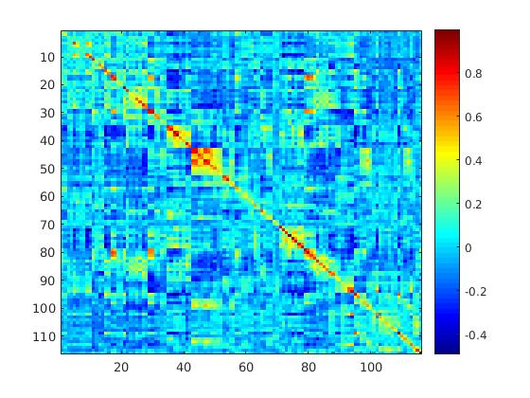
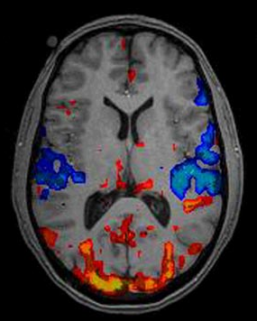




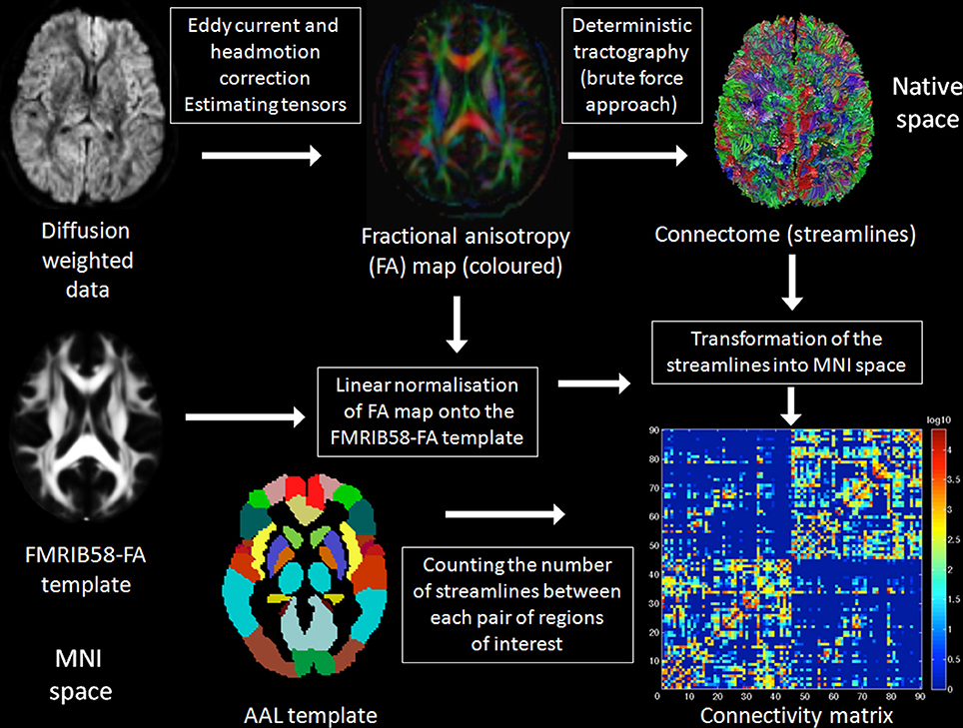
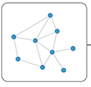
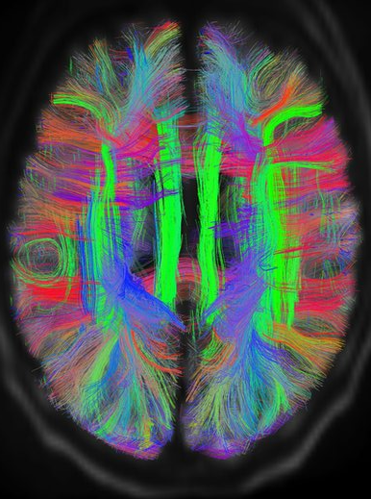
Representation Learning – Graph Convolutional Model
Regression Model
rs-fMRI
Behavior
Leaky ReLU
DTI
Fully Connected
+
Leaky ReLU

Slide 2
