Slide 1


Deep-Generative Hybrid Models to Map Brain Connectivity to Behavior
Niharika Shimona D’Souza*,
Dept. of Electrical and Computer Engineering, Johns Hopkins University
Authors: Mary Beth Nebel, Deana Crocetti, Nicholas Wymbs,
Joshua Robinson, Stewart Mostofsky, Archana Venkataraman
Notes:
Hello everyone, my name is Niharika. I am a fifth year PhD student at the department of Electrical and Computer Engineering working with Dr. Archana Venkataraman on computational neuroimaging. My project looks at mapping brain connectivity, from connectomics data to symptom severity or behavior in the context of neurodevelopmental disorders such as Autism

Slide 2
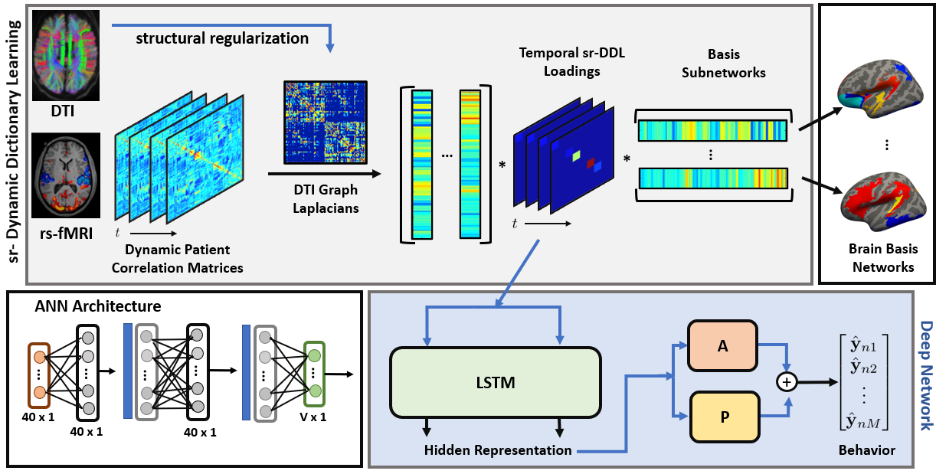
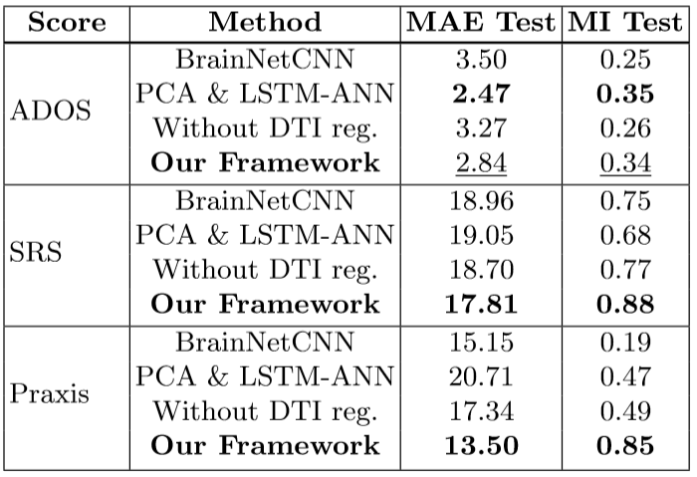
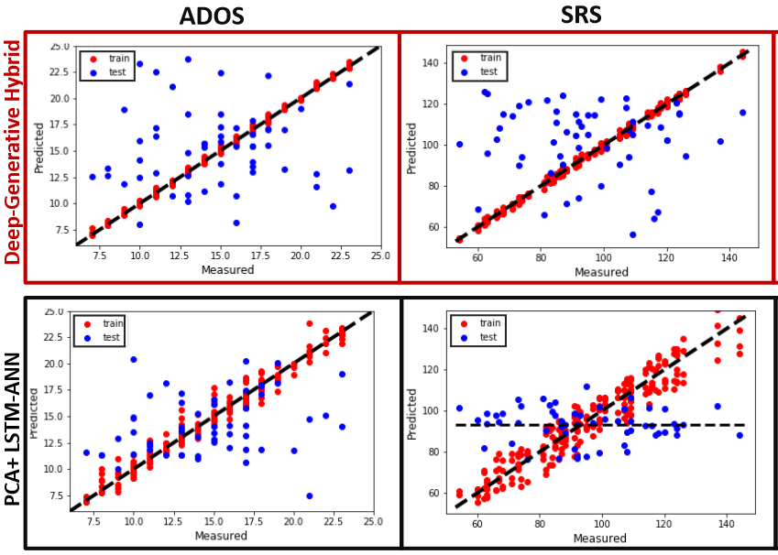
Deep-Generative Hybrid to Integrate Multimodal and Dynamic Connectivity with Behavior
Results
Integration of structural and dynamic functional connectivity with behavior
Jointly optimize for the neuroimaging representation and behavioral prediction
Generalizes to prediction of multiple deficits

