Slide 1

LicenseEye
An Automated Solution for Vehicle Entry Management
Team Members:
Shrinkhal Asthana (CSE-AI)
Niharika Bhati (CSE-AI & ML)
Anushka Singh (CSE-AI & ML)
Bhumi Chaudhary (CSE-AI & ML)

Slide 2
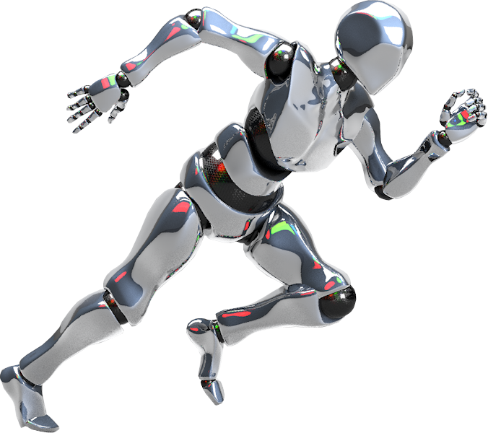

Content
01
INTRODUCTION
02
WORKFLOW
03
ARCHITECTURE
04
TECH STACK
05
FUTURE SCOPE
06
CONCLUSION

Slide 3
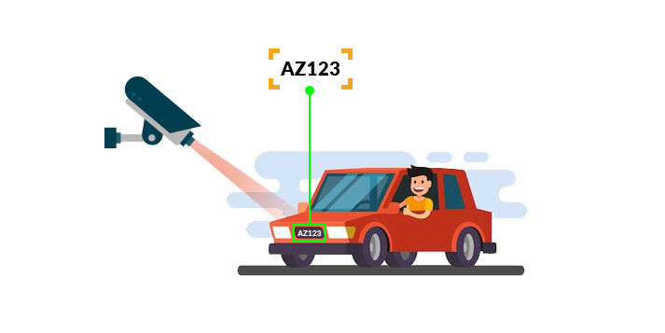
Introduction
Manual monitoring of vehicle entries is inefficient, prone to human error, and lacks scalability.
Develop a web-based license plate recognition system using YOLOv8 and OCR technology to automate vehicle entry authorization.

Slide 4
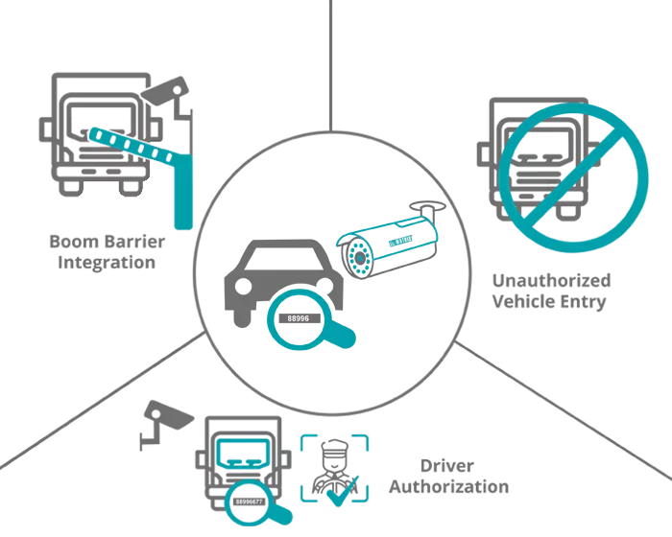
WorkFlow

Slide 5
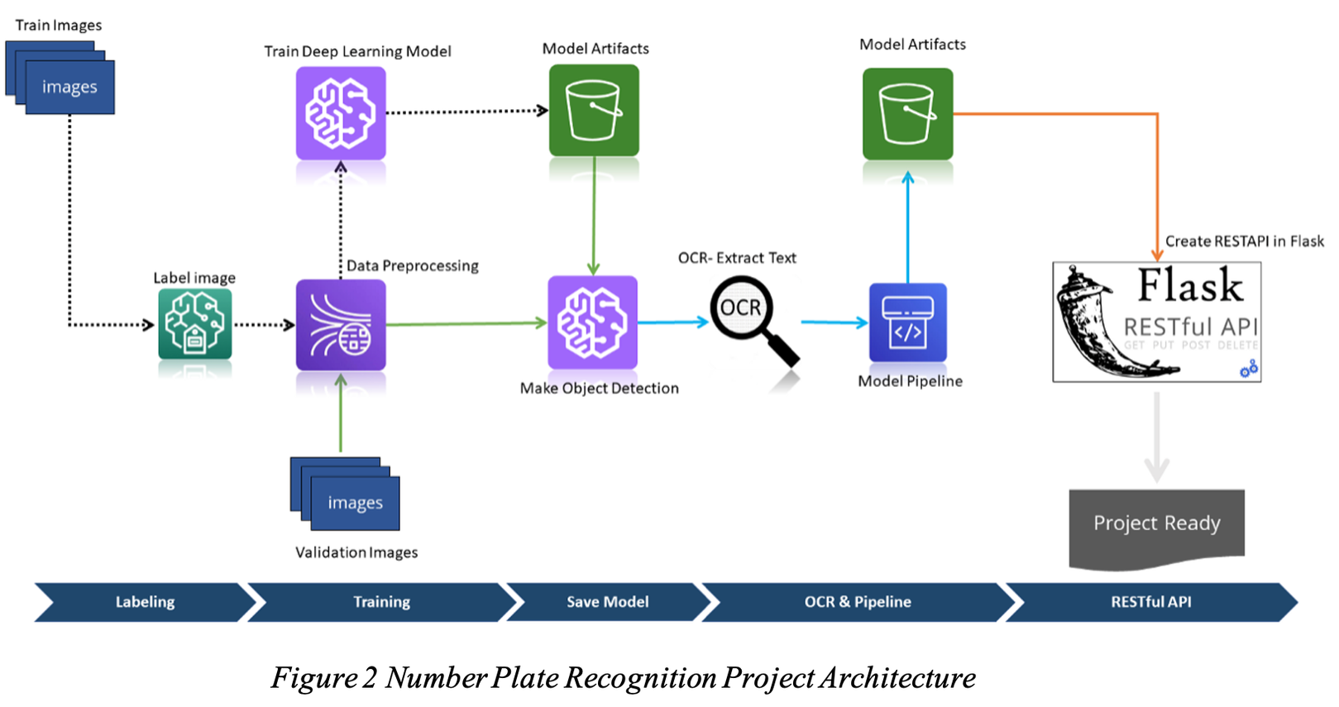
Project Architecture

Slide 6






Tech Stack

Slide 7
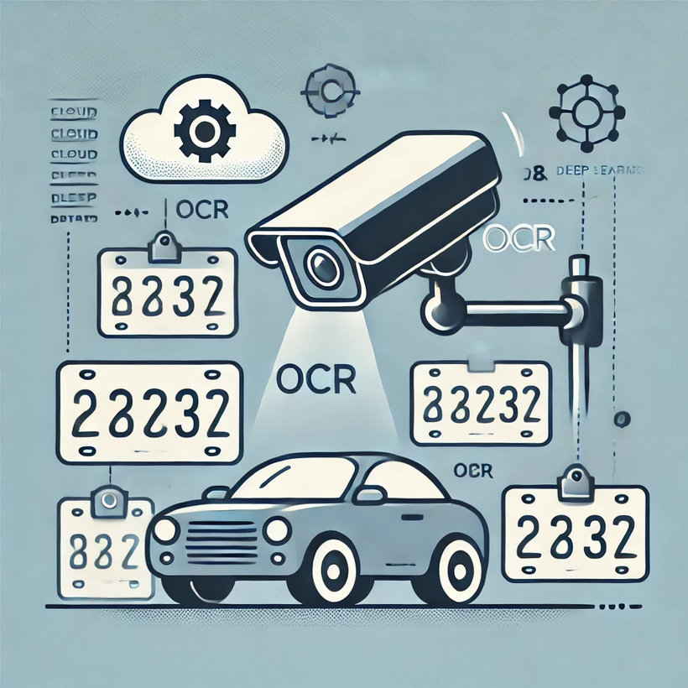

Future Scope
The system can be expanded to:
Handle multiple languages and formats of license plates from different regions.
Integrate with larger, cloud-based databases for:
Real-time law enforcement applications.
Parking management.
Toll management.
Enhancements to the model could include:
Improved OCR techniques.
Incorporation of deep learning for better accuracy under challenging conditions.

Slide 8
Conclusion
Automates and enhances vehicle entry authorization.
Provides a scalable solution for managing authorized access.
Ideal for security at gated premises and institutions.

Slide 9
Thank You!

