Slide 1
Adaptive Traffic Signal Control
using Reinforcement Learning
CIA-3 · Component 1 Case Study · Course: Reinforcement Learning
Team: Member 1 · Member 2 · Member 3 · Member 4
September 2026
1 / 16
Notes:
MEMBER 1 — Opening. Greet the evaluator. State the team, course, and title. Say in one sentence: we treat a traffic light as a sequential decision agent, not as a fixed timer. Mention that Component 2 uses the same case. Pause, then hand the problem over.

Slide 2
Agenda
Problem: isolated intersection, keep-or-switch control
Why it is sequential / real-time — and why rules are not enough
MDP: state, action, reward
Problem characteristics (Unit 4/5 checklist)
Base algorithm: Q-learning, and the four TD variants
Workflow loop + Component 2 headline result
Innovation: Safe RL shielding
Conclusion and what the video could not include
2 / 16
Notes:
MEMBER 1. Walk the agenda quickly. Emphasise that the same MDP is used in the micro-project. Do not spend time on software here.

Slide 3
A. Problem definition
Domain: Transportation — one four-approach urban intersection
Agent: the signal controller (cabinet logic)
Decision every tick: KEEP current phase or SWITCH to the other phase
Long-term objective: minimise waiting + spillback over a whole peak window
Not a classification problem: today’s green changes tomorrow’s queues
3 / 16
Notes:
MEMBER 1. Explain North–South versus East–West as two phases. Stress delayed cost: a greedy green can starve the cross street until overflow. Long-term objective is discounted return, not instantaneous discharge. ~90 seconds.

Slide 4
Why sequential, real-time — and why not only rules
Sequential: residual queue + random arrivals = next state
Real-time: an action is required every control interval
Fixed-time (Webster) assumes stationary mean flows
Gap-based actuation is reactive and myopic
Hand-tuned thresholds do not track a mid-peak directional flip
RL learns a closed-loop mapping from occupancy patterns to phase decisions
4 / 16
Notes:
MEMBER 1 closing this block. Contrast Webster and actuation with value-based control. Admit we still need a conflict monitor — RL is for the split, not for safety hardware. Hand over to Member 2 for the MDP.

Slide 5
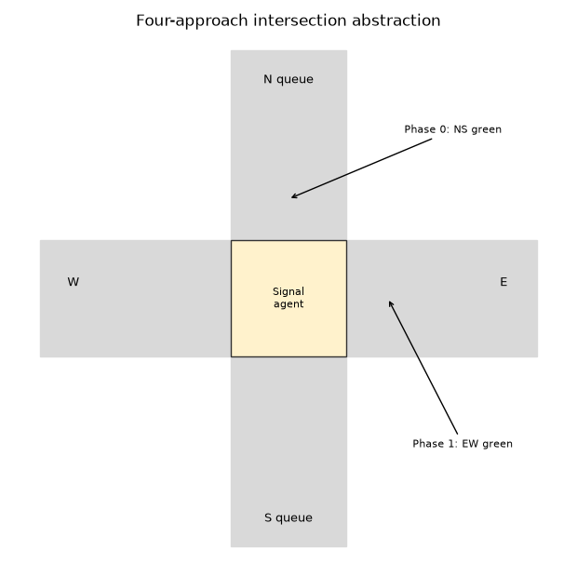
Environment abstraction
Gridworld-style lane cells
Phase 0: NS green
Phase 1: EW green
Poisson arrivals (synthetic)
Min-green lock = 4 steps
Assumption: no real detectors
5 / 16
Notes:
MEMBER 2. Point at N/S/E/W. State the explicit assumption: synthetic Poisson demand, not a named corridor. Occupancy cap of five keeps the problem tabular (|S| = 6,480).

Slide 6
B. State, action, reward
State s = (qN, qS, qE, qW, phase, t_green)
  Queues: congestion is the primary signal
  Phase: discharge capability depends on who is green
  Timer: so the agent knows when a switch is legal
Action (discrete): 0 keep, 1 switch — ignored if min-green not met
Reward: R = −Σq − 8·blocked − 0.35·switched
  Negative: waiting, spillback, chatter
  Positive: returns nearer to zero (short queues, no overflow)
6 / 16
Notes:
MEMBER 2. Justify each state variable in one line. Read the reward equation slowly. Mention that throughput is not double-counted: serving cars reduces future occupancy.

Slide 7
C. RL problem characteristics
Episodic — T = 120 step peak window (field would be continuing)
Dynamic — arrival means drift (NS-heavy → more EW-heavy)
Stochastic — Poisson arrivals + random stalls
Fully observed in the simulator (field detectors → POMDP later)
Discrete finite S and A | |S|=6480, |A|=2
Simulation-based online TD | long-term discounted objective γ=0.95
7 / 16
Notes:
MEMBER 2. This slide is the rubric checklist — say each label out loud. Note the honest gaps: episodic training versus continuing operations; fully observed sim versus noisy loops. Hand to Member 3 for algorithms.

Slide 8
D. Base algorithm — Q-learning
Why not DP? Transition kernel P is unknown (and time-varying)
Why not Monte Carlo? 120-step wait before the first update
Why TD? Bootstrap every tick — matches real-time control
Why off-policy Q-learning? Train with ε-greedy, deploy greedy
Update: Q(s,a) ← Q(s,a) + α[R + γ max_a' Q(s',a') − Q(s,a)]
α=0.12, γ=0.95, ε: 1.0 → 0.05 over 1400 episodes
8 / 16
Notes:
MEMBER 3. Derive the update in words: target is r plus discounted best next action. Stress deployed policy is greedy, so off-policy is the right default. Mention SARSA would be preferred if exploration stayed on in the cabinet.

Slide 9
Four connected TD methods (Component 2)
SARSA — on-policy; target uses the action actually taken next
Q-learning — off-policy; target uses max next action-value
Expected SARSA — on-policy expected target; lower variance
Dyna-Q — Q-learning + learned model + 8 planning updates
Headline (real runs): Dyna-Q best late return and greedy eval
Q-learning looked ‘fastest’ to plateau but at a weaker policy
9 / 16
Notes:
MEMBER 3. One sentence each. Quote the idea that stability ≠ quality: Q-learning hit the rolling-mean test at episode 248 but Dyna-Q’s last-100 mean was better (about −811 versus −859). Do not read the full table; that lives in the report.

Slide 10
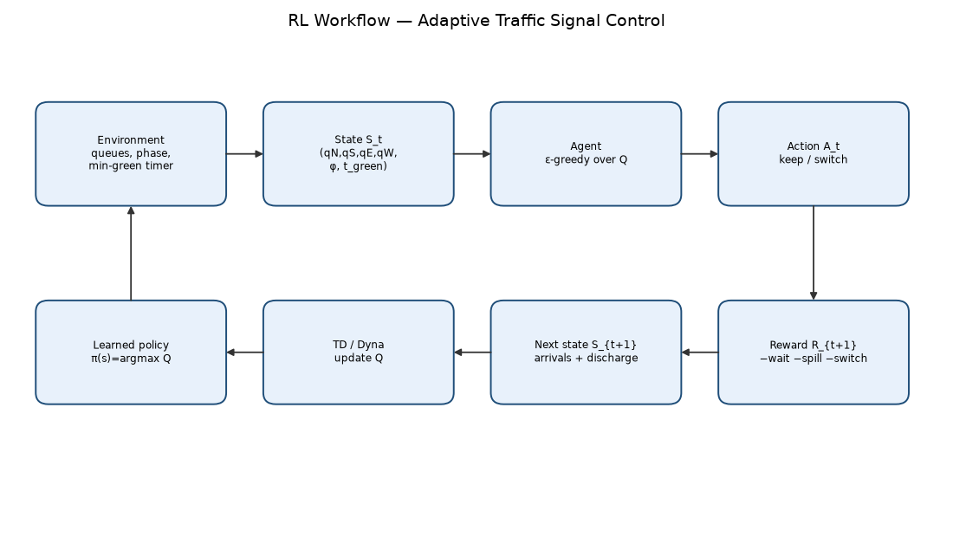
E. RL workflow
10 / 16
Notes:
MEMBER 3. Trace the arrows: environment to state to ε-greedy action to reward and next queues, then the TD/Dyna update. Mention that a shielded Safe-RL agent would insert a filter between agent and action. Hand to Member 4.

Slide 11
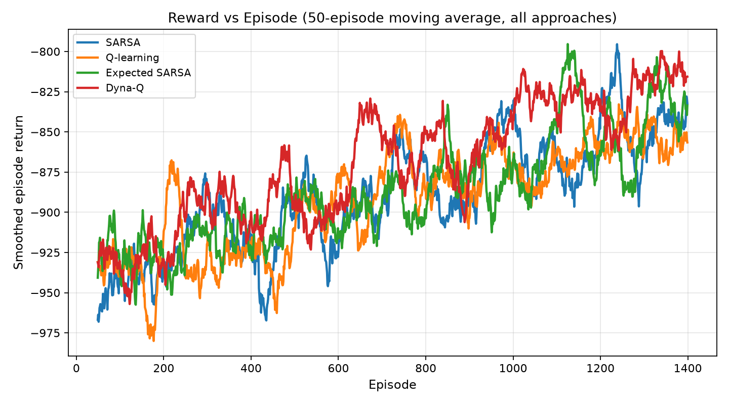
Learning curves (actual training, not mock-ups)
11 / 16
Notes:
MEMBER 4. Returns are negative because reward is a cost. All four curves rise (become less negative). Dyna-Q is on top of the smoothed overlay. Variance remains because arrivals are random — that is physics, not a bug.

Slide 12
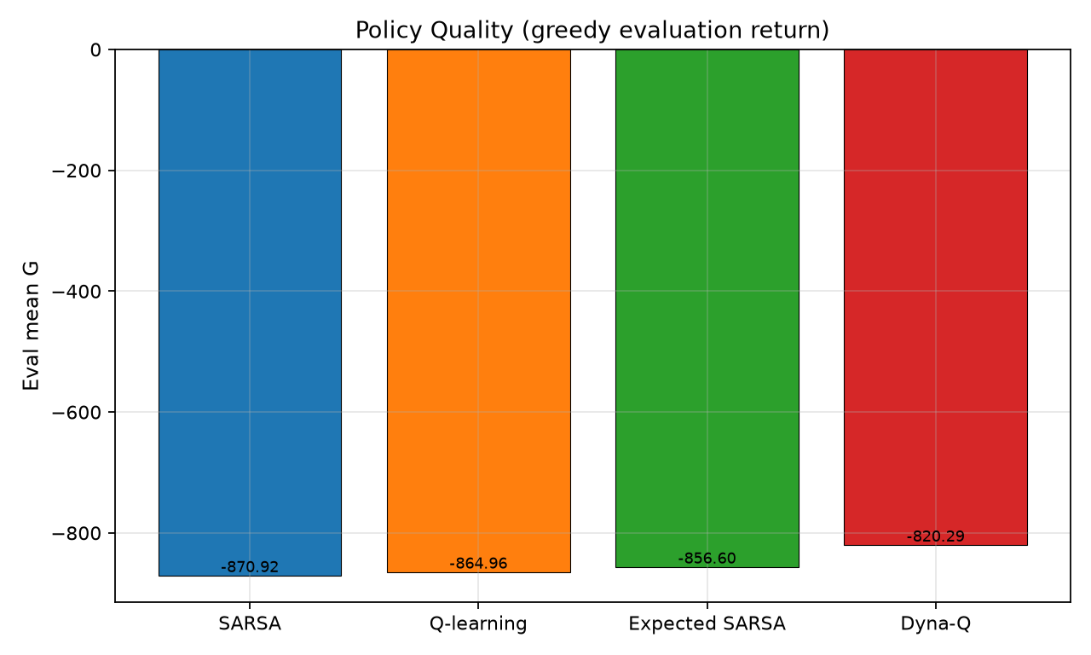
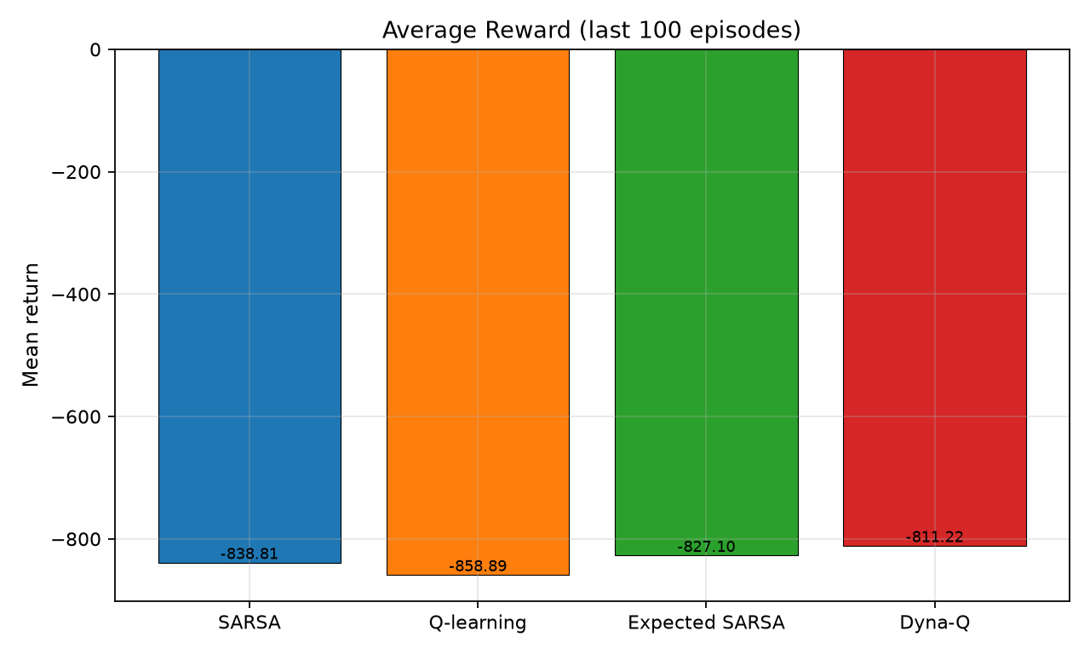
Evaluation snapshot
12 / 16
Notes:
MEMBER 4. Left: greedy evaluation return. Right: last-100 training mean. Same ranking. This is the evidence slide; keep it short.

Slide 13
F. Innovation — Safe Reinforcement Learning
Average return is not a municipal SLA
Hard shield A_safe(s): min green, max red, spillback veto, pedestrian lock
Agent maximises Q only inside the safe set (projection, not a finite penalty)
Optional Lagrangian cost for long-run wait-time frequency constraints
Fits this case: keep/switch chatter and directional greed are the failure modes
Multi-agent corridors and digital twins come after the shield, not before
13 / 16
Notes:
MEMBER 4. Distinguish shield (instant illegal actions) from Lagrange (average costs). Give one concrete example: forbid KEEP when an approach is at capacity and the other phase could serve it. Tie back to the min-green already in the simulator.

Slide 14
Assumptions we want the examiner to see
Synthetic Poisson demand — no city loop-detector log
Two phases only; no protected lefts; no geometric yellow interval
Perfect queue observation in sim
Occupancy clipped at 5 vehicles / approach (tabular design choice)
One seed per algorithm — ranking is indicative, not a 30-seed test
Video of this PPT must be recorded by the four members (not generated here)
14 / 16
Notes:
MEMBER 4. Academically safer to list assumptions than to hide them. Mention the self-recorded video is a team task after this slide deck is frozen.

Slide 15
Conclusion
Signal control is a real-time sequential MDP, not one-shot classification
Tabular keep/switch MDP is enough to compare Unit 4/5 TD methods
Base algorithm: Q-learning; strongest implemented variant: Dyna-Q
Read ‘time to stability’ together with asymptotic return
Safe RL shielding is the responsible extension before any field story
15 / 16
Notes:
MEMBER 4. Close: problem, formulation, result, innovation. Thank the examiner. Invite questions. Members 1–3 should be ready on environment, characteristics, and updates.

Slide 16
Thank you
Questions welcome
Member 1 · Member 2 · Member 3 · Member 4
Replace placeholders with official names before submission.
16 / 16
Notes:
All members: smile, stop, wait for questions. Do not ad-lib new results.

