Slide 1
CIA-3 · COMPONENT 1 & 2 CASE STUDY | REINFORCEMENT LEARNING
Adaptive Traffic Signal Control
using Reinforcement Learning
Formulating an isolated intersection as a Markov Decision Process, and benchmarking four temporal-difference control algorithms.
Aarnav Sabherwal
Amrit Raj Dhar
Niharika Singh
Esha Bobby
Course: Reinforcement Learning | September 2026

Slide 2
Agenda & Structure
01
Problem definition & why classical rules fail
Aarnav Sabherwal
02
MDP formulation: state, action, reward, characteristics
Amrit Raj Dhar
03
Four TD algorithms: SARSA, Q-learning, Expected SARSA, Dyna-Q
Niharika Singh
04
Empirical results, Safe RL innovation & conclusion
Esha Bobby
Adaptive Traffic Signal Control — RL Case Study
2

Slide 3
PART 1 · PROBLEM FRAMING
Problem Definition
PRESENTING Aarnav Sabherwal
Domain
ISOLATED 4-WAY INTERSECTION
Intelligent Transportation Systems — control of an isolated urban intersection.
N
Control agent
The signal controller cabinet. At every short tick it decides: KEEP the current green phase, or SWITCH to the opposing phase.
W
E
Sequential nature
Decisions have delayed consequences — clearing North-South now can create queued spillback on East-West minutes later.
Phase 0 North–South green Phase 1 East–West green
S
Part 1 — Problem Definition
3

Slide 4
PART 1 · PROBLEM FRAMING
Why Classical Rules Fall Short
PRESENTING Aarnav Sabherwal
✕
✕
✕
Fixed-Time (Webster)
Actuated (Vehicle Gap)
Threshold Heuristics
Assumes static, stationary traffic flow — cannot react to non-stationary demand bursts.
Extends green as long as cars cross the sensor — greedy, and starves the competing approach.
Needs a hand-tuned delta and collapses when the peak direction reverses mid-day.
✓
The RL advantage
Reinforcement learning learns a closed-loop mapping from occupancy states directly to keep-or-switch decisions, from interaction — no hand-tuned thresholds, no stationarity assumption. It replaces the split decision, not the conflict monitor.
Part 1 — Problem Definition
4

Slide 5
PART 2 · THE MDP
Environment Abstraction
PRESENTING Amrit Raj Dhar
Isolated 4-way geometry
FOUR APPROACH QUEUES — GRIDWORLD-STYLE CELLS
Phase 0 = North–South green, Phase 1 = East–West green.
Cap = 5 vehicles per lane. Occupancy above cap is a blocked / spillback arrival.
Synthetic Poisson demand
No loop-detector traces were available, so arrivals are Poisson — North–South heavier early in the peak, East–West heavier later.
Minimum-green lock
A switch is illegal until a minimum green of 4 steps has elapsed — the lock is already built into the environment.
Explicit assumption
North
South
East
West
Treat the synthetic demand profile as a stated assumption, not a field measurement.
4/5
3/5
2/5
5/5
Part 2 — MDP Formulation
5

Slide 6
PART 2 · THE MDP
State, Action & Reward
PRESENTING Amrit Raj Dhar
6,480
2
4 steps
Total states
(4 queues × phase × timer)
Actions
KEEP or SWITCH
Minimum green
before a switch can fire
State s = (q_N, q_S, q_E, q_W, φ, t_green) — queues describe congestion, φ (phase) tells us who can discharge, t_green tells us whether a switch will actually fire.
REWARD
R = − Σ qᵢ − 8 · n(blocked) − 0.35 · 𝟙(switch)
Penalizes total queue backlog, applies an 8× penalty on blocked/spillback arrivals, and a small cost for signal chatter. “Good” performance is a return closer to zero — no separate throughput bonus, since serving a car already reduces tomorrow's occupancy.
Part 2 — MDP Formulation
6

Slide 7
PART 2 · THE MDP
Problem Characteristics — Unit 4/5 Checklist
PRESENTING Amrit Raj Dhar
✓
Episodic
✓
Dynamic
✓
Stochastic
120-step peak windows represent one control interval.
Arrival means drift — North-South heavy early, East-West heavy later.
Poisson arrival noise plus an 8% random vehicle stall probability.
✓
Fully observed
✓
Discrete
✓
Online TD control
Fully observable inside the simulator (would be partial in the field).
Finite state set |S| = 6,480 and finite action set |A| = 2.
Tabular, simulation-based learning with discount γ = 0.95.
Part 2 — MDP Formulation
7

Slide 8
PART 3 · ALGORITHMS
Base Algorithm — Q-Learning
PRESENTING Niharika Singh
✕
✕
✓
Dynamic Programming
Monte Carlo
One-step TD
Needs the transition kernel P(s'|s,a) — unknown for real-world traffic.
Waits until the end of all 120 steps to learn from a bad switch made at step 10.
Bootstraps and updates every tick — matches real-time signal control.
OFF-POLICY UPDATE RULE
Q(s,a) ← Q(s,a) + α [ R + γ·max over a' of Q(s',a') − Q(s,a) ]
Trains an optimal greedy target while behaving with an exploratory ε-greedy policy in simulation — we deploy a greedy cabinet, so we learn greedy action-values.
α
γ
ε
0.12
0.95
1.0 → 0.05
Part 3 — Algorithms
8

Slide 9
PART 3 · ALGORITHMS
Four TD Variants Compared
PRESENTING Niharika Singh
SARSA
Q-Learning
Expected SARSA
Dyna-Q
On-policy
Off-policy
On-policy, expected
Model-based
Bootstraps on the action actually taken next, A' ~ πε(S').
Bootstraps on the max over a' of Q(S',a') — the greedy next action-value.
Averages over Σ πε(a|S') Q(S',a) — cuts variance from exploration.
Adds a learned model plus 8 simulated planning updates per real step.
Headline result: on real training runs, Dyna-Q had the best late return and the best greedy evaluation. Q-learning looked fastest to ‘stability’ but plateaued at a weaker policy — stability is not the same as quality.
Part 3 — Algorithms
9

Slide 10
PART 3 · ALGORITHMS
Interaction & Learning Workflow
PRESENTING Niharika Singh
Environment
Agent
Action
Shield
Discharge
& Arrivals
Update Q
queues, phase, timer
encodes state s
keep / switch
block illegal actions
traffic updates
TD / Dyna-Q writes table
feeds back into the next control tick
Reward & next state feed back into the update
The environment produces queues; the agent encodes the state and acts keep or switch.
The shield sits between the agent and the environment in the Safe-RL extension, so illegal actions never execute.
Vehicles discharge and arrive, producing a reward and next state, which the TD or Dyna-Q update writes into the Q-table.
Part 3 — Algorithms
10

Slide 11
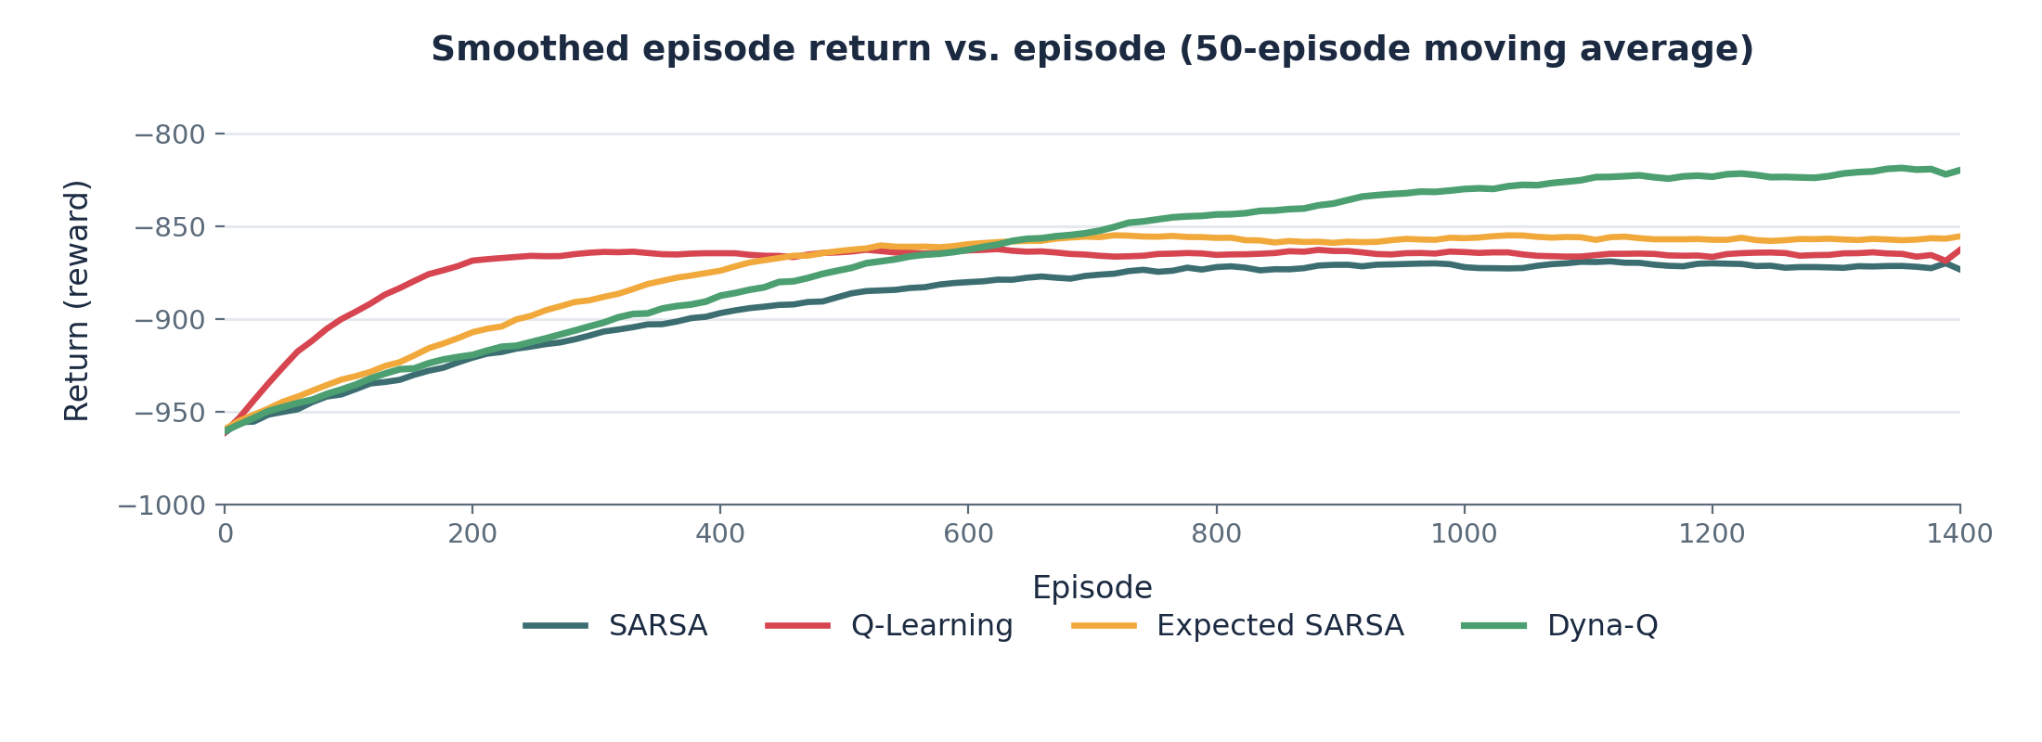
PART 4 · RESULTS
Learning Curves & Training Progress
PRESENTING Esha Bobby
These curves are drawn from the team's actual NumPy training runs, not artist's impressions. Returns are negative because reward is formulated as a cost; residual jitter reflects Poisson demand, not a failed implementation.
Part 4 — Results & Innovation
11

Slide 12
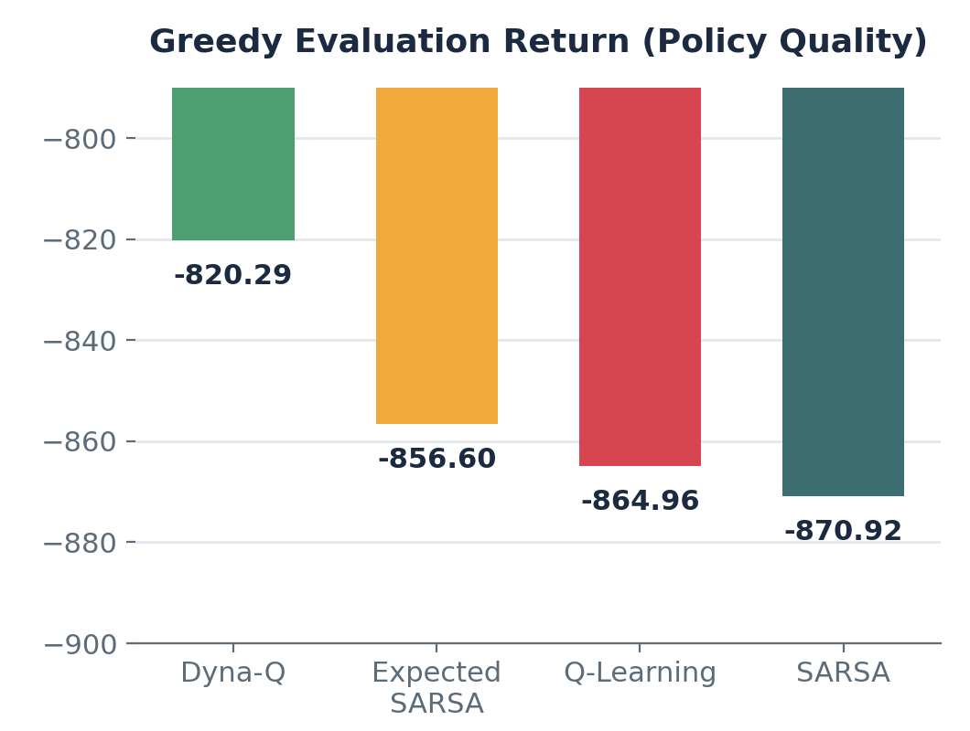
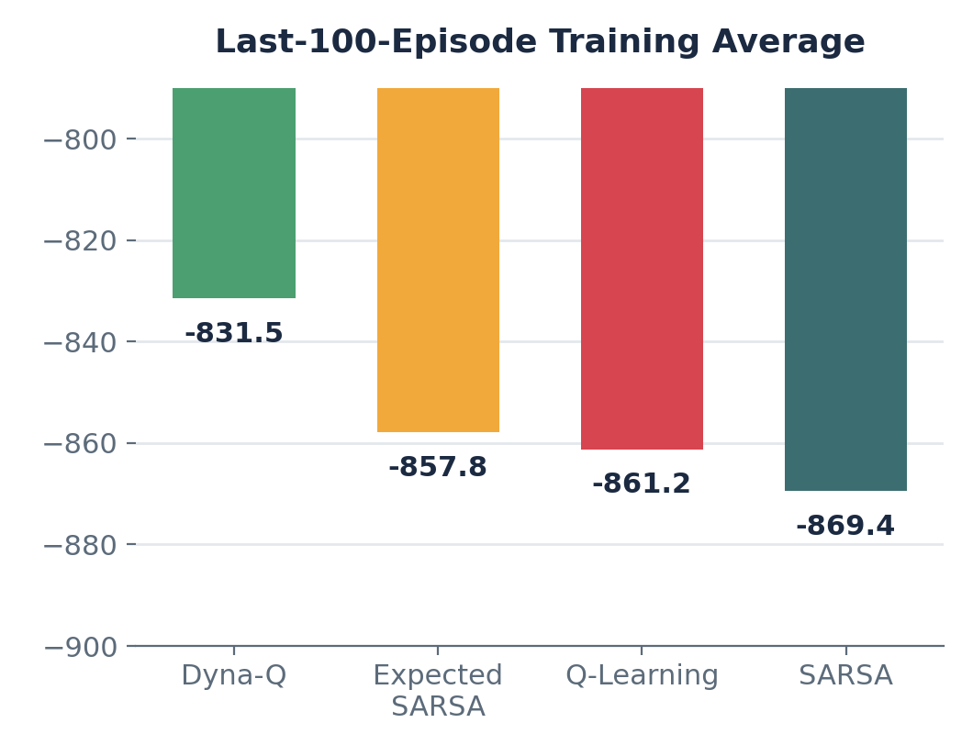
PART 4 · RESULTS
Quantitative Comparison & Ranking
PRESENTING Esha Bobby
The stability paradox: Q-learning stabilized fast (~episode 248) but plateaued at a weaker policy. Dyna-Q kept refining until ~episode 678 and won on both metrics — stability is not the same as quality.
Part 4 — Results & Innovation
12

Slide 13
PART 4 · RESULTS
Why Dyna-Q Won — Algorithmic Analysis
PRESENTING Esha Bobby
1
2
3
Planning overcomes sparsity
Expected SARSA cuts noise
Q-learning's maximization bias
With 6,480 states and 120 steps per episode, real experience is scarce. Dyna-Q's 8 planning updates per tick propagate rewards backward far more efficiently.
Averaging over the policy's next action-values, instead of sampling one, reduces variance from exploratory actions relative to plain SARSA.
In a stochastic environment, taking the max over a of Q(s',a) systematically overestimates values, causing premature convergence to a weaker policy.
Part 4 — Results & Innovation
13

Slide 14
PART 4 · INNOVATION
Innovation Layer — Safe Reinforcement Learning
PRESENTING Esha Bobby
Safety Shield
Agent
Environment
maximizes Q(s,a)
A_safe(s) — only safe actions pass through
hardware / cabinet
Minimum green
Maximum red
Pedestrian lock
Spillback veto
no rapid flipping
prevents starvation
clearance guaranteed
blocks a bad switch
Average return is not a municipal SLA. The agent may only maximize Q inside the safe set; a Lagrange multiplier can add long-run wait-time frequency constraints on top. Multi-agent corridors come after safety.
Part 4 — Results & Innovation
14

Slide 15
PART 4 · INTEGRITY
Experimental Assumptions & Integrity
PRESENTING Esha Bobby
Synthetic Poisson arrivals — not an empirical field loop-detector dataset.
!
Discretized queue occupancy capped at 5 vehicles per approach.
!
Two-phase control only; no protected left turns modeled.
!
One designated random seed per algorithm — ranking is indicative, not a 30-seed statistical test.
!
Perfect, fully-observed queue state inside the simulator (would be partial in the field).
!
We maintain academic transparency: these constraints validate the TD algorithms cleanly, before introducing deep RL or SUMO co-simulation. This video was recorded by the four team members — no generated lecture video is included in the fileset.
Part 4 — Results & Innovation
15

Slide 16
SUMMARY & CONCLUSION
Traffic Signal Control as a Real-Time Sequential MDP
1
It's an MDP, not classification
2
Dyna-Q is the strongest tabular method
Signal control is fundamentally sequential and real-time — not a one-shot classification problem.
Planning and sample reuse deliver large gains in a sparse, 6,480-state queueing space.
3
Expected SARSA is the best model-free choice
4
Safe RL shielding is essential
Target-variance reduction gives it a clear edge over plain SARSA.
It bridges the gap between simulation and real municipal deployment.
Thank you — we welcome questions.
Aarnav Sabherwal
Amrit Raj Dhar
Niharika Singh
Esha Bobby
16

