Slide 1
CODEALPHA • INTERNET OF THINGS
AUTOMATIC LIGHT
CONTROL USING LDR
Task 2 — Sensor-Based Simulation
Student: Niharika Varshitha T.
Platform: Tinkercad Circuits • Board: Arduino Uno R3
SIMULATED PROJECT PRESENTATION

Slide 2
1. Objective
To design and simulate an automatic light control system using an LDR sensor and Arduino Uno. The system detects light intensity and controls an LED according to the sensor reading.
SENSE
LDR detects light
PROCESS
Arduino checks value
RESPOND
LED turns ON or OFF
CodeAlpha IoT Internship • Task 2 02

Slide 3
2. Components Used
Arduino Uno R3
LDR / Photoresistor
LED
Reads the sensor and controls the LED
Senses surrounding light
Shows the system output
1 kΩ resistor
10 kΩ resistor
Breadboard & jumper wires
Limits current through the LED
Forms a voltage divider with LDR
Connect the components
Tinkercad Circuits
Online simulation environment
CodeAlpha IoT Internship • Task 2 03

Slide 4
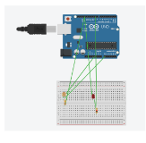
3. Circuit Connections
INSERT Task2_Circuit.png
Replace this box with your saved screenshot
• LDR output junction → A0
• LED control pin → D9
• 1 kΩ resistor in series with LED
• 10 kΩ resistor from LDR junction to GND
• LDR connected to 5V
• Common ground (GND)
CodeAlpha IoT Internship • Task 2 04

Slide 5
4. Working Principle
1
LDR senses light
Sensor produces an analog reading.
2
Arduino reads A0
The value is checked repeatedly.
3
Compare with 500
The program uses 500 as its threshold.
4
Control the LED
Below 500: ON • 500 or above: OFF.
CodeAlpha IoT Internship • Task 2 05

Slide 6
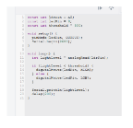
5. Arduino Program
const int ldrPin = A0;
const int ledPin = 9;
const int threshold = 500;
void setup() {
pinMode(ledPin, OUTPUT);
Serial.begin(9600);
}
void loop() {
int lightLevel = analogRead(ldrPin);
if (lightLevel < threshold) {
digitalWrite(ledPin, HIGH);
} else {
digitalWrite(ledPin, LOW);
}
Serial.println(lightLevel);
delay(200);
}
INSERT Task2_Code.png
Replace this box with your saved screenshot
Threshold = 500
LED pin = 9 • LDR pin = A0
CodeAlpha IoT Internship • Task 2 06

Slide 7
6. Code Explanation
A0
Analog input used to read the LDR value.
Pin 9
Digital output used to control the LED.
Threshold 500
Reference value for switching the LED.
analogRead()
Reads the current sensor value.
digitalWrite()
Sets the LED output HIGH or LOW.
Serial.println()
Displays readings in the Serial Monitor.
delay(200)
Waits 200 milliseconds between readings.
CodeAlpha IoT Internship • Task 2 07

Slide 8
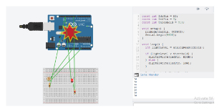
7. Simulation Result — LED ON
INSERT Task2_LED_ON.png
Replace this box with your saved screenshot
LOW-LIGHT TEST
Example reading
54 (below 500)
LED STATUS: ON
The LED glows when the reading is below 500.
CodeAlpha IoT Internship • Task 2 08

Slide 9
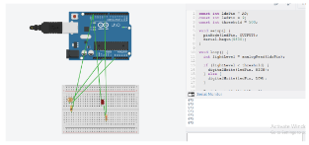
8. Simulation Result — LED OFF
INSERT Task2_LED_OFF.png
Replace this box with your saved screenshot
HIGH-READING TEST
Example reading
973 (above 500)
LED STATUS: OFF
The LED switches off when the reading is above 500.
CodeAlpha IoT Internship • Task 2 09

Slide 10
9. Overall Result
The circuit responded to sensor readings and switched the LED according to the programmed threshold.
LDR reading < 500
LDR reading = 500
LDR reading > 500
Low-light test
LED ON
At threshold
LED OFF
High-reading test
LED OFF
Note: A reading equal to 500 follows the ELSE branch, so the LED is OFF.
CodeAlpha IoT Internship • Task 2 10

Slide 11
CONCLUSION
The project demonstrates a simple sensor-based automation system. The LDR provides an input reading, and the Arduino processes it to control an LED automatically.
THANK YOU
CodeAlpha IoT Internship • Task 2

