Slide 1

Recursion Tree Analysis for Three-Way Recurrence with Constant Work
NAME OF THE GUIDE:
Dr Gnanajeyaraman Rajaram
PRESENTED BY
M .Niharika(192472392)

Slide 2


INTRODUCTION
Recursion is a technique where a function calls itself.
Recursive algorithms are represented using recurrence relations.
The Recursion Tree Method is used to analyze recursive algorithms.
It calculates the work performed at each level.
The total work gives the overall time complexity.

Slide 3
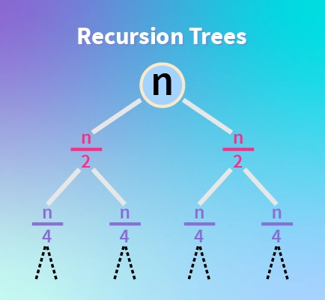
Problem Statement
Given Recurrence:
T(n) = 3T(n/3) + 1
Meaning
3 → Three recursive calls
n/3 → Size of each subproblem
1 → Constant work at each call
Objective
Construct the recursion tree.
Calculate the cost at each level.
Find the overall time complexity.

Slide 4
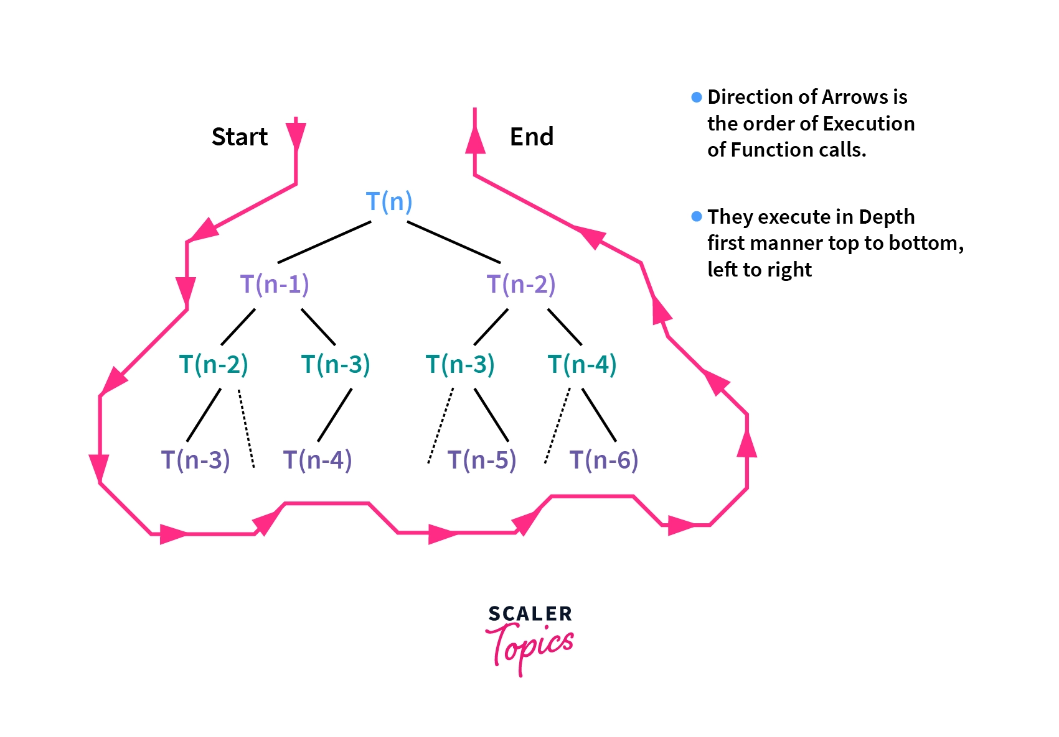
Recursion Tree Construction
Recursion Tree
T(n)
Cost = 1
/ | \
T(n/3) T(n/3) T(n/3)
1 1 1
/ | \ / | \ / | \
T(n/9)... T(n/9)... T(n/9)...
Observation
Level 0 → 1 node
Level 1 → 3 nodes
Level 2 → 9 nodes
Level 3 → 27 nodes
Number of nodes increases by a factor of 3.

Slide 5
Cost Analysis
Level | Nodes | Cost per Node | Total Cost
0 | 1 | 1 | 1
1 | 3 | 1 | 3
2 | 9 | 1 | 9
3 | 27 | 1 | 27
k | 3ᵏ | 1 | 3ᵏ
Observation:
Every node performs constant work.
Total cost equals the number of nodes at each level.

Slide 6
Time Complexity Analysis
Total Cost
Cost at each level forms a geometric series:
1 + 3 + 9 + 27 + ... + 3^(log₃ n)
The number of nodes increases by a factor of 3 at each level.
The height of the recursion tree is log₃ n.
The last level contains approximately n nodes.
The total work is proportional to n.
Final Result
Time Complexity = Θ(n)

Slide 7
Results and Discussion
The recurrence relation T(n) = 3T(n/3) + 1 was successfully analyzed using the Recursion Tree Method.
The problem is divided into three equal subproblems at every recursive step.
The recursion tree has log₃ n levels, and the total work at all levels forms a geometric series. The overall running time is Θ(n), indicating linear time complexity.
The Recursion Tree Method provides a simple and visual approach for analyzing recursive algorithms and understanding their efficiency.

Slide 8
Conclusion
The Recursion Tree Method is an effective technique for analyzing recursive algorithms.
The recurrence relation T(n) = 3T(n/3) + 1 divides the problem into three equal subproblems with constant work at each recursive call. The recursion tree has log₃ n levels, and the total cost grows linearly with the input size.
The final time complexity of the recurrence is Θ(n).
This method helps evaluate the efficiency of divide-and-conquer algorithms and supports better algorithm design.

Slide 9


