Slide 1
Cyberbullying Detection Using Machine Learning Batch-4 Guide – Ms. Y. Latha (Assistant Professor) Niharika D -19K91A05E5 P Ram Kumar -19K91A05F5 P Aryan Raj -19K91A05F6 P Bhargavi -19K91A05F8 R Sai Varsha -19K91A05G3

Slide 2
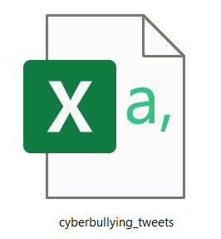
Data Sets Information
Gathering historical data
Csv Files
Cyberbullying_tweets

Slide 3
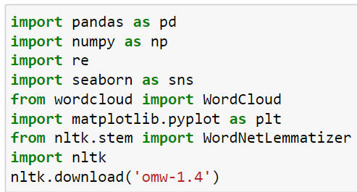
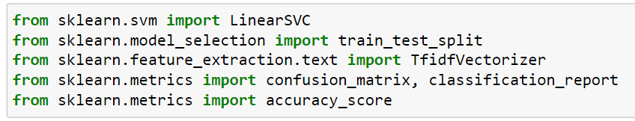
Installing & Importing Libraries
Pandas
Pip install pandas
Numpy
Pip install numpy
Matplotlib
Pip install matplotlib
Seaborn
Pip install seaborn
Sklearn
Pip install sklearn
NLTK
Pip install NLTK

Slide 4
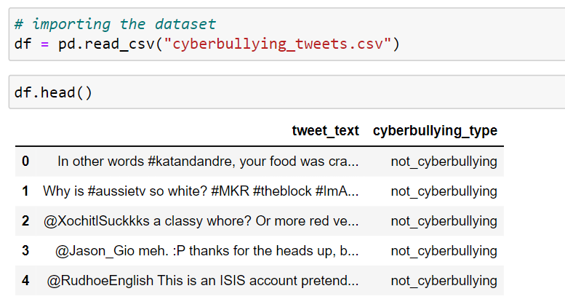
Loading Tweets Using Pandas
Reading csv File, and displaying top 10 rows.

Slide 5
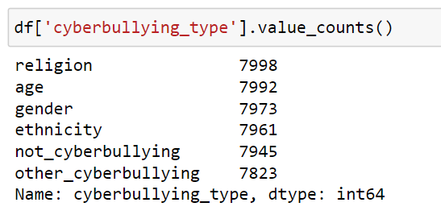
Exploratory Data Analysis
Finding the classes in the cyberbullting_type

Slide 6
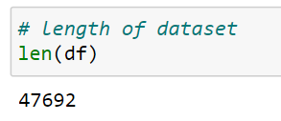
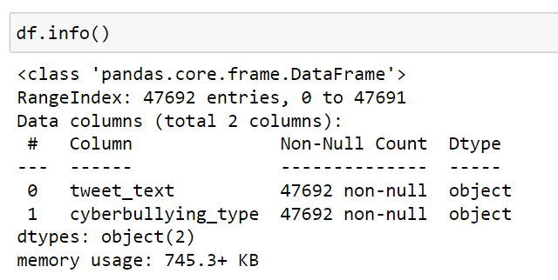
Tweets Information
Total Number of tweets
Information of the tweets

Slide 7
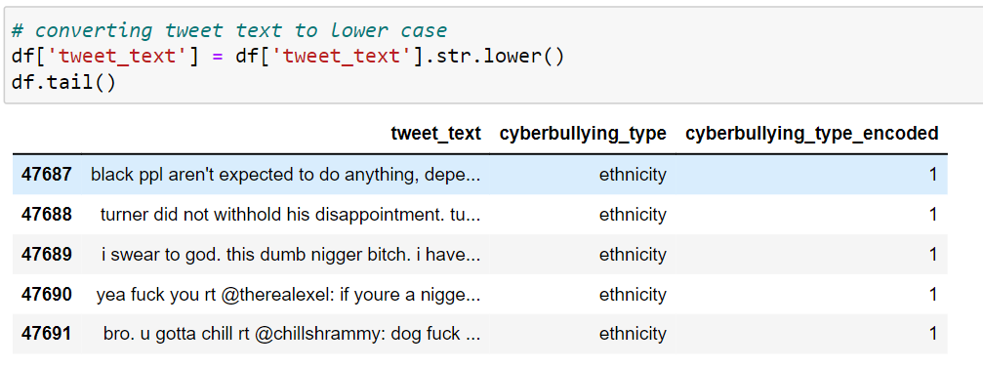
Converting tweets into lower case

Slide 8
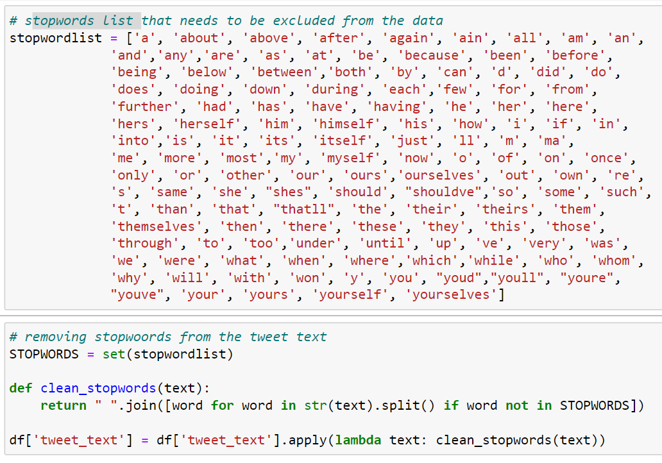
Stop words Cleaning

Slide 9
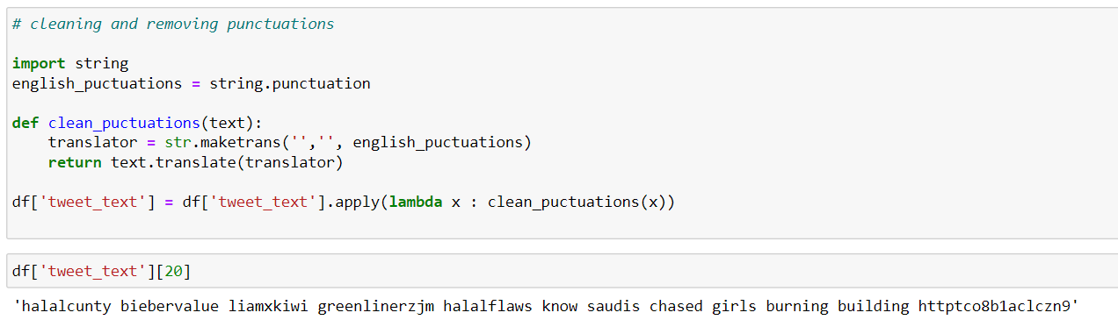
Removing Punctuations

Slide 10
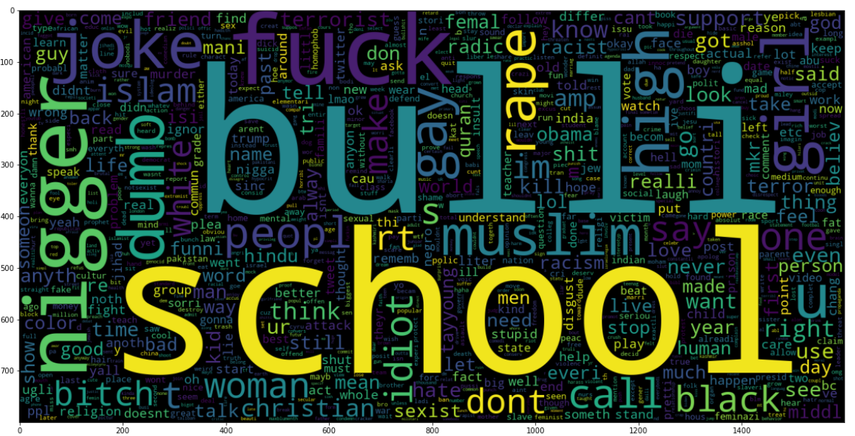
Graphs
# plotting word cloud excluding other_cybberbullying and not_cyberbullying

Slide 11
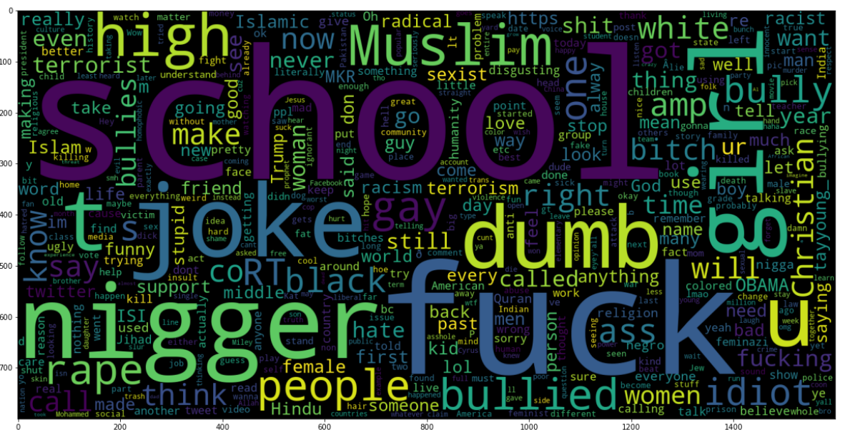
Graphs
# We will have to exclude the tweets which are not_cyberbullying for this task

Slide 12
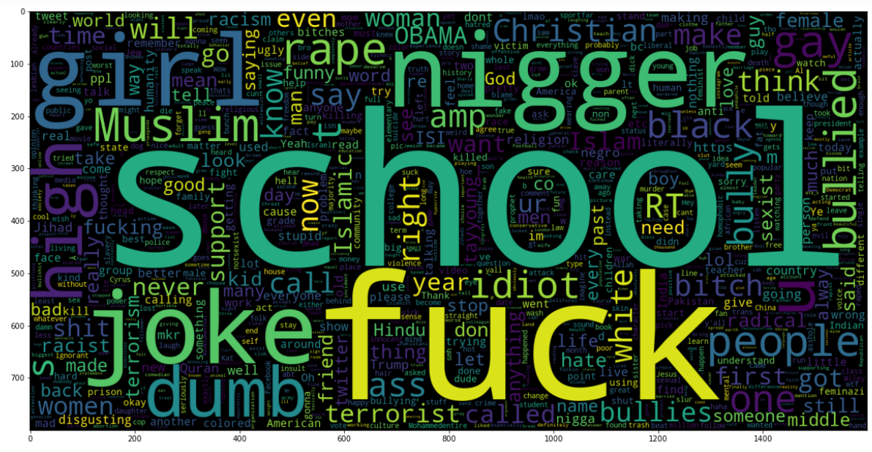
Graphs
# excluding the other_cyberbullying values and plotting again

Slide 13

Splitting Data
Train – 70
Test - 30

Slide 14
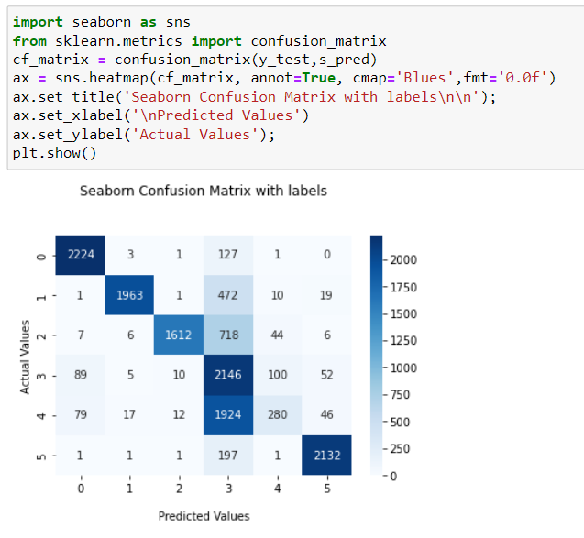
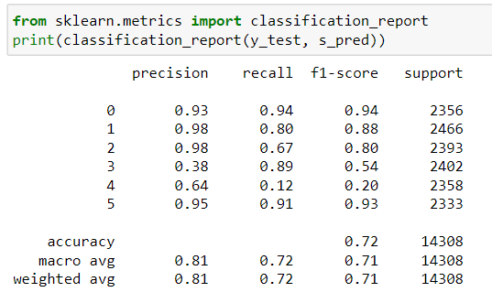
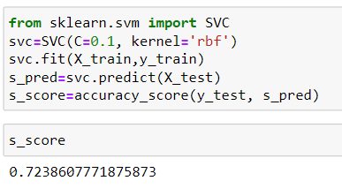
Support Vector Machine
Report
Confusion Matrix
Model Applying

Slide 15
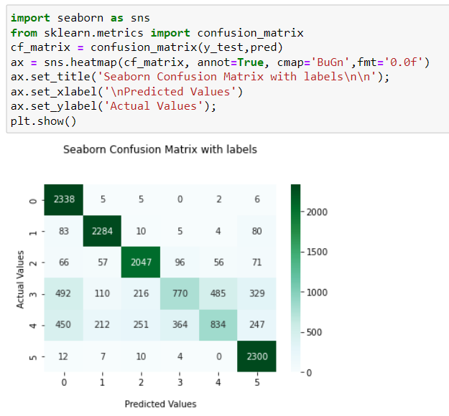
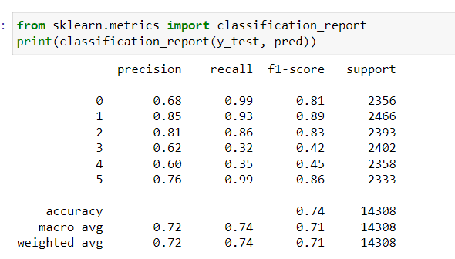
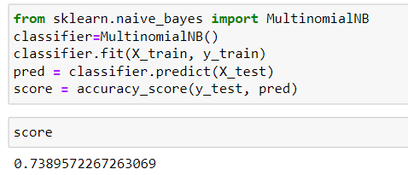
Naive Bayes
Report
Confusion Matrix
Model Applying

Slide 16
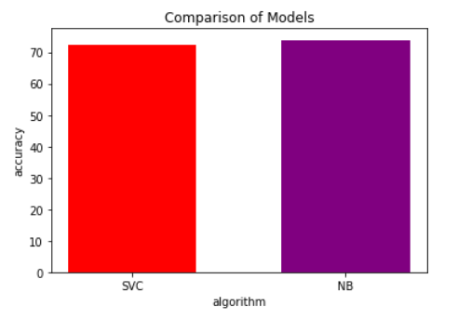
Comparison Report
Naïve Bayes is having more accuracy than SVM

Slide 17
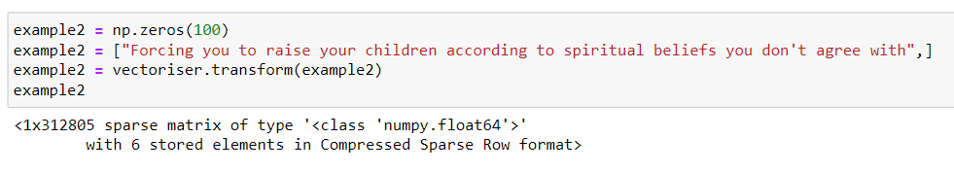
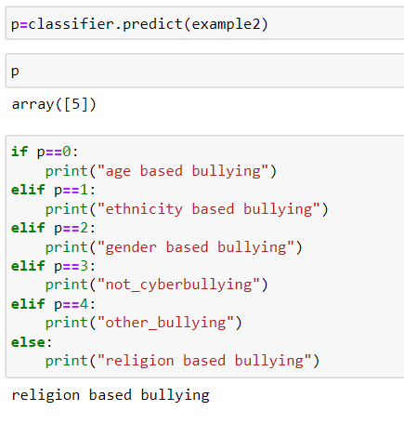
Predictions

Slide 18
Thank You

