Slide 1
Category Management Dashboard
PURPOSE:
To track yesterday’s performance if it was better or worse than usual.
To check the top and bottom line development over time.
Highlight the main drivers of the performance.
CONTENT:
Daily Performance – Performance Comparison
Top and Bottom line performance – High level data about business and profitability.
Main Drivers of Performance – The section highlights the key growth drivers.
Glossary – KPIs Definitions and key takeaways

Slide 2
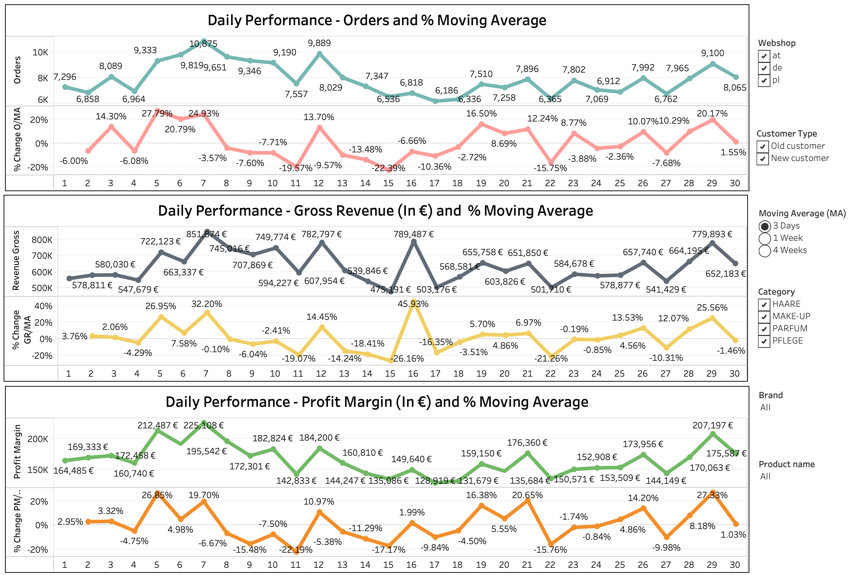

Slide 3
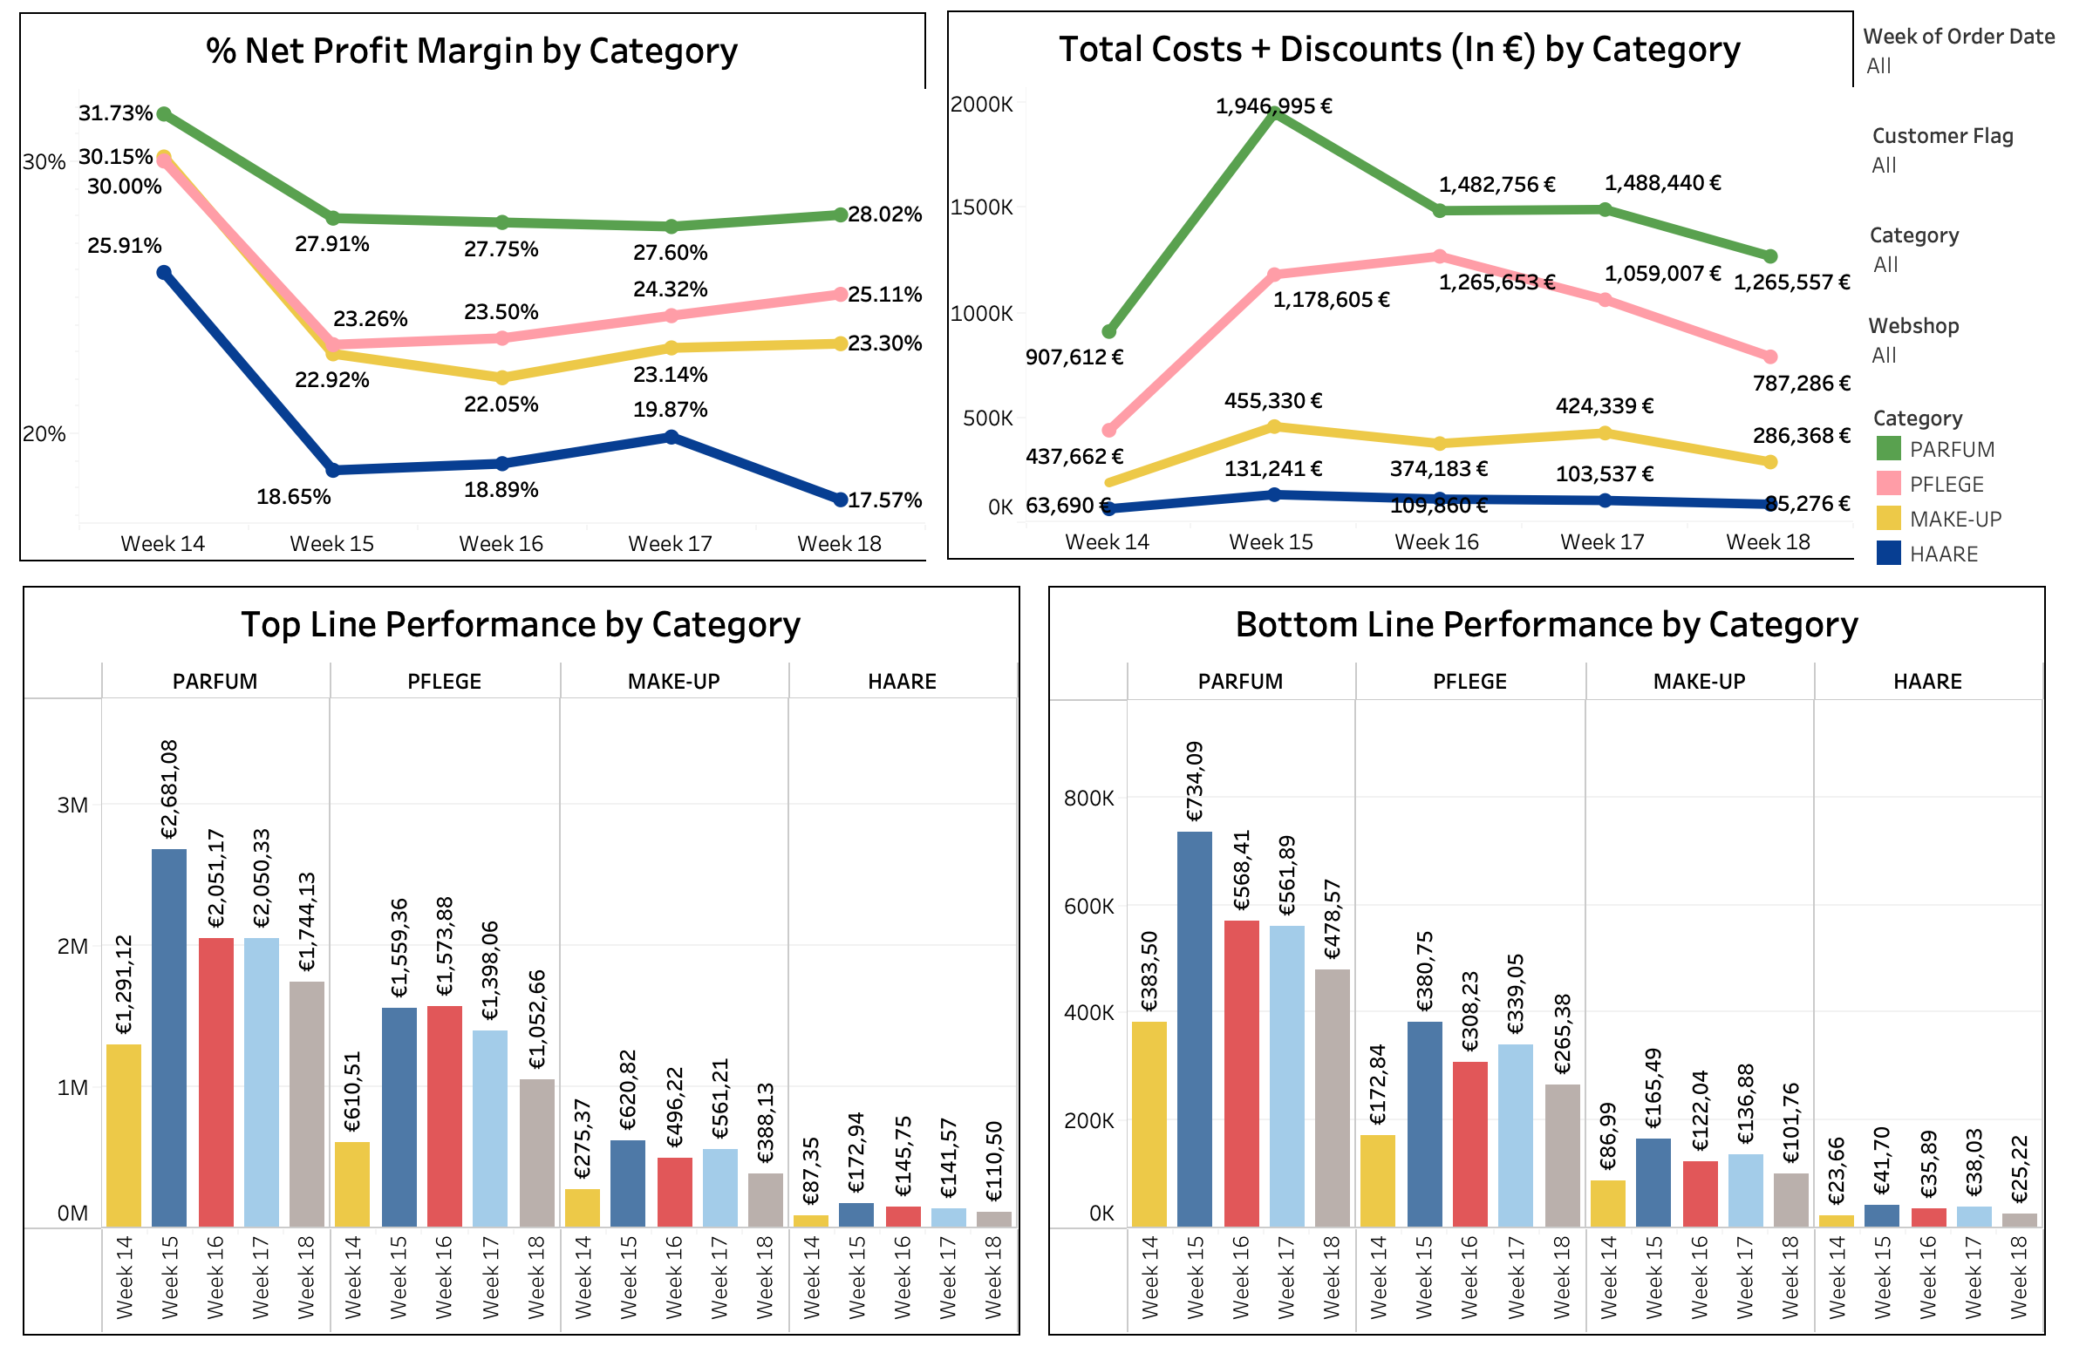

Slide 4
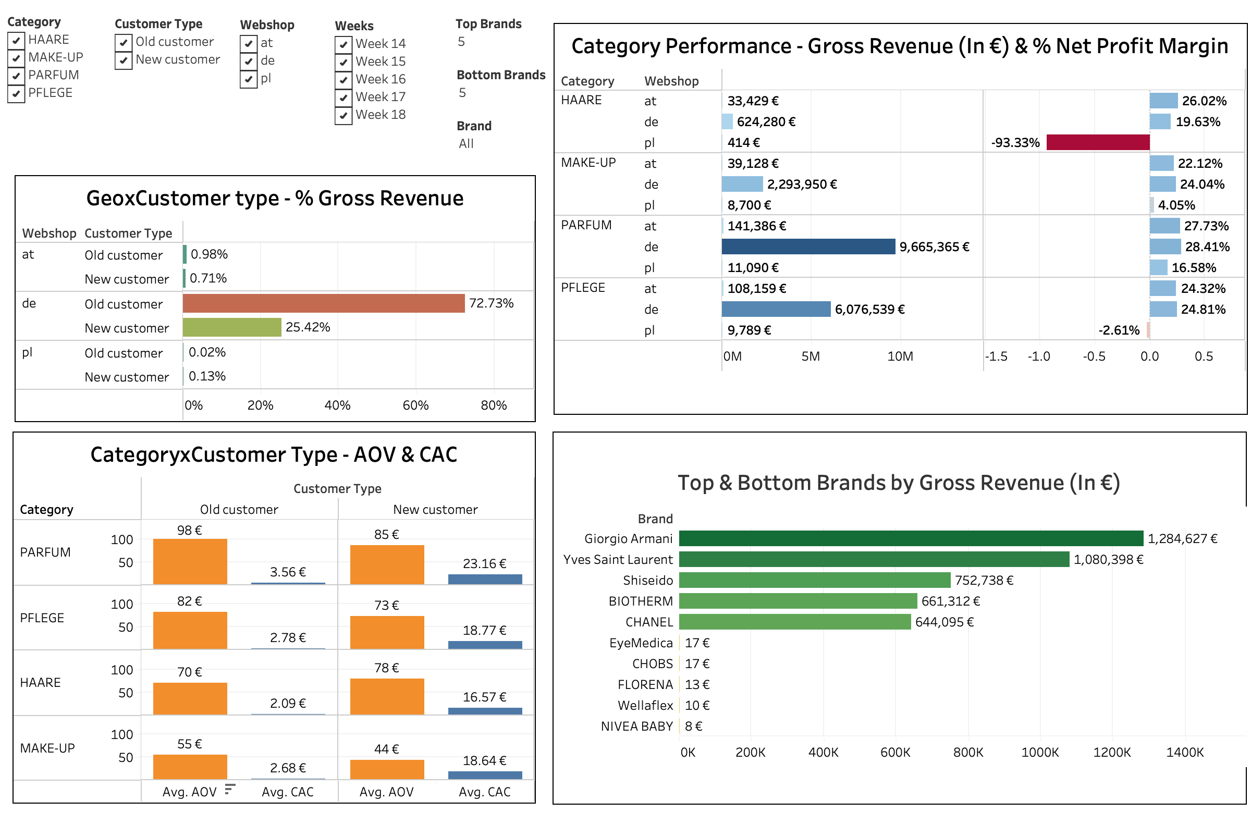

Slide 5
