Slide 1
Norms, Angles,
and Your Movie Choices
Linear Algebra Based Movie Recommendation System
Mini Project | MFAD
Team Members:
1. Kritika Singh
2. Ishita Gulati
3. Hemal S
4. Janaki Niharika
Python • NumPy • SciPy • Matplotlib • Streamlit

Slide 2
1. Problem Statement
• Use movie ratings to represent user preferences mathematically.
• Represent each user using a 20-dimensional rating vector.
• Find users with similar preferences.
• Use the similar users to recommend movies.
• Compare Euclidean distance and Pearson correlation.
Ratings → Vectors → Similarity → Similar User → Recommendations
2

Slide 3

2. Dataset and Matrix Representation
Code-
• Dataset file: users_movies.mat
• Full dataset: 6040 users × 3952 movies.
• Selected working matrix: 6040 users × 20 selected movies.
• Rows represent users; columns represent selected movies.
• Each matrix entry is a movie rating.
# Execute in project root
import scipy.io
import numpy as np
d = scipy.io.loadmat("data/users_movies.mat",squeeze_me=True,
struct_as_record=False
)
print(d["users_movies_sort"].shape)
print(d["trial_user"])
Output-
3

Slide 4

3. Data Filtering
def filter_complete_raters(ratings_20):
mask = np.all(ratings_20 != 0, axis=1)
return ratings_20[mask], mask
ratings = d["users_movies_sort"]
mask = np.all(ratings != 0, axis=1)
print("Before:", ratings.shape)
print("Complete users:", np.sum(mask))
print("After:", ratings[mask].shape)
Why?
• 0 means the movie was not rated.
• Similarity calculations need a complete 20-value vector.
• Filtering leaves only users with all 20 ratings.
4

Slide 5
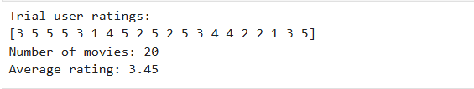
4. User Rating Vector
trial = np.asarray(
d["trial_user"]
).flatten()
print("Trial user:", trial)
print("Number of ratings:", len(trial))
print("Mean:", trial.mean())
• Vector dimension = 20.
• Each position corresponds to one selected movie.
• This vector is the query used for similarity comparison.
5

Slide 6
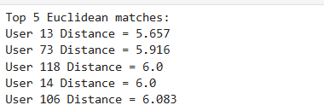
5. Linear Algebra Concept — Euclidean Distance
d(x,y) = ||x − y||₂ = √Σ(xᵢ − yᵢ)²
distances = np.linalg.norm( complete_ratings - trial_user, axis=1 ) user_indices = np.where(mask)[0] best_euclidean = np.argsort(distances)[:5]
print("Top 5 Euclidean matches:") for i in best_euclidean: print( "User", user_indices[i], "Distance =", round(distances[i], 3) )
Interpretation:
• Smaller distance = more similar exact ratings.
• np.linalg.norm() calculates the L₂ norm.
• Nearest user is the first result after sorting.
6

Slide 7
6. Mean Centering
Centered value = rating − user's mean rating
def center_rows(X):
row_means = X.mean(
axis=1,
keepdims=True
)
return X - row_means
Example
[5, 4, 3] → mean 4 → [ +1, 0, −1 ]
• Centering is done row by row.
• After centering, values show whether a movie is above or below that user's average.
• This centered data is used for Pearson correlation.
7

Slide 8
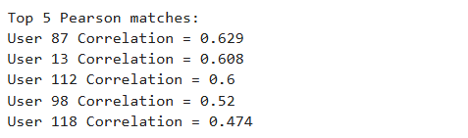
7. Linear Algebra Concept — Pearson Correlation
r = (xᶜ · yᶜ) / (||xᶜ|| ||yᶜ||)
def pearson_similarity(ratings_cent, query_cent):
numerator = ratings_cent @ query_cent
denominator = (
np.linalg.norm(ratings_cent, axis=1)
* np.linalg.norm(query_cent)
)
return numerator / denominator
pearson = numerator / denominator
order = np.argsort(-pearson)
for i in order[:5]:
print(i, pearson[i])
Higher positive value → stronger preference-pattern similarity.
8

Slide 9
8. Comparison of Similarity Methods
EUCLIDEAN
Best User: User 13
Distance: 5.657
PEARSON
Best User: User 87
Correlation: 0.6290
The two methods select different best users because they measure similarity differently.
Comparison table
Feature
Euclidean
Pearson
Input
Original ratings
Centered ratings
Measure
Distance
Correlation / angle
Best
Smaller
Closer to +1
Bias removal
No
Yes
9

Slide 10

9. Recommendation Algorithm
titlesmovies = np.asarray(D["movies"]).flatten()
best_user_position = best_euclidean[0]user_13_ratings = complete_ratings[best_user_position]
recommendationsrecommendation_indices = recommend( user_13_ratings, trial_user, movies, top_n=10)
print("EUCLIDEAN RECOMMENDATIONS:")
for i in recommendation_indices:
print(movies[i])
• Take the best matching user.
• Find movies that this user rated 5.
• Find movies already rated 5 by the query user.
• Remove the already-liked movies.
• Return up to 10 remaining movie titles.
10

Slide 11
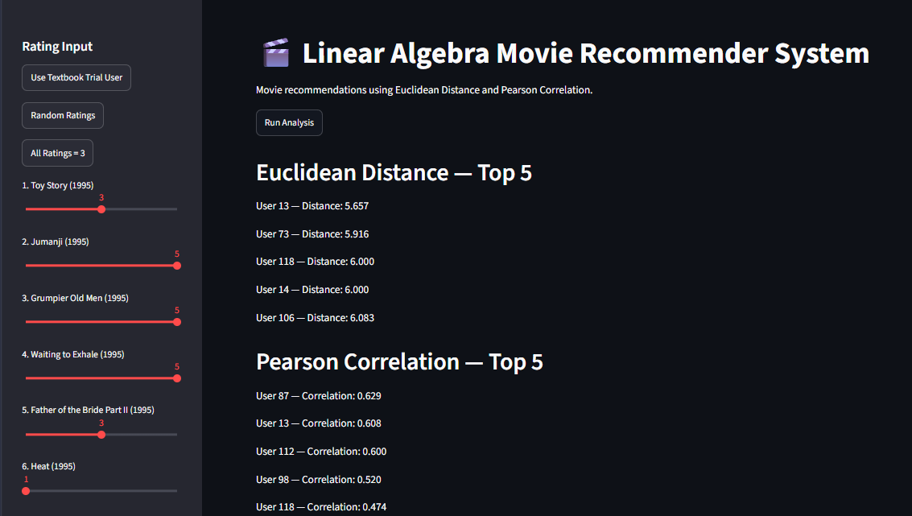
10. Final Application — Streamlit Dashboard
• 20 sliders allow the user to enter movie ratings.
• Quick presets: textbook trial user, random ratings, all 3s.
• Run Analysis displays Euclidean and Pearson top-5 matches.
• Matplotlib compares rating profiles.
• Recommendation lists show Euclidean, Pearson and common recommendations.
Run command:
streamlit run src/app.py
Demo: change a rating → Run Analysis →
show similarity → show recommendations.
11

Slide 12
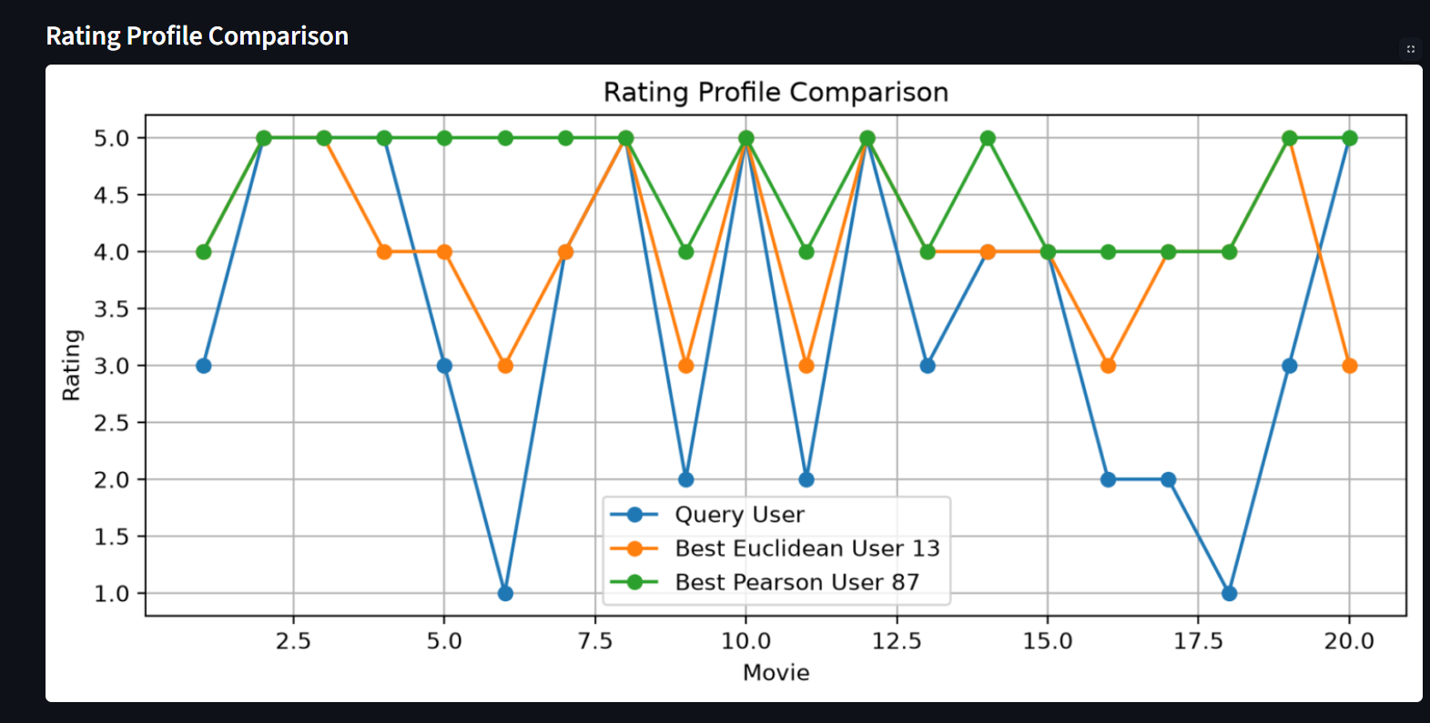

11. Final Results
TOP EUCLIDEAN MATCH
User: 13
Distance: 5.657
TOP PEARSON MATCH
User: 87
Correlation: 0.629
COMMON RECOMMENDATIONS
Ace Ventura
12

Slide 13
12. Conclusion
• Matrix/vector representation — ratings become mathematical vectors.
• Euclidean L₂ norm — finds users with small exact-rating differences.
• Mean centering — removes overall rating-level bias.
• Pearson correlation — compares centered preference patterns using dot product and norms.
• Recommendation step — converts the nearest-user result into movie titles.
• Application output — Streamlit makes the complete pipeline interactive.
Future scope: compare more similarity measures, improve recommendation ranking, evaluate with more users, and add stronger validation metrics.
Thank You
13

