Slide 1

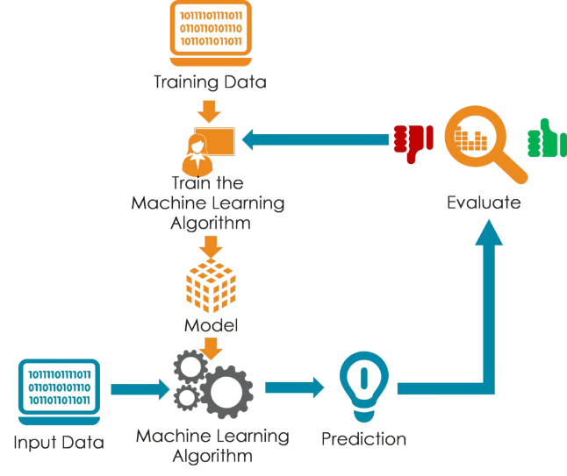

Introduction to KNN Classification
K-Nearest Neighbors (KNN) is a powerful and versatile algorithm in machine learning. It's a non-parametric method used for classification and regression tasks.

Slide 2

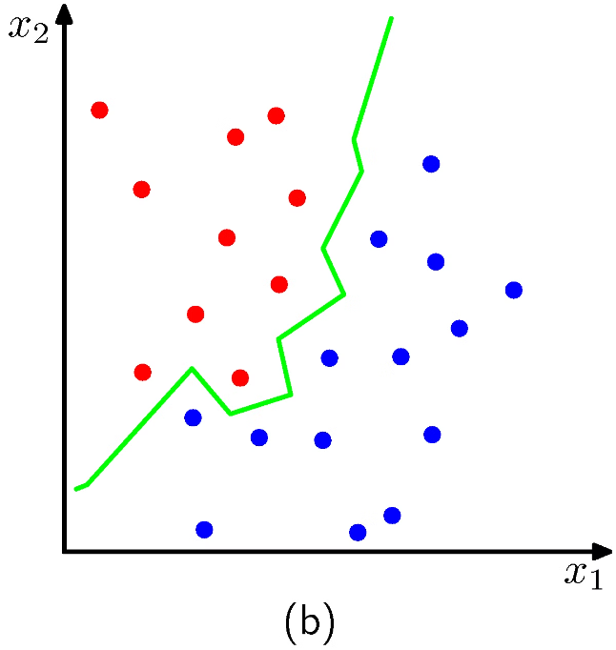
What is KNN?
KNN is a supervised learning algorithm that classifies data points based on the majority class of their nearest neighbors. It assumes that similar data points are likely to belong to the same class.
Non-Parametric
Lazy Learning
KNN doesn't make assumptions about the underlying data distribution.
KNN does not build a model explicitly, but instead relies on the training data during prediction.
Instance-Based
It makes predictions based on the similarity to known data points, rather than a model.

Slide 3

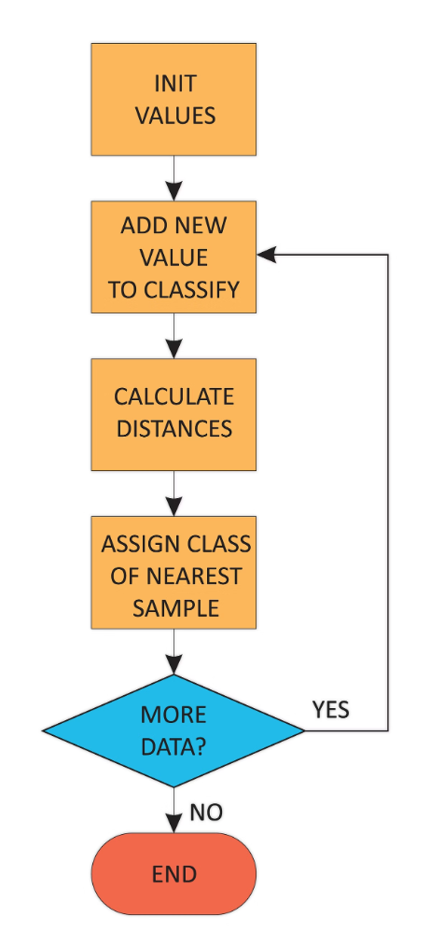
How does KNN work?
KNN works by finding the k nearest neighbors to a new data point and assigning it to the class that is most frequent among those neighbors.
1
Calculate Distance
Measure the distance between the new data point and all existing data points in the training set.
2
Find Nearest Neighbors
Identify the k data points closest to the new data point based on the calculated distances.
3
Assign Class
Determine the most common class among the k nearest neighbors and assign it to the new data point.

Slide 4

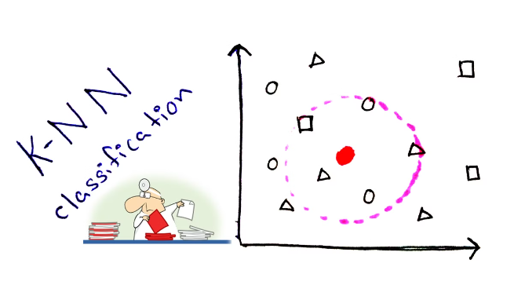
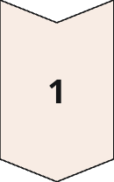
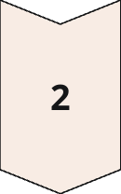
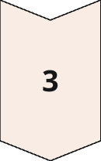
Choosing the right value of K
The value of K, the number of nearest neighbors to consider, is a crucial hyperparameter that affects KNN's performance.
Small K
More prone to noise and overfitting, as it focuses on local patterns.
Large K
More robust to outliers but can lead to underfitting, as it considers a wider range of data points.
Optimal K
A balance between bias and variance, resulting in a model that generalizes well to new data.

Slide 5

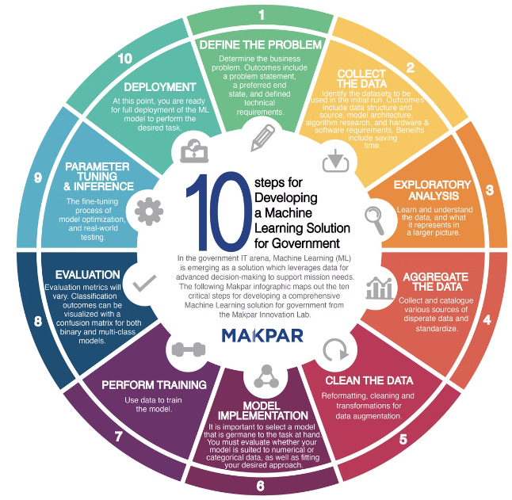
Algorithm Steps
Distance Metric: The common distance metrics used based on Nature of the Data.(Euclidean distance,Manhattan distance)
1
Choose the number of neighbors (k).
2
Calculate the distance between the query point and all other points.
3
Sort the distances and determine the nearest neighbors.
4
Assign the most common class among the nearest neighbors to the query point.

Slide 6
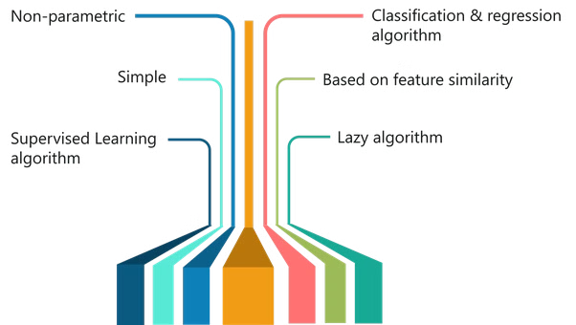
Advantages of KNN
KNN offers several advantages that make it a popular choice for various machine learning applications.
1
Simplicity
2
Versatility
Easy to understand
It can be used for both classification and regression tasks.
and implement. Also no training phase is reuired.
3
Non-Parametric
4
Easy to Update
It doesn't assume a specific data distribution, making it suitable for complex datasets.
New data points can be easily added to the training set without retraining the entire model.

Slide 7
Disadvantages of KNN
Computational Complexity
Sensitive to Noise
Curse of Dimensionality
Outliers or noisy data points can significantly influence the classification result, affecting accuracy.
In high-dimensional datasets, distances become less meaningful, potentially leading to inaccurate results.
It requires calculating distances to all training data points during prediction, which can be computationally expensive for large datasets.

Slide 8




Implementing KNN in Python
Implementing KNN in Python is relatively simple using libraries like scikit-learn.
Import Libraries
Load Data
Preprocess Data
Train Model
Import necessary libraries for data manipulation, preprocessing, and KNN implementation.
Load your dataset into a suitable data structure for processing and model training.
Clean and transform your data to ensure it's suitable for KNN, including scaling, imputation, and outlier handling.
Initialize a KNN model with your chosen parameters and train it using the preprocessed data.

Slide 9

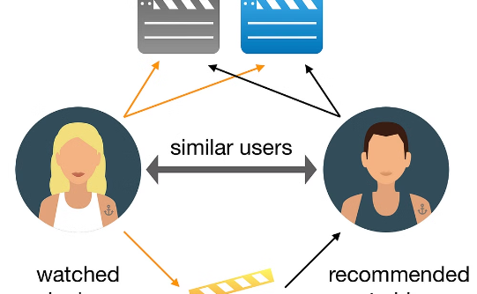

Applications of KNN
KNN has numerous applications in various domains, demonstrating its versatility and practical value.
Image Recognition
Recommender Systems
Medical Diagnostics
Classifying images based on visual features, such as object identification or scene analysis.
Predicting user preferences for products or services based on similar items or users.
Identifying diseases or conditions based on patient data, such as symptoms or medical history.

