Slide 1


HOTBIRD

Slide 2

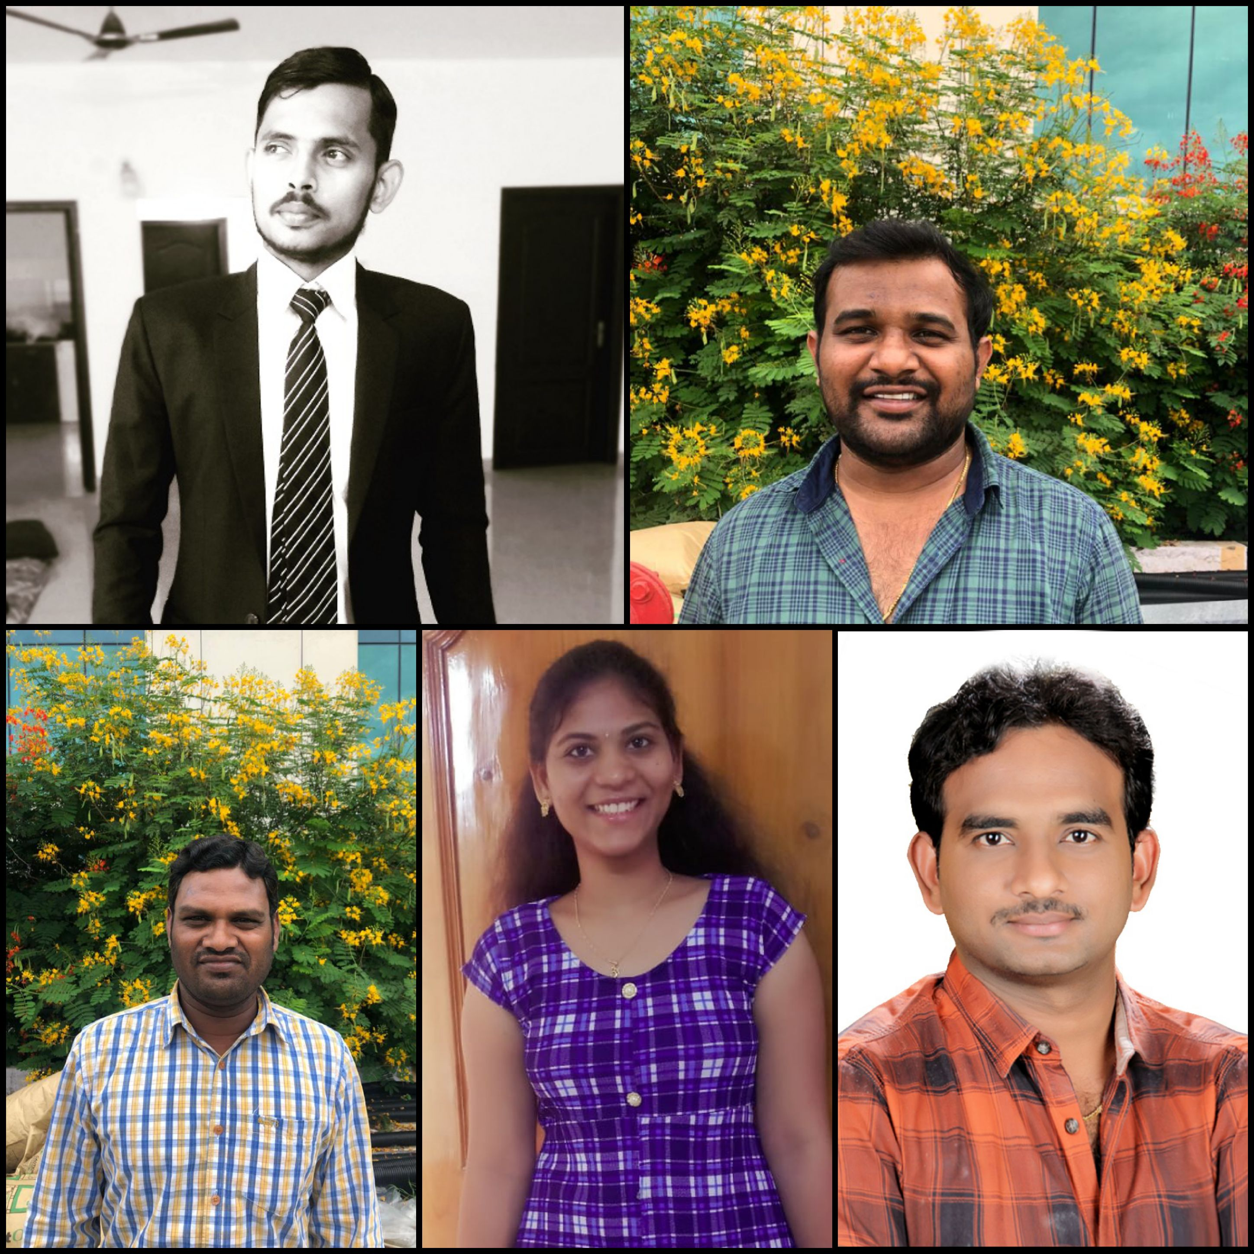
Call for Code 2019 Challenge
Akshit Priyesh
Bestha Prasad
Sunil V
Sarojkumar Turakapalli
Jahnavi Maddela

Slide 3

CHALLENGE
Over 2.3 Billion people are affected due to floods in last 20 years and causing countless death. More than 92 million cattle are lost every year, seven million hectares of land is affected, and damage is over trillions dollars when taken globally in last 5 years.
Floods are complicated natural events. It depends on several parameters, so it is very difficult to model analytically.
The floods in a catchment depends on the characteristics of the catchment, rainfall and antecedent conditions. So the estimation of the flood peak is a very complex problem.
Its due to the lack of Flood Prediction System which can predict the situation accurately.
To Overcome this challenge we are building a Flood Prediction System using Predictive modelling.
However we have divided our idea into small fragments but enough to be used globally.
We have considered most flooded state of India that is Bihar, but can be used widely for all the low lying geographical regions

Slide 4
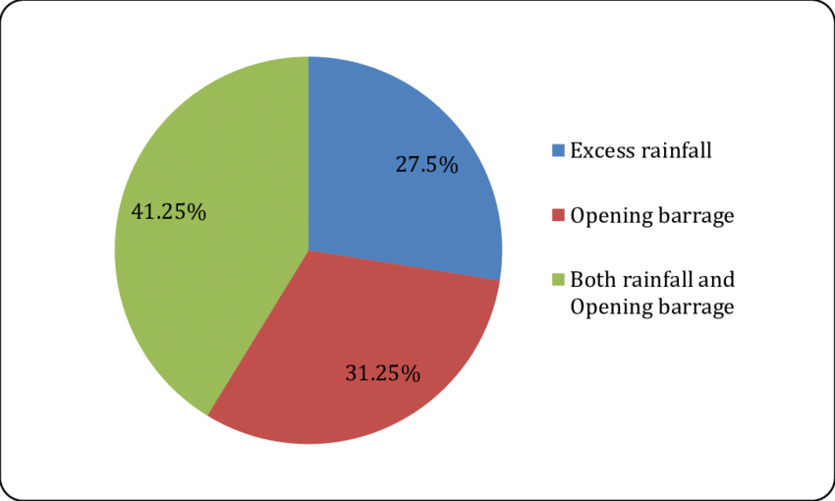
Complexity of Challenge
The plains of Bihar, adjoining Nepal, are drained by a number of rivers that have their catchments in the steep and geologically nascent Himalayas. Kosi, Gandak,Burhi Gandak, Bagmati, Kamla Balan, Mahananda and Adhwara Group of rivers originates in Nepal, carry high discharge and very high sediment load and drops it down in the plains of Bihar.
About 65% of catchments area of these rivers falls in Nepal/Tibet and only 35% of catchments area lies in Bihar.

Slide 5
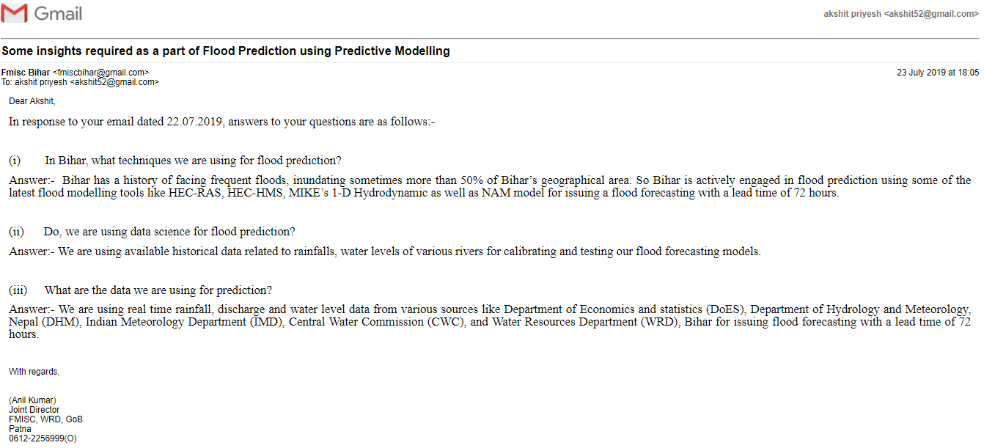
Historical & Current Facts

Slide 6
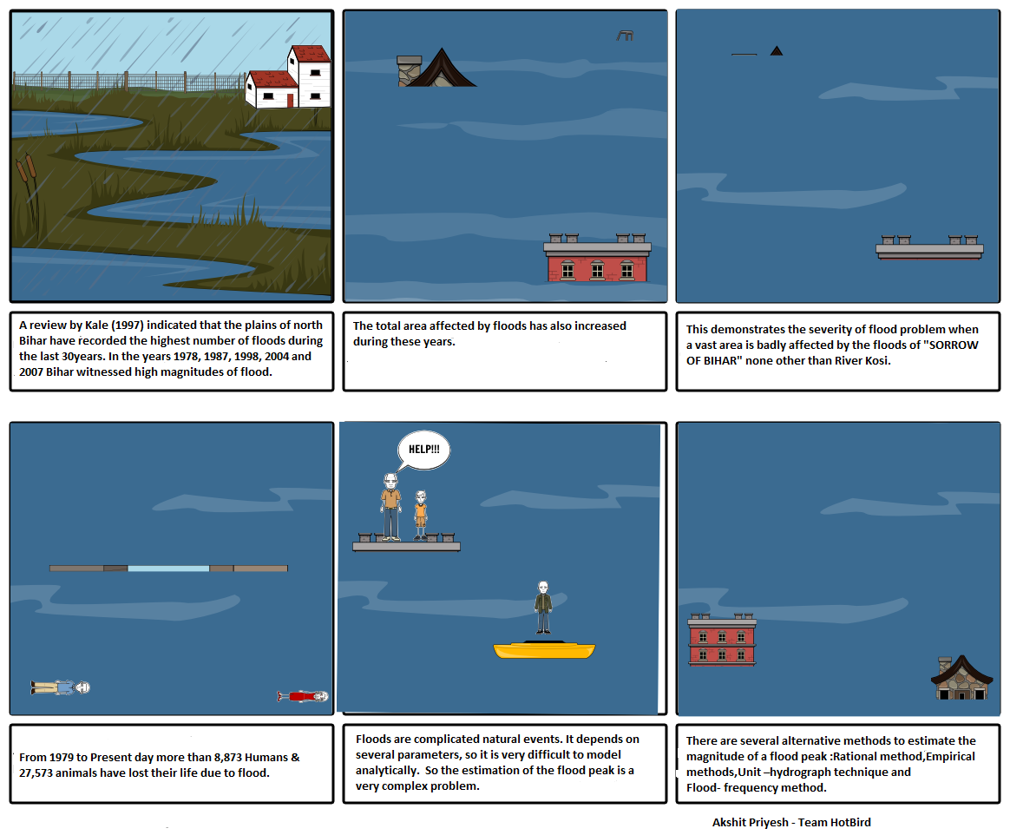
STORY BOARDS

Slide 7
TECHNOLOGY SUGGESTIONS
Some of Tools & Technology which is being used & can be used for Flood Prediction
IBM. Watson Studio democratizes machine learning and deep learning to accelerate infusion of AI in to drive innovation.
An Intelligent Hydro-informatics Integration Platform for Regional Flood Inundation Warning Systems.
Three-Parameter Muskingum Model Coupled with an Bat Algorithm.
Deep Learning with a Long Short-Term Memory Networks Approach for Rainfall-Runoff Simulation

Slide 8

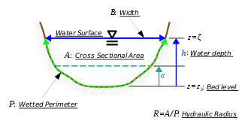
TECHNOLOGY OVERVIEW
Three-Parameter Muskingum Model Muskingum flood routing equation:
Hydro-informatics Integration Platform is based on MIKE'S 1D HYDRODYNAMIC
The Hydro-informatics modelling of unsteady flow is based on an implicit, finite difference numerical solution of the one-dimensional shallow water equations (Saint Venant equations). The numerical algorithms provide efficient and accurate solutions in branched and looped pipe and river networks.

Slide 9
SOLUTION APPROACH
We have studied several Solutions for Short-Term Flood Prediction Using Single ML Methods that is currently been used in different geographical regions across the world such as USA, Japan, Greece India & Brazil.
We Observed a wonderful Insights for why almost all the flood prediction model using Predictive modelling has been failing miserably.
The reason is that instead of predicting flood they end up in predicting the water level of the river or depth of a water body due to rainfall. We have came with a solution for the same.
Instead of calculating only the generalized flood factor we have included the output of several advanced flood predicting system and the geographical factors also. As floods are complicated natural event so instead of building a ideal model we have more focused on the real approach.
So, we have considered the most flooded state of India.
The reason behind it was to make it available for Billions of users so we have considered the most worst scenario.

Slide 10
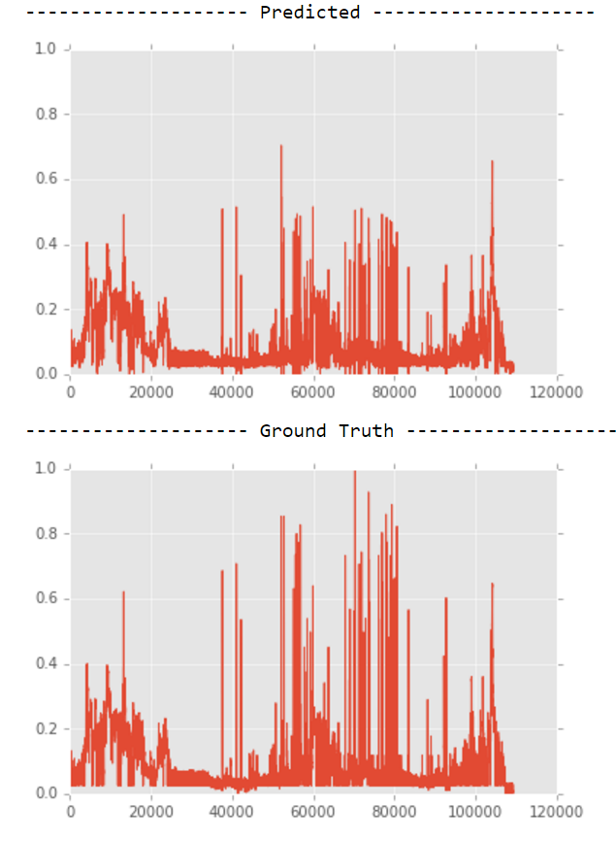
Accuracy

Slide 11
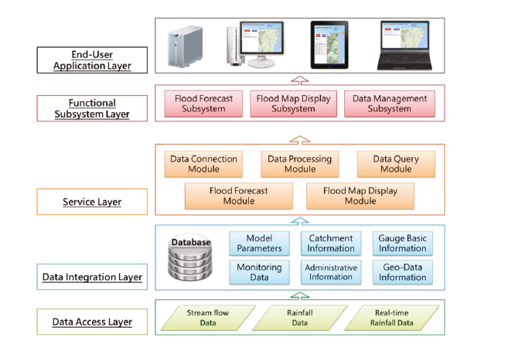
HIGH LEVEL ARCHITECTURE

Slide 12
Source Code
https://app.box.com/file/497306151227
https://github.com/akshitpriyesh/HotBirdFloodPredictionModel

Slide 13
Data Sets
Data sets
1. District wise rainfall monthly Data from 1901- 2019
2.Hydrometer Monthly Reading
3.River basin discharge monthly.
4.Rainfall forecast in Nepal
5. River basin Catchment Area.
6.Death Records Human 1979-2019.
7.Death Records Animals 1979-2019.
8.Hydro-informatics Integration Platform monthly readings.
Notes:
Add GIT link

Slide 14
RECOMMENDED RESOURCES
Opinion pieces
1. Mr. Anil Kumar (Joint Director, FMISC, India) has been engaged for the past thirty years, in conducting
researches in technology revolution and the modernization of data-driven modelling, particularly
in the fields of artificial intelligence
2. Mr. D Mukherjee (Scientist, Flood Management Information System), He find his genesis in the brainstorming meeting on Jan 18, 2006 in which the Government of Bihar (GoB) and the World Bank agreed on a water sector partnership matrix and action plan in three time horizons.
References:
Daily Flood Bulletin.
Kosi Flood Bulletin
FMIS Report 2018
Daily Flood Map

