Slide 1

Library Management System
DBMS CS 571 01 24SP
Niharika Reddy Bokka.
353485.

Slide 2
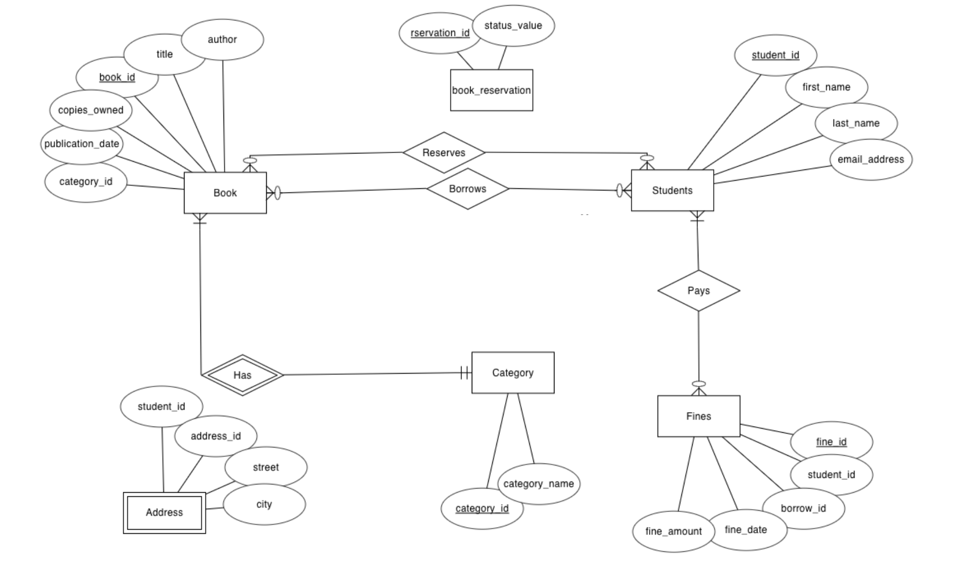
Entity-Relationship Diagram (ERD)

Slide 3
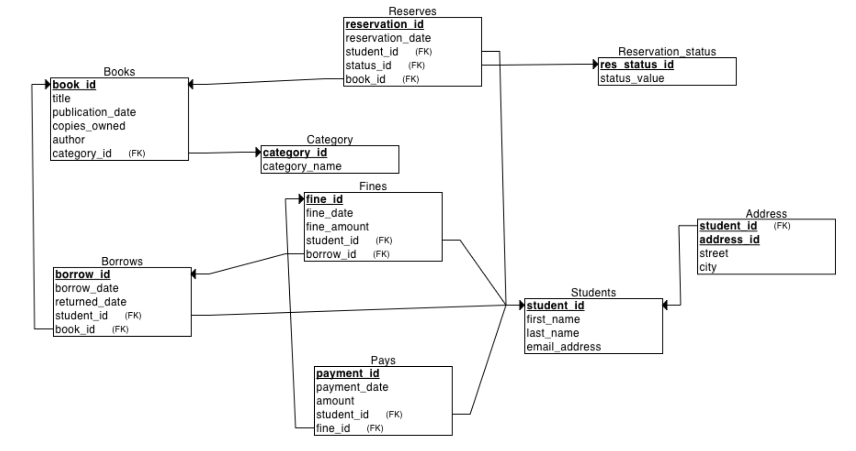
Relational Schema Diagram.

Slide 4
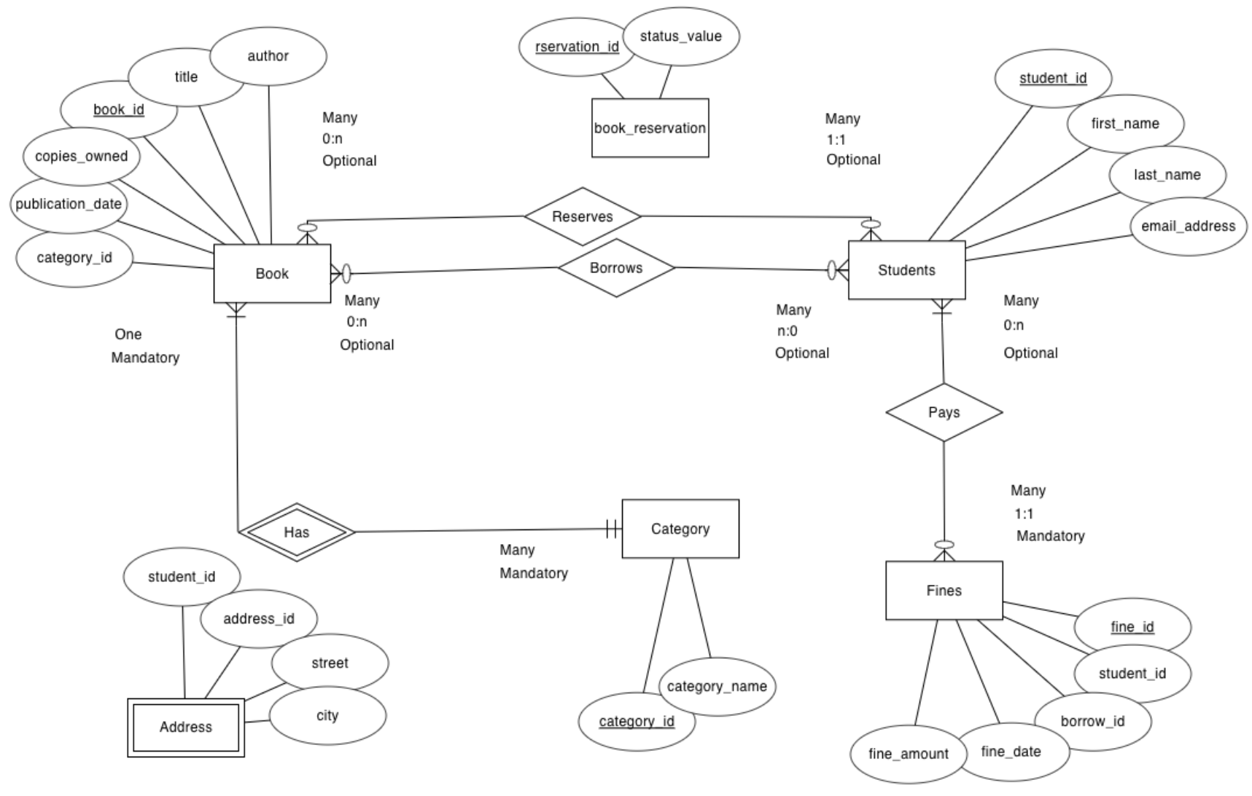
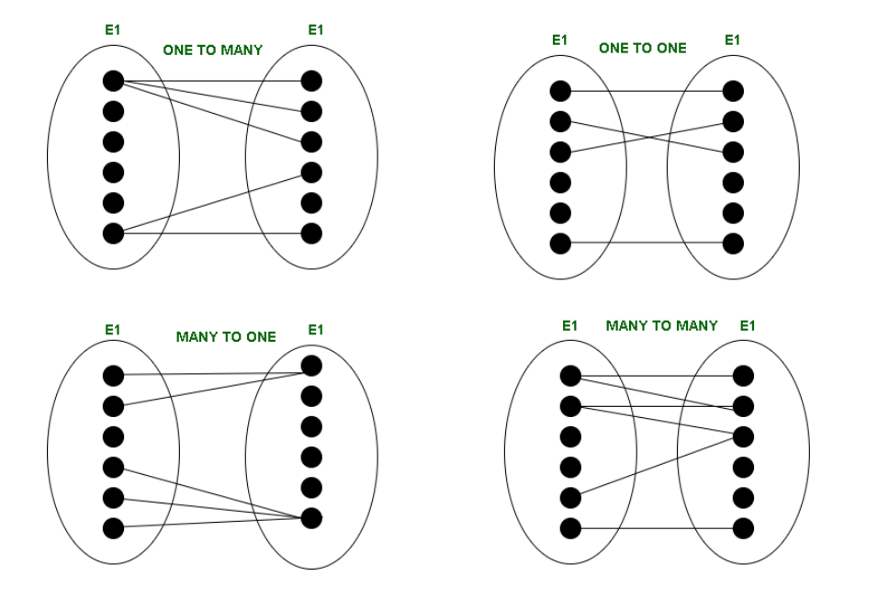
Cardinality Relationship

Slide 5
Strong and Weak Entity Sets
Strong Entity Sets:
Books
Students
Borrows
Fines
Pays
Reserves
Category
Reservation Status
Weak Entity Sets:
Address

Slide 6
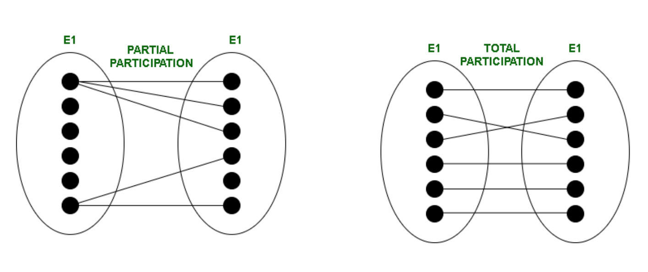
Partial and Total Participation

Slide 7
Development/Coding
Data Base
MySql
Design
HTML/EJS
CSS
Developed/Controlled
JavaScript
Let’s get into the Live Server…!

