Slide 1
Hack the Future:
A Gen AI Sprint Powered by Data

Slide 2

Guidelines
The template should consist of the following and it is mandated to be used by your team for submitting your innovative ideas/solutions. Follow file naming format: Team name_Idea Name.pptx

Slide 3




Hack the Future: A Gen AI Sprint Powered by Data
Data and AI Week
Team details
TEAM NAME: SmartPickers
Niharika Shrivastava
(Team Leader)

Slide 4
Entry Submission Summary
Idea Title (Provide a concise and impactful title for your idea.) | "Tailorly: AI-Powered Personalized Shopping for Every Style"
Team Name | SmartPickers
Problem Statement | Shoppers often struggle with finding products that match their personal style due to generic recommendations on e-commerce platforms. There is a need for an AI-driven solution that delivers personalized, data-based product suggestions to enhance user experience and satisfaction.
Proposed Solution | Tailorly is an AI-powered personalized shopping platform that analyzes user data, preferences, and behavior to deliver curated product recommendations. By leveraging machine learning algorithms and real-time analytics, Tailorly creates a unique shopping experience for each user—minimizing search effort, increasing satisfaction, and boosting conversion rates.

Slide 5
Problem statement you are trying to address
Existing e-commerce platforms provide generic product recommendations.
Users struggle to find items that match their unique tastes and preferences.
Lack of personalization leads to poor user engagement and satisfaction.
The overwhelming number of choices causes decision fatigue.
There is a need for an AI-driven solution that delivers personalized shopping experiences using user behavior and data insights.

Slide 6
Proposed Solution Overview
Brief approach description or methodology used to tackle the problem
User Profiling: Collect and analyze user data such as purchase history, browsing behavior, preferences, and style choices.
AI-Powered Recommendation Engine: Use machine learning algorithms (like collaborative filtering and content-based filtering) to generate personalized product suggestions.
Real-Time Personalization: Continuously adapt recommendations based on real-time user interactions.
Smart Segmentation: Group users into dynamic segments to deliver tailored content and offers.
Feedback Loop: Incorporate user feedback to improve recommendation accuracy over time.
Seamless UX Integration: Embed AI suggestions into the shopping interface for a smooth and engaging experience.

Slide 7
Technologies Used
List the key technologies, frameworks, and tools you utilized in your solution
Frontend:
HTML5 / CSS3 / JavaScript For building a responsive and interactive user interface.
React.js For dynamic component-based UI and state management.
Backend:
Node.js or Spring Boot (Java) For handling API requests and server-side logic.
Express.js (if using Node) Lightweight backend framework.
Machine Learning & AI:
Python For implementing AI algorithms.
Scikit-learn / TensorFlow / Keras For building and training recommendation models.
Pandas / NumPy For data preprocessing and manipulation.
Database:
MongoDB or MySQL For storing user data, preferences, and purchase history.
Recommendation Engine:
Collaborative Filtering
Content-Based Filtering
Hybrid Recommendation Models
Deployment & Hosting:
Firebase / Netlify / Vercel For frontend hosting.
Render / Heroku / AWS For backend and model deployment.
Version Control:
Git & GitHub For source code management and collaboration.

Slide 8
Agents' interaction design
1. User Agent
Browses, searches, and interacts with the shopping interface.
Provides inputs (likes, purchases, reviews, preferences).
Receives personalized product recommendations.
2. Data Collection Agent
Tracks user behavior (clicks, time spent, cart activity).
Gathers and stores user profile data and interaction history.
3. Recommendation Agent (AI Engine)
Processes user data using ML algorithms.
Generates real-time personalized suggestions.
Learns and adapts with each interaction.
4. Feedback Agent
Collects user feedback (thumbs up/down, ratings).
Feeds responses back to the recommendation agent to refine accuracy.
5. Admin/Manager Agent
Monitors overall system activity.
Updates inventory, handles backend configurations.
Analyzes analytics dashboards for performance metrics.
6. Product Agent
Interacts with the recommendation engine to match products with users.
Maintains metadata like categories, tags, availability, price.

Slide 9
Code structure
tailorly/
├── frontend/ # UI and client-side logic
│ ├── public/ # Static files (images, icons, etc.)
│ ├── src/
│ │ ├── components/ # Reusable UI components
│ │ ├── pages/ # Main page views (Home, Profile, Cart)
│ │ ├── App.js # App entry point
│ │ └── index.js # React root rendering
│ └── package.json # Frontend dependencies
│
├── backend/ # Server-side logic
│ ├── controllers/ # Route logic (e.g., userController.js)
│ ├── models/ # Database schemas/models
│ ├── routes/ # API endpoints
│ ├── services/ # Recommendation engine & ML
│ ├── app.js # Main backend app entry
│ └── config/ # DB & environment configs
│
├── ml/ # AI/ML model logic
│ ├── recommend.py # Recommendation model
│ ├── preprocess.py # Data cleaning and transformation
│ └── model.pkl # Trained model file
│
├── database/ # DB scripts or backups
│ └── init.sql # Table creation or seed data
│
├── .env # Environment variables
├── README.md # Project overview
└── package.json / pom.xml # Backend dependencies (Node/Java)

Slide 10
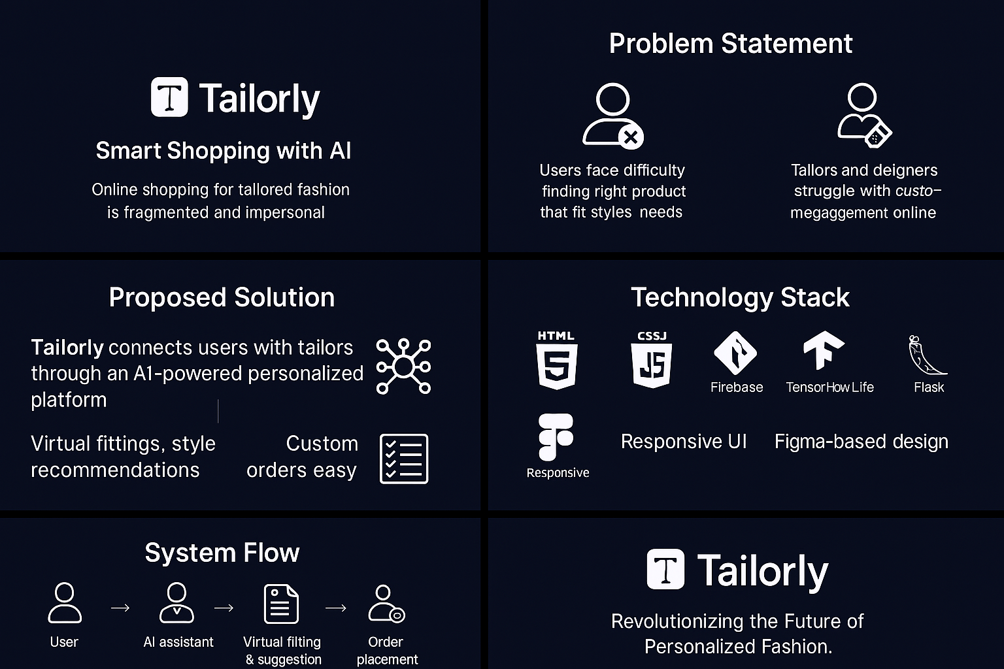
Demo video

Slide 11
Conclusion
Summarize the impact and effectiveness of your solution. Reiterate how it solves the problem statement.
Tailorly revolutionizes the online shopping experience by introducing AI-powered personalization, ensuring users receive fashion suggestions that truly match their style, size, and preferences. By bridging the gap between tailors and customers through smart recommendations and virtual fittings, our solution solves the core problem of impersonal, overwhelming product choices in e-commerce.
With real-time feedback, machine learning models, and user-centric design, Tailorly not only enhances customer satisfaction but also empowers local tailors and fashion retailers to engage more meaningfully with their audience.
In essence, Tailorly makes shopping smarter, simpler, and truly personal.

Slide 12
References/Other details
Research & Inspiration
McKinsey – The State of Fashion Report
Statista – Global Online Shopping Trends
Academic papers on personalized recommendation systems and AI in retail
Technologies Referenced
React.js, Node.js / Spring Boot
Firebase / MongoDB / MySQL
Scikit-learn, TensorFlow for ML models
Figma for UI/UX design prototyping
GitHub for version control and collaboration
Tools Used
Canva, PowerPoint, and Figma – for demo visuals and UI mockups
VS Code, IntelliJ – for development
Python Notebooks – for ML model development
Google Colab – for AI experimentation and testing

Slide 13
Thank You

