Slide 1
Abstract
Primary eye care providers refer glaucoma patients
This finding challenges the assumption that explanations alongside AI suggestions will improve clinicians’ performance, as observed in previous healthcare AI evaluations27, and underscores the challenges of designing explanations for AI support under knowledge imbalance.
Optometrists are frontline service providers and a key part of the main screening force for glaucoma, trained to detect visual defects, damage symptoms, and ocular illnesses or abnormalities, and to provide referrals to ophthalmologists or other specialists when necessary6.
Their scope of practice includes diagnostic imaging and instrumentation covering both anterior and posterior segments of the eye7.

Slide 2
Glaucoma is a chronic progressive optic neuropathy that can
Glaucoma is a chronic progressive optic neuropathy that can cause vision loss and blindness by damaging the optic nerve head (ONH) and retinal nerve fiber layer (RNFL).
This condition encompasses multiple subtypes, with open-angle glaucoma being the most common form.
It is often associated with elevated intraocular pressure due to impaired fluid drainage, although damage can also occur at normal pressures; vision loss typically begins peripherally, progresses silently over time and cannot be recovered.
Glaucoma assessment and progression monitoring relies on multiple sources of data that include measurements of intraocular pressure (IOP), visual function via visual field (VF) tests, and ONH changes via optical coherence tomography (OCT)1.
Because structural and functional damage coexist in glaucoma but may not occur at the same time3, clinicians tend to interpret both sources of data when managing glaucoma suspects of patients with glaucoma.
Given the complex interplay of structural and functional changes and the variability within the disease diagnosis, specialized clinical interpretation is required to synthesize this complementary information.

Slide 3
Despite this broad clinical capacity, studies have shown con
Despite this broad clinical capacity, studies have shown considerable variability in how optometrists screen for glaucoma6,8,9, reflecting differences in protocols, thresholds, and referral practices.
While ophthalmologists are equipped to manage and treat advanced eye disease, including surgical interventions, many do not undergo additional fellowship training in glaucoma care specifically10.
As eye care delivery continues to adapt to rising demand and technological advancement, artificial intelligence (AI) through data-driven decision support tools may be a key enabler to empower these providers to make more informed, timely and accurate referral decisions.
Introducing AI creates various issues: On the one hand, specialist AI may be precisely tailored for glaucoma referral tasks and achieve high performance.
On the other hand, while the AI may handle multimodal data11, including VF and OCT, AI models only process a subset of all available data and context due to rigid problem formulations.
Further, machine and deep learning-based AI, most commonly used in contemporary AI, can exploit spurious correlations, ignore task-relevant features, or learn data shortcuts12, leading to AI-specific mistakes a human would be highly unlikely to make.
Indeed, primary eye care providers excel in common sense reasoning, understand the pathophysiology of ocular diseases, and have experience managing a range of eye conditions13, making them robust to statistical fallacies and other unexpected behaviors AI may fall victim to.
However, on their own, providers may not perform at a similar level to task-trained AI, allowing for improvements in the human-AI team performance by leveraging AI support to incorporate insights from specialists and identify patterns not quickly apparent during a patient encounter.
This scenario of specialist AI aiming to support generalist providers in enhancing decision-making then creates a knowledge imbalance.
Designing AI for effective collaboration in knowledge imbalance scenarios presents challenges like communication barriers, trust, and coordination14.
For instance, when humans perform worse than AI, they often struggle to determine when to trust the algorithm or rely on their judgment, leading to lower overall performance than AI alone.

Slide 4
To investigate this potential, we envision a human-AI teamin
To investigate this potential, we envision a human-AI teaming experience that assists providers with referral decisions by offering AI recommendations with explanations based on a suite of XAI algorithms that predict the need for glaucoma surgery and determine referral urgency from routine eye care data.
We incorporated explainability into a Vision Transformer model in a post-hoc manner by computing local feature contributions.
Intrinsic explainability was provided by a risk scorecard model, which broke down the predicted urgency score.
Figure 1 shows the different types of AI support for referrals.
On a test set of 500 patients, our black-box post-hoc and intrinsically explainable models achieved an accuracy of 76% and 71%, respectively, in predicting referral urgency.
Through a user study with 87 optometrists, we explored how AI support, both with and without explanations, influences human behavior, performance, and perception in assessing the urgency of glaucoma referrals compared to an unassisted condition.

Slide 5
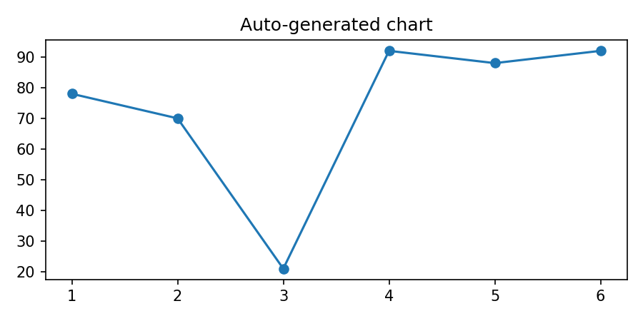
Participants also made fewer adjustments to AI-suggested ref
Auto-generated chart

Slide 6

An important consideration is that users with different leve

Slide 7
Our study design also constrained the breadth of clinical in
Our study design also constrained the breadth of clinical information available to participants.
Future work should explore incorporating additional parameters that may enhance human, AI, or human-AI performance, including family history and alternative imaging modalities such as anterior segment OCT that reveal complementary indicators, and provide more realistic contexts for referrals.
This expanded information landscape could enable different interaction paradigms between humans and AI where AI systems process narrow diagnostic context while clinicians access comprehensive clinical data, fostering a complementary distribution of knowledge.
Given the persistent knowledge imbalance challenges, future works should expand beyond explanations to explore alternative support mechanisms and their effective communication, while validating this approach through multi-center studies with diverse patient populations.

Slide 8


Positive impressions toward integrating AI support for breas

Slide 9
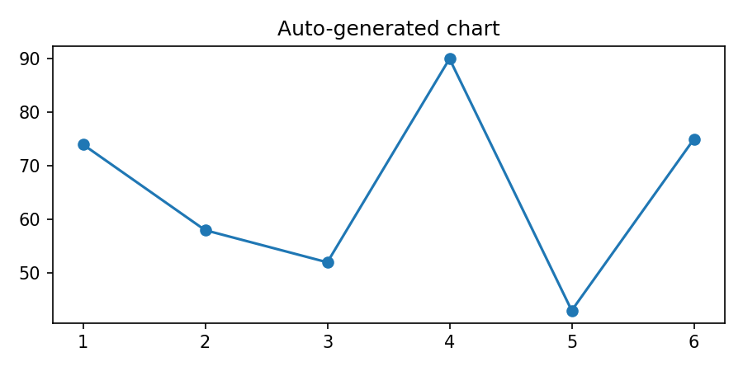
Each participant experienced all four conditions following a
Auto-generated chart

Slide 10

Agreement with AI reflects the percentage of cases in which

