Slide 1
Abstract
Primary eye care providers refer glaucoma patients
Abstract
Primary eye care providers refer glaucoma patients using their clinical experience and context.
Specialized Artificial Intelligence (AI) excels in referrals trained on clinical data but relies on assumptions that may not hold in practice.
To address this knowledge imbalance, we proposed using AI explanations to help providers assess AI predictions against their experience and improve referrals.
We developed AI models to identify patients needing urgent referrals from routine eye care data and created intrinsic and post-hoc explanations.
In a user study with 87 optometrists, human-AI teams achieved higher accuracy (60%) than humans alone (51%), but explanations did not enhance performance.
Instead, they introduced uncertainty about when to trust AI.
Post-hoc explanations increased over-reliance on incorrect AI recommendations, and both explanation types contributed to anchoring bias, making participants align more closely with AI referrals than without explanations.
Overall, human-AI teams still underperformed the AI alone (80% accuracy).
Challenges persist in designing effective support mechanisms to surpass AI performance while preserving human agency.
Introduction
Primary care providers serve as the first point of contact in healthcare, managing various health issues and referring patients to specialists for advanced treatment or diagnosis.
Prompt referrals to specialists are crucial in detecting mild- or asymptomatic conditions that still cause irreversible damage to prevent severe outcomes, like permanent vision loss and rapidly progressing glaucoma1,2.
Glaucoma is a chronic progressive optic neuropathy that can cause vision loss and blindness by damaging the optic nerve head (ONH) and retinal nerve fiber layer (RNFL).
This condition encompasses multiple subtypes, with open-angle glaucoma being the most common form.

Slide 2
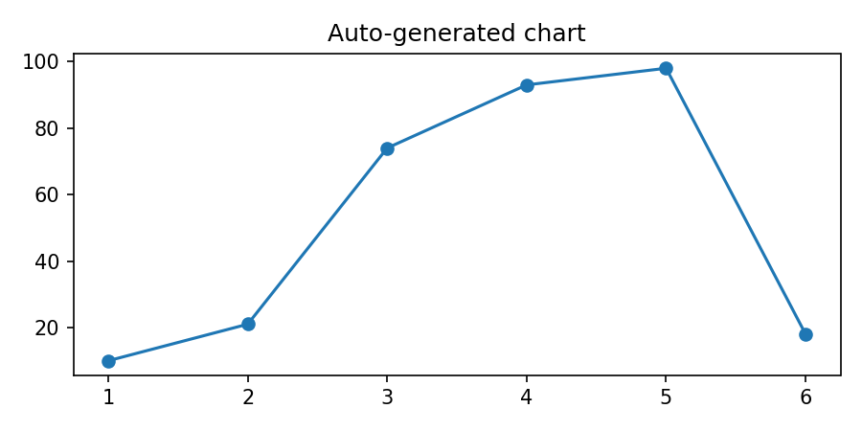
It is often associated with elevated intraocular pressure du
Auto-generated chart

Slide 3
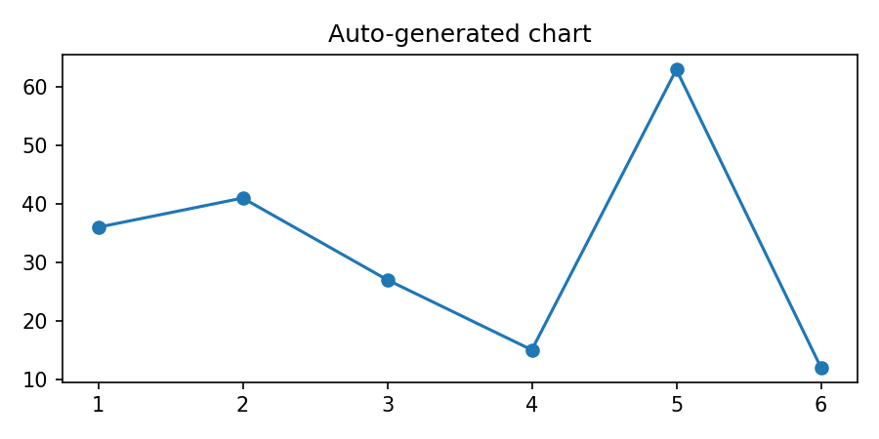
On the other hand, while the AI may handle multimodal data11
Auto-generated chart

Slide 4

Participants reviewed 20 ophthalmic patient vignettes from t

Slide 5
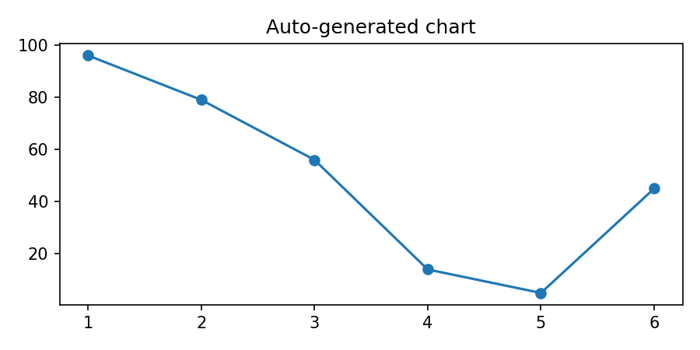
Discussion
We evaluated AI support in human-machine teams fo
Auto-generated chart

Slide 6
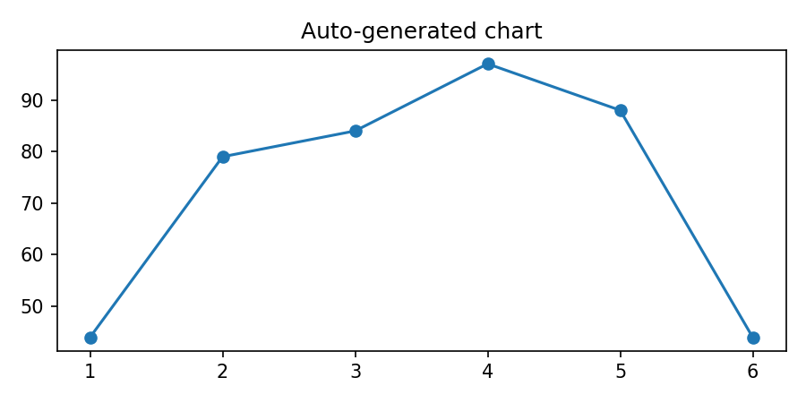
Further validation with larger samples is needed to address
Auto-generated chart

Slide 7
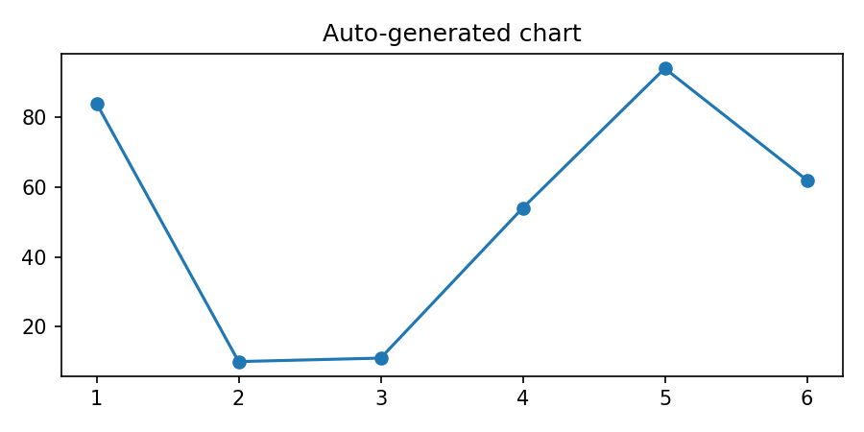
Understanding benefits of AI support over humans working ind
Auto-generated chart

Slide 8

They then assessed patient vignettes without AI support, fol

