Slide 1
Diabetes Prediction Using Machine Learning Algorithms

Slide 2
Group members Information:
Ajay Elika - 700745608
Niharika Jogi -700746159

Slide 3
Role and responsibilities and contribution in project
Ajay:
Coding and implementation. Choosing the applied algorithms, Comparing four different Models, and finding the accuracies to pick the best one.
Niharika:
Manual Testing by giving random values not in either training and testing sets and involved in the coding part. Collected the data set from PIMA and preprocessed data. Description and Documentation. Both have contributed equally i.e., 50% each

Slide 4
Motivation
Since a decade ago, the number of persons with diabetes has dramatically increased.
The fundamental cause of the rise in diabetes is human behavior. The patient must determine whether they fall into the diabetes or non-diabetic categories.
To prevent or minimize diabetes, they need to be aware of whether they are diabetic or non-diabetic.
Due to the severity of this impact, a system that would produce correct results while requiring less human work must be developed employing machine learning algorithms.

Slide 5
Objectives
The goal is to build a diabetes prediction model with a high classification accuracy.
To achieve cutting-edge techniques for diabetes early detection, advanced machine learning and predictive model techniques are used.

Slide 6
Significance
Even among young people, diabetes is a rapidly expanding disease.
Understanding what occurs in the body without diabetes is essential to comprehending diabetes and how it develops.
Our diets, notably those high in carbohydrates, are where sugar (glucose) is obtained. Everyone requires carbohydrates, including those with diabetes, as they are the body's primary source of energy.
Foods high in carbohydrates include fruit, vegetables, dairy products, bread, cereal, pasta, and rice (especially starchy vegetables). These foods are converted into glucose by the body when we eat them.

Slide 7
Significance Continued…
In the bloodstream, glucose circulates throughout the body. Some of the glucose is transported to our brains to help us think clearly and function.
The remainder of the glucose is transported to our body's cells for energy, as well as to our liver, where it is stored as energy to be used later by the body.
Insulin is required for the body to use glucose for energy. Insulin is a hormone that is produced in the pancreas by beta cells.

Slide 8
Significance Continued….
Insulin functions similarly to a door key. Insulin binds to cell doors and opens them, allowing glucose to flow from the bloodstream through the door and into the cell.
Being aware of diabetes in the early stages can help people to take the precautions

Slide 9
Related Work
Ioannis Kavakiotis, Olga Tsave, Athanasios Salifoglou, Nicos Maglaveras, Ioannis Vlahavas and Ioanna Chouvarda have proposed different Machine Learning and Data Mining Methods in Diabetes Research[1].
Diabetes is a deadly disease that distorts the body’s regularities. In this survey, the authors proposed a systematic review of applications of machine learning, and data mining methods with respect to different aspects like Prediction and Diagnosis, Diabetes Complications, Genetic Background, Environment, and Health Care and Management

Slide 10
Related work continued…..
Machine learning and artificial intelligence-based Diabetes Mellitus detection and self-management is the systematic review done by Jyotismita Chaki, S.K Cidham, S. Ananda Theeratan and S. Thillai Ganesh.
They have addressed Diabetes Mellitus as unregulated diabetes that causes multi-organ failure in patients. In this survey they have mentioned that they have defined different artificial intelligence algorithms are better indications of diabetes mellitus compared to the manual diagnosis based upon a review of 107 main publications from the Scopus and PubMed repositories.

Slide 11
Related work continued…..
A complete review of Machine Learning and Artificial Intelligence techniques K-nearest neighbor classifier, Naïve Bayes, Support Vector Machine, Linear Discriminant Analysis, Decision Trees, Random Forest, Deep Learning, Ensemble learning classifiers, Fuzzy based methods and other unsupervised classifiers is based on analysis on different performance metrics.

Slide 12
Problem Statement
Diabetes is a dangerous disease that has a continuous effect on the human health condition.
Our body breaks the food that we eat into sugar and releases it into the bloodstream. Pancreas release insulin which releases sugar into the body cells whenever the sugar content goes up.
With diabetes our body cannot generate enough insulin and which results in the accumulation of sugar in the bloodstream.

Slide 13
Some of the usual symptoms of diabetes.
Feeling weak
Tired
Thirsty than usual.
Weight Loss and urinating often.

Slide 14
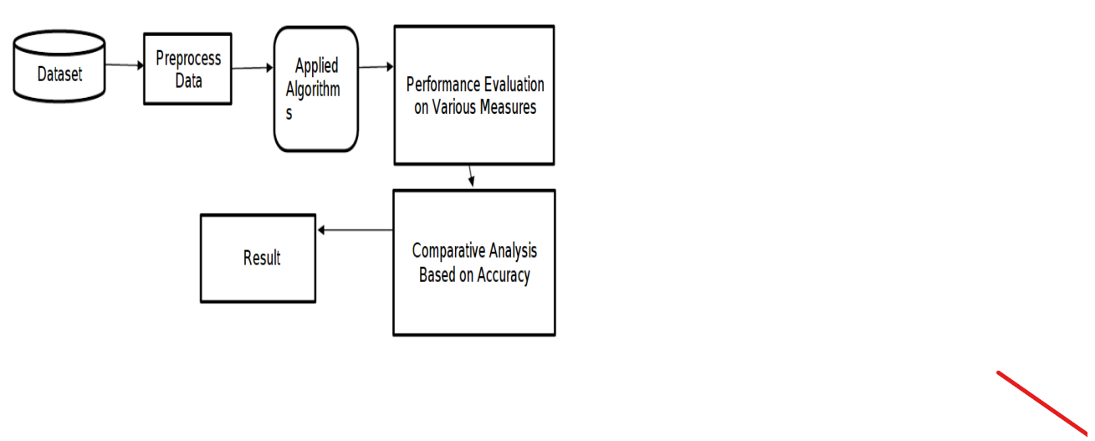
Model Diagram

Slide 15
Features
Number of pregnancies
Glucose level
Blood Pressure
Skin thickness
Insulin
Body Mass Index
Diabetes Pedigree Function (Genetic relationships of the patient)
Age

Slide 16
Algorithms used
Logistic Regression
K nearest neighbor
Random Forest Classifier
Support Vector Machine

Slide 17
Algorithms Used Continued…..
Each machine learning algorithm has its own way of learning from data. So, we can predict which method perfectly fits.
We can do it by calculating the accuracy of the models. In this case, by predicting diabetes correctly with high accuracy we can help people to identify the symptoms before having any severe effect on their health.
So, that we can help people to take necessary precautionary measures by predicting the possibility of diabetes using machine learning models

Slide 18
Data Set Used
A benchmark PIMA Indian Diabetes dataset is used for experimental evaluation. A binary dependent (outcome) parameter and numerous medical parameters make up PIDD.
This dataset primarily includes females, and The dataset is described as follows.
9 columns, each with 8 independent parameters and 1 outcome parameter, uniquely identify 768 observations, of which 268 are positive for diabetes (1) and 500 are negative (0)

Slide 19
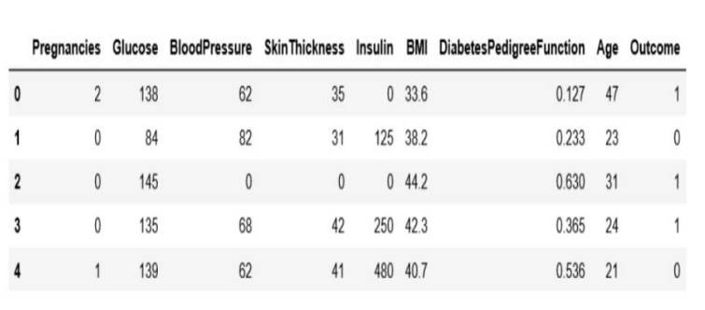
Data Set Continued….
The diabetes data set contains 2000 data points, each with 9 features.
The feature we will predict is "outcome," where 0 means no diabetes and 1 means diabetes.

Slide 20
Proposed Solution
Machine Learning Algorithms can make predictions based on their previous experience.
Consequently, we can accurately determine whether a person has diabetes by training a machine learning model using medical data that includes both healthy and diabetic individuals.

Slide 21
Results
By giving the following information about the person
Number of pregnancies, Glucose level, Blood Pressure, Skin thickness,
Insulin, Body Mass Index, Diabetes Pedigree Function, Age.
Our project predicts whether the person is having diabetes or not based on the previously given data.

Slide 22
References
Ioannis Kavakiotis, Olga Tsave, Athanasios Salifoglou, Nicos Maglaveras, Ioannis Vlahavas, Ioanna Chouvarda. Machine Learning and Data Mining Methods in Diabetes Research (2017). Computational and Structural Biotechnology Journal 15 (2017) 104-116.
Jyotismita Chaki, S. Thillai Ganesh, S.K Cidham, S.Ananda Theerthan. Machine learning and artificial intelligence based Diabetes Mellitus detection and self-management: A systematic review (2022).
Tannu Chauhan, Surbhi Rawat, Samrath Malik, Pushpa Singh. Supervised and Unsupervised Machine Learning based Review on Diabetes Care

Slide 23
References Continued…..
Md. Faisal Faruque, Asaduzzaman, Iqbal H. Sarkar, Performance Analysis of Machine Learning Techniques to Predict Diabetes Mellitus.
Lejla Alic, Hasan T. Abbas, Marelyn Rios, Muhammad AbdulGhani, and Khalid Qaraq e. Predicting Diabetes in Healthy Population through Machine Learning(2019) IEEE 32rd international Symposium on Computer Based Medical Systems(CBMS).
Juncheng Ma, Machine Learning Predicting Diabetes in the Early Stage (2020) 2nd International Conference on Machine Learning, Big Data and Business Intelligence(MLBDBI).

Slide 24
References Continued…..
Priyanka Sonar and Prof . K .JayaMalini. Diabetes Prediction Using Different Machine Learning Approaches (2019) IEEE.
Wu, Xindong; Kumar, Vipin; Ross Quinlan, J.; Ghosh, Joydeep; Yang, Qiang; Motoda, Hiroshi; McLachlan, Geoffrey J.; Ng, Angus; Liu, Bing; Yu, Philip S.; Zhou, Zhi-Hua (2008-01-01). "Top 10 algorithms in data mining". Knowledge and Information Systems.
Qin, J. and He, Z.S., 2005, August. A SVM face recognition method based on Gabor-featured key points. In Machine Learning and Cybernetics, 2005. Proceedings of 2005 International Conference on. IEEE

Slide 25
Thank You

