Slide 1
SLEEP-AWARE DIGITAL TWIN
NightWatch
Modeled next-24-hour hypertension episode risk for clinician review
Synthetic-data research prototype for decision support
Home cuff readings define the target. Wearables provide context only. This is not a diagnosis or treatment recommendation.
Ramdeobaba University, Nagpur | Team details to be completed by the team
Notes:
Sources: README.md; docs/model_card.md. All patient records and outcomes shown by NightWatch are synthetic.

Slide 2
01 / PROBLEM AND USE CASE
Clinical use case
Review home blood-pressure readings alongside recent synthetic EHR and wearable context when considering near-term hypertension risk.
NightWatch presents a modeled estimate for a hypertensive episode in the next 24 hours. The episode label is next-day systolic BP >= 140 mmHg or diastolic BP >= 90 mmHg.
The clinician reviews the estimate, measured cuff history, trends, and alerts, then decides whether follow-up is appropriate.
The home cuff is ground truth; a watch does not measure BP in this prototype.
NIGHTWATCH | SYNTHETIC DATA ONLY | NOT A MEDICAL DEVICE
Notes:
Sources: README.md; docs/data_dictionary.md. All patient records and outcomes shown by NightWatch are synthetic.

Slide 3
02 / STATIC EHR AND DYNAMIC CONTEXT
Data used by the synthetic twin
STATIC EHR
DYNAMIC CONTEXT
Demographics, prior diagnoses, laboratory results, medications, and family-history fields.
Simulated sleep stages, HRV, steps, resting heart rate, and medication timing.
LABEL SOURCE AND LIMITATION
Labels come from simulated next-day cuff readings generated from a hidden latent risk score that includes sleep debt, HRV drop, activity, and stress. This partly circular setup measures recovery of simulator assumptions, not evidence on real patients.
NIGHTWATCH | SYNTHETIC DATA ONLY | NOT A MEDICAL DEVICE
Notes:
Sources: README.md; data/README.md; docs/data_dictionary.md. All patient records and outcomes shown by NightWatch are synthetic.

Slide 4
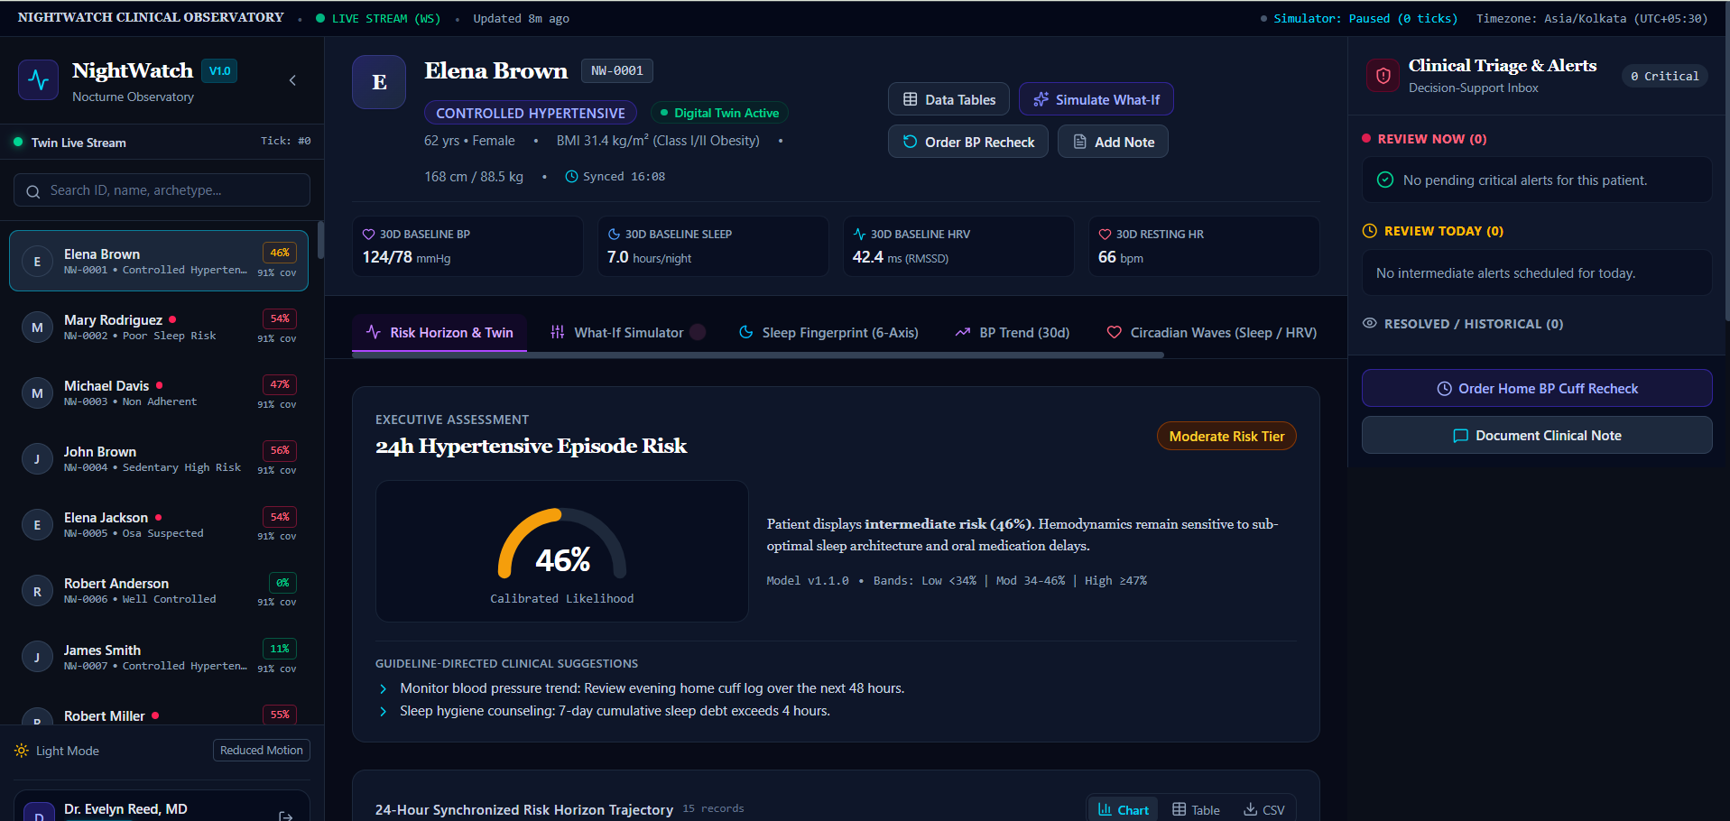
03 / PROTOTYPE
Clinician dashboard
Example clinician session on synthetic records; displayed values are specific to this demo session.
NIGHTWATCH | SYNTHETIC DATA ONLY | NOT A MEDICAL DEVICE
Notes:
Sources: User-provided clinician dashboard screenshot; README.md. All patient records and outcomes shown by NightWatch are synthetic.

Slide 5
04 / PATIENT-GROUPED FIVE-FOLD CV
Model evaluation
POOLED OUT-OF-FOLD ROC-AUC
FIVE-FOLD MEAN ROC-AUC
0.7751
0.8143 +/- 0.0283
Patient-cluster 95% CI: 0.7338 to 0.8155
A separate quantity from pooled out-of-fold AUC
POOLED OUT-OF-FOLD PR-AUC
These results are measured on synthetic data. They are not external validation and do not establish clinical performance.
0.5194
NIGHTWATCH | SYNTHETIC DATA ONLY | NOT A MEDICAL DEVICE
Notes:
Sources: ml/artifacts/metrics.json; docs/evaluation_report.md; docs/model_card.md. All patient records and outcomes shown by NightWatch are synthetic.

Slide 6
05 / HELD-OUT TEST COUNTS
Threshold operating points
Operating point | Threshold | Sensitivity | Specificity | Precision | False alerts / patient-week | TP / FP / TN / FN
Moderate | 0.34 | 69.9% | 70.4% | 42.5% | 1.580 | 525 / 711 / 1688 / 226
High | 0.47 | 36.8% | 91.7% | 58.0% | 0.444 | 276 / 200 / 2199 / 475
FEATURE ABLATION / FOLD-MEAN PAIRED ROC-AUC DIFFERENCE +/- SD
Tier 2 (EHR+BP) vs Tier 1 (EHR): +0.1671 +/- 0.0405; wins 5/5
Tier 3 (+Sleep/HRV) vs Tier 2 (EHR+BP): +0.0035 +/- 0.0093; wins 3/5
Tier 4 (Full Twin) vs Tier 3 (+Sleep/HRV): -0.0016 +/- 0.0039; wins 2/5
NIGHTWATCH | SYNTHETIC DATA ONLY | NOT A MEDICAL DEVICE
Notes:
Sources: ml/artifacts/metrics.json; ml/artifacts/thresholds.json; docs/evaluation_report.md. All patient records and outcomes shown by NightWatch are synthetic.

Slide 7
06 / PAIRED COMPARISON: EHR + BP VS EHR + BP + SLEEP/HRV
Wearable value under sparse cuff readings
BP availability | Fold-mean dAUC +/- SD (n=5) | Wins / 5 | Pooled OOF dAUC | Pooled bootstrap mean [95% CI] | Fold t-test p | Conclusion
Daily | +0.0035 +/- 0.0093 | 3/5 | +0.0040 | +0.0042 [-0.0093, +0.0166] | 0.4891 | not supported
2–3 readings/week | +0.0186 +/- 0.0222 | 4/5 | +0.0360 | +0.0364 [+0.0165, +0.0579] | 0.1689 | suggestive (CI excludes 0 but fold evidence weak)
1 reading/week | +0.0474 +/- 0.0386 | 4/5 | +0.0620 | +0.0619 [+0.0292, +0.0960] | 0.0702 | supported
Wearable gain is supported only when wins are >=4/5, the pooled patient-cluster CI excludes zero, and the fold t-test p-value is <0.10. Otherwise the evidence is suggestive or not supported.
NIGHTWATCH | SYNTHETIC DATA ONLY | NOT A MEDICAL DEVICE
Notes:
Sources: ml/artifacts/metrics.json; docs/evaluation_report.md. All patient records and outcomes shown by NightWatch are synthetic.

Slide 8
07 / RESPONSIBLE USE
Interpretation and limits
NightWatch is a synthetic research prototype for decision support, not a diagnostic tool or medical device.
The labels are partly circular and generated from simulator assumptions. The evaluation has no external or clinical validation. What-If results are modeled associations in synthetic data, not treatment effects. No real wearable integration, CGM, or genetic markers are included.
Use measured home cuff history as the source of BP truth; treat wearable signals as context only.
NIGHTWATCH | SYNTHETIC DATA ONLY | NOT A MEDICAL DEVICE
Notes:
Sources: README.md; docs/model_card.md; docs/model_card.md. All patient records and outcomes shown by NightWatch are synthetic.

