Slide 1
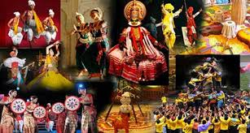
Art and culture -Ishani Pandya

Slide 2
Slides are available on mrunal.org

Slide 3

Importance in exam
prelims
2013-16 MARKS
2014-30 MARKS
2015-10 marks
Mains examination-APPROX 20-30 MARKS EACH YEAR

Slide 4
Difference between art and culture
Art
culture
Art is the creative expression of one’s experiences, emotions and other qualities
Art is one aspect of culture.
Art is influenced heavily by culture and is born as a by-product of culture, reflecting some of its customs, beliefs and values.
it comprises a wide variety of human behaviours
The evolved human capacity to act creatively and imaginatively and represent and classify experiences with symbols
Culture is the ensemble of social forms, material traits, customary beliefs, and other human phenomena that cannot be directly attributed to a genetic inheritance of a religious, racial, or social group.

Slide 5
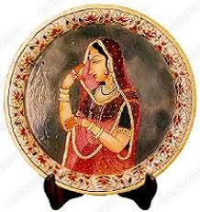
Understanding of Indian art
architecture has been described as an art of organizing space, functionally and beautifully.
The character of Indian art is best described as plastic, organic and sculptural
Also in ancient India, the arts were not separated as they unfortunately are today the architect; the sculptor and the painter were often one man.

Slide 6
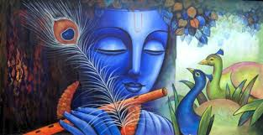
Qualities of Indian artists
If the Greeks excelled in the portrayal of the physical charm of the human body, the Egyptians in the grandeur of their pyramids and the Chinese in the beauty of their landscapes, the Indians were unsurpassed in transmitting the spiritual contents into their plastic forms embodying the high ideals and the common beliefs of the people.
Indian artists visualized the qualities of various gods and goddesses as mentioned in their scriptures and infused these qualities into their images whose proportions they based on the idealized figures of man and woman.
There were two qualities about which the Indian artists cared more than about anything else, namely, a feeling for volume and vivid representation, even at the risk of sacrificing, at times, anatomical truth or perspective.
Indian art is a treasure house of ancient contemporary life, its faiths and beliefs, customs and manners.

Slide 7
Introduction
We can divide the subject in three parts for our convenience.
1.Visual arts
2.Performing arts
3.Miscellenous arts

Slide 8
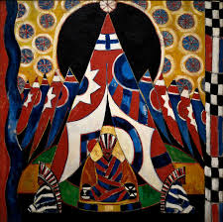
1.Visual arts
architecture
sculpture
pottery
painting

Slide 9
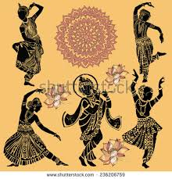
2.Performing Arts
Indian Music
Indian puppetry
Indian circus
Dance forms
Indian theatre & drama

Slide 10
3.Miscelleneous Art forms
Religion
Medicine, astronomy
Language
Literature
cinema
calendars
philosophy
festivals
fairs
Handicrafts coinage
institutions
maths &science

Slide 11
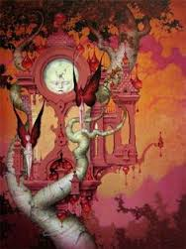
Visual arts
1.Indian Architecture
2.Indian Sculpture

Slide 12
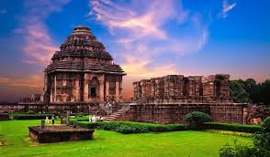
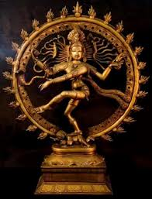
Architecture Sculpture

Slide 13
comparison
Architecture
sculpture
Art of designining and making buildings
Different types of materials are used
Requires engineering skill
architecture involves aesthetic appeal.
ie.Taj mahal,konark temple
Art of designing 3D figures
Single material is used.
Engineering skill not necessary.
Sculpture involves creative appeal.
Ie.bronze dancing girl of mohenjodaro,nataraj idol

Slide 14
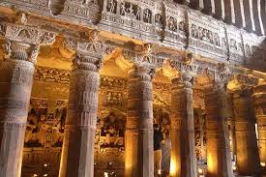
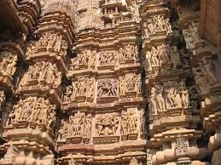
Combination of architecture and sculpture

Slide 15
Indian Architecture and sculpture
Temple architecture(Gupta age sculpture & south Indian art)
Indus valley civilization
Buddhist architecture & sculpture (mauryan period)
Indo-Islamic architecture and medieval sculpture
Modern architecture and sculpture

Slide 16
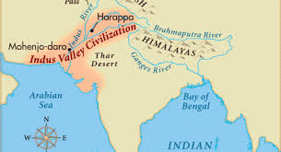
1.Indus valley civilization
Architecture
1.Town planning
2.Public bath
3.Granaries
4.dockyard
Sculpture
1.Bronze and terracotta sculpture
2.Seals
3.Stone sculpture
Miscelleneous
1.Ornaments
2.pottery

Slide 17
Indus valley architecture
Indigenous art
No influence of outside.
Different from ancient and medieval architecture.
No integral use of sculpture.
Concentration on utility factor rather then artistic factor.
(Decorative embellishment may have been lost over time)

Slide 18
Town planning
3rd milleneoum B.C.
On and around Indus river bank.
Walled cities for security.
No evidence of temples or any religious structure.
Burnt brick was widely used
roads were wide and at right angles to one another-rectangular grid pattern of layout
Existence of assembly halls,workshops,hostels and market place

Slide 19
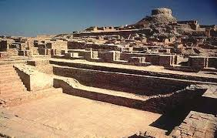
Two parts of the town
1.citadel-upper part-for elite class
-dominant citadel suggests some kind of political authority.
2.non-citadel-lower part-for common people

Slide 20
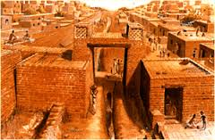
Houses
Built of begged clay
Fixed size
Use of stone and wood
Included bath,upper-storeys and wells.
Evidence of big buildings-public buildings or administrative or business centre.-pillared halls and courtyard.

Slide 21
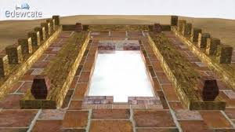
Public bath
Tank type,stairs
Small rooms along with the bath.
Importance of ritual bathing.
Importance of cleanliness.
Ie.The great bath of mohe-jo-daro.
Still functional. No leakages or cracks

Slide 22
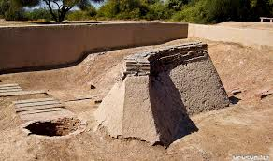
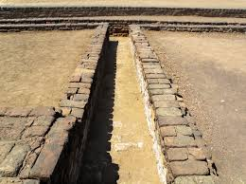
Granaries
Found in citadel
Intelligent construction-strategic air ducts and platform
Drainage system
Almost like modern system
Temporarily covered drains-cleaning purpose

Slide 23
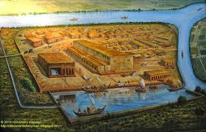
Dockyard of Lothal
The dockyard was located away from the main current to avoid deposition of silt.
It is speculated that Lothal engineers studied tidal movements, and their effects on brick-built structures, since the walls are of kiln-burnt bricks.
The dock, with a canal opening to allow water to flow into the river, thereby maintaining a stable water level.
The dock also possessed a lock-gate system—a wooden door could be lowered at the mouth of the outlet to retain a minimum column of water in the basin so as to ensure floatation at low tides.

Slide 24
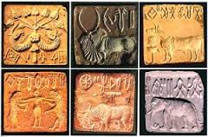
Indus valley sculpture
Seals
square or rectangular,circular and few are cylindrical piece of stone
Average size-2*2 inches
Stone-soft riverstone- statite,copper and terracotta
Decorated with animal motifs-except cow
Pictographic script on both sides of the seals
Some gold, silver and ivory seals.

Slide 25
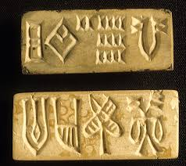
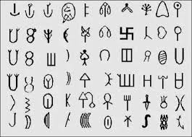
script
Script-pictographic
-along with animal impressions which are yet to be deciphered.
-direction of writing-right to left.

Slide 26
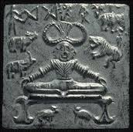
Seal of pashupati
This seal shows a seated figure of a Yogi, probably Shiva Pashupati, surrounded by four animals - a rhino, a buffalo, an elephant and a tiger. There are two deer shown under the throne. Pashupati means the lord of animals.
religion of the Harappan age
Most of these seals have a knob at the back through which runs a hole and it is believed that they were used by different guilds or merchants and traders for stamping purposes.

Slide 27
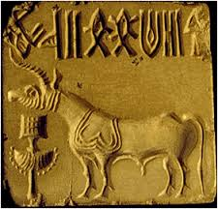
Purpose of the seal
Unit of trade and commerce-found in Mesopotamia
Copper seal-as an immolate
-proof-some seals had small hall in upper side.
As an education tool-pie is shown in one seal.
Examples-pashupati seal-lord shiva type deity
-Unicorn seal-bull

Slide 28

Terracotta sculpture
The sculptor at Mohenjodaro was adept in his art and could fashion both realistically as well as stylistically.
Technique-hand-made
Pinching method
Famous figures—
Mother Goddess-
from mohenjo-daro
Worshipped for fertility and prosperity

Slide 29
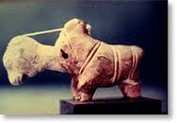
Toy carts-The toy animal, with a moveable head
Birds and animals
Terracotta figure of a bull- shows the study of anatomy
The pair of squirrels - in a very natural and characteristic fashion seated on their haunches and nibbling at some fruit.

Slide 30
Bronze sculpture
Technique-lost wax method (cire perdue)
Used for bronze casting
At first the wax figures are covered with the coating of clay
Then allowed it to dry.
Then it is heated and the molten wax is allowed to drain out through a tiny hall at the bottom of clay curve.
The hollow mould is then filled with bronze or any other metal.
Once the metal is cooled, the clay is removed.

Slide 31
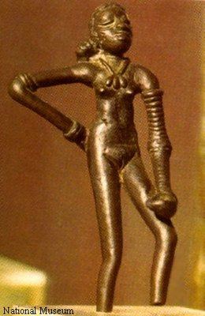
Major sites-kalibangan,Harappa,Diemabath
Bronze Dancing girl
Found at Mohenjo-Daro
Naked sculpture-a naked woman only wearing ornaments
Bengles,necklace,emulates and a particular hair-style
figure shows a female dancing figure standing as if relaxing after a dance number, with her right hand on her hip and the left dangling free.

Slide 32
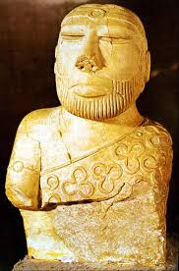
stone Sculpture
Bearded priest
from Mohenjodaro
weaving a shawl with trefoil pattern.
It bears a close resemblance to a similar figure discovered in the Sumerian sites of Ur and Susa.
Male torso-made of red limestone.
From Harappa
remarkable for its naturalistic pose and sophisticated modelling, highlighting its physical beauty.
The head and arms of this figure were carved separately and socketed into the drilled holes of the torso.
The figure of a male dancer belonging to the same period and discovered at Harappa

Slide 33
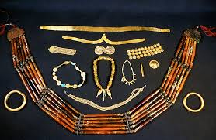
Ornaments
Use of ornaments by both male and female
Large variety of material-bne,precious metal,gem stone,begged clay
Some unisex ornaments-necklace,armlets etc.
Evidences of dead bodies with ornaments.
Spinning of cotton and wool.
Consciousness of fashion.
Cillabar was used as a cosmetic
Variety of cosmetics-lipstick ,eye-liner,face paint

Slide 34
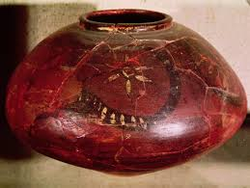
Pottery
Red and black pottery.
Use of 2 colours-red and black
background color –red color
To draw some design –black color
Hence the name black and red pottery.
Not hand made but wheel made ware.
Some plain pottery which was more common.
Some painted pottery.

Slide 35
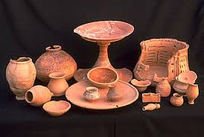
Use of pottery
Household purpose
For decoration purpose-
proof-some very small sized pottery.
can’t be used for household or storage purpose
Perforated pottery-for straining liqueur.

Slide 36
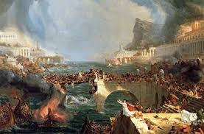
End of Indus valley civilization
The Indus civilization came to an end in about C.1500 B.C. probably due to the Aryan invasion of India.
Except for some antiquities of the copper hoard culture and ceramics, no trace of any plastic art is found during the next 1000 years.
This may perhaps be due to perishable materials like wood which could not withstand the rigors of time.
The carvings of flat surface, as met with at Bharhut and Sanchi, are an echo of an earlier tradition in wood or ivory.
But this intervening period of about 1000 years is important, because it was during this time that a synthesis took place between the fertility cults of the Dravidians, who were the original inhabitants of India, and the Aryan elements of rites and rituals.

Slide 37
(Q)To what extent has the urban planning and culture of the Indus valley civilization provided inputs to the present day urbanization? Discuss.
(GS-1-Mains-2014)

Slide 38
current
1Q. Examine how recent excavations of remnants of the Harappan Civilization in India have helped historians to understand Harappan culture. (200 Words)

Slide 39
The remnants are the only sources to study Harappan civilization which had flourished 3000 BCE and vanishes around 1500 BCE. Recently during excavation at Rakhigarhiin Haryana 4 skeletons and lot of terracotta’s and potteries were found.
Reconstruct facial Software and DNA test would reveal the physical structure of the harrapan people, their height and skin colours, eye colours etc.
Idli shaped terracotta found in Rakhigarhi are in more than in other harrapan sites and perhaps which shows the terracotta may be manufactured in Rakhigarhi.
The size of burial pit and the quality & quantity of goods kept with burial pit would
perhaps reveal the socio economic condition of the harrapan people.
Huge amount of painted potteries were found at the rakhigarhi site so the site may be the home of rich and dominants people of society.
Excavation near burial pits has revealed about the Burial customs and rituals, being followed

Slide 40
The chemical tests will give insight about the diet of Harrapan people and health status. The people were either vegetarian or non-vegetarian. It will also tell about the cause of death whether they died due to malnutrition.
The finding of a lot of broken pottery and charred animal remains outside the burial pits point to some ritual been done before the body was placed inside the pit at Rakhigarhi.
Hearths, furnaces, broken bangles and burnt bangles, all made of faience, found in the trenches at RGR-4 indicate the presence of an industrial unit there. Bangles made of shell point to the Harappans’ trade contacts with the Saurashtra region in present-day Gujarat.
Figurines of dogs with a belt around the neck show that the Harappans kept dogs. A seal with the carving of a tiger and the impression of a similar one on a "terracotta sealing" points that such seals were used for trade.
Since no evidence has been found of a Late Harappan phase having existed at Rakhigarhi, it is possible that the rivers Saraswati and Drishadvati were not active as they were during the Early and Mature Harappan phases. The Saraswati could have gone dry around 2000 BCE and so the Late Harappan people moved away from the Saraswati river banks. So the Early and the Mature Harappan sites are mostly on the banks of the Saraswati and the Drishdavati.

Slide 41
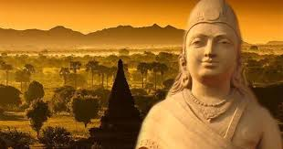
Mauryan and post-Mauryan period (Buddhist Art)
Outside influence is present-Persian and achaemenian
Court art
State initiative
Stupa, pillar
Popular art
Individual art
Sculpture,pottery,caves

Slide 42

Mauryan period
Time period- 4th-3rd centuries B.C.
Asoka, first mauryan to ‘think in stone’
Pillars
The great Buddhist Emperor Ashoka caused the erection of monolithic pillars of sandstone.
Asokan pillars were lofty free standing monolithic columns erected on sacred sites.
30 to 40 feet high, crowned by animal figures like the bull, lion and elephant
inscribed with the Buddhist concepts of morality, humanity and piety, which he wished his people to follow
Famous Ashokan pillars are from Lauriya Nandangarh in Bihar, Sanchi and Sarnath.

Slide 43
Purpose-
Symbol of state
To declare the victory
To spread the moral ideas.

Slide 44
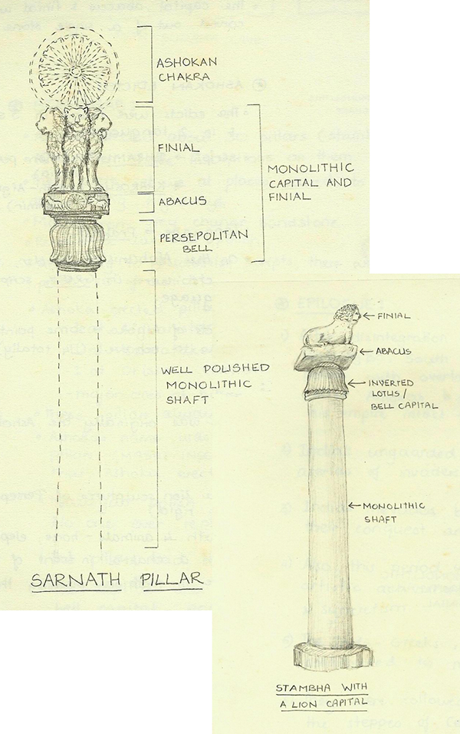
Design of the pillar

Slide 45
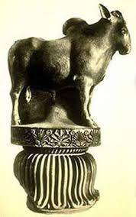
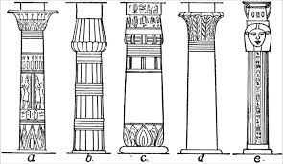
Different types of capital
a - Lotus Column (Bell) b - Lotus Column (Bud) c - Papyrus Column (Bud) d - Papyrus Column (Bell)
bell-shaped base consisting of a lotus

Slide 46
Features of Mauryan pillar
Uniformity in all pillars of Mauryan art
Chunar sandstone was used.
Monolith shaft
Use of animal
Different types of abacus-round,rectangular,square etc.
Edicts were inscribed-generally on abacus,sometimes on the shaft,too.
Achaemanian influence-Bell shaped capital
Iranian/Persian influence-clusterous/Highly polished pillars

Slide 47
Difference between Mauryan and achamanian pillars
Mauryan pillars are monolith
Achamanian pillars are made from different stones

Slide 48
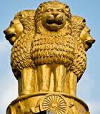
Sarnath Pillar
Most remarkable
highly polished monolithic lion-capital , which is now the Emblem of the Government of India
represents four roaring lions back to back facing the four cardinal directions.
The round abacus is decorated with four dharmachakras or wheels of law, alternating with an elephant, a bull, a horse and a lion.
alternating with an elephant, a bull, a horse and a lion, all carved with masterly skill. The abacus is supported by a bell-shaped base consisting of a lotus with dharma chakra.

Slide 49

Invested with a great power and dignity, and reveals the aristocratic and international nature of Mauryan art.
it was only Asoka who started making extensive use of stone for sculptures and great monuments whereas the previous tradition consisted of working in wood and clay .
the animals on the abacus will reveal that these animals are not static or rigid. They have been very keenly and lovingly observed in nature and are very naturalistically represented, full of life.

Slide 50
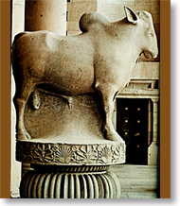
Bull capital of Rampurva, Bihar
3rd B.C.
mixture of Persian and Indian elements
lotus capital
The motifs on the abacus are beautiful decorative elements like the rosette, palmette and the acanthus ornaments-- none of them is Indian.
Bull-
master-piece of Indian craftsmanship.
a humped bull is well modelled

Slide 51
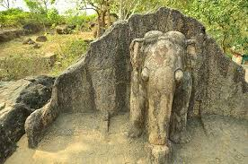
Rock-cut elephant,Dhauli,Odisha
Dhauli hill is presumed to be the area where the Kalinga War was fought.
has major Edicts of Ashoka engraved .
concern for the "welfare of the whole world".
The rock-cut elephant is above the Edicts.
the earliest Buddhist sculpture of Odisha.
The stone elephant shows the animal's foreparts only, though it has a fine sense of form and movement.
He built several chaityas, stupas and pillars there. He got abodes excavated for the recluse, instructions inscribed for officials, expounded the main principles of dandaniti for the public, provided special status to his new kingdom including the stupas at Dhauli

Slide 52
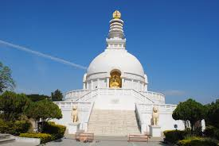
Stupa
Started during vedic period
Flourished during Mauryan period.
STUPA-
Conventional representation of funerary mound
It was once the resting place of the bones and ashes of a holy man.
In the Buddhist traditions,originally,9 stupas were constructed.
8 stupas-ashes and relics of Buddha
1 stupa-over the vessel in which such relics were originally kept.
Definition-Stupa is the Buddhist monument that is hemispherical dome with Buddha’s relics inside.

Slide 53
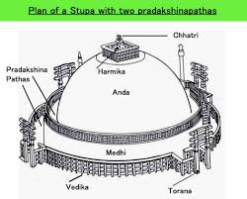
Architecture of stupa

Slide 54
Understanding of architecture of stupa
Anda-hemispherical dome
Medhi-circular base with the enclosed walls.
Toran-gateway
Vedika-upraised platform
Chhatri-3 chhatras
Represents triratna-Buddha,dharma and sangha.
Core of the stupa-unburned bricks
Outer surface-burnt bricks with lime plaster
Maximum stupas were constructed by asoka

Slide 55
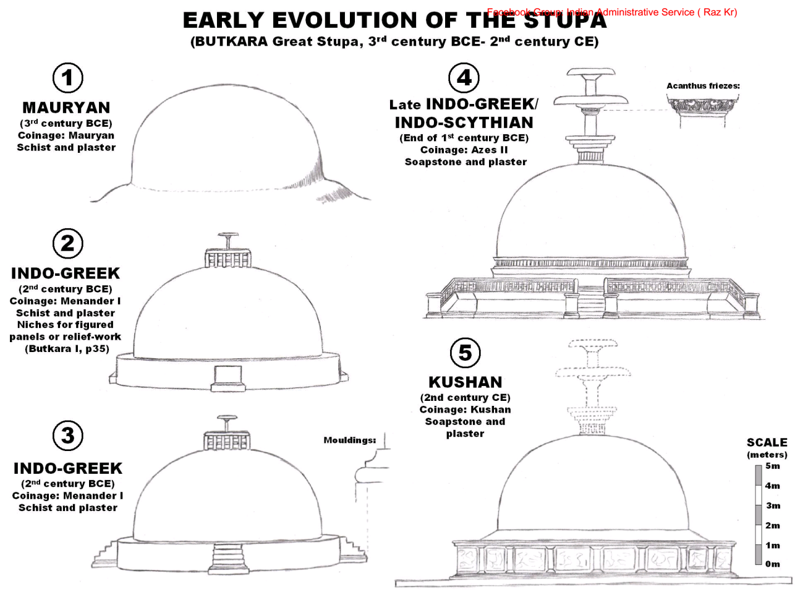
Development of stupa architecture

Slide 56
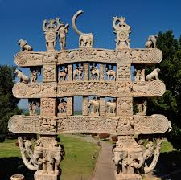
Gateway of stupas
The railing and gateways at Bharhut, Sanchi and Bodh Gaya are the most famous in the north .
at Amravati and Nagarjunakonda in the South.
Upright pillars and cross bars, based on wooden construction, were made and provided the occasion for dome of the finest low relief carvings to be found anywhere in Indian art.
On these surfaces are carved the favourite symbols of Buddhism, the lotus, elephant, bull, lion and horse and some of the Jataka stories.
depicted in low relief with such exuberant details that they are considered a land-mark in the story of Indian art.

Slide 57
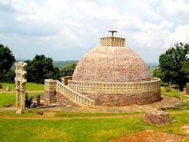
Sanchi Stupa
Hemispherical in shape,with low base.
The existing stupa at Sanchi encloses the original stupa and has been enlarged.
It is enclosed within the stone railing or balustrade, when stone was adopted in the place of wood.
a circumambulatory path as well as the stone railing with four elegantly carved gateways in the four cardinal directions were added in 1st century B.C.

Slide 58
Originally wooden umbrella-represented royalty and dignity
Later it developed in composition on top of the dome, the Harmika; a square Buddhist railing from which rises the shaft that holds the imperial umbrella, sometimes single and later on multiplied to three or even more-3 chhatras(triratna), diminishing in size as they go upwards.
Symbolized the cosmic mountain
Inscription by ivory carvers on the southern gateway-suggests the transference of stupa from wood and ivory to stone.

Slide 59
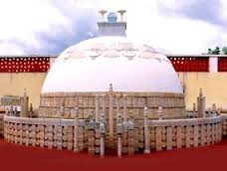
Amravati stupa
2nd or 1st B.C.
Amravati, which was the capital of the ancient Satavahana dynasty, came under influence of the Buddhist faith through the Kushanas of Mathura.
Marbles used instead of bricks and stones. its Inner side has engraving of Buddha’s life.
In later centuries it was transformed from hinayan shrine to mahayan shrine.

Slide 60
Further development of stupas at sanchi and barhut
The base,dome and hemisphere dome was sculpted.
Stupas of nagarjunkoda in Krishna valley-very large
Maha chaitya of nagarjunkoda has the base in the form of swastika-which represents the sun

Slide 61
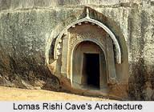
Popular art
(1)Caves
Real beginning of rock cut architecture
Ie-elephant rock cut at Dhauli,Odisha.
Mauryan caves-vihar
Post-mauryan caves-chaitya

Slide 62
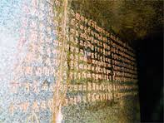
Features
(1)Artistic gateway
(2)Polishing inside the cave
7 sisters-4 caves of barabar caves+3 caves of Nagarjuni caves
Use of caves
Vihar-rest places for monks
Ajivikas-jain sect,some caves were given to the monks of this sect.

Slide 63
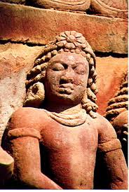
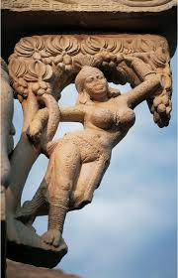
(2)Sculpture
Yaksh and yakshini sculptures
Objects of worship in folk religion
Places-yaksh-parkham in UP,pawaya in MP,
-Yakshini-Didarganj in Bihar
The sculptor in India took delight in fashioning his beautiful creations in poetic or visual metaphors in preference to direct observation.
The surface of figure bears the typical lustrous polish of the period.
striking example of Mauryan art in the 3rd century B.C. is the handsome torso of a male figure from Lohanipur. The modelling of the figure executed in a realistic manner, is invested with a wonderful vitality. It probably represents a Jain Tirthankara or a Saviour of the Digambara sect.

Slide 64
The sunga influence on Mauryan sculpture
185 B.C.
Their native style, distinguished by its simplicity and folk appeal is best represented in monolithic free standing sculptures of Yakshas and Yakshis, discovered from Gwalior and Mathura
On the pillars of barhut stupa-The figure of Chulakoka Devta - representing its indigenous character and folk quality.
Yaksha-The two amulets strung on his necklace ward off evil spirits from his devotees.
The back of his right hand bears an inscription giving the name of the sculptor

Slide 65
Yaksha and yakshini
Yaksha and yakshini figures are related to all three religions
Hinduism-reference in tamil script-shilpadhikaram
Buddhism-On the walls of stupa there are so many sculptures of yaksha.
Jainism-In the jain scripts,Every teerthankar is found to be associated with one Yakshi.

Slide 66
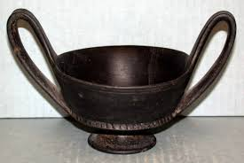
(3)pottery
Northern black polished wear
Maturity and climax in pottery making.
Some silver pottery is found.
Purpose of silver pottery-luxury wear.

Slide 67
Post-Mauryan Period
Mauryan period-climax of pillar and stupa
Post-mauryan period-climax of sculpture
3 important developments
(1)Caves
(2)Stupa
(3)sculpture

Slide 68
(1)caves
In mauryan-there were only vihars
Now 2 types of caves –
1-vihar-residence or rest places
2-chaitya-prayer halls.
For ex-Ajanta has 29 caves-4 chaitya and 25 vihar.
Famous caves of this period-
Chaitya-karle chaitya
Vihar-Nasik Vihar

Slide 69
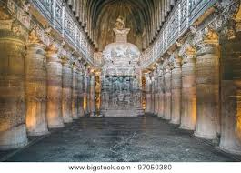
Karle chaitya
Largest Chaitya-griha among all Buddhist monuments in India
Has a huge lion pillars in front of Chaitya-griha. (only two caves have this design- Karla and Kanheri)
stupa has cylindrical drum shape
Octagone shaped pillars behind Stupa, without any decoration
has been excavated from the living rock and is unparalleled for its lofty and elevated impression

Slide 70
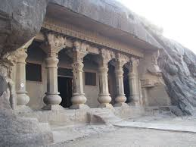
Vihars of Nasik
Also known as Pandu Leni
A group of 24 caves
representing the Hinayana Buddhist caves and has nothing to do with the characters of Mahabharata (the Pandavas).
Most of the caves are Viharas except for the 18th cave which is a Chaitya.
The caves lodge idols of Buddha and Bodhisattva.
Some caves are intricately connected by stone-cut ladders that join them to the other caves
contain interesting sculptures
The caves were called Pundru which in Pali language means "yellow ochre color”.

Slide 71
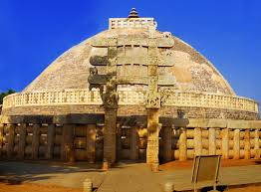
(2)stupas
Enlarged stupas compared to Mauryan period.
Gateways(torans) are now more intricately decorated.

Slide 72


Sculpture
Reached at its climax
Buddha is never represented in human form in Buddhist art before the Christian era,
The adherents of the Buddhist faith followed the Hinayana path as a means of attaining salvation.
Buddha's presence in early Indian art is, therefore, suggested by symbols like the Bodhi tree under which he attained enlightenment, the wheel of law, his foot prints, the royal umbrella, the stupa and an empty throne, etc.
This change came about as a result of the new changes that had crept into the religious outlook of Buddhism due to the influence of the Devotional School of Hindu Philosophy, requiring the worship of personal gods.

Slide 73
Beginning of human representation of Buddha
After Alexander's invasion of India in 326 B.C., the Indo-Greek, Indo Scythian and Kushan kings ruled over its north-western territories
under their patronage emerged a distinct style of sculpture, popularly known as the Greco-Roman, Buddhist or Gandhara art.
It was a product of the combination of Hellenistic, West Asiatic and native elements. Greek and Roman techniques, modified according to Indian requirements, were employed in fashioning the Gandhara sculpture..
His person was given some of the 32 suspicious bodily signs associated with the Mahapurushalakshana, such as the protuberance of the skull, the hair-knot, bindi between the eyebrows and elongated ears
In each case, it was produced by the local artist craftsmen working in the local tradition. At Mathura it clearly emerges from the Yaksha tradition.
The Gandhara image might seem to resemble Apollo in some extraneous forms and does look characteristically Greco-Roman in drapery,
but even there most of the images represent Buddha as seated in the typically Indian Yogic posture, a feature completely unknown to the Hellenistic tradition of art.

Slide 74
3 schools and their features
(1)Gandhar school of sculpture
(2)Mathura school of sculpture
(3)Amravati School of sculpture

Slide 75
Gandhar
Gandhar
Grey sandstone
Mathura
Mathura
Spotted red sandstone
Amravati
Amravati
White marble
Completely Buddhist
All 3 religions
Buddhism dominated
Kushana
Kushana
Satvahana
NWFP
Around UP
Krishna-Godavri lower valley
Spiritual Buddha
delighted buddha
Narrative art
Bearded,mushtaq, eyes-half closed, propumurance, weavy hair,large ears,seated in ‘yogi’ posture
Masculine,Grace on the face,energetic body,tight dress,seated in padmasana posture
Depicting themes from jataka tales,life of Buddha
Outside influence
Indegeneous
Indegeneous
Reminds Apollo
Reminds Yaksha

Slide 76

Contribution of Gandhar school
Most important contribution
Evolution of beautiful images of Buddha and bodhisattva
difference between a Buddha and Bodhisattava-
Buddha is one who has attained the enlightenment of supreme knowledge, while the Bodhisattva is still a candidate for it.
Executed in black stone and modelled on the characteristics of indo-graeco-roman-pantheon.
Tallest rock cut statue of lord Buddha-Bamiyan,Afghanistan(3rd or 4th A.D.)
image of the Buddha reached perfection in the Gupta age, three centuries later.

Slide 77






Gandhar Mathura Amravati

Slide 78
(Q)Gandhara sculpture owed as much to the romans as to the greeks.Discuss
Gs-1-UPSC mains-2014

Slide 79


Bamiyan,Afghanistan
two 6th-century monumental statues of standingbuddha carved into the side of a cliff in the Bamyan valley in the Hazarajat region of central Afghanistan.
the statues represented the classic blended style of Gandhara art.
The main bodies were hewn directly from the sandstone cliffs, but details were modeled in mud mixed with straw, coated with stucco. This coating, practically all of which wore away long ago, was painted to enhance the expressions of the faces, hands, and folds of the robes; the larger one was painted carmine red and the smaller one was painted multiple colors
They were dynamited and destroyed in March 2001 by the Taliban

Slide 80

The Gupta age
Timeline-4 A.D. to 6 A.D. approx.
Art, science and literature flourished greatly during their time.
The iconographic canons of Brahmanical, Jain and Buddhist divinities were perfected and standardized.
Two climax in this era
Architecture
Cave architecture
Temple architecture
Sculpture
Sarnath school of sculpture

Slide 81

Guptas
Brahmanical by religion
Showed tolerance towards Jainism and Budhhism.
Development of Hinudism.
Mainly Three deities of Hinduism
Vishnu-Northern and central India
Shiv-Southern India
Shakti-Bengal and eastern India, Malabar region of kerala

Slide 82
Cave architecture
Earliest rock cut caves-by Asoka(around 270 B.C.) and his grandson Dasharatha.
Early caves-excavated on wooden models
Standardised religious meeting places
Ex-Barabar caves and Nagarjun I caves
Inner walls-finely polished
Later cave temples and monestries found in many parts of India.
West Deccan-under Satvahana rulers-largest and most famous artificial caves were excavated.
Eventually this rock cut architecture developed into powerful and popular architectural style.

Slide 83

Phases of cave architecture
3 definite phases
1st phase or earliest phase-2nd B.C. to 2nd A.D.
Related exclusively to early budhhism
Buddha was represented symbolically
Major excavations-chaitya and vihar
Practised in less permamnent materials like wood.
Ex-karla,kanheri,Nasik,Bhaja,Bedsa caves.

Slide 84
2nd phase-5th to 7th century
Elimination of timber
Introduction of the image of the Buddha
The plan of excavations-specially for chaitya remained the same as before.
Vihar - some changes-housed the image of Budhha
3rd phase-or the last phase-7th to 10th century.
The hindus and Jains extended the Buddhist architectural tradition
With some modifications-suitable to their rituals

Slide 85

Dravidian cave architecture
Dominant features-
The Mandapa-open pavallion excavated out of a rock-simple columned hall with two or more cells
The Ratha-monolithic shrine carved out of a single rock

Slide 86
Suitability of cave architecture
Primarily developed in western ghats
Rock architecture was suited to India ,for the country had plenty of rocky mountains.
Structures excavated in stone-most durable

Slide 87

Bhimbetka caves
Near Bhopal,M.P.
Buddhist site
More than 700 shetlers
2 groups
Bhimbetka group
Lakha juar group
Rock paintings dated back to stone age era-30,000 years

Slide 88

Kanheri caves
Near Mumbai
Time period-2nd century to 9th century.
More than 100 caves
Belong to first phase-Hinayana Buddhism.
Image of Buddha in chaitya hall-suggests later additions.
Main feature-flights of connecting steps
-stone seats provided for the monks to rest on.

Slide 89


Jogeshwari caves
Within the island of salsette
Time period-second half of the 8th century
Defaced
Belongs to the 1st stage of Mahayana Buddhist architecture.
Brahmanical influence is evident.
Shrines are isolated and stand in the centre of cruciform hall with more than one entrance.

Slide 90

Mandapeshwar caves
Also known as Montepezir
Contemporary with Jogeshwari caves
Only brahmanical caves to be converted in Christian shrine.
Ruins of old Portuguese church is found.
Franciscan monastery nearby.
caves have sculptures of Nataraja, Sadashiva and a splendid sculpture of Ardhanarishvara.
It contained the largest Mandapa and a prominent Garbhagriha.

Slide 91

Karle,Bhaja and Bedsa caves
Karle caves-Hinayana period-main feature-chaitya, its entrance and arrangement of the sun-window.
Bhaja caves-18 caves-built for Buddhist nuns.-around 2 B.C.-Last cave-fine sculptures-prince seating on the elephant,Dancing couple.
Bedsa caves-belong to later period than bhaja caves-smaller chaitya than karle but quite similar to it.

Slide 92

Ajanta caves
a UNESCO World Heritage Site.
Near Aurangabad,Maharashtra.
Time period-200 B.C. TO 650 A.D.
An aesthetic vision and advanced technical knowledge was combined in the architects.
Discovered in 1829
Shaped like a crescent.
Entirely Buddhist
Chinese travelers Huan-tsung and fa-hien referred to Ajanta in their accounts.

Slide 93

Buddhist monastic buildings, apparently representing a number of distinct "monasteries" or colleges.
The Ajanta caves are cut into the side of a cliff that is on the south side of a U-shaped gorge on the small river Waghur.
The majority of the caves are vihara halls for prayer and living, which are typically rectangular with small square dormitory cells cut into the walls, and by the second period a shrine or sanctuary at the rear centred on a large statue of the Buddha, also carved from the living rock.
The caves were built in two phases starting around the 2nd century BCE, with the second group of caves built around 400–650 CE

Slide 94

1st phase of Ajanta caves
Satvahana period-around 230 B.C.
caves 9, 10, 12, 13 and 15A caves 9, 10, 12, 13 and 15A
often called the Hinayāna phase
Satavahana period caves lacked figurative sculpture, emphasizing the stupa instead.

Slide 95

2nd phase of Ajanta caves
Vakataka period-around 4th to the 7th centuries CE
most of the work took place over the very brief period from 460 to 480 CE,during the reign of Emperor Harishena of the Vākāṭaka dynasty.
Caves of the second period are 1–8, 11, 14–29, some possibly extensions of earlier caves. Caves 19, 26, and 29 are chaitya-grihas, the rest viharas.
The second phase of Ajanta shows that the stupa and image coincided together.
typically described as "Mahayana", but do not show the features associated with later Mahayana Buddhism.
In Mahayana it is not Gautama Buddha but the Bodhisattva who is important.
Jataka tales paintings and sculpture-early births of Buddha as a king ,not animals etc and settings of palaces resemble the royal life of Harisena

Slide 96

Technical aspects
Carved in perpendicular steep side of the hill
So they don’t have courtyards outside the temples.
Paintings technique
Mural paintings
Outline is drawn with red color
Fresco paintings
Mixture of cow dung and rice husk is spread on the surface of the caves, than coating of white lime plaster.
Surface is kept moist until the color is applied
Natural colors-primary+secondary
Except blue

Slide 97


theme
Jataka stories,incidents of Buddha’s life
Famous paintings-
The Dying Princess
The Flying Apsara
The Preaching Buddha
Elegant cave-cave no-16
The shrine has a large statue of Buddha preaching
Famous fresco paining-The dying princess

Slide 98

Ellora caves
Ellora is known for Hindu, Buddhist and Jain cave temples built during (6th and 9th centuries) the rule of the Kalachuri, Chalukya and Rashtrakuta dynasties.
Time period-between 6th and 9th centuries
UNESCO World Heritage Site
The 34 "caves" are actually structures excavated out of the vertical face of the Charanandri hills.
Hindu, Buddhist and Jain rock-cut temples and viharas and mathas were built between the 5th century and 10th century.
The 17 Hindu (caves 13–29), 12 Buddhist (caves 1–12) and 5 Jain (caves 30–34) caves, built in proximity, demonstrate the religious harmony prevalent during this period of Indian history
Excavated on the sloping side of the hill and not in a perpendicular cliff
So most of the temples have courtyards and sometimes an outer wall with an entrance

Slide 99

Hindu caves
between the middle of sixth century to the end of the eighth century
The early caves (caves 17–29) were constructed during the Kalachuriperiod.
he caves 14, 15 and 16 were constructed during the Rashtrakuta period
All these structures represent a different style of creative vision and execution skills. Some were of such complexity that they required several generations of planning and co-ordination to complete.
Cave 16, also known as the Kailasa temple,
This is designed to recall Mount Kailash, the abode of Lord Shiva – looks like a freestanding, multi-storeyed temple complex, but it was carved out of one single rock, and covers an area double the size of Parthenon in Athens.^{[8]} Initially the temple was covered with white plaster thus even more increasing the similarity to snow-covered Mount Kailash.

Slide 100


Kailasha temple
One of the grandest monolithic excavation in the world
A two-storeyed gateway resembling a South Indian Gopuram opens to reveal a U-shaped courtyard. The courtyard is edged by columned galleries three storeys high.
The temple itself is a tall pyramidal structure reminiscent of a South Indian Dravidian temple.
Most of the deities at the left of the entrance are Shaivaite (followers of Shiva) while on the right hand side the deities are Vaishnavaites (followers of Vishnu).
There are two Dhvajastambhas (pillars with the flagstaff) in the courtyard.
The grand sculpture of Ravana attempting to lift Mount Kailasa, the abode of Lord Shiva, with his full might is a landmark in Indian art.
The temple is a splendid achievement of Rashtrakuta Karnataka architecture. This project was started by Krishna I (757–773) of the Rashtrakuta dynasty
Its builders modelled it on the lines of the Virupaksha Temple in Pattadakal.

Slide 101

Other Hindu caves
The Dashavatara (Cave 15) was begun as a Buddhist monastery.
It has an open court with a free-standing monolithic mandapa at the middle and a two-storeyed excavated temple at the rear.
The layout of the temple is closely related to caves 11 and 12. Large sculptural panels between the wall columns on the upper floor illustrate a wide range of themes, which include the ten avatars of Vishnu.
the finest relief of this cave is the one depicting the death of Hiranyakashipu

Slide 102

Other notable Hindu caves are the Rameshvara (Cave 21), which has figurines of river goddesses Ganga and Yamuna at the entrance
the Dhumar Lena (Cave 29) whose design is similar to the cave temple on Elephanta Island.
Two other caves, theRavan ki Khai (Cave 14) and the Nilkantha (Cave 22) also have several sculptures.
The rest of the Hindu caves, which include the Kumbharvada (Cave 25) and the Gopilena (Cave 27) have no significant sculptures.

Slide 103

Buddhist caves
during the 5th-7th century
These structures consist mostly of viharas or monasteries: large, multi-storeyed buildings carved into the mountain face, including living quarters, sleeping quarters, kitchens, and other rooms.
Some of these monastery caves have shrines including carvings of Gautama Buddha,bodhisattvas and saints.
Most famous of the Buddhist caves is cave 10,(refer map) a chaitya hall (chandrashala) or 'Vishvakarma cave', popularly known as the 'Carpenter's Cave'.
cathedral-like stupa hall also known as chaitya, whose ceiling has been carved to give the impression of wooden beams. At the heart of this cave is a 15-foot statue of Buddha seated in a preaching pose.
he Vishwakarma (Cave 10) is the only chaitya griha amongst the Buddhist group of caves. It is locally known as Vishwakarma"celestial architect" or Sutar ka jhopda "carpenter's hut“
A large Bodhi tree is carved at the back.

Slide 104


Jain caves
belong to the ninth and tenth centuries.
belong to the Digambara sect
reflect a strict sense of asceticism – they are not relatively large as compared to others, but they present exceptionally detailed art works.
The most remarkable Jain shrines are the Chhota Kailash (cave 30), the Indra Sabha(cave 32) and the Jagannath Sabha (cave 33).
Amongst other devotional carvings, a place called Samavasarana can be found in Elora caves. Samavasarana is of special interest to Jains, as it is a hall where the tirthankara preaches after attaining omniscience.

Slide 105

The Indra Sabha
The Indra Sabha (Cave 32) is a two storeyed cave with one more monolithic shrine in its court.
It has a very fine carving of the lotus flower on the ceiling. It got the appellation "Indra Sabha" probably it is significantly ornate and also because of the sculpture of the yaksha Matanga on an elephant, which was wrongly identified as that of Indra. On the upper level of the double-storied shrine excavated at the rear of the court, an U image of Ambika, the yakshini of Neminath, is found seated on her lion under a mango tree, laden with fruits.
Jagannath sabha is smaller than Indrasabha
Well proportioned torana,within it is a seated mahavira.
Upper storey has images of 24 tirthankaras.
On the top of the hill-rock-hewn statue of Parshwanath.

Slide 106


Junagadh caves
Time period-around 300 A.D.
Main feature-Uparkot(citadel)
Lower portion-halls
Its entrance is in the form of an arcway-fine specimen of the hindu Torana
Many Buddhist caves
Site of Buddhist monastery
Halls,connected by winding staircases
Upper chamber-a small refractory and a tank surrounded by corridor
All supported by 6 richly carved columns

Slide 107


Bagh caves
Near Bagh river,M.P.
Time period-around 6th century CE
Similar to Ajanta caves in all aspects.
Entirely Buddhist
9 sandstone caves
Beautiful fresco and sculptured stone work

Slide 108

Elephanta caves
Time period-around 8th century A.D.
On the islands of elephant,off the Mumbai
natively known as Gharapurichi Leni
UNESCO World Heritage Site
Island derived it name from the giant carving of an elephant which used to stand at the old landing stage.
consists of two groups of caves—the first is a large group of fiveHindu caves, the second, a smaller group of two Buddhist caves.
The Hindu caves contain rock cut stone sculptures, representing the Shaiva

Slide 109

the Elephanta cave resembles in some aspects the 8th-century Rashtrakuta rock-temple Kailash at Ellora.
The Trimurti of Elephanta showing the three faces of Shiva is akin to the Trinity of Brahma, Vishnu and Mahesh (Shiva), which was the royal insignia of the Rashtrakutas. T
he Nataraja and Ardhanarishvara sculptures are also attributed to the Rashtrakutas
The ganesh gumpha-one of the earliest example of Brahmanical temple
Inresting sculpture-wedding of shiv-parvati,shiv tandav,ardhnarishwar,ravan shaking kailasa

Slide 110


Miscellaneous caves
Nasik caves-
Belongs to 1 A.D.,also known as panduleni,23 Buddhist caves
Buddha represented in symbols-throne,footprint
Undavalli caves-
Near vijaywada,AP,7TH century hindu cave temple
Cut into 5 tiers along the slope of a black granite hill
Main attracton-reclining statue of Vishnu,sculpted from a single block of granite
Udaygiri caves
20 rock cut chambers during gupta period
Cave 5-varaha cave
Vital documents.inscriptions
Eladipattam caves
At sittanavasal, 1 B.C. to 8 A.D.
Jain shelter-inscriptions in brahm script,in tamil language
Site for kayotsarga and sallekhana

Slide 111


