Slide 1
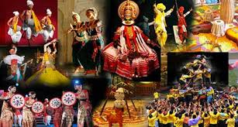
Art and culture -Ishani Pandya

Slide 2
Slides are available on mrunal.org

Slide 3
Introduction
We can divide the subject in three parts for our convenience.
1.Visual arts
2.Performing arts
3.Miscellenous arts

Slide 4
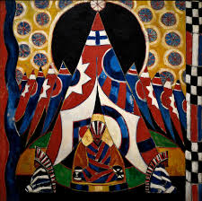
1.Visual arts
architecture
sculpture
pottery
painting

Slide 5
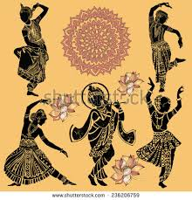
2.Performing Arts
Indian Music
Indian puppetry
Indian circus
Dance forms
Indian theatre & drama

Slide 6
3.Miscelleneous Art forms
Religion
Medicine, astronomy
Language
Literature
cinema
calendars
philosophy
festivals
fairs
Handicrafts coinage
institutions
maths &science

Slide 7
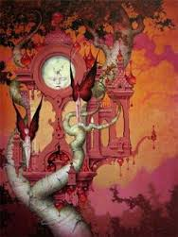
Visual arts
1.Indian Architecture
2.Indian Sculpture

Slide 8
Indian Architecture and sculpture
Temple architecture(Gupta age sculpture & south Indian art)
Indus valley civilization
Buddhist architecture & sculpture (mauryan period)
Indo-Islamic architecture and medieval sculpture
Modern architecture and sculpture

Slide 9
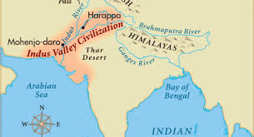
1.Indus valley civilization
Architecture
1.Town planning
2.Public bath
3.Granaries
4.dockyard
Sculpture
1.Bronze and terracotta sculpture
2.Seals
3.Stone sculpture
Miscelleneous
1.Ornaments
2.pottery

Slide 10
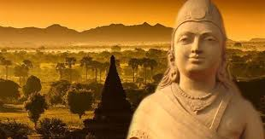
Mauryan and post-Mauryan period (Buddhist Art)
Outside influence is present-Persian and achaemenian
Court art
State initiative
Stupa, pillar
Popular art
Individual art
Sculpture,pottery,caves

Slide 11
Gandhar
Gandhar
Grey sandstone
Mathura
Mathura
Spotted red sandstone
Amravati
Amravati
White marble
Completely Buddhist
All 3 religions
Buddhism dominated
Kushana
Kushana
Satvahana
NWFP
Around UP
Krishna-Godavri lower valley
Spiritual Buddha
delighted buddha
Narrative art
Bearded,mushtaq, eyes-half closed, propumurance, weavy hair,large ears,seated in ‘yogi’ posture
Masculine,Grace on the face,energetic body,tight dress,seated in padmasana posture
Depicting themes from jataka tales,life of Buddha
Outside influence
Indegeneous
Indegeneous
Reminds Apollo
Reminds Yaksha

Slide 12
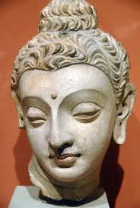
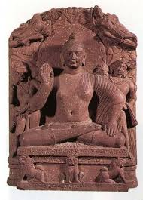
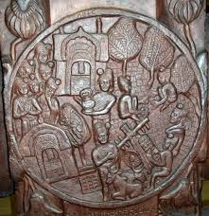
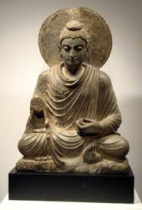
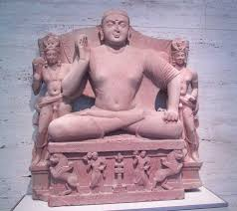
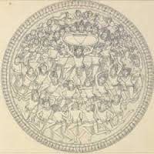
Gandhar Mathura Amravati

Slide 13
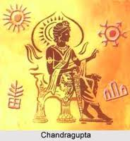
The Gupta age
Timeline-4 A.D. to 6 A.D. approx.
Art, science and literature flourished greatly during their time.
The iconographic canons of Brahmanical, Jain and Buddhist divinities were perfected and standardized.
Two climax in this era
Architecture
Cave architecture
Temple architecture
Sculpture
Sarnath school of sculpture

Slide 14
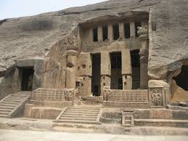
Phases of cave architecture
3 definite phases
1st phase or earliest phase-2nd B.C. to 2nd A.D.
Related exclusively to early budhhism
Buddha was represented symbolically
Major excavations-chaitya and vihar
Practised in less permamnent materials like wood.
Ex-karla,kanheri,Nasik,Bhaja,Bedsa caves.

Slide 15
2nd phase-5th to 7th century
Elimination of timber
Introduction of the image of the Buddha
The plan of excavations-specially for chaitya remained the same as before.
Vihar - some changes-housed the image of Budhha
3rd phase-or the last phase-7th to 10th century.
The hindus and Jains extended the Buddhist architectural tradition
With some modifications-suitable to their rituals

Slide 16
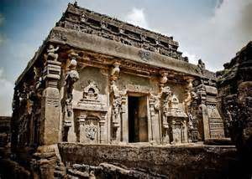
Dravidian cave architecture
Dominant features-
The Mandapa-open pavallion excavated out of a rock-simple columned hall with two or more cells
The Ratha-monolithic shrine carved out of a single rock

Slide 17
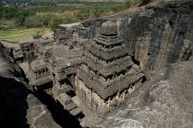
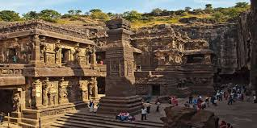
Kailasha temple
One of the grandest monolithic excavation in the world
A two-storeyed gateway resembling a South Indian Gopuram opens to reveal a U-shaped courtyard. The courtyard is edged by columned galleries three storeys high.
The temple itself is a tall pyramidal structure reminiscent of a South Indian Dravidian temple.
Most of the deities at the left of the entrance are Shaivaite (followers of Shiva) while on the right hand side the deities are Vaishnavaites (followers of Vishnu).
There are two Dhvajastambhas (pillars with the flagstaff) in the courtyard.
The grand sculpture of Ravana attempting to lift Mount Kailasa, the abode of Lord Shiva, with his full might is a landmark in Indian art.
The temple is a splendid achievement of Rashtrakuta Karnataka architecture. This project was started by Krishna I (757–773) of the Rashtrakuta dynasty
Its builders modelled it on the lines of the Virupaksha Temple in Pattadakal.

Slide 18
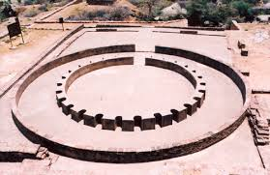
Temple architecture
Began and reached at climax during Gupta period
The gupta period is described as classic-degree of perfection
Perfect balance and harmony of all elements in style and iconography.
Earlier developments
A circular brick and timber shrine of the Mauryan period of 3rd century B.C., was excavated at Bairat District of Jaipur, Rajasthan.
Temple 40' at Sanchi, has a similar plan, it was a stone temple on an apsidal plan enclosed by an ambulatory, and raised on a high, rectangular scale, approached by two flights of steps from diagonally opposite sides. The super-structure was possibly built of wood, and has disappeared.

Slide 19
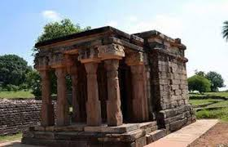
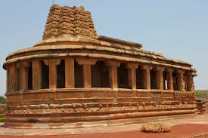
This is a little structure built of huge almost boulder-like blocks of stones. The temple consists of a simple square cell the garbhagriha or sanctum sanctorum, in front of which there is a coveredverandah, a portico, which consists of four heavy pillars supporting a stone roof. The pillars as well as the entire structure is as simple
he didn’t take the climate into consideration and did not provide gargoyles to allow the rain water to run off the roof. The entire structure is heavy, bulky and clumsy. Probably, this was constructed near about 300 to 350 A.D.
the earliest structural temple still standing in its original condition is the one constructed at Aihole in Karnataka.
There are five stages of temple architectural development

Slide 20
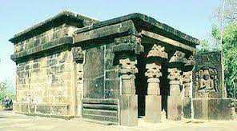
1st stage
Square temple
Flat roof temple
Shallow pillared approach
Temple constructed on low platform
Ex-temple no-17 at Sanchi
Kankalidevi temple,Tigwa,MP.

Slide 21
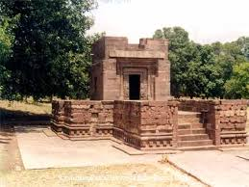
2nd stage
Square temple
Flat roof temple
Higher platform
Covered embulatory passage around The garbhgriha(santum santorum)
2 storeyed temples are found
Ex-Parbati temple at Nachna kuthara,MP

Slide 22
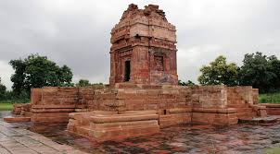
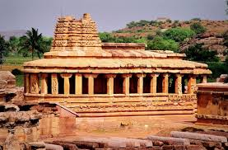
3rd stage
Square temple
Concept of shikhar introduced
Low and square shikhar
Pillar approach
Higher platform continued
Introduction of panchayatan style-main shrine+4 subsidiary shrines
Main shrine-rectangular shape
Crucified ground plan
Precursor to nagara style
Ex-Dashavatar temple-deogarh,UP
Durga temple-Ahihole,karnataka

Slide 23
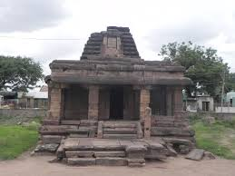
4th stage
Rectangular temple
Shikhar
Higher platform
Panchayatan style
Ex-Ter temple-Sholapur,maharashtra

Slide 24
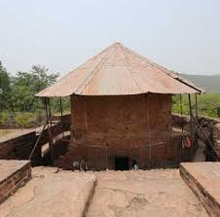
5th stage
Circular temple with shallow rectangular projections at four cardinal faces
Ex-Maniar matha-Rajgir,Bihar

Slide 25
Styles of temples
The Shilpashastra recognizes three styles along with a geographical distribution of each.
Nagara style-northern region
Dravida style-southern region
Vesara style-region between the vindhyas and the krishna

Slide 26
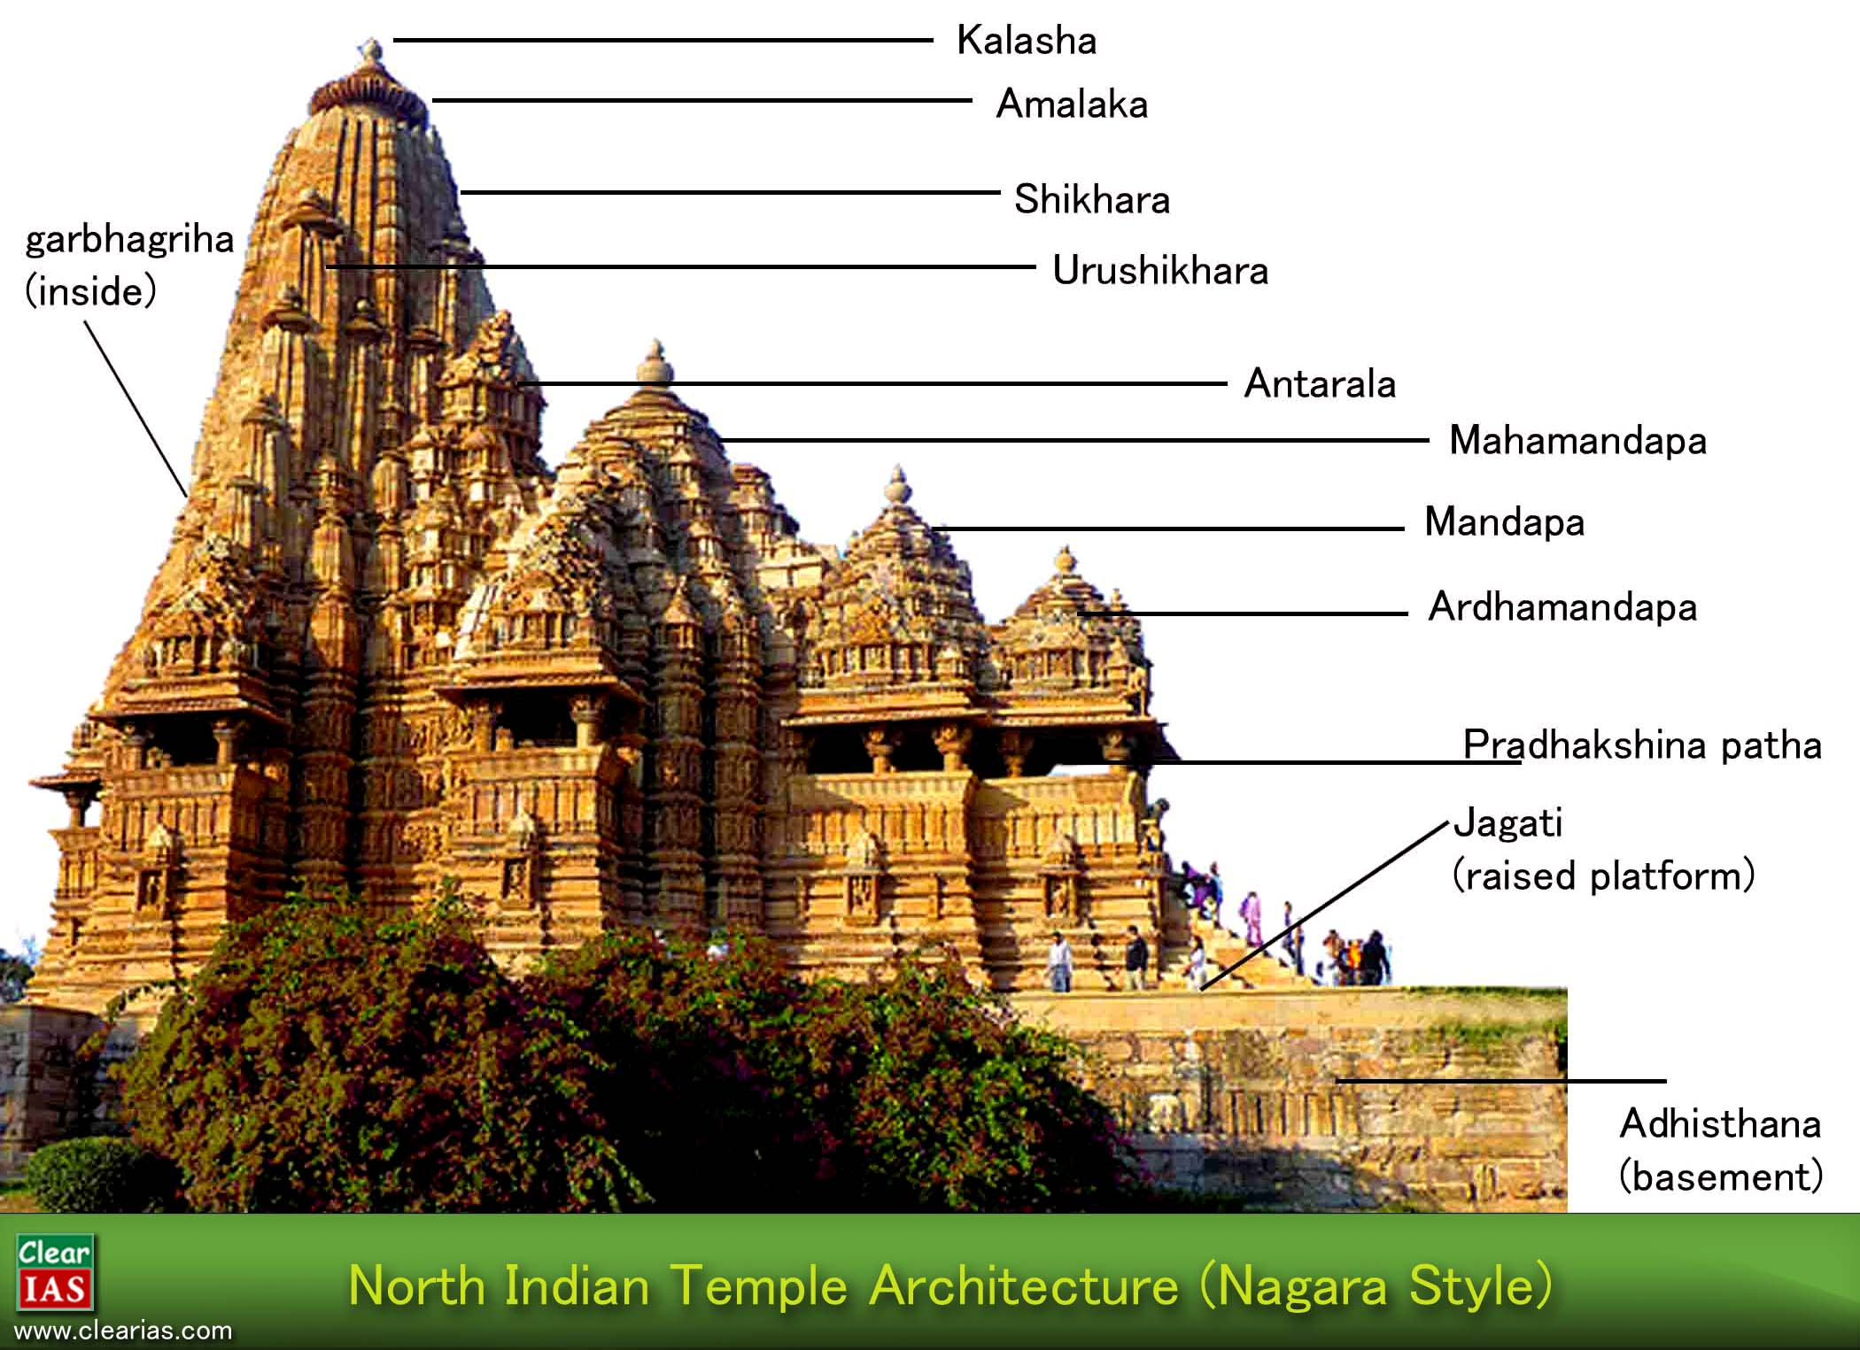
Nagara style

Slide 27
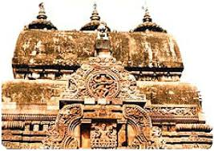
Nagara style
Crucified ground plan
Square/rectangular temple
garbhgriha
Panchayatan style
Each vertical plane was divided in three vertical walls-3 ratha-used to do sculptures
Absence of tank(tank was the main feature of Dravidian style)
Pillared approach
Shikhara gradually curving inwards-curvilinear tower9shikhara)
Developed regionally.

Slide 28
Three subschools
Odisha school
Chandella school/Khajuraho school
Solanki school-maru-gurjar school

Slide 29
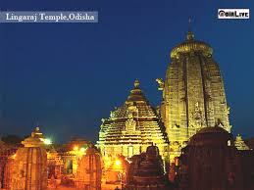
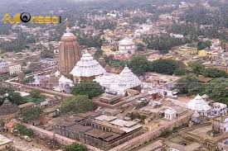
(1)Odisha school
Time period-8th to 13th century
Part of nagara school.All features of nagara style are present.
Exterior walls are beautifully carved and Interior walls are plain
No use of pillars
technical innovation-Use of iron girders-the roof was partly supported by these iron girdars
The shikhar in this Odisha style is called-Deul
Mandap(assembly hall) is called –jagmohan
Ground plan of main temple-square
They have boundary walls
Erotic sculptures found on the walls of kornak temple
Ex-Lingraja temple,Bhuvneshwar
Konark temple,Rajarani temple

Slide 30
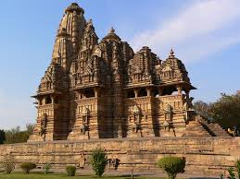
(2)Chandella school/Khajuraho school
Integrated carvings on both interior and exterior walls
Temple stands on heigher terrace comparatively.
Temple has main three elements
Garbhgriha
Mandap
Portico
theme of sculpture-erotic themes taken from kamsutra
Impression of mountain range from distance
Panchayatan style
Ex-kandaria mahadeo temple

Slide 31
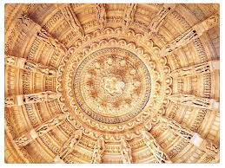
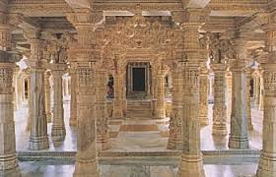
(3)Solanki school/maru gurjar style
Branch of later chalukyas
Not fundamentally different from khajuraho
Main feature-minute and lovely decorativeness
The ceillings are carved to give the impression of a true dome.
Arch –like effect but no true arch was employed.
Mostly of sandstone
Grey to black basaltic stone
Lavish carving on both sides of the walls and sculpture work
Walls of central shrine devoid of carving.
Civic type of monuments
Ex-gateway of dhubai,
delwara,vastupal,vimala and tejpala jain temples at mt.abu,rajasthan
Jayastambh at chittor

Slide 32
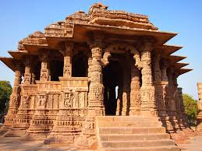
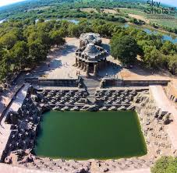
Modhera sun temple
Temple faces the east.
Every year at the time of equinox,the sun shines directly into this central shrine.
3 principal components
A rectangular reservoir with flagged flights of steps interspaced by small shrines.
The lofty kirtitoranaa
Open pillared half of cruciform shape

Slide 33
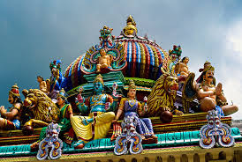
Dravid school of temple architecture
Functions
Religious matter
Administrative centres
Control of vast areas of land

Slide 34
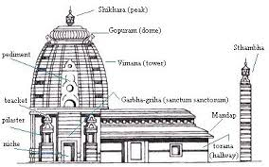
architecture

Slide 35
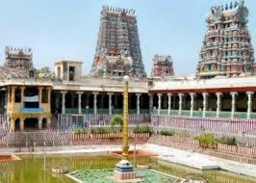
Features of dravida school
Single vimaan on main shrine
Shikhara octagonal shape on vimaan
Pillared wall
Presence of tank
Huge gopuram-gateway
Sculptures of dwarpal instead of ganga/mithuna of nagara school
Dravidian architecture –developed dynastically
Dravidian style was initiated by pallavas and flourished by cholas
Ex-gangeykondacholapuram bu rajendra-1
Brihadeswara temple at tanjore,tamilnadu

Slide 36
Four styles of Dravidian architecture
Pallava art
Chola art
Nayaka art
Vijayanagar art

Slide 37
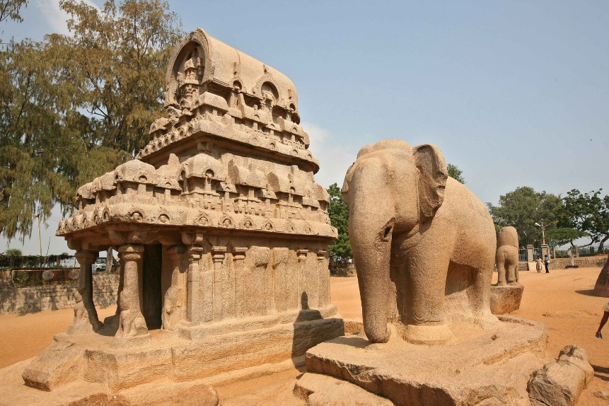
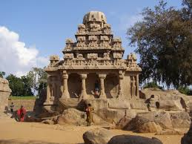
(1)Pallava school of art
Around 600 A.D.
Dravidian temple architecture started by pallavas
Developed in 4 phases
1) Mahendra varman-600-625 A.D.
JUST THE ROCK CUT CAVES
The word mandap was used instead of temple
No real temple structure
Ex-adivaraha cave,Durga cave-mahishsurmardini,panchpandava cave
2) Narsimhan varman
Decoration in rock cut caves.
Mandapas now became rathas
6 rathas in one cave
Largest ratha-dharmraja,smallest ratha-draupadi
Dharmaraja ratha was the precursor of the Dravidian style

Slide 38
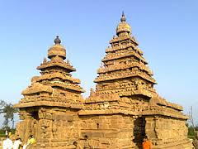
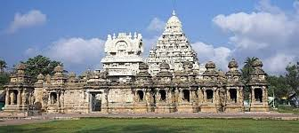
3)Rajsimhan varman
Real structural temples
Open air carving in relief on a rock surface
Sculpture –different from gupta sculpture
More oval face,higher cheek bones,great slenderness and freer movements of the forms.
Exellency in animal representation
Later,structural temples made of masonry and stone.
Ex-kailashnath temple at Kanchipuram-3 parts-sanctum with pyramedial tower,mandapa and rectangular courtyard-for subsidiary shrines
shore temple,mahabalipuram
4)Nandivarman
Started the concept of small temples
Confined all the features of Dravidian style

Slide 39
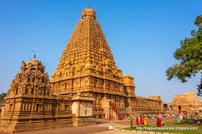
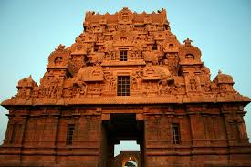
(2)Chola school of architecture
10-11th centuries
Revived the pallava heritage with fresh approach
The vimaana dominates the whole structure.
2 beautiful creations-Brihadeswara temple at thanjaur,tamilnadu
Gangeykonda cholapuram
Brihadeswara temple-dedicated to shiva
Huge lingam
A massive monolithic bull(2nd biggest,1st at lepakshi)
On the square forming the topmost tier is poised a huge rounded cupola of a single stone,the shadow of which never falls on the ground.-unique achievement
Immense gopuram

Slide 40
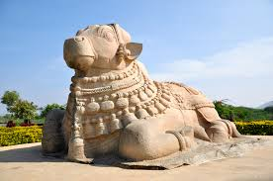
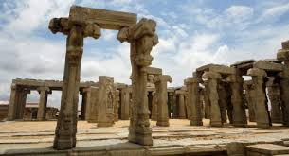
(3)Vijaynagar school of architecture
Around 16th century.Hampi was the capital.
Important ruler-krishnadevraya-Built temples,pillared mandapas,gopurams-called as rayagopurams
More larger gopuram and High enclose walls
More decoration-perticular design-supernatural horse
Secular buildings were built.for ex-lotus mahal
Vitthalswamy temple
Amman shrine and kalyana gopuram
Centraal raised platform surrounded by rows of carved pillars-open pavallion
Ex-hall of dance at lepakshi
Festival hall at Vellore
Virabhadra temple,Lepakshi-three figures share four legs
Nandi near lepakshi
Seated ‘Ugra narsimha’

Slide 41
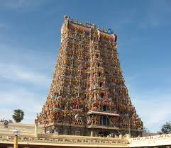
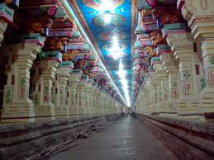
(4)Nayaka school of architecture
Around 17th century
Dominant in Madurai region
The nayakas rose on the fall of the vijaynagara empire
Continued the artistic traditions of vijayanagara empire
Most famous-meenakshi-sundareswara temple at Madurai
By thirumalai nayak
Temple complex has 2 shrines-1st-shiva as sundareswara
2nd-his wife in the form of goddess meenakshi
Every space is filled with surface carvings.
large tank-surrounded by steps and a pillared portico
Prominent feature-development of prakaram-roofed embulatory passageways-to connect various parts of the temples
Most famous prakaram of this period-at rameswaram

Slide 42
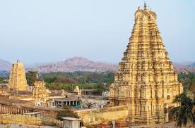
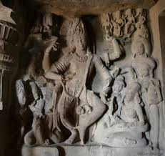
Vesara school of temple architecture
Also called as chalukya/Karnataka style
Around 7th-8th century.
Fusion of nagara and dravida styles. 2 components-vimaan and mandapa joined by antaral-Dravidian concept
-shikhara-nagaran concept
Chalukyan temples don’t have a covered embulatory passage
treatment of exterior walls-blending of both styles
Inegrate carving on pillars,ceillings and door plains
Ex-virupaksha temple at pattadakal,rameswara cave temple at ellora-4 armed dancing shiva

Slide 43


Hoyasala school of art
1050-1300 A.D.
Near mysore,south Karnataka
Unique feature-star ground plan
Multiple shrines-deities-equal importance and power
Jagati-upraised platform
Inticrate carving on both sides of the walls as well in the jewellary of the gods.
Stone-choristic schist
Temple pillar looks like monolith
Temple walls-zigzag form
Ex-chhenakeshava temple,Belur
Hoyasaleswara temple,helevied

Slide 44

Pal school of art
Under pala and sena rulers
Bengal and Bihar
10th-12th century around
Finely finished
Highly polished-stone sculpture looks like metal-found at nalanda,rajgir and Bodhgaya-nalanda art is divided in three stages
Mahayana phase of Buddha and bodhisattva images
Sahajyana images
Kalchakra/kapalika system
Both Buddhist and hinduist
Figures are much decorated

Slide 45
Rashtrakuta school of art
8th century
Successors of chalukya
Kailash temple at Ellora caves by Krishna-2
Trimurti at elephant caves

Slide 46


Sculpture of Gupta age
New school was added-Sarnath school of sculpture
A perfect balance between sensuousness of the kushan figures and symbolic abstraction of the early medieval ones.
Representation of HARI-HARA-from MP.
Cream coloured sandstone
Nackedness was lacking-more dresses on Buddha
The aura is more decorated
Gupta image of Buddha-smile on face-suggesting the ultimate harmony achieved by him.
Every aspect of image-according to prescribed canons of beauty and meaning.
The four Buddha image at sanchi entrance
Both standing and seated Buddha evolved.
Very few stupa

Slide 47

Chola sculpture
Natraja
Dedicated to lord shiva
Mainly bronze sculpture
Upper right hand-damru-
Represents a great sound from which all creations springs.
Upper left hand-eternal fire
Destruction feature

Slide 49
Lower right hand-gesture of benediction
Lower left hand-moksha path
Standing on dwarg-indivisual ego
Mettler lock-ganga river
Crescent moon-shine its all glory
Small earing in one ear,big earing in the other-ardhnarishwar
Snake-represents kundalini
Circle-unending cycles of life

Slide 50

Medieval Architecture
Also known as Indo-Islamic Architecture
Indo-Islamic architecture encompasses a wide range of styles from various backgrounds that helped shape the architecture of the Indian subcontinent from the advent of Islam in the Indian subcontinent around the 7th century. It has left influences on modern Indian, Pakistani and Bangladeshi architecture. Both secular and religious buildings are influenced by Indo-Islamic architecture which exhibit Indian, Islamic, Persian, Central Asian, Arabic and Ottoman Turkish influences, many of which themselves were influenced by Indian architecture through the spread of Indian culture before the advent of Islam.
Replaced the indian trabiate style with arcuate style

Slide 51
Turks and Afghans Muslims having inherited a wealth of varied designs from Sassanian and Byzantine empires and being naturally endowed with good taste for buildings
Ornamental decoration, open space for prayer toward mecca(quibla), light and open, lesser decoration in prayer hall, purdah hall system for females coming for prayer, tower/minaret to call prayer(azaan),
The Muslims, like the Romans, were also responsible for making extensive use of concrete and lime mortar as an important factor of construction and incidentally used lime as plaster and a base for decoration which was incised into it and held enamel work on tiles.

Slide 52
Trabeate style
lintel
Shikhar
Arcuate style
Lintel replaced by arch
Dome
No use of minar
Concept of minar
Material-sand stone
Material-brick,lime and mortar-used for making dome

Slide 53





Slide 54
Medieval architecture
Delhi sultanate
Imperial style
Provincial style
Mughal period

Slide 55
Delhi sultanate-Imperial style
Slave dynasty
Khilji dynasty
Tughlaq dynasty
Lodhi dynasty

Slide 56

(1)Slave dynasty
Also called as mamulak dynasty
Ilbar dynasty(Ilbari tribe)
Started converting the existing Hindu structures into mosques
Ie-Qwaat-ul-islam mosque
Arhai din ka jhopra,Ajmer
Qutub minar-Qutubuddin Aibak+Iltutmish+Firozshah Tughlaq

Slide 57


(2)Khilji dynasty
Seljuk style-richest style in Delhi sultanate
Sand stone-Red sandstone used in all structures
Ie-Siri fort
Alai darwaja in Qutub complex

Slide 58

(3)Tughlaq dynasty
Crisis period
Not much interested in architecture
Focus on strength rather than beauty
Sloping walls called”batt” was introduced-combined the techniques of lintel and arch(Batt=lintel+arch)
Generally grey sandstone was used
Established 3 cities
Tughlaqgabad by Gyasuddin Tughlaq
Jahapanah by Mummad Tughlaq
Firozshah kotla by Firozshah Taghlaq

Slide 59

Delhi
Present Delhi is made of 7 cities
Lalkot/Killa Rai Pithora by Rajput Tomar(1060 A.D.)
Siri by Alauddin Khilji(1304 A.D.)
Tughlaqabad by Giyassuddin Tughlaq(1321-1323 A.D.)
Jahanpanah by Muhammad Tughlaq(1324 A.D.)
Firozshah Kotla by Firozshah Tughlaq
Delhi Shershahi/sgergadh by Sher shah Suri(1534 A.D.)
Shahjahanbad by Shahjaha

Slide 60

(4)Sayyid and Lodhi dynasty
Unstable kingdom
Scarcity of money
Only tombs were made in this period
Sikandar lodhi established the city of AGRA
This architectural period during Sayyid and Lodhi dynasty was known as the period of the macabre Concept of double dome was introduced by Lodhis
The three royal tombs of Mubarak Sayyid, Muhammed Sayyid and Sikandar Lodi reflect the prototype of architecture during Sayyid and Lodhi dynasty..
It is a good example of a combination of the Hindu and Islamic styles of architecture. The Hindu features include eight chhatris, each of them capped by a lotus finial with a decorative band around the base; corner ornamental pinnacles (guldastas)and chhajja

Slide 61
Tomb
Hard structure
Jali work
Sayyids and Lodis constructedThe tombs in two different forms; one pattern was based on octagonal plan surrounded by arched walkway with one storey in height and the other one was based on square plan without walkway with two or three storey in height.
Double Dome- A double dome is built of two layers. There is one layer inside which provides ceiling to the interior of the building. The other layer is the outer one which crowns the buildings. The devices of double dome enable the ceiling inside to be placed lower and In better relation to the Interior space it covers.
The attempts in the direction of Double Dome started with tomb of Taj Khan (1501 ) and the tomb of Sikandar Lodi (1518), both in Delhi. However, the fully mature form of the double dome is seen, for the first time in India in the tomb of Humayun
An important feature of the architecture during Sayyid and Lodi dynasty is the amazing measurements of height and width to match with the structure of the basements.

Slide 62


Double dome

Slide 63
Delhi sultanate-Provincial styles
Bengal school
Malwa school
Jaunpur school
Bijapur school

Slide 64

(1)Bengal school of art
Brick was used
Use of mortar,lime plaster was very less
Use of black marble
Focus was not on decoration or strength but Focus was on construction of massive buildings
Ie.Kadamrasul mosque,Gor
Adina mosque,Pandua

Slide 65

(2)Malwa school of Art
Absence of minars in mosques
European influence can be found here
Imaginative use of water in pools and fountains
Use of arch along with pillar and beam
Well proportioned staircase
Ie-jahaaz mahal at mandu,Rani Rupmati pavallion

Slide 66

(3)Jaunpur school of art
Developed by sharqui dynasty
Absence of minar suggests Persian influence
Bold and forceful character
Ie-Babri masjid,atala mosque

Slide 67

(4)Bijapur school of art
Adil shahi rulers
3 arch method instead of single arch
Bulbus dome-unique feature
Gol Gumbaj-Largest dome of the world
-minar-graceful,tall and slender
Use of cornice(chhajja)
Important feature-treatment of ceiling-without any apperant support-slab of stones are bounded by iron clamps and mortar
Gol Gumbaj is the maqbara of Muhammad Adil shah

Slide 68
Mughal period
Indo-Islamic style fully developed under Mughals
Features of Indo-Islamic architecture
Arch and dome method(arcuate style)
Existence of minar
Mortar used as a cementing agent to create arch and dome
Avoided the representation of human beings
Provided spaciousness,massiveness and breath to hindu architecture
Use of calligraphy-pietradura technique
Use of arabesque method
Significance of light
Symmetry
Use of water in premises
Foresightening technique
Charbag style

Slide 69


Slide 70

Pietra dura technique
It is an decorative art.
Also called parchin kari in South Asia, is a term for the inlay technique of using cut and fitted, highly polished colored stones to create images.
The stonework, after the work is assembled loosely, is glued stone-by-stone to a substrate after having previously been "sliced and cut in different shape sections; and then assembled together so precisely that the contact between each section was practically invisible".
Stability was achieved by grooving the undersides of the stones so that they interlocked, rather like a jigsaw puzzle, with everything held tautly in place by an encircling 'frame'.
It first appeared in Rome in the 16th century

Slide 71

Arabesque mathod
Mathod of design and decoration
Under this technique,A continuous stem is drawn which splits regularly producing the series of conter poised leafy secondary stems which can in turn split again or returned to be reintegrated into the main stem.

Slide 72

Use of water
Cooling purpose
Mirror image
To add the beauty to the monument

Slide 73

Charbagh style
Char bagh is a Persian-style garden layout. The quadrilateral garden is divided by walkways or flowing water into four smaller parts.
Ie-humayun’s tomb,taj-mahal

Slide 74

Babur
No time for development
Babur built 2 mosques
Rohilkhand
Panipat

Slide 75

Humayun
He didn’t live long to emphasize on architecture
He led the foundation of Dinpanah-later became shergarh under sher shah Suri
Sher shah started developing the architecture-shergarg city,grand trunk road.
4 centered arches
Semi domed roofs
Double dome continued
Inverted lotus dome
Humayun’s tomb was iniated by his wife Haji beghum
All features of Indo-Islamic architecture are present here
1st time white marble was used
Humayun’s tomb is made of red sandstone and white marble

Slide 76


Akbar
Thearchitecture of the Akbar period is characterized by a strength made elegant and graceful by its rich decorative work, which reflects many traditional Hindu elements.
The style is best exemplified by the fort atAgra (built 1565–74) and the magnificent town of Fatehpur Sikri (1569–74), but fine examples are also found in the gateway to the ʿArab Sarāʾī (guesthouse at Humāyūn’s tomb), Delhi (1560–61), the Ajmer fort (1564–73), the Lahore fort with its outstanding decoration (1586–1618)
The capital town of Fatehpur Sikri (named a World Heritage site in 1986) is one of the most notable achievements of Islamic architecture in India. The town, which was deserted only a few years after it was built, is a great complex of palaces and lesser residences and religious and official buildings, all erected on top of a rocky ridge 26 miles (42 km) west of Agra. The Hall of Private Audience (Diwan-i-Khas) is arresting in its interior arrangement, which has a single massive column encircled by brackets supporting a stone throne platform, from which radiate four railed balconies.

Slide 77


The most imposing of the buildings at Fatehpur Sikri is the Great Mosque, the Jāmiʿ Masjid, which served as a model for later congregational mosques built by the Mughals. The mosque’s southern entrance, a massive gateway called the Buland Darwaza (Victory Gate), gives a feeling of immense strength and height, an impression emphasized by the steepness of the flight of steps by which it is approached.
All these buildings reflected Akbar's design and architectural philosophy. This "Akbari" style of architecture
For example, Akbar's tomb, though Islamic in spirit, is a blend of styles. The magnificent entrance, use of exquisite patterns, excellent jaali work (intricately perforated decorative stone screens), fine Persian style calligraphy, the charbagh garden layout (four-quartered garden layout, with the main building at the center), etc., are representative of Islamic influence.On the other hand, the absence of a dome, use of chhatris (small domed canopies, supported by pillars), tiers of airy pavilions, etc., reflect a local influence, which are also found in the buildings built by Akbar in Agra Fort and Fatehpur Sikri.

Slide 78


The employment of Hindu masons and architects who unconsciously introduced in the Muslim buildings their own ideas of art.
He established a public works department and his plans were carried out by his able architects and engineers.
Even Hindu buildings of Rajut at Amber and Jodhpur were influenced by the Mughal style of Architecture. Not only civil buildings, but even the Hindu temples could not escape the nationalizing effects of Akbar’s architecture. While Akbar had freely borrowed from indigenous temple architecture, Hindu temples erected during his reign did not fail to borrow some of the features of the new eclectic style evolved at Agra and Fatehpur Sikri. Hindu temples at Vrindaban show clearly that certain of their features are borrowed from the contemporary style of the Mughals.
Mosaic and ebony decoration, in which our craftsmen of the Mughal age were proficient, was also lavishly used in the buildings of the time. Glazed tiles and decorative carvings form another special feature of the Mughal architecture. The Turkish Sultana’s palace at Fatehpur Sikri is one of the finest specimens of glazed tile work.

Slide 79

Haram
Fatehpur sikri-panch mahal,jodhabai palace,salim Chishti tomb-inticrate jail work-climax of jail work
Akbar built a temp;le of govinddev at vrindavan

Slide 80

Jahangir
Akbar’s tomb was constructed by Jahangir at sikandara
Noorjahan constructed the tomb of her father at Agra-Idmat-ul-Daula
Here first time complete use of white marble is found
Pietra dura technique was used for the 1st time in this tomb
Moti masjid at Lahore was built by Jahangir
Jahangir constructed his own maqbara at lahore

Slide 81

shahjahan
Mosque building reached its climax
Established the city-shahjanbad
Moti masjid of Agra fort
Jama masjid
Shalimar bagh at Lahore
Taj mahal

Slide 82
Taj Mahal
taj Mahal was built in Agra by Shah Jahan as a mausoleum (a kind of large tomb) for his deceased wife Mumtaz Mahal.
It was commissioned in the year of 1632 and is a UNESCO World Heritage Site.
Taj Mahal was the apogee of the evolutionary architectural process in medieval India.
The Taj complex is entered through a monumental red sandstone gateway, the opening arch of which beautifully frames the mausoleum.
The tomb is laid out in a Chahar Bagh (garden), crisscrossed with paths and water courses, interspersed with pools and fountains.
The structure is placed on the northern extremity of the bagh instead of the middle to take the advantage of the river bank (Yamuna).
The straight path through the bagh reaches the plinth of the tomb.
At the corners of the terrace stand four tall minarets, one hundred and thirty two feet high.

Slide 83


Slide 84


The main body of the building is topped with a drum and a dome and four cupolas forming a beautiful skyline.
Towards the west of the white marble faced tomb lies a red sandstone mosque and a similar construction in the east to maintain balance.
The marbles for the building was quarried from the Makrana Mines, Rajasthan.
The inner arrangement of the mausoleum consists of a crypt below and a vaulted, octagonal tomb chamber, with a room at each angle, all connected by corridors.
Light to every part of the building is obtained by means of carved and perforated Jalis, set in the arched recesses of the interior.
Four types of embellishments have been used with great effect for the interior and exterior surfaces of the Taj Mahal.
These are stone carvings in high and low relief on the walls, the delicate carving of marble into jails and graceful volutes (spiral ornament on the pillars), and the creation of arabesque with pietra dura on walls and tombstones and geometric designs with tessellation.
The art of calligraphy is used with the inlay of jasper in white marble to unite Quranic verses.
Calligraphy provides a decorative element on the walls and a continuous connection with the almighty.

Slide 85

aurangzeb
Decline in architecture
Bibi ka makbara-poor replica of taj mahal
Construction of red fort at delhi
Badshahi mosque at lahore

Slide 86

Sikh form of architecture
Golden temple at Amritsar
Also known as harminder sahib
Foundation by Ramdas,completed by Arjun Deb
Multiplicity of chhatris
Fluted dome covered with brass and copper gilt
Chhajja-shallow cornicce

Slide 87

Rajputana form of architecture
Concept of henging balconies
Carved cornice like in the shape of arch producing shadows arch like a bow
The Kirtistambha, or Tower of Fame, was constructed by the Solanki ruler of Gujarat and one such is that of the Chittor Fort, the capital of Mewar before Udaipur. The tower, was constructed in the eight years following 1440 and restored in 1906 to commemorate the building of the Kumbhaswami Vaishnava temple, consecrated in 1440.
Of many "experimental" works, in which the Hindu and the Islamic traditions had combined to create something novel is the interesting example of the 'Hava Mahal' (the Palace of the Wind) at Jaipur.
Here an extraordinary experiment has been made to create a building suited to the hot, dry climate of Rajasthan, by making the entire facade a perforated screen by creating over fifty slightly raised pavillions, each a half oriel window, as it were, to allow little breeze to waft through those hundreds of perforated jali windows.
These half raised pavilions are covered by little domes and curvilinear roofs, whilst the openings are arch-shaped. These are probably inspired by the tiers of small shikharas rising one above the other, of Bhubaneswar or Tanjore.

Slide 88
Modern Indian architecture
Two styles
Indo-gothic
Neo-roman

Slide 89
Iberian style vs Gothic style
Iberian style
Iberian peninsula,portugese church
Lime stone and red sand stone used
Gothic style
Originated in france
Brick used as a material
Involved creation of new shapes and structures
Doesn’t involve new shape structure but they reinterpreted the existing western style
No wooden roofs
Expensive material
Non expensive material
Wooden roofs

Slide 90



Slide 91

Indo gothic style
Florished in 19th century till 1911
Hybrid style having Mughal,hindu and western influence
Also known as Indo-saracenic style
Features
Elaborate and large constructions
Advance british structural engineering standards hence fine use of steel,iron and poured concrete
Thinner walls
Pointed arches
Large windows
Church-crucified ground plan

Slide 92
Examples
St.poule’s cathredal,Kolkata
Victoria memorial,Kolkata
Gateway of india
Laxmivilas palace

Slide 93

Neo roman style
Started by Edwin lutyen and Edward baker
Features
Hybrid s\tructure
Conjusted style
Modernity,simplicity and utility was compromised
Upturned dome
Examples,parlament building,rashtrapati bhawan

Slide 94


Contribution of lourie baker
Architect of poor
He was a pioneer of sustainable architecture as well as organic architecture
Merged building with environment
Ventilation and thermal comfort arrangement
Used loacally available material
Introduced pillar-slab construction method-reduce the consumption of steel and cement
Revolutionize the mass housing in kerala

Slide 95


Le Corbusier

Slide 96
Green building in India
A green building is one which uses less water, optimises energy efficiency, conserves natural resources, generates less waste and provides healthier spaces for occupants, as compared to a conventional building
EDGE Program in India[edit]
The IFC, a member of the World Bank Group, and the Confederation of Real Estate Developers' Associations of India (CREDAI), apex body of private real estate developers, have partnered to promote green buildings in the country through IFC’s EDGE certification. An MoU was signed in the presence of Minister for Environment and ForestsPrakash Javadekar on^{[2]} November 25, 2014.
The Indian Bureau of Energy Efficiency (BEE) launched the Energy Conservation Building Code (ECBC).
GRIHA is a rating tool that helps people assesses the performance of their building against certain nationally acceptable benchmarks. It evaluates the environmental performance of a building holistically over its entire life cycle, thereby providing a definitive standard for what constitutes a ‘green building’. The rating system, based on accepted energy and environmental principles, will seek to strike a balance between the established practices and emerging concepts, both national and international.

Slide 97

Indira Paryavaran Bhawan
It’s India’s first net zero energy building that has been constructed with adoption of solar passive design and energy-efficient building materials
It covers only 30 per cent of the total area, while more than 50 per cent area outside the building is a soft area with plantation and grass
The successful adoption of green building strategies can maximise both the economic and environmental performances of buildings
The building has received GRIHA 5-star (provisional) rating for the following features.
The design allows for 75 per cent of natural daylight to be utilised to reduce energy consumption.
The entire building has an access friendly design for differently-abled persons.
With an installed capacity of 930 kW peak power, the building has the largest rooftop solar system among multi-storied buildings in India.

Slide 98
The building is fully compliant with requirements of the Energy Conservation Building Code of India (ECBC). Total energy savings of about 40 per cent have been achieved through the adoption of energy efficient chilled beam system of air-conditioning. As per this, air-conditioning is done by convection currents rather than airflow through air handling units, and chilled water is circulated right up to the diffuser points unlike the conventional systems.
Green materials like fly ash bricks, regional building materials, materials with high recyclable content, high reflectance terrace tiles and rock wool insulation of outer walls have been used.
Use of renewable bamboo jute composite material for doorframes and shutters.
UPVC windows with hermetically sealed double glass. Calcium Silicate ceiling tiles with high recyclable content and grass paver blocks on pavements and roads.
Reduction in water consumption has been achieved by use of low-discharge water fixtures, recycling of waste water through sewage treatment plant, use of plants with low water demand in landscaping, use of geothermal cooling for HVAC system, rainwater harvesting and use of curing compounds during construction.

Slide 99
1Q. It is argued that there is a need to re-write Indian history textbooks. Critically examine why and comment if such arguments have any merit. (200 Words)

Slide 100
History is a means to understand our heritage and strengthen our links with our ancestors. In that context it is frequently argued that we need to rewrite Indian history textbooks due to following reasons:
There is excessive focus on political history while other cultural, sociological, economic aspects have been relatively neglected.
There is a very strong focus on North and North Western region to the detriment of other regions in the country.
Often, myths and legends have been embellished as popular fact without any strong basis in historical fact.
New insights are gained from archaelogical sources, from newly discovered documents, paintings etc. which needs to be interpreted.

Slide 101
Indian history mainly has narratives of two schools of thoughts - Marxist and Colonial. There is a need to broaden the perspective by analysis through other ideological prisms.
In any field, revision and updation of text books should be an organic process which keeps pace with the new discoveries. Hence, the demand for revision of history textbooks is justified. However, there are few dangers associated with this -
While different perspectives on history can be there, the perspective of the dominant group should not be used for the purpose of establishing a cultural hegemony.
The rewriting should be strictly based on facts and not myths or legends.
The task should be entrusted to eminent historians which integrity and strong credentials so that the task is not unduly politicised.
Instead of 'rewriting' history books what is needed instead is addition of different perspectives with critical analysis that brings new insights into the public domain

Slide 102
1Q. ―The crisis in Indian museums is less of resources and more of imagination and commitment.‖ Critically comment. (200 Words)

Slide 103
The dismal state of Indian museums especially the govt ones is no secret. Various reasons can be attributed to it:-
Mere collection of artefacts ignoring viewers' interest:-Museums should not be just a place of repositories of objects. Efforts should be made to make it people friendly so that they can connect to the place and engage with the rich collections.
No skilled manpower:-Leading to sub standard maintenance, lighting and signage, among other issues. Proper training has to be introduced for better handling of such things.
Lack of expertise:-Often responsibilities of museums are given to IAS officers who are generalists and not any specialist. Barring few exceptions, it can be least expected that they would come up with any imaginative idea. Many a times they are given the responsibility of museums as a form of punishment which shows how seriously the matter is being taken up.
Lack of autonomy:-For effective functioning of the museums they have to be given the much required autonomy lack of which leads to ad hoc arrangements.
Few instances of collaboration with similar foreign organisations:-Such collaborations help to bring in the much required expertise and knowledge in proper handling of museums.
Museums are guardians of objects of historical and cultural objects. However they need to be handled intelligently in order for them to gain wide acceptance among the people. A great collection with average people will give an average museum but an average collection and great people often produces a great museum.

