Slide 1
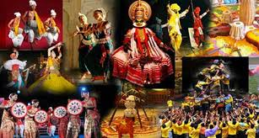
Art and culture -Ishani Pandya

Slide 2
Slides are available on mrunal.org

Slide 3
Introduction
We can divide the subject in three parts for our convenience.
1.Visual arts
2.Performing arts
3.Miscellenous arts

Slide 4
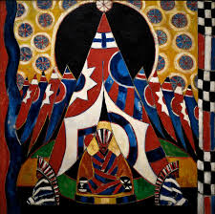
1.Visual arts
architecture
sculpture
pottery
painting

Slide 5
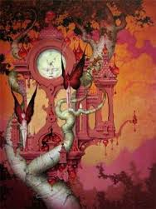
Visual arts
1.Indian Architecture
2.Indian Sculpture

Slide 6
Indian Architecture and sculpture
Temple architecture(Gupta age sculpture & south Indian art)
Indus valley civilization
Buddhist architecture & sculpture (mauryan period)
Indo-Islamic architecture and medieval sculpture
Modern architecture and sculpture

Slide 7
Medieval architecture
Delhi sultanate
Imperial style
Provincial style
Mughal period

Slide 8
Modern Indian architecture
Two styles
Indo-gothic
Neo-roman

Slide 9
1.Visual arts
architecture
sculpture
pottery
painting

Slide 10
Paintings of India

Slide 11
Painting as an art
In Kamasutra,painting is tslisted as one of the fine arts out of 64 fine arts.
Vatsayana has mentioned 6 principals(limbs) of painting.
Shadanga(6 limbs/principals)
Rupbheda
Praman
Lavan yojanam
Sadrashyam
Bhaav
Varnika bhanga

Slide 12
Indian painting
Mural paintings
Miniature paintings

Slide 13
Mural paintings
They are large works executed on the walls of the large structure
Ajanta caves,Lepakdhi temple,Ellora caves etc
Mostly done during Gupta age

Slide 14
Mural paintings of Gupta age
Ajanta paintings
Expression of emotions through hand postures
Birds and animals are also shown with emotions
Fresco paintings
Tempera style used-using pigments
Theme-Buddhism-jataka tales,life of Buddha
Bagh paintings
Same as Ajanta paintings

Slide 15
Ellora paintings
Theme-Hinduism,Buddhism and Jainism
Scenes of Ramayana and Mahabharata
Shiva as Natraj,battle scenes, elephant in the lotus pond
Techniques same as Ajanta paintings

Slide 16
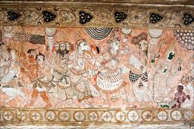
Mural paintings of Vijayanagar empire
Lepakshi paintings
Flourished during Vijayanagara kingdom
Theme-not religious but secular
Complete absence of primary colours
Bad quality
Decline in paintings

Slide 17
Some of the wall paintings of this declining period in the reign of Prince of Travancore in Kerala
in the palaces of Jaipur in Rajasthan and in the Rangmahal of the Chamba palace in Himachal Pradesh are worth mentioning.

Slide 18
Indian painting
Mural paintings
Miniature paintings

Slide 19
Miniature painting
Very detailed and small paintings
Executed on very small scale
In books,manuscripts or on other material like paper,cloth and even glass

Slide 20
TECHNIQUE
Paintings were executed in the traditional tempera technique.
After mixing colors in water along with a binding medium they were applied on the drawing.
First, the sketch was freely drawn in red or black over which a white priming was given.
The surface was thoroughly burnished till the outline showed clearly through it. Then a second outline was drawn with a fine brush.
First the background was colored and then the sky, buildings and trees, etc. Figures were painted last of all after which a final outline was drawn.
When copies were made from perforated sketches by rubbing- charcoal powder, the dotted outline took the place of the first drawing.
Colors used in paintings were obtained from minerals and ochers. Indigo was the vegetable color. Lac-dye and red carmine were obtained from insects.

Slide 21
Technical rule for miniature painting
Miniature painting’s size should not greater than 25 inch square
The subject must not be painted greater than one sixth of its original size
Paintings are not merely about size but also the level of detail that differentiates it from small paintings
Miniature is derived from latin word minium meaning red led paint used in illuminated manuscript during renaissance
It has nothing to do with size

Slide 22
Features of Indian miniature painting
Most human characters are shown with side profile
Big eyes
Pointed nose
Women-slim waste,long hair
Skin colour-brown
Hair and eye-black
Skin colour of Krishna-blue
Dress-traditional indian dress
Men have turbans on their head
Initially natural colours were used
Famous painters-vaachak,Nihaal chand

Slide 23
Various types of miniature painting
Pal school of painting
Apabhransha school
Mughal painting
Regional schools

Slide 24
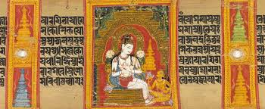
Pal school of miniature
Lonely human figures found
Mainly manuscript paintings
Initially done on palm leaf, later on paper
Theme-Buddhist and Hinduism
Nature representation-banana and coconut tree

Slide 25
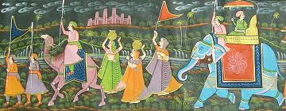
Apabransha school
Mewar and Gujarat region
Theme-Jain and Vaishnav
Charesteristic-
Bulgin eyes
Pointed nose
Double chin
Use of bright and gold colours
Figures are stiff
Animals and birds are represented as toys

Slide 26
Medieval paintings
Mughal paintings
Regional school

Slide 27
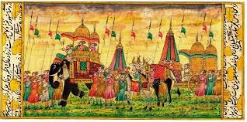
Mughal paintings
Indian,Persian and European influence
Features
mostly or generally miniature paintings
Use of brilliant colours
Accuracy in line drawing
Ornamentation
Variety of themes
Use of forsightening technique

Slide 28
Babur
No time for painting
Patronized a Persian painter-Bihzad
Humayun
He brought 2 Persian painters-
Abdus sammad
Mir sayyed Ali
So Persian influence is there

Slide 29
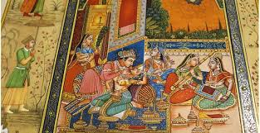
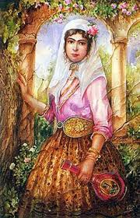
Akbar
Established the separate department for painting
Concept of karkhana
In the karkhanas,indian painters were invited---Indian influence
Features
Famous painters-Dashwant,Baswan,Kesu
Mostly miniature painting
3D figures
Indian,Persian and European influence
Caligraphy,forsightening technique
Theme-fairs and festivals
Combined efforts of painters started

Slide 30
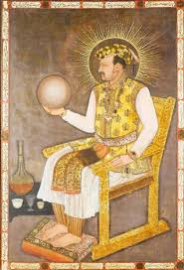
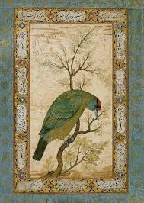
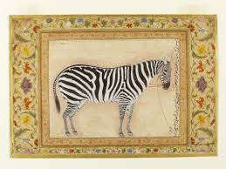
Jahangir
Mughal period reached at its climax
Jahangir was naturalist-preferred paintings on the theme of birds,animals and other elements of nature like flowers
Portrait painting started
Decorated margins
He had his workshop too
Famous painter-Ustad Mansoor
Famous paintings-zebra,Turkey,maulaana do pyaaza

Slide 31
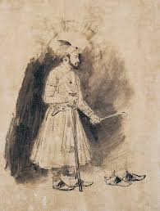
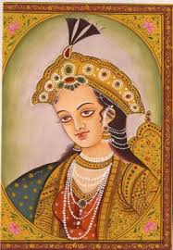
shahjahan
Too much use of gold,silver and bright colours
Reduced liveliness
Artificial look
This unnatural look suggests European influence
Pencil drawing/sketching started

Slide 32
Aurangzeb
Discouraged paintings
Dispersal of artists from Mughal court
Hence the concept of regional school started

Slide 33
THE DECCANI SCHOOLS (CIRCA 1560-1800 A.D.)
no pre-Mughal painting from the Deccan are so far known to exist
it can safely be presumed that sophisticated schools of painting flourished there, making a significant contribution to the development of the Mughal style in North India.
Early centres of painting in the Deccan, during the 16th and 17th centuries were Ahmednagar, Bijapur and Golconda.
In the Deccan, painting continued to develop independently of the Mughal style in the beginning. However, later in the 17th and 18th centuries it was increasingly influenced by the Mughal style.

Slide 34
Regional school
Rajastahni school
Malwa school
Jaipur/amber school
Pahari school
Basohli school
Jammu school
Marwar school
Bundi school
Chamba school
Thangka school
Mewar school
Kota school
Bikaner school
Kishangadh school
Kangra school
kullu–mandi school
Guler school
Odisha school

Slide 35
Rajasthani school of painting
Themes based on hindu tradition and mythology
Battle scenes,hunting scenes and riding scenes
Developed in 3 phases
(1)1st phase-16th century
Mural paintings-simple and on solid & dark background
(2)2nd phase-early 17th century
Sophisicated paintings
(3)3rd phase-17th-18th century
Portrait painting in rajasthani style
Mughal influence,miniature painting mainly
Representation of Radha-Krishna,nayak-nayika and hunting scenes

Slide 36
Malwa school
Some of the important paintings executed in the Malwa style are a series of the Rasikapriya dated 1634 A.D.
a series of the Amaru Sataka painted in 1652 A.D.

Slide 37
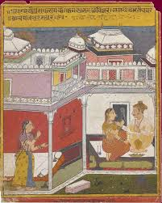
Mewar school
Also known as ragmala paintings
Paintings were based on Ragas
Paintings,music and poetry comes togather in these paintings
unique

Slide 38
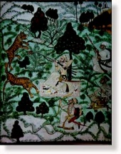
Marwar school
Theme-Radha-Krishna
Liberal use of gold
The face of male and female is similar.
Krishna is painted in blue
Narrow eye-brows
Lotus fatal shaped eyes
Minimum Mughal influence
The miniatures are executed in a primitive and vigorous folk style and are completely uninfluenced by the Mughal style. .
A large number of miniatures comprising portraits, court scenes, series of the Ragamala and the Baramasa, etc. were executed from the 17th to 19th centuries at several centres of painting like Pali, Jodhpur and Nagour etc. in Marwar.

Slide 39
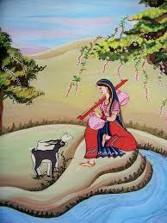
Bundi school
Around Aravalli range
Sky is painted in different colours-mostly-red colour ribbon is visible in the sky
Local vegetation is painted in detail
Themes-scenes of pleasure-loving princess etc
Mostly miniature
Human face-round
Sharp nose,narrow eye brows
The Mughal influence is visible in the refined drawing of the faces and an element of naturalism in the treatment of the trees.
The text is written in black against yellow background on the top.

Slide 40
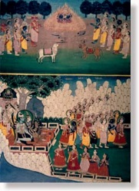
AMBER – JAIPUR school
The State of Amber had the closest relations with the Mughal Emperors.
It is generally believed that a school of painting originated at Amber, the old capital of the Amber State, in early 17th century.
Later on in the 18th century, the centre of artistic activity shifted to Jaipur, the new capital.
There is a fairly large number of portraits of the Jaipur rulers and miniatures on other subjects which can definitely be assigned to the Jaipur School.

Slide 41
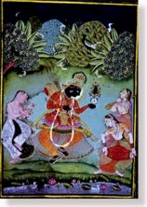
Kotah school
A style of painting very much akin to the Bundi style also prevailed in Kotah a place near Bundi, during the late 18th and 19th centuries.
Themes of tiger and bear hunt were very popular at Kotah.
In Kotah paintings, most of the space is occupied by the hilly jungle which has been rendered with a unique charm.

Slide 42

Bikaner school
Bikaner was one of the States which had close relations with the Mughals.
Some of the Mughal artists during the later half of the 17th century were given patronage by the Bikaner court
They were responsible for the introduction of a new style of painting having much similarity with the Mughal and the Deccani styles.
One important artist Ali Raza "the Ustad (master) of Delhi", was employed by Raja Karan Singh of Bikaner in about 1650 A.D.
Some other noteworthy artists who worked at the Bikaner court were Ruknuddin and his son Shahadin.

Slide 43
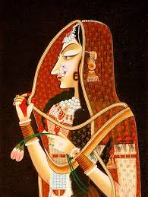
Kishangarh school
During the second quarter of the 18th century, there developed the most charming school of Rajasthani painting in Kishengarh under the patronage of Raja Savant Singh (1748-1757 A.D.)
He wrote devotional poetry in praise of Krishna, under the assumed name of Nagari Das.
Unfortunately only a small number of Kishengarh miniatures are available.
Most of them are believed to have been done by the master painter Nihal Chand who, in his works, has been able to create visual images of his master's lyrical compositions.
The artist has executed types of human figures, delicately drawn, with slender bodies and uptilted eyes.
The painting is marked by delicate drawing, fine modelling of the human figures and cows and the broad vista of landscape showing a stream, rows of overlapping trees, and architecture.
The artist has displayed a masterly skill in the grouping of many figures in the miniature. The painting has a golden inner border. It is ascribed to the middle of the 18th century and may be the work of Nihal Chand the famous artist of Kishengarh.

Slide 44
Rajasthani style
Based on indigenous fresco and mural paintings-later miniature-Mughal influence
Theme-religious and devotional
Mughal style
Miniature-Persian influence
Theme-royal pomp, court scenes, animals and birds(less emphasis on human)
Depicts Sanskrit textual details
Based on Persian poetry and Mughal history
Hindu symbols used-swastika,swan,lotus
Use of trees, camels and falcon

Slide 45
Pahari school of painting
Started in 7-18th century
Mostly miniature
Discovered by Met calf in kangra valley(1836)
Pahari school has 2 influence-Mughal and rajasthani
Theme-boyhood pranks of Krishna,delicate grace of Indian womanhood,radha-Krishna love scenes

Slide 46
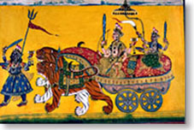
BASOHLI school
The earliest centre of painting in the Pahari region was Basohli where under the patronage of Raja Kripal Pal, an artist named Devidasa executed miniatures in the form of the Rasamanjari illustrations
The Basohli style of painting is characterised by vigorous and bold line and strong glowing colours
An illustration from a series of Gita Govinda painted by artist Manaku shows further development of the Basohli style depicts Krishna in the company of gopis in a grove on the bank of a river.
There is a change in the facial type which becomes a little heavier and also in the tree forms which assume a somewhat naturalistic character, which may be due to the influence of the Mughal painting
Otherwise, the general features of the Basohli style like the use of strong and contrasting colours, monochrome background, large eyes, bold drawing, use of beetles wings for showing diamonds in ornaments, narrow sky and the red border are observable in this miniature also.

Slide 47
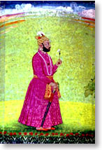
Guler school
The last phase of the Basohli style was closely followed by the Jammu group. of paintings mainly consisting of portraits of Raja Balwant Singh of Jasrota (a small place near Jammu)
by Nainsukh, an artist who originally belonged to Guler but had settled at Jasrota.
He worked both at Jasrota and at Guler.
These paintings are in a new naturalistic and delicate style marking a change from the earlier traditions of the Basohli art.
The colours used are soft and cool. The style appears to have been inspired by the naturalistic style of the Mughal painting of the Muhammad Shah period.

Slide 48
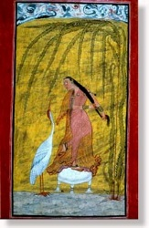
Kullu-mandi school
flourished a folk style of painting in the Kulu-Mandi area, mainly inspired by the local tradition.
The style is marked by bold drawing and the use of dark and dull colours. Though influence of the Kangra style is observed in certain cases yet the style maintains its distinct folkish character.
A large number of portraits of the Kulu and Mandi rulers and miniatures on other themes are available in this style.
example of the Kulu painting is of two girls flying kites.
The miniature is in the folk style of the late 18th century and is marked by bold drawing and dark and dull colour scheme.
The background colour is dull blue. The girls are wearing the typical costumes and ornaments which prevailed in the Kulu region in that period.
Two flying parrots indicate sky in a symbolic manner. The miniature belongs to the collection of the National Museum.

Slide 49
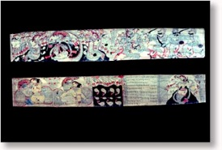
Orissa school
The earliest surviving examples of miniature painting in Orissa appear to belong to the 17th century A.D.
Some good examples of the paintings of this period are a court scene and four illustrated leaves of a manuscript of the Gita Govinda
In Orissa, palm-leaf continued to be used even upto the 19th century. The outline drawing was rendered with a stylus on the palm-leaf and then charcoal or ink was rubbed on the drawing.
A few colours were sparingly used to fill in the designs. The technique of painting on paper was, however, different and was like the one used in other schools of painting.
The early manuscripts display a neatness in drawing. Later on in the 18th century the line becomes bold and a little crude but the style in general is very decorative and ornamental.

Slide 50
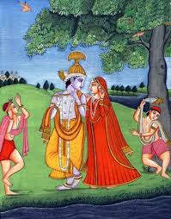
Kangra school
Raja samsarchand promoted
Love scenes of Radha-Krishna
The school translated poetry into paintings
Famous painters-manku,kishanlal and pattu

Slide 51
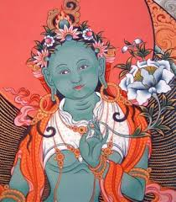
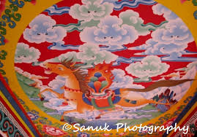
Thangka school
Ladakh region
Miniature paintings
Chinese influence
Popular symbol-dragon
Theme-Buddhist
Use of silk in the painting

Slide 52
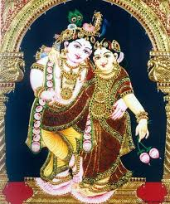
South Indian Painting
(1) Tanjore school
By Chola rulers
Theme-hindu Gods and Goddesses
Pictures of child Krishna-smiling faces of figures
Mainly glass paintings—miniature
Pure concentration on decoration
Liberal use of gold

Slide 53
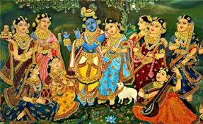
(2)Mysore school
17th-19th century
Theme-Hinduism
Particular type of paste-known as GESSO
Paste made of zinc oxide and Arabic gum
Unique feature-it has two or more figures. The main subject is shown larger than others(inequality)
Use of muted colors
Mostly miniature paintings

Slide 54
Folk paintings
Developed regionally
Folk tales, native heroes painted
Local vegetation,
Reflects the customs and culture directly

Slide 55
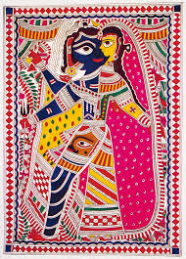
Madhubani paintings
Mithila region,Bihar
Theme-Hindu Gods,mythology,wedding scenes,festival scenes,erotic scenes,Royal court scenes
Exclusively done by women painters
Before 1967-mural paintings mainly
After 1967-shifted to miniature paintings
No space left empty
Unique feature-outline directly drawn with brush without any preliminary sketching
2D figures
Symbols are used in stead of things
Used of coloured rice-Aripan
Kohbar-mural paintings in bedroom-erotic theme
Painters-Sita devi

Slide 56
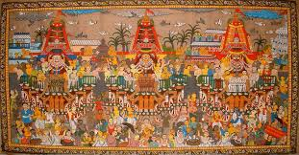
Pattachitra
Traditional painting of Orissa, India.
Based on Hindu Mythology and inspired by Jagannath and Vaishnava cult.
Natural colours are used in fully old traditional way by Chitrakaras that is Oriya Painter
Is painted on canvas (Patta). Carefully done craftsmanship, rich colors, unique designs & creative motifs, & simple themes, which are chiefly mythological in origin on canvas.
Paintings on the cave walls of Khandagiri and Udayagiri, Konark temple, and many other temples in Orissa.

Slide 57
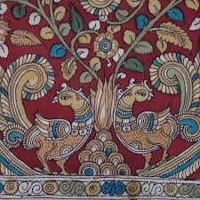
kalamkari
Done by using kalam (pen).
Has two subtypes:
Mausalipatnam style paintings focus on the Islamic aesthetics and the ripe fruits is used to color the paintings.
Srikalahasti style draes paintings on the hindu mythology and the color is drawn from raw fruits.

Slide 58
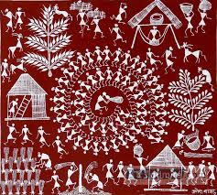
Warli paintings
Tribal paintings
Maharashtra region
Mural paintings
Cow dung is used for background plaster
White coloured rice paste is used to draw figures

Slide 59
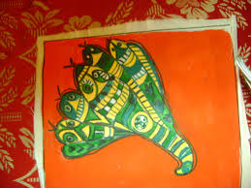
Manjusha paintings
Bhagalpur region,Bihar
Also called as Angika art
Mainly snake paintings
Done on the boxes of jute and paper

Slide 60
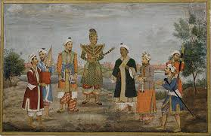
Patna qulam paintings
Theme-common man,daily life scenes
Miniature
Male artists dominates
Indo-british style
Painters-sevakram

Slide 61
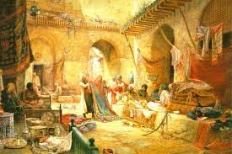
Baazar paintings
Bengal region
European influence-figures of roman and greek statues are copied
Figures of Indian gods with many arms etc are condemned because they didn’t follow human representation
Everyday baazar scenes,female dancers dancing before british officers

Slide 62
Modern painting
Western influence
Started by Raja Ravi Varma
Not started for glorification
Paintings-lady in moon light,Ravan kidnapping sita

Slide 63
Bengal school
Use of simple colours
Reactionary approach
Primitive features are revived
Painters-Abhanindranath Tagore-Arabian night series
Rabindranath Tagore

Slide 64
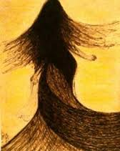
Rabindranath Tagore
Use of black ink lines-dominate
Sense of rhythm
Spiritituality in his images
Paintings are directly linked to his writings

Slide 65
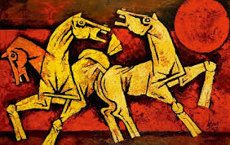
M.F.Hussain
Perfect balance between line and color
Photographer,painter and film-maker
Picasso of India
Theme-persofication of romance
Theme-abstract art
Favourite motif-horse
Cubist style

Slide 66
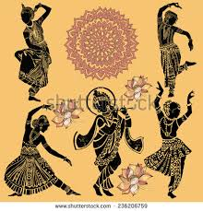
2.Performing Arts
Indian Music
Indian puppetry
Indian circus
Dance forms
Indian theatre & drama

Slide 67
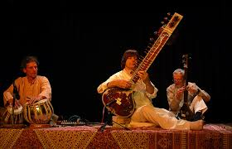

Slide 68
Indian Music
Origin-samveda and its Upveda-Gandharvaveda
Narad is the first person who heard the message from God
Naad is supposed to be the basis of all creations
Bharatmuni’s natyashastra contains several chapters on music
Bharat muni defined music as nritya,gayan and vadan

Slide 69
Pillars of Indian Musical system
Swara
Raga
Taal

Slide 70
(1)swara
Pitch or tone
Notes
Primitive sound AUM gave birth to swaras
7 swara-Sa Re Ga Ma Pa Dha Ni
Sa-sadcha, Re-Rishabh, Ga-Gandhara, Ma-madhyam,
Pa-Pancham, Dha-Dhaiwat, Ni-Nishad

Slide 71
(2)Raga
It forms the basis of melody
Combination of swaras
In every raga,there are at least 5 swaras
Hence,there are 3 kinds of Ragas
Odava Raga-5 swara/notes
Shadava Raga-6 swara
Sampurna Raga-all 7 swara
In Hindustani music, there are 6 principal ragas
Ragas are time specific, season specific and mood specific.

Slide 72
Hindola raga-
Time-dawn,season-spring,mood-sweetness of young couple
Dipak raga-
Time-night,season-summer,mood-compassion
Megh raga-
Time-mid-day,season-monsoon,mood-courage
Sri raga
Time-evening,season-winter,mood-gladness
Malkaus
Time-mid night,season-winter,mood-youthful love
Bhairavi
Time-morning,season-autumn,mood-peace and devotional

Slide 73
(3)Taal
Basis of rhythm
Arrangement of bits in a circular manner
Total 32 kinds of taal
range of bits-3 bit to 108 bits
3 taal-16 bits

Slide 74
Indian music
classical
Hindustani style
Modern
Rock
Blues
Others(fusion of classical and folk)
Stree geet
Lavani
Carnatic style
Jazz
Pop
Trans
Folk Music
Sugam Sangeet
Rabindra Sangeet
Haveli Sangeet
Gana Sangeet
Panihari
Wanawan
Mand

Slide 75
Classical Music
Hindustani style
Continuity back to Vedic times
Freedom to artists
Carnatic style
Of more recent origin
No freedom
Hence, concept of gharana
No such Gharana
Intellectual and spiritual music
Emotional music
Northern and western India
Peninsular India
More Ragas(72)-melakarta
Less Ragas-6
Ragas adhers to time,mood and season etc.
Ragas doesn’t adhere to time or anything else
More emphasis on vocal music
More emphasis on Instruments
Instruments-veena,mridangam,mendolin
Common instruments-violin,flute
Outside influence
Completely indegeneous
Gradual building up of tempo from very slow to very fast
Constant and fairly fast tempo throughout
Raga based
nstruments-table,sarangi,sitar,santoor
Composition based

Slide 76
Sub styles under Hindustani classical
Dhrupada
Khayal
Dhammar
Thumri
Tarana
tappa

Slide 77
(1)Dhrupad
Mother of all sub-styles
Vedic origin
Developed in temples
Pronouncing mantras in proper tone
Performance of dhrupad-aalap and Bandish
Systematic arrangements of musical parts
Theme-Religion,philosophy,devotion,celebration of seasons
Promoted by Rja Mansingh Tomar of Gwalior
Akbar also made it popular through Haridas,Tansen and Baiju Bawra

Slide 78
4 gharanas under Dhrupad style
1)Dagar Gharana
Also known as Jaipur gharana
Related to Dagri Bani
Gundecha brothers,Haridas,Behram Khan
2)Darbhanga Gharana
Bihar
Related to gauhar bani
Founder-kartaram
Malik family

Slide 79
3)Betiah Gharana
bihar
Related to Khandar bani
Hyder khan
4)Talwandi gharana
Punjab
Related to Nauhari bani

Slide 80
(2)Khayal
Khayal means an idea,thought or imagination
More free and flowery
Theme-divine love, separation of lovers,pranks of lord Krishna
Lyrics-ornamental
More words are used
Use of taan-tempo
Performance of khayal on the base of tempo
1)Bada khayal
2)Chhota khayal

Slide 81
4 ghranas under khayal style
(1)Gwalior gharana
Oldest
Vishnu palushkar-famous song-raghupati raghav raja ram
(2)Kirana gharana
Kurukshetra,Haryana
Pt.Bheemsen Joshi,Gangubai
(3)Patiala gharana
Rhythm is important
Focus on emotions
Founder-ustad bade gulam ali khan
Begum Akhtar,Naina devi
(4)Agra gharana
Also known as rangeela gharana
Importance of raga
Vijay kichlu,C.R.vyas

Slide 82
(3)Dhammar style
Dhammar taal
14 beats-irregular beat
More freedom
Theme-erotic,Krishna,festsivals etc

Slide 83
(4)Thumri style
Mixed ragas
Use of light and romantic words
Theme-romantic
Songs sung in BRAJ BHASHA
2 types
(1)Purbi thumri
(2)Punjabi thumri

Slide 84
(5)Tarana style
Rhythm is important
No meaning words
Fast tempo
Emphasis on producing rhythm
Requires specialization and skill for rythemic manipulation

Slide 85
(6)Tappa style
Punjab
Initially sug by camel drivers of north-west
Very quick phrases are used
Short taan,without much elaboration
The style is getting extinct
Artist-Miyah sodi

Slide 86
Other styles(fusion of classical and folk)
Sugam sangeet
Rabindra Sangeet
Haveli sangeet
Gana sangeet

Slide 87
(1)Sugam sangeet
Devotional songs
(1)Bhajan-sung in praise of god-meera,nanak,kabir
(2)Kirtan-Bengal region,music+dance,influence of Gitagobinda
(3)Shabad-Punjab,sung by sikh gurus
(4)Quawalli-sufi element,started by Aamir khushro
(5)Abhanga-maharashtra-namdev,tukaram harashtr
(6)Bhatiyali-boat songs from Bengal,devotional theme
(7)Tewaram-tamilnadu,sung by shaivites
(8)Ghazal-devotional touch-Persian influence on indian music
Independent couplets,theme-mystical,secular or philosophical
Artists-Mirza galib,bahadurshah zafar

Slide 88
(2)Rabindra sangeet
Sung by rabinranath tagore
Worship,nature,love,celebration

Slide 89
Haveli sangeet
Temple music
Popular in rajasthan and Gujarat
Pushtimargi sampraday

Slide 90
Gana sangeet
• Eg: Apni Azadi Ko Hum Hargis Mita Sakte Nahin, ajadee hoyni tor, Kadam kadam badhaye jaa, Vande Mataram etc.
• Generally sung in chorus carrying some social message.
• The songs are usually about Freedom, community strength, patriotism.
Due to the British occupation in India, a lot of protest songs about anti-imperialism/pro-socialism

Slide 91
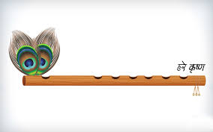
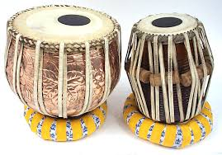
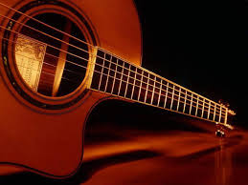
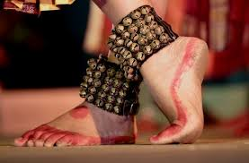
Musical instruments
(1)Sushir vadhya
Wind instruments
Also known as aerophones
Flute,pungi,mouth organ,nadswaram
(2)Avanad vadhya
We have to strike it to get the sound
Ie-tabla.,dhol,pakhwaj
(3)Taar vadhya
String instruments
Guitar,violin,ravanhattha,santoor
(4)Ghana vadhya
Solid instruments
Rhythm keepers
Ghunghru,jal tarang.dandiya,matki

Slide 92
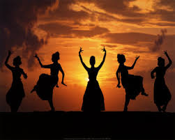
Indian Dance

Slide 93
Dance is a form of art, where the body is used as a medium of communication
The dance heritage of India is at least 5000 years old.
Dance is of divine origin
Ritual form of worship in temples
The wall paintings of Ajanta and Ellora, the sculptures of Khajuraho stand ample evidence for popularity of Indian dances from ancient times
Nataraja, the dancing Lord Shiva, is the supreme manifestation of Indian dance

Slide 94
Natyashastra
Principals of Indian classical dance derived from natyashastra of bharatmuni
Bharatmuni traces its origin from lord brahma-5th veda-natyaveda from existing 4 vedas
Pathya(words) taken from Rigveda
Abhinaya(gestures)taken from Yajurveda
Music taken from Samveda
Rasa(emotions) taken from Atharvaveda

Slide 95
Basic aspects of dance
(1)Tandav-movements and rythm
(2)Lasya-bhaav,grace,ras and abhinaya
In every dance,presence of mudras and rasa is must
9 rasa-happiness,sorrow,compassion,wonder,anger,fear,courage,disgust and peace
108 fundamental mudras
Dancde is considered to be complete art

Slide 96
Indian Classical dance
8 classical dances
Two elements
(1)governed by rules of natyashastra
(2)Guru-shishya parampara
(3)Recognized by Sangeet-natak akademi

Slide 97
8 classical dances of India
Bharatnatyam
Kuchipudi
Kathakali
Mohiniattam
Odishi
Manipuri
Kathak
sattariyaa

Slide 98
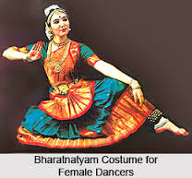
Bharatnatyam
Oldest among all slassical dances
Bhava (expression), Raga (music), Tala (rhythm) and Natya (classical theater).
It originates in South India.
It consists of multiple items:
Nritta- pure dance movements Abhinaya- dramatic art of storytelling
Nritya- combination of nritta & abhinaya
Evolved from devdasi tradition
Previously known as sadir,bashiattam and tanjaur natyam
Intially solo dance performane dominated by females
Performed on Carnatic music.

Slide 99
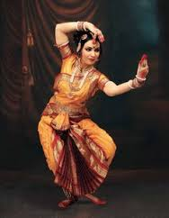
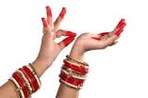
Costume are made of silk saris with gold embroidery and has a lot of pleats
Necklace, Bangles and head ornaments are used as jewelry
Bells mounted on woven pads are worn on the feet
Fire dance
Tandav and lasya both aspects are involved
Knees are bent
Dancers right hand mundra-katkamukh generally
Visualise her body like triangle
Theme-religious and devotional
Ekcharya lasyanga style-one dancers plays many different roles
Generally perfoemance completed with chanting of shlokas
Music-carnAtic,language-Sanskrit,tamil
artists-chiniya,ponaiyya pilley,vadivelu,shivanandam
Present-rukmani Arundey-kalakshetra academy,yamini krishnamurti,sonal mansingh

Slide 100
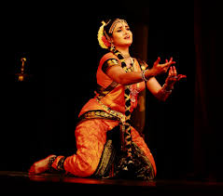
kuchipudi
It originates from Andhra Pradesh.
Village name-kuchipudi
Intially done by male artists in group-called bhagvatharu
It shares many common elements with Bharatanatyam.
Theme-initially based on bhagwatpuran later a secular theme with dominance of shringar
In Tarangam (a unique kuchipudi dance)- dancer dances on plate with diyas in the hands and vessel of water on the head.
Carnatic music is used.
Costumes are similar to Bharatanatyam.

Slide 101
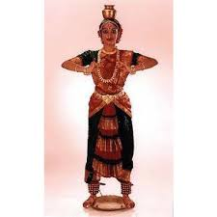

Costume also include ‘Katcham’ (long fold) at the back of the costume
Female characters wear ornaments and jewelry.
Dancer combines herself into singer
Use of speech
Unique feature-Taal chitra natya-dancers draw painting on the floor with dancing toes
Manduk shabdam-story of a frog
Laasya and tandav both present
Artists-Raja and radhar Reddy,esther sharman,Indrani Rehman

Slide 102

Kathakali
It originates from Kerala state.
Katha+kali
Dance drama
Theme-mythological
Conflict between God and evil in grand manner-bhadrakali n asur wars
Facial expression-eye and eye-brows
Attractive make-up of characters and elaborate costumes are used.
Performance is a combination of five elements: >Natyam (expression),
>Nritham
(dance), >Nrithyam (enactment), >Geetha m (vocal) and >Vadyam (instruments)
Carnatic music is used with Manipravalam as language of songs.

Slide 103

Elaborate make-up is used
Green face color- noble characters (Pacha) >Green with red streaks- characters with evil streaks >Red face color-excessively evil characters >Women have yellow face color
• Costumes are elaborate and differ according to character
Origin in temples
Generally it performed in open air
It starts at night and ends with the arrival of dawn
Brass lamp on the stage
At the starting,continuous thundering of drums
Arists-kala mandalam gopi,kala mandalam murli

Slide 104

Mohiniattam
Its name is derived from:
Mohini- temptress and Attam- dance
It’s a graceful dance performed only by women.
Theme-love,devotion
Laasya aspect dominates
It has influences from Bharatanatyam and Kathakali
Music includes Vocal (called chollu), Veena, flute, Maddalam & Idakka.
It is characterized by realistic makeup and simple dressing.
Costume includes white or cream sari with gold border and is profusely pleated
Mainly gold ornaments are used as jewelry
Artists-madhvi amma,chinnamu amma

Slide 105

Odishi
It originates from Orissa.
Patronized by king kharvel
Theme-radha Krishna love,dashavtar,jagannath philosophy
Consists of three schools(1) Mahari, (2 )Nartaki and (3) Gotipua
Mahari-devadasi tradition
Nartaki-royal courts
Gotipua-young boys acting as female
Main feautres of performance are:
>Tribhangi- independent movement of head, chest and pelvis
>Chauka- basic square stance

Slide 106


Odissi music is used.
Similar to bharatnatyam in terms of mudras and expression
Costume feautres Sari- beautiful cloth wrapped around body in traditional style in bright shades of orange, purple, red or green.
Jewelry includes:
Tikka (forehead ornament)
Allaka (headpiece where tikka hangs)
Ear covers in intricate shapes with jumkis (bell shaped earrings) hanging from them --Chains
Two sets of bangles (thin bracelets) worn on upper arm and wrist
Generally group dance-create geometrical patterns-most beautiful pattern-spiral odishi performance concludes with a sculpture like pose-mobile sculpture
Artists-sonal mansingh

Slide 107

Manipuri
It originates from Manipur state.
Few features in its performance are:
>Movements are subtle and aim at devotion and grace
Both elements nritta and natya are balanced here
Laasya aspect dominates
Focus-knee and hand movements,not on expression
>Rounded movements without jerks and sharp lines
>Dancers feet never strike the ground hard
Music is provided by a singer, ‘Pung’(drum), cymbals and flute.

Slide 108

Costume includes:
> Female- dress called patloi and lehenga called kumin. Transparent odni is worn on the head and covers the face.
>Male- usually saffron dress depicting Lord Krishna
Dancers do not wear ankle bells in this dance form
The dance attempts to connect body through curves with a pose in the shape of 8-Nagbhanga mudra
Theme-life of Vishnu,radha krishna
Contribution of Rabindranath tagore-he promoted Manipuri dance in shantiniketan

Slide 109


sattriya
It originated in Assam state.
Traditionally performed by male monks-bhokoths in monestries as part of daily rituals
Promoted by bhakti saint-Shankar dev
Performances are based on mythological stories and is performed by both men and women.
It is recognized as one of the classical dance forms of India in 2000.
Devotional songs called borgeets are used.
1st position called-ora
Both tandav and laasya aspect involved
Instruments used are khols (drums), taals (cymbals) and flute.
Costume are made of pat (type of silk).
Ornaments are based on traditional Assamese design

Slide 110


kathak
Name is derived from Katha (story) and Katthaka (who tells stories).
It originates from North India.
Used to a temple dance,later royal patronage-court entertainment
Spontenity
Freedom
Room for innovation and improvisation
There are three main gharanas or schools: >
Lucknow
Jaipur
Benares

Slide 111


Based on bhaav,raga and taal
Usually dancers sing themselves
Emphasis on footwork
Fundamentally-solo performance
Main attraction –jugalbandhi between dancer and tabla artist
Theme-radha-Krishna
Dance progresses from slow to fast pieces. Has Footwork & spins and includes abhinaya-expression Performed on Hindusthani music provided by Tabla, Sitar, Santoor
Costume includes-Ghungroos or bells on the ankles
Female- lehenga choli or chudidaar kameez
Male- bare chest and dhoti or kurta churidar
Artists-Birju maharaj,lacchu maharaj,sitara devi
Some kathaks are called gat bhaav

Slide 112

Folk dance-chhau
Recognized by UNESCO
Mask dance
Chhau means chhaya or shadow
Theme-mythological-based on Ramayana or Mahabharata-conflict between God and Evil
Martial movements are present here
Hindustani music
Performed during Chaitra nonth
3 sub styles
Sarai kella chhau-popular in Jharkhand
Purulia chhau-in w.Bengal
Mayurbhanj chhau-mask is not used

Slide 113

Purulia chhau
Originated from the Purulia distrct .
Mostly performed in the open space or ground field during the night.
•It is a mask dance performed only by the male dancers.
The masks are made up from the clay and paper.
It is mythological, as it is mainly based on various episodes of the epics Ramayana and Mahabharata.
As the singer complete the invocation song, a host of drummers and musicians start beating the Dhol and the Dhamsa

Slide 114



Martial dances
Chhau
Gatka from Punjab-nihanga community
Thangta-fro Manipur-display of swords important
Kalaripattu-from kerala

Slide 115
Indian puppetry
A form of theatre or performance involving manipulation of puppets.
The process of animating inanimate performing objects. Used both as entertainment - in performance - and ceremonially in rituals and celebrations such as carnivals.
Originating in India 4000 years ago, where the main character in Sanskrit plays was known as “Sutradhara”, “the holder of strings”.

Slide 116

Types of puppetry

Slide 117

String puppetry
Jointed body and limbs that allow movement.
Made of wood, or wire, or cloth stuffed with cotton, rags or saw dust and are usually small.
Manipulated by operating the control as well as by loosening or pulling the relevant string
Regional variations:
Andhra Pradesh (Koyya Bommalata), Assam (Putala Nach),
Karnataka (Sutrada Gombeyata), Maharashtra (Kalasutri Bahulya),
Rajasthan (Kathputli),
Orissa (Gopalila),
Tamil Nadu (Bommalatam) and West Bengal (Tarer or Sutor Putul)

Slide 118

Shadow puppetry
Flat figures cut out of leather, treated to make it translucent.
Pressed against the screen with a strong source of light behind it.
The manipulation between the light and the screen make silhouettes or colourful shadows, as the case may be, for the viewers who sit in front of the screen.
Prevalent in Orissa. Kerala, Andhra Pradesh, Karnataka, Maharashtra and Tamil Nadu.
Tholu Bommalata, Andhra Pradesh
Large in size and have jointed waist, shoulders, elbows and knees.
The classical music of the region
Coloured on both sides. Hence, throw coloured shadows on the screen.

Slide 119


Ravanachhaya, Orissa
Small in size and are in one piece with no joints.
Made of deer skin and are conceived in bold dramatic poses.
Not coloured, hence throw opaque shadows on the screen
Apart from human and animal characters, many props such as trees, mountains, chariots, etc also used.

Slide 120


Glove puppetry
The head is made of either papier mache, cloth or wood, with two hands emerging from just below the neck.
The rest of the figure consists of a long flowing skirt.
The movements are controlled by the human hand the first finger inserted in the head and the middle finger and the thumb are the two arms of the puppet.
Popular in Uttar Pradesh, Orissa, West Bengal and Kerala.
Dilogues play an important role

Slide 121

Rod puppetry
Extension of glove-puppets, but often much larger and supported and manipulated by rods from below.
Found mostly in West Bengal and Orissa

Slide 122

Putul Nautch, West Bengal
costumed like the actors of Jatra, a traditional theatre
Carved from wood and follow the various artistic styles of a particular region.
Used to be of human size, but existing puppets vary from 3 to 4 feet in height
Music of Jatra theatre (drum, harmonium and cymbals)
Puppeteers themselves sing and deliver the stylized prose dialogues along with a group of musicians
Manipulated by a bamboo-made hub tied firmly to the waist of the puppeteer on which the rod holding the puppet is placed.
Puppeteers move and dance imparting movements to puppets.

