Slide 1

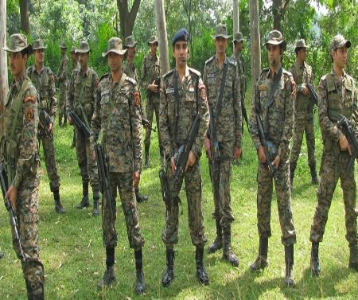
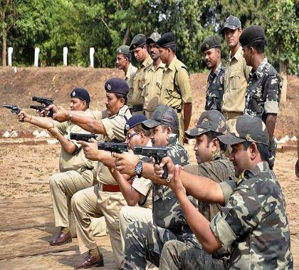
Internal Security in India- Naxal Movement
Compiled by : Pratik Nayak
Mrunal.org

Slide 2

Introduction
Kautilya wrote in the Arthashastra
A state could be at risk from four different threats
Internal
External
Externally-aided internal and
Internally-aided external
Internal security scenario in India has a mix of all the shades of threats visualized by Kautilya
According to an estimate, 252/640 districts→ affected by varying intensities of subversive, insurgent and terrorist activities
Naxalist/Maoist-173 district
Separtists,Terrorist in J&K-15 district
Ethnic insurgents outfits-64 districts of NE India
Mrunal.org

Slide 3
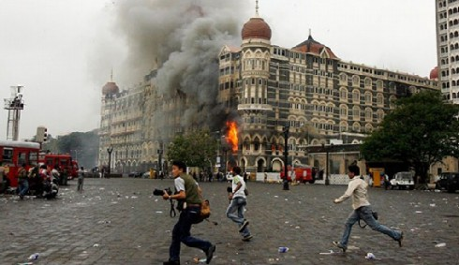
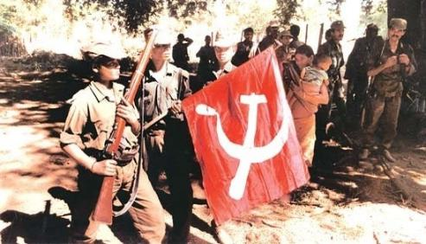
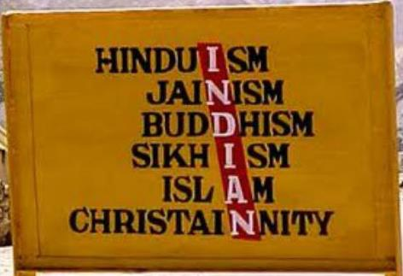

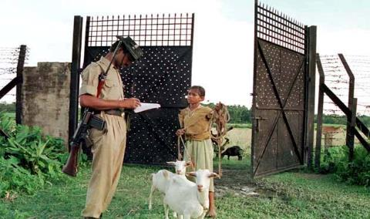
Major Challenges
Threat of terrorism, international and domestic
China fishing in the troubled waters of the northeast
Maoist insurgency spreading to other areas largely due to absence of a strategic plan to deal with the problem
Illegal Migration/Movement
Regional aspirations
Inter-state disputes
Communal problems
Caste tensions
Mrunal.org

Slide 4
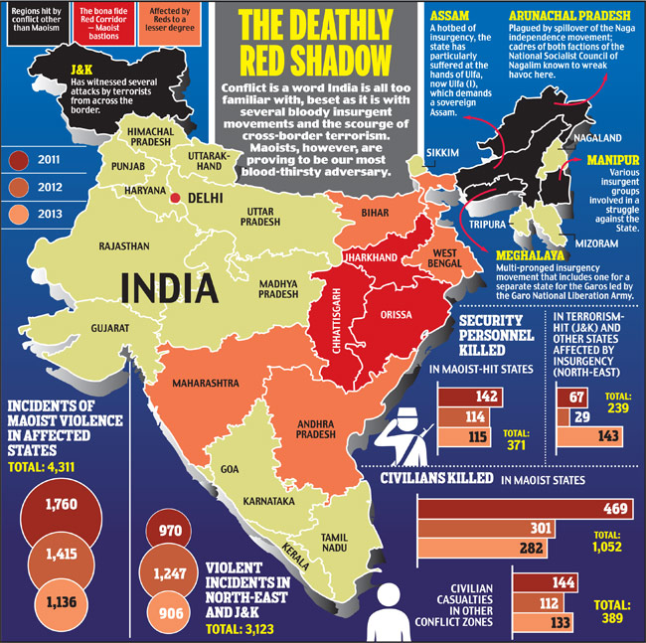
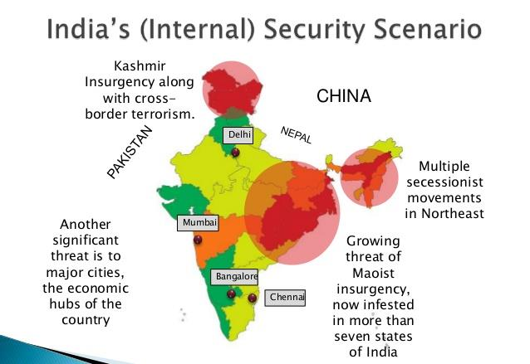
Major Challenges
Mrunal.org

Slide 5

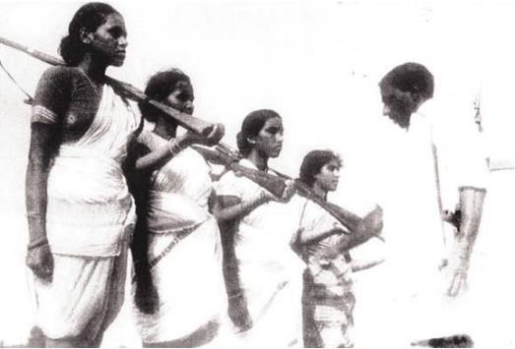
Naxal: History
Definition of Naxalites
left-wing extremists, adhering to the
ideology of Maoism
Revolutionary communism against the state in India did not begin with the birth of Naxalism
Agitation by communists was present in the Telangana movement (1946 – 1951)
Rebellion focused its ire against the land-owning elite and was helped along by the Communists of the time spreading propaganda against the land-owners
Objective of the movement was to establish its own state, which would be ruled by a Telugu-speaking majority
Communist ideology was not the starting point of the rebellion
Mrunal.org

Slide 6
Naxal:History
Due to Existing land rights disputes people had made them sympathise with the Communist party members, who in turn helped the Telangana movement become more wide-spread and better organized
Eventually this conflict was ended by the security forces of the newly independent Indian state
Telangana movement provided an inspiration for the Naxalite movement, but the political context of the late 1960's is also important
Mrunal.org

Slide 7
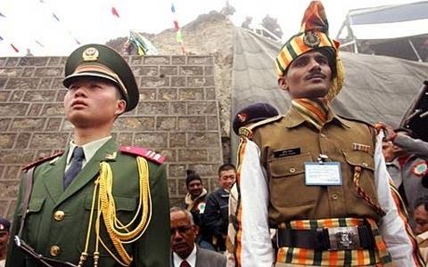
Naxal:History
Indian communist movement was having its discussions throughout the decade about which strategic approach would be best in the Indian society – the revolutionary or the reformist
Communist Party (Marxist) had split from the Communist Party of India (CPI) in 1964, influenced by the Sino-Indian War of 1962, but also by the differences of opinion on what stage the revolution was in
(Congress) formed the United Front government alongside CPI(M) in 1967 in West Bengal
Mrunal.org

Slide 8
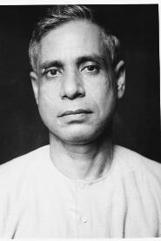
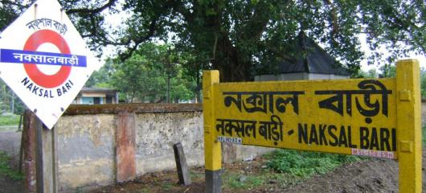
Naxal:History
The day the new Chief Minister Ajoy Mukherjee was sworn in, there were news of the first incident in the village of Naxalbari
Tribal youth named Bimal Kissan obtained a judicial order permitting him to plough his land
Incident began with Bimal Kissan going to plough his land, when attacked by landlords and their goons
other Tribal people attacked the landlords
Chaotic period of Indian history were the food shortages caused by rationing after the Indo-Pakistan border conflict in 1965 - 1966
Mrunal.org

Slide 9
Naxal:History
Conflict in Naxalbari was a slow, simmering one with the occasional flare up – eventually, in July 1967, after the death of a policeman and nine adivasis, the state government had to formulate a response to the Naxalite problem
Solution was to speed up land reform, set up distribution committees and tackle the violence with police response
Government itself was questionable, and protests in favour of Naxalbari were increasing in the state capital, Kolkata
1968- President’s rule imposed in state
May 1968 Formation of All India Coordination Committee of Communist Revolutionaries (AICCCR)
Mrunal.org

Slide 10
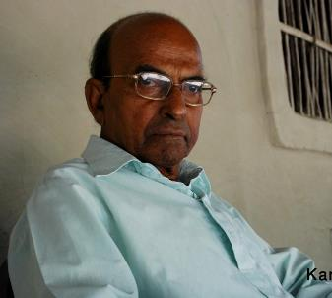

Naxal:History
1969, defections from CPI(M) and the release of Naxalite leader Kanu Sayal lead to the formation of a new party aimed to become a true revolutionary party: The Communist Party of India (Marxist- Leninist)
Kanhai Chatterjee who believed that “annihilation of the class enemy should only be undertaken after building up a mass agitation” would form the Maoist Communist Centre(MCC)
Naxalites spreading their ideology in universities radicalised some students and mid-year, a group of students stormed the state's Legislative Assembly
Naxalites had launched violent campaigns in rural areas and the state was rife with peasant unrest, inter-party violence as well as Naxalite violence
Mrunal.org

Slide 11
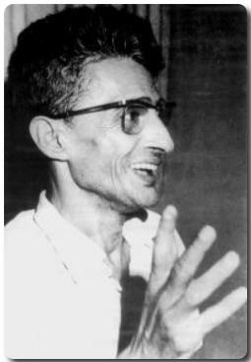
Naxal:History
February 1970, main ideologue, Charu Mazumdar detailed his plans-later titled as “murder manual”, essentially directions for how the movement could spread hatred of class enemies (mainly landlords) among the peasantry
Congress party began organising hoodlums to fight Naxalites, forming resistance groups with significant numbers
Naxalites were soon subdued, and Charu Mazumdar was arrested in 1972, later died in police custody
Movement in West Bengal was not the only centre of militant left-wing activism, it inspired communist groups in the southern state of Kerala and Srikakulam, Andra Pradesh, to ally themselves with the Naxalite cause and even call themselves Naxalites
Mrunal.org

Slide 12
Naxal:History
Charu Majumdar’s death, the CPI (M-L) was deprived of any credible central leadership and the party withered away to be finally reborn as CPI (M-L) Liberation in 1974
General consensus is that the movement had ceased most activities by the time prime minister Indira Gandhi imposed a state of Emergency on the whole nation in 1975
In 1977. There was subsequently a split in radical left-wing thinking in India – movement began favouring participation in elections and trade unions, while others still saw armed struggle as the way to move forward
Post emergency Communist movement splitting yet again to give birth to the CPI (ML) (People’s War Group-PWG)
1982, formation of the Indian People’s Front (IPF), which would later become the political front of the CPI (ML) Liberation
Mrunal.org

Slide 13
Naxal:History
Original CPI (ML) was committed to an “armed struggle” against the Indian State, the CPI (ML) Liberation adopted a more centrist line advocating participation in the larger parliamentary democratic process
Under the banner of the IPF, its political front, when it emerged victorious in the Ara Lok Sabha Constituency (in Bihar) in the 1989 elections. This was a feat of sorts as Bihar sent the first ever “Naxalite” to the Lok Sabha in history of India’s Parliamentary democracy
1994, the Indian People’s Front (IPF) was disbanded and the Election Commission recognized the CPI (ML) as a political outfit
CPI (ML) Liberation adopting a more moderate stance and participating in the parliamentary process
Mrunal.org

Slide 14
Naxal:History
Similarities between the PWG line of thought and that of the Kanhai Chatterjee faction of the AICCCR which formed the Maoist Communist Centre (MCC) which advocated creating of mass organisations to sustain the “armed struggle” is hard to miss. It is this convergence of thought that would later lead to a merger of the two outfits
End of the 80's and throughout the 90's, the groups seeking armed struggle had established militant peasant bases in Bihar, Madhya Pradesh, Maharastha and Orissa
Activities took place in what would eventually be titled “the red corridor”, an area stretching from the north-east (Bihar), across the subcontinent to the south-west (Maharasthra)
Mrunal.org

Slide 15
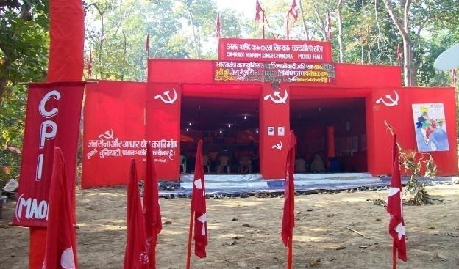
Naxal:History
Q. Present day Communist party of India (Maoist)
Communist Party of India (Maoist) came into existence in September 2004 following the merger of the Maoist Communist Centre (MCC) and the People’s War Group (PWG).
Merger was officially recognized in November 2004 at a press conference in Hyderabad on the eve of the peace-talks between the PWG and the Andhra Pradesh Government
Meger re-energised the movement, though their goals remain the same – agrarian revolution through people's war for seizure of power from the state
Mrunal.org

Slide 16
Naxal:History
Coming together of PWG and the MCC wasn’t a smooth ride and was fraught with hurdles along the way. Clashes between the MCC and the PWG would occur on regular basis
People’s War Group (PWG) line of thought completely rejected the idea of parliamentary democracy - most important of all the splinter groups as the prevalent Naxal ideology and policies of today arise primarily from the principles espoused by the PWG
Creation of the State of Jharkhand in the year 2000 and the security offensive mounted by the Administration acted as a ballast for closer cooperation between the PWG and the MCC which resulted in their coming together under one umbrella which later came to be known as the CPI (Maoist) in 2004
Mrunal.org

Slide 17
Naxal Timeline
CPI
CPI (Marxist)
1964
AICCCR
1968
CPI(Marxist-leninist)
1969
CPI(M-L) Liberation
1974
Maoist Communist Centre -MCC
1975
CPI (M-L) Peoples War Group
1977
Merger of MCC and PWG→ CPI (Maoist)
2004
Mrunal.org

Slide 18

Naxal: Ideology
Began principally on the foundations of an ‘agrarian struggle’ as encapsulated by the events at Naxalbari, West Bengal in 1967
Muppalla Lakshmana Rao alias Ganapathy, Head of the CPI (ML) (PWG)
In our agenda for a new democratic revolution, there are two aspects -- the agrarian revolution and fight for nationality
Its a Departure from the objectives of the original CPI (ML)
new agenda to “fight for nationality”
Concept of “nationality” targets the diverse and delicate fault lines that exist in India today
India is a diverse mix of culture, language and religion. Over the years, regional sub-nationalism and identity has come into the forefront. It is primarily this faultline that the Maoists seek to exploit to advance their agenda
Mrunal.org

Slide 19
Naxal: Ideology
The Maoists seek to broad base their movement
Organisationally, they seek to capture the country side though a prolonged guerilla war and then move towards urban areas
They also seek to attract professionals to defend and propagate their agenda among the educated classes and opinion makers
Principal aim to create sympathy and provide visibility to the movement lies on the shoulders of these professionals who will play a supporting role to spread the Maoist line of thought
Principal undercurrents of the Maoist thought has been its agenda against feudal lords and waging of a “class war”.
Initial years of the movement, the main objective of the Naxalite movement was to carry out an “armed struggle” against the landlords and win back tribal land for tilling and other agricultural activities
Mrunal.org

Slide 20
Naxal: Ideology
Change of ideologues in the Maoist rank in a bid to broadbase their movement, have identified a new enemy: The imperialist forces and their evil designs to inflict economic repression on the poor
2009 document released by the CPI (Maoist) Politburo, it extensively talks about how the parliamentary system has been compromised in the hands of the “imperialists” and the role of the Indian State in carrying out the agenda of such forces at the cost of the poor
Interesting observation in the document is the lenient stance of the Maoists towards regional parties
It is highly critical of the two national parties, it is supportive of the growth of the regional parties and their influence at the national level
Why??
Indirect support to regional parties from the Maoist in a way builds upon the PWG line of thought on “nationality”, emphasizing the importance of regional sub-nationalism and the assertion of regional identities
Mrunal.org

Slide 21
Naxal: Ideology
Post liberalization era has seen tremendous economic growth which has led to an unequal distribution of wealth
This has led to discontent among the poor and the frustrations of having been left out of the growth process has provided a fertile ground for the CPI (Maoist) to spread their movement further by creating a new enemy in the form of the Indian State which is presented to the tribals and the deprived classes as a “fascist force” carrying out the Imperialist agenda
Q. Naxalism Spread in 1990s and 2015
From a small “agrarian struggle” against the local landlords in Naxalbari village to as broad an “enemy”, the Maoists have successfully created a strong mass organisation from the tribes and local communities in deep forests of India capitalizing on their fears and frustrations
Q. Why this has spread????
Mrunal.org

Slide 22
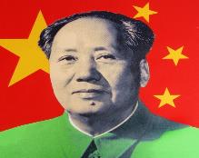
Reasons for Growth of Naxalism
Naxalite movement engages in guerrilla warfare
Mao delineated factors such as terrain, communications, popular support, quality of cadres, base areas, technical aid, surprise attacks, and relative military capability of the opposing side as crucial for victory.
Yu Chi Chan (‘Guerrilla Warfare’, 1937
Theory and practice of revolutionary warfare has 3 phases
1- organization, consolidation, and preservation of regional base areas situated in isolated and difficult terrain
2- progressive expansion, which includes attacks on police stations, sabotage, terror tactics, elimination of persons with alternate viewpoints, and procurement of arms and ammunition from the enemy,
3- destruction of the enemy through conventional battles including mobile warfare, protracted conflicts, negotiations, and unified command and control structures
Mrunal.org

Slide 23
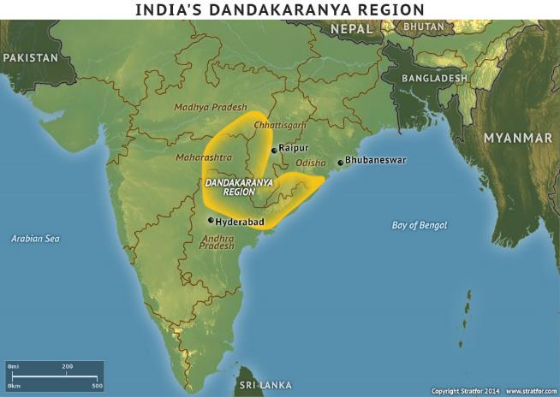
Reasons for Growth of Naxalism
Modus Operandi
Regions that have remained the showpiece of the Maoist ideology is the forests of Dandakaranya, which lie in between the borders of Madhya Pradesh, Orissa, Chhattisgarh and Maharashtra
Historically the Maoists capitalized on local sentiments to expand their influence
PWG began their work in South Bastar and Gadchiroli
PWG regrouped and led an agitation on behalf of the tribals against the low prices they were being paid for tendu leaves, used for making beedis
Event was an important development as the tribal community realized their political power for the first time
Success also brought the local tribal villages closer to the PWG
Arun Shourie in his book states, the Naxalites first commence with surveys of “Prospective Areas” that they seek to target
Mrunal.org

Slide 24
Reasons for Growth of Naxalism
Front organisations of the CPI (Maoist) are formed to instigate the local people on these issues culminating into agitations and strikes
State unleashes force, this too creates sympathy for the front organisations among the locals as they are seen to be fighting for their cause
Historically, while issues relating to livelihood remained, it was primarily the heavy handedness of the Forest Department officials that the local tribal community despised
Other issues taken up by Maoists
Caste Based Discrimination and Gender Inequalities
Religious Minorities and Nationality Struggles
SEZs and Development induced displacement
Agrarian situation in country
Maoists emerged as the protector of rights of the tribals, something that the Indian State should have done
Where the Indian State failed, the PWG emerged as a force that safeguarded their interests
Mrunal.org

Slide 25
Reasons for Growth of Naxalism
Absence of Real Empowerment
Initial expectations that PESA ignited among the tribal community has turned into disappointment that continues to alienate them from participating in the processes of local governance and asserting their rights
Gram Sabha is empowered and has the following powers:
a. The power to prevent alienation of land in the Scheduled Tribe areas and to take appropriate action to restore the land back to the Scheduled Tribe.
b. The ownership of minor forest produce
c. The power to enforce prohibition, or to regulate consumption of liquor
d. The power to exercise control over money lending to the Scheduled Tribes
e. The power to control local plans and resources
f. The power of permission/recommendation in granting licenses or mining leases for minor minerals
g. The right to be consulted before any land acquisition
h. The power to issue certificate of utilisation of for government works etc.
PESA recognized the Gram Sabha to be pre-eminent as against the Gram Panchayat
Matters such as Land Acquisition and Mining, it directly seeks to empower the Gram Sabha to give permission to mining activity and prior recommendation before any land acquisition
Report prepared by the Institute of Rural Management, Anand (IRMA), “the legislative and executive work, which state governments were meant to undertake, still remains incomplete
Many of the States have devolved power to the Panchayats, and not directly to the Gram Sabha
Mrunal.org

Slide 26
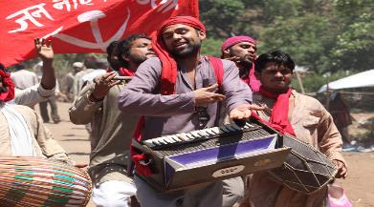

Reasons for Growth of Naxalism
Absence of Real Empowerment
Maoist goal- regime change and destruction of the oppressed structure of society in India, their mobilization strategy include amongst others, a wide ranging network of “Janathana Sarkar” (people’s government), to replace the feudal nature of society
Mobilization is based on issues of local grievances, and protests by front organizations, social and economic cooperatives, cultural activities like street plays Jan Natya Mandali and Jan Adalats (People’s courts) for dispensing justice
Problems and the injustices still meted out to the tribal community
Mrunal.org

Slide 27
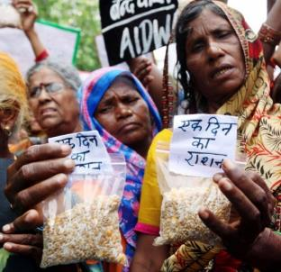

Reasons for Growth of Naxalism
Denying the tribal rights
Non regularisation of traditional land rights
Displacement and forced evictions caused by
Infrastructure projects-Irrigation and power projects
Large scale land acquisition for public purpose without proper rehabilitation and compensation
Livelihood and Social Issues
Not given dignity
Lack of food security- no proper PDS
Lack of alternative work opportunities
Poor implementation of special laws for tribals
Governance Issues
Corruption
Lack of basic amenities- essential public services Health, Education
Unsatisfactory working of local government institutions
Mrunal.org

Slide 28
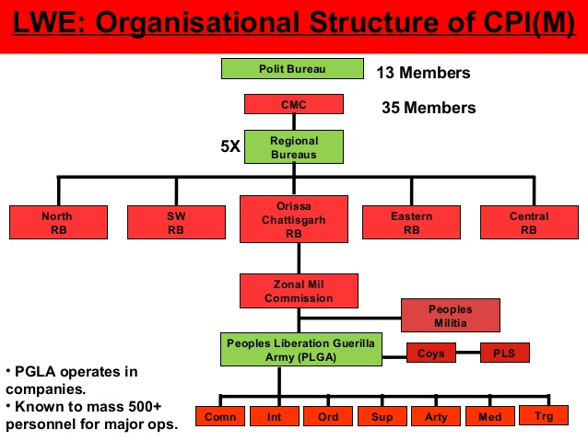
Structure of CPI(Maoist)
Mrunal.org

Slide 29
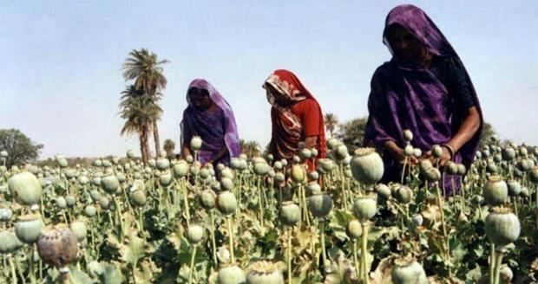

Finance of CPI(Maoist)
Ministry of Home Affairs puts the figure close to Rs 1400 crore annually
Sources at a Glance
Government Works and Schemes
Industry and Businesses
Social Institutions
Infrastructure
People
Membership Fees
Supporters/Sympathizers
Revolutionary Taxes in cash and kind
Fines on Defaulters
Another report, Extortion money is close to Rs. 2000 crore
Main targets are road contractors, contractors of forest produce like tendu patta, bamboo, wood etc
Each bag of tendu leaves earns the contractor around Rs. 1100, of which about Rs. 120 is extracted by the Maoists as extortion money
Poppy and opium cultivation among the top sources of funds
Mining activity forms the main cornerstone
Threatening local village schools and demand money sanctioned to them under the government’s schemes
Corporate houses too have become a source of large funds
Mrunal.org

Slide 30
Naxal: Cadres and Arms
Q. Cadre Recruitment process?
Use of coercion in Naxal recruitment
forcibly recruiting one cadre from each Adivasi family, compelled many families to give the female member
Recruitment strategies include the following:-
i) Ideological indoctrination.
ii) Economic and social Issues.
iii) Coercion.
iv) Promised future benefits from recruitment.
v) Participatory political organizations.
vi) Better education and health care.
vii) Recognition and redistribution of land.
Recruitment and use of children in hostilities
For part time cadres, recruitment is also targeted at educated university students affiliated to student movements
Clandestine urban networks, ethnic and tribal appeals and rural bases
Forging alliances with local populations like farmers, peasants, and tribal leaders
Collective benefits motivate individual recruitment tendencies and participation
Incentives need not necessarily be of a monetary nature, but food ration to the family, land issues, private goods, positions of authority, and security in unstable environment help recruitments
Mrunal.org

Slide 31
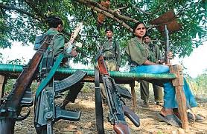
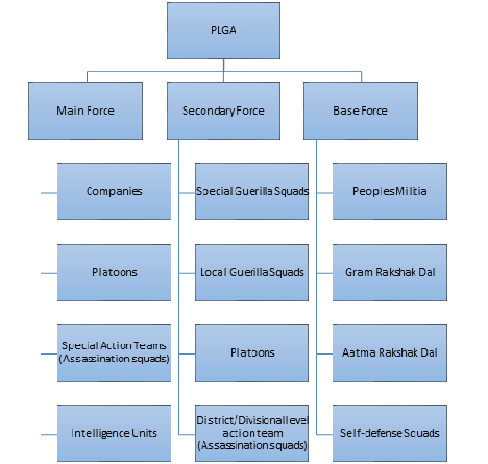
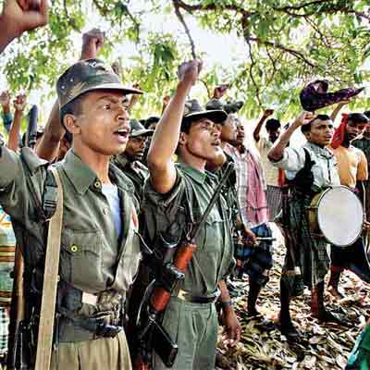
Naxals: Military and Arms
CPI (Maoist) has an elaborate military organization
Villages are dominated by the village level militia
PLGA starts forming the backbone of the rest of the military organization
Armed cadres dressed in olive green uniforms
Main attack force of the CPI (Maoist) and have a formidable armoury of weapons at their disposal
INSAS rifle, SLR, AK-47, country made rockets, mines, timer devices
sophisticated weapons that have swelled Maoist armoury from the loot have been .303s, LMG, SLR, Mortars, Stens, Revolvers and Pistols
Mrunal.org

Slide 32
Naxals: Military and Arms
Mines and mining activity has been a huge source for explosives
The use of landmines- Crippling of Security forces
“Bastar region is spread over nearly 40,000 sq km, of which up to 25,000 sq km is intensively mined
Q. how have the Maoists succeeded in acquiring such lethal weapons ?
Mainly those that are looted from police or paramilitary forces-easiest route
Also been able to procure high grade weapons from illegal arms markets in China,Bangladesh and Myanmar as well
Mrunal.org

Slide 33
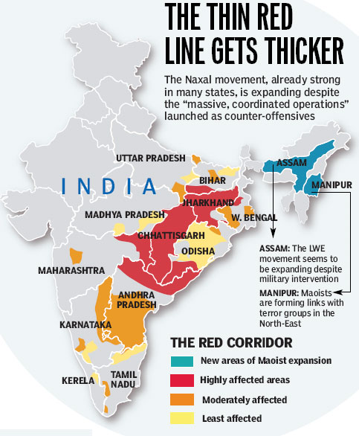
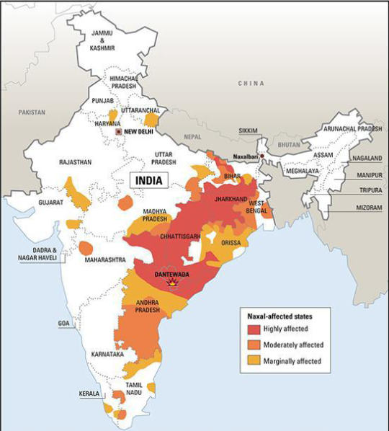
Geographical Reach
Mrunal.org

Slide 34
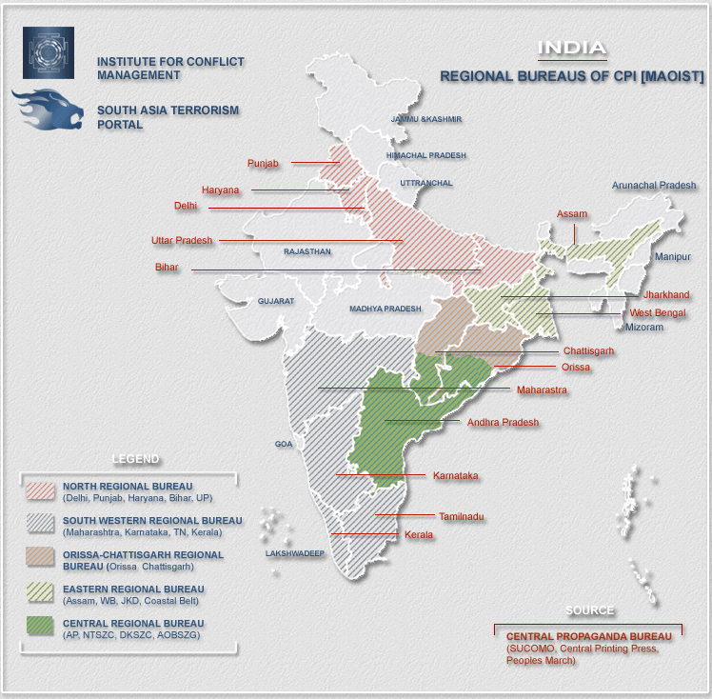
Geographical Reach
Mrunal.org

Slide 35

Cross Border Linkages
2001-formation of the Coordination Committee of the Maoist Parties and Organizations in South Asia (C-COMPOSA)
Includes ten Maoist groups from
Bangladesh, India, Nepal, and Sri Lanka
August 2002, Declaration that the CCOMPOSA cited its chief aims as resisting not only US imperialism and globalization, but also the “centralized” Indian state and its internal repression of minority people, through the Naxalite People’s War and India’s expansionist designs backed by US imperialism in South Asia
Instances of Maoist links with insurgent groups such as NSCN, supply through Bangladesh or Myanmar
Some reports of foreign government helping the naxalites/maoists
Mrunal.org

Slide 36
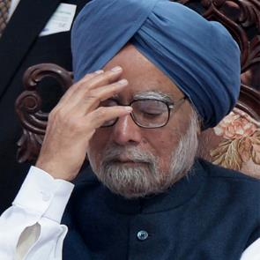
Response by the Government
Indian Government has risen to the Naxal challenge on 3 distinct grounds
1) From a Security standpoint
2) Economic & Social Development
3) Reconciliation & dignity of the Tribals
Naxalism is the biggest
challenge to India’s internal security
Advocated a coordinated effort under a Unified Command structure to deter Naxalism
Mrunal.org

Slide 37

Response by the Government
Naxalism is the biggest
challenge to India’s internal security
N.T. Rama Rao described the Maoists as "true patriots, who have been misunderstood by ruling classes
Political leaders have also realized that Naxalism is not just a law-and-order problem but is a result of low levels of development in tribal areas
Andhra Pradesh, the “blow hot, blow cold” strategy
Successes on the security front and the advantages accrued as a result were often nullified due to a soft political approach
Later on naxals were flushed out- Andhra Model
Mrunal.org

Slide 38
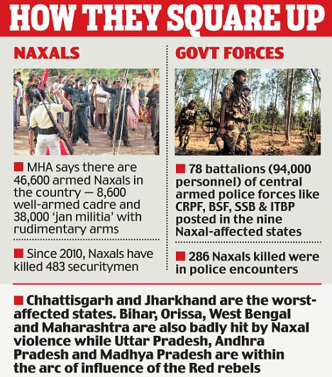

Governments Response
Security Stand Point
2006, a high-level coordination centre was also set up, headed by the Union Home Secretary, with the chief secretaries and directors general of police of Naxalite-affected states as its members
In2009
1) Increasing the strength of various central paramilitary forces such as the Central Reserve Police Force (CRPF) and the Commando Batallions for Resolute Action (CoBRA).
2) Providing assistance and training to State Police forces through Ministry of Defence and Central Police Organisations.
3) Modernization and upgradation of State Police forces and their Intelligence machinery under the Scheme for Modernization of State Police (MPF)
4) Streamlining intelligence collection and dissemination between security agencies.
5) Setting aside additional budgets for building security related infrastructure in Naxal are as such as Police stations, bunkers, roads etc.
6) Setting up of a Unified Command in each of the Naxal Affected States for better co-ordination and assistance
But no desired results due to turf battles between the local police and paramilitary forces in an affected area hamper an effective military response
Mrunal.org

Slide 39
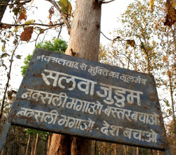
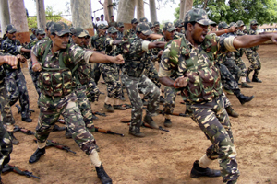
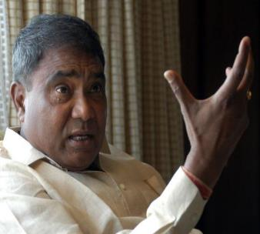
Governments Response
Security Stand Point
Counter-revolutionary Operations- How were they done?
3 steps strategy
1.Location of Base Areas
2.Isolating the Naxalites from the Support Base-
Physical Segregation + Ideological Fight
Use of Salwa Judum –Special Police officers
3.Eradication of Naxalites-
2006 the central government deployed nearly 37,000
central security forces in Chhattisgarh and 30 companies in Jharkhand
Forces shall actively enter villages and nab Naxal elements
Mrunal.org

Slide 40
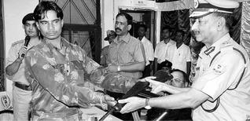
Governments Response
Socio-Economic Measures
Surrender Policies
Jharkhand government offered Rs. 50,000 to surrendered Naxalites plus a monthly allowance of Rs. 2000, one acre of agricultural land, and educational and health benefits to their children
Chhattisgarh government offered up to Rs. 3 lakh for weapon surrender
Odissa government announced Rs. 10,000 for surrender, Rs. 20,000 for arms surrender, and Rs. 2 lakh of bank loan without interest for two years
Planning Commission set up a sixteenmember expert group in July 2006 to study the root causes of Naxalism.
Schemes- PMGSY, BRGF, MGNREGA
Enactment of the Forest Rights Act, 2006 also sought to empower the local communities living in the forests to participate in the decision making pr
Mrunal.org

Slide 41
Andhra Model
late 1990s, the Naxalite movement in the North Telangana (NT) districts of Adilabad, Nizamabad, Karimnagar, Warangal and Khammam
Strong state response to the Naxalite movement by way of the Grey Hounds, an elite commando force raised by Andhra Pradesh to exclusively deal with the problem
Effective surrender and rehabilitation policy.
Culture of police leadership.
Infrastructure development.
Sound knowledge of local terrain.
Grass roots involvement in anti-Naxal operations.
Development schemes to back police response.
Incentives to police for good work.
Superior intelligence coordination and assessment.
Operations based on local intelligence.
Utilization of the “civil vigilante groups” against the mass mobilization strategy of the Naxalites
Utilized the surrendered Naxalites in anti-Naxal operations under names of
“Cobra” and “Tigers” to systemically oust
Involved a developmental response including schemes like Janma Bhoomi, Joint Forest Management (JFM), which provided people the opportunity to enjoy the benefits of the forest
Mrunal.org

Slide 42
What can the government do?
Way forward
1.Decentralisation of Power
2. Economic and Social Security
3. Security- Focusing on Intelligence
Sternly deal with naxalites indulging in violence- no blow hot blow cold strategy
Addressing this menace on political, security, developmental and public perception management fronts in a holistic manner
Its an inter-state problem, approach should be collective and coordinated
States will have to improve police response and defense infrastructure
Continuing peace dialogue with naxals forcing/asking them to give up violence and arms
Strengthening the base of political parties is needed, as youth →diverted towards state ideology →Towards Democracy
Mrunal.org

Slide 43
What can the government do?
Way forward
Continued efforts to promote local resistance groups against naxals on ideological scale
For this mass media can play very important role
Take lessons from Andhra Pradesh surrender policy
State govt. Need to accord higher priority in these affected areas
Special focus on landless poor, physical and social infrastructure
Adequate security measures for working of contractors and other agencies
Cutting source of Finance- for this even organisations like BRO can take development work for some time
Mrunal.org

Slide 44
What can the government do?
For all this to happen, few things are immediately required to shape up
Capacity building of
Security forces
Administrative institutions
need of the hour
Government personnel-eg. PMRDF
Local bodies
Mrunal.org

Slide 45
Thank You
Mrunal.org

