Slide 1

Communalism
Compiled by -Pratik Nayak
Mrunal.org

Slide 2
Communalism
Definition
Political Philosophy
Western Meaning
Communalism is a political philosophy, which proposes that market and money be abolished and that land and enterprises to be placed in the custody of community
Indian meaning
Tensions and clashes between different religious communities in various regions
Abdul Ahmed says, “Communalism is a social phenomenon characterized by the religion of two communities, often leading to acrimony, tension and even rioting between them”.
Prabha Dixit writes, “Communalism is a political doctrine which makes use of religious and cultural differences to achieve political ends.
Mrunal.org

Slide 3
Communalism
It is nothing but the misuse of religion to accomplish one’s own vested interest
It is an instrument in the hands of to upper class to concentrate power by dividing people
The elites strive to maintain a status quo against transformation by dividing people on communal and religious lines
Reality
Faith/belief in ones own religion doest not make a person communal
It is more of ideology based on religion
Mrunal.org

Slide 4
Communalism
Characteristics of Communalism
Communalism is an ideological concept
Communalism is simply engineered by opportunistic political and economic interest of contending groups and factions within a political party or by political parties
It has a broader base which encompasses social, economic and political aspects for its manifestation
It causes rivalry, violence and tension among masses
It is used by the higher class people and elites as an instrument for division and exploitation of the communal identities of the poorer sections of their co-religionists
It strikes at the roots of democracy, secularism and national integration
It is a complex process
Mrunal.org

Slide 5
Communalism
Characteristics of Communalism
Exclusive in outlook
Gives feeling of:
We
Vs.
They
Our religion is true
Hatred
Others religion is false
For a Communal Person
To get this feel, emphasize given to rituals & superstitions, orthodox thoughts
Religion isn't a faith but a feel
Mrunal.org

Slide 6
Communalism
Steps to Communalism
1. Identity of Interests
Particular religion identifying temporal interests
Beginning of communalism
2. Difference of Interest
Particular religion followers start believing that their interest are different from followers of other religion
3. Contradiction of Interest
Opposite Interest
Highest stage of Communalism
Mrunal.org

Slide 7
Communalism
Factors responsible for growth of communalism
Divide & Rule Policy Of British
Political Organizations & Political Factor
Communalisation of Politics
Economic Factor- Relative backwardness of Muslims
Poverty and Underdevelopment
Communal & distorted interpretation of history
Inertia Indifferent Government
Ineffective Handling Of Communal Riots
Psychological Causes
Negative Impact of Mass Media
Nationalism with communal overtones
Mrunal.org

Slide 8
Communalism
Impact of communalism
Anti development
Large scale damage to
Human life
Property
Psychological Damage to affected community/persons
It creates atmosphere of fear
Can become easy targets of vested interests
Worst form- Communal Riots
It Separates people on the basis of religion, language, territories and ethnic origin
Communalism gave rise to terrorism
Mrunal.org

Slide 9
Communalism
Q. How to fight against communalism?
Strict laws should be passed & stricter execution as well
Concept of Pluralism→
Public Opinion
Should be promoted in the society
Concept of Tolerance→
Use of Mass Media
Removal of preconceived notions / prejudices
Supporting rationality in religion/religious thought is also necessary
Prohibiting misuse of religion in politics
Prohibiting communal political parties
Try spreading message of ‘Sarvadharma Sambhav’
‘Prevention of Communal and Targeted Violence (Access to Justice and Reparations) Bill, 2011’
provided for a seven-member National authority for communal harmony, justice and reparations
Mrunal.org

Slide 10
Communalism
Q. Globalisation & Communalism
1. Globalisation discouraged communalism
Globalisation→ New Ideas
New Ideas→ Secularism, Democracy etc.
2.Globalisation→ Industrialisation
Industrialisation→ Economic growth
Economic growth→ Growth of all sections
3.Globalisation→ Western Culture
Western Culture→ Influence on local culture
Rise of fusion culture
No discrimination based on culture→ No communalism
Mrunal.org

Slide 11
Communalism
Q. Globalisation & Communalism
1. Globalisation encourages communalism
Globalisation→ Impact of western culture
Minority feeling→ My culture under threat
Saving own culture by taking course of communalism
2.Globalisation→ Industrialisation
Industrialisation→ Advantage to skilled labour & economically powerful
Rise in Economic disparity
Poor people gets influenced on communal lines
Mrunal.org

Slide 12
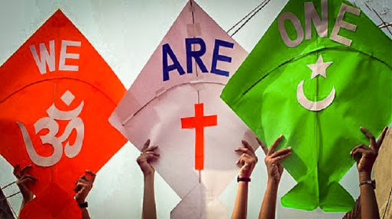
Thank You
Mrunal.org

Slide 13

Secularism
Compiled by-Pratik Nayak
Mrunal.org

Slide 14
Secularism
Definition
Humanist philosophy which believes Social, Political & Economic aspect of life should be separated from religion
‘Law should rule, instead of religion’
But, Q?
Why , this philosophy came into existence?
Mrunal.org

Slide 15
Secularism-History
Medieval Times
Religion creates the system
Religion decides the rule of the society
Political system, Economic system, Social system etc.
Eg. Ancient India→ Guidelines for ruling according to Dharmshastra
Similarly, Shariat Law-Islam
Theocratic State
Gospel Law- Christianity
Modern day Iran- Ayatollah, Supreme leader
Mrunal.org

Slide 16
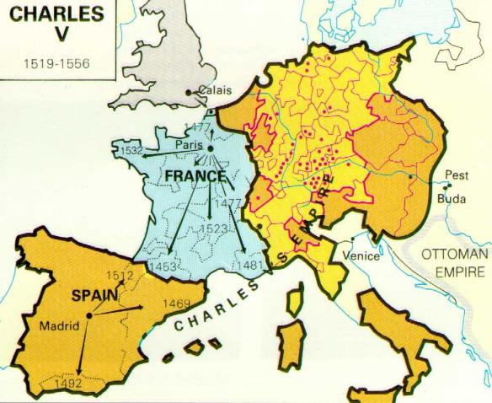
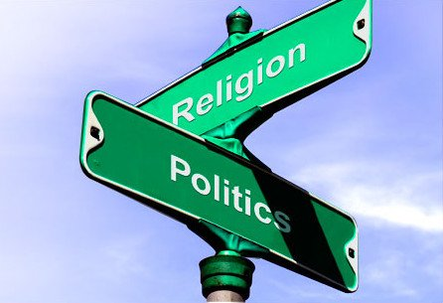
Secularism- History
On that line, in Europe→
Rule by→
Holy Roman Church→
Holy Roman Empire
Till 15-16th CE this Holy Roman Church was playing dominant role
King used to accept the hegemony of the church, why?
Less Revenue was there, so king had to rely on church to legitimise his rule
15-16th Centure→ Towards Modernism→ Commercial Revolution
Revenue to the king→ Strengthening of his own army, administration
Decreasing the role of church
King: Religion has no role in administration of the state
Post revolutions, Equality among all religions came
Eg. Modern day turkey
Religious liberty given to all citizens
Mrunal.org

Slide 17
Secularism- History
Reasons for rise of Secularism
Medieval Europe
1.Domination of Catholic Religion
Renaissance→ Enlightenment
Emergence of Protestant Religion
Division of European society into two parts
Therefore, need aroused for nations to get neutral in terms of religion
2. Rise of Intellectual Class→ Religious neutrality
3. Development of Science
It started fulfilling the needs of common man
Mrunal.org

Slide 18
Secularism
Secularism
Positive Aspect
Negative Aspect
Mrunal.org

Slide 19
Secularism
Positive Aspect
Negative Aspect
Emphasizes on:
Emphasizes on
This World
Neutrality from religion
Supports Material Aspects
Religion→ Shouldn't govern temporal aspects of life
Material aspect→ Rational Thinking & Scientific Outlook
Mrunal.org

Slide 20
Secularism
Secularism
Western Model
Indian Model
Mrunal.org

Slide 21
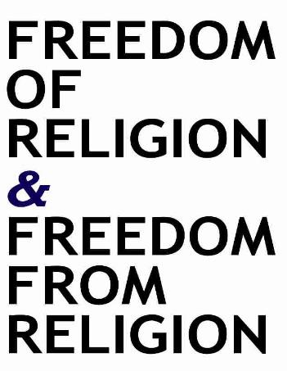
Secularism
Why it was introduced? √
Features of Western Model of Secularism
1. Neutrality from Religion
Separation of state & religion
2. Believes in This Worldliness
3. Has Scientific thought & outlook
Rational way of thinking
4. Morality is Secular
Ethics & religion are different
Mrunal.org

Slide 22
Secularism
Features of Western Model of Secularism
Focus on Individual→ Freedom & Equality
No scope for the Community Liberty
Liberty of the community to follow practices on its own
Why this?
Western Society→ Fairly Homogeneous in religion
Except Jews & Some Others
It doesn't talk of Inter religious ( minority) rights
Now, Q. What is Indian secularism?
Mrunal.org

Slide 23
Secularism
Q. What is Indian Model of Secularism?
Inter religious tolerance
Historical Idea
Peaceful Coexistence
1. Equality within Community
Intra religious reforms
Dalits, Women
2. Western model→ Deals with liberty of Individuals
Indian Model→ Liberty of Individual
+ Liberty of Community
Right to exist & maintain their culture, educations institutions
Mrunal.org

Slide 24
Secularism
3. Ending Interreligious discriminations
Banning Untouchability
State supported religious reform
eg Hindu Code Bill
Abolishing Child Marriage
Q. What is Indian Model of Secularism?
When does the state engages itself?
2 ways
Generally to stop religious tyranny
At times, to help religious educational institutes in form of Grant-in-aid
Mrunal.org

Slide 25
Secularism
So, Can we say that→ Indian notion of Secularism
Based on ‘Sarvadharma Sambhaav’
All religion are Equal
S. Radhakrishnan: Indian Secularism is a Dynamic Concept
It suits our plural society
Q. What if state keeps itself neutral?
Minority religion will suffer
No one will be there to help them
Therefore, State Interferes in Positive sense
Mrunal.org

Slide 26
Secularism
Q. What is Indian Model of Secularism?
Where do you find Secular nature in Indian Constitution?
1. Preamble→ Basic Feature
Unlike England
2.India has No Official Religion
3.Prohibition of all forms of discrimination→ Religious
4.Individual & Community rights
5.Freedom to profess, propagate & practise religion
Mrunal.org

Slide 27
Secularism
Q. What is Indian Model of Secularism?
Criticism on Indian Secularism
1. It is Anti- Religious
It is against institutionalised religion
Therefore, cant say it is anti religious
2. It is an Western Import
First of all big difference can be seen between western & Indian models
Second, we can definitely borrow +ve things from west, nothing wrong in it.
Mrunal.org

Slide 28
Secularism
Q. What is Indian Model of Secularism?
Criticism on Indian Secularism
3. Favours Minoritism
Yes, It advocates minority rights
Eg. 4 Persons in train compartment-A,B,C,D
Person A wants to smoke
Person B,C smokes but currently in no mood
Voting on whether to smoke or not
Person D doesn’t smokes at all
Conclusion: Minority loses even if proper democratic process is followed
1:3
Mrunal.org

Slide 29
Secularism
Q. What is Indian Model of Secularism?
Criticism on Indian Secularism
4. It is Interventionist
Critics: It is interferes excessively with religious freedom
Indian Secularism→ Concept of Principled Distance
If need arises, the state intervenes
5. It promotes Vote bank Politics
We are a Democracy
In democracy→ Politicians are bound to seek vote
If, the real motive is religious polarisation, then it is bad
Mrunal.org

Slide 30
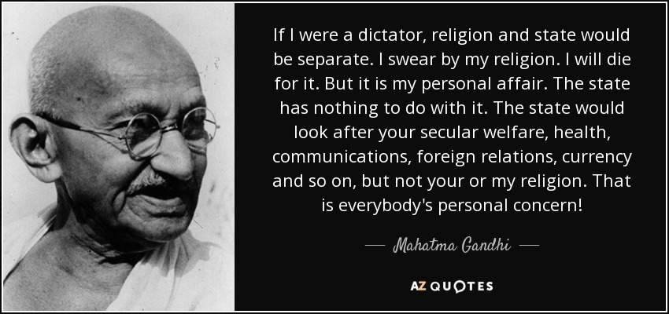
Secularism
Q. What is Indian Model of Secularism?
Gandhi’s View
Spiritualisation of Politics
Politics should be guided by ethics drawn from religion
Not any one religion, but moral values that informs all religions
Didn't supported western model of secularism
Mrunal.org

Slide 31
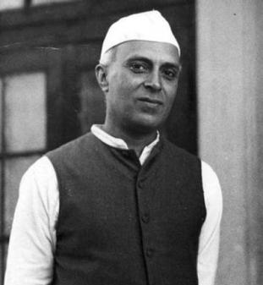
Secularism
Q. What is Indian Model of Secularism?
(Swarg, Heaven, Jannat)
Nehru’s View
Opposed synthesis of state & religion
Objectives of religion → Extra worldly
Objectives of politics → This worldly ( PM,CM, DM)
What will happen when there will be synthesis of politics & religion?
It will lead to problem for minority
Communalism
State may become instrument of dominant religious group
Religion→ It is against scientific outlook
Opposed the role of religion in public sphere
Supports religious freedom of every individual ( concerned @ individual rights)
Mrunal.org

Slide 32
Secularism
Why India adopted Secularism?
For a development of a democratic society
Secularism is needed
Administration-
It Should be secular
India is a multi-religious country.
Inclusive development will only be possible when we adopt secularism
this freedom can be only achieved when we give religious freedom & remain secular
Democracy→
Freedom/Rights→
Democracy→ Development of Citizen
It will happen only when there is religious freedom
Mrunal.org

Slide 33
Secularism
Is India a secular country?
Yes
No discrimination based on religion
Every persons intuition→ free to follow religion of his/her choice
Every religion is equal

Slide 34
Secularism
No
Is India a secular country?
Administration→ Governed by People
People→ not all are secular
Holidays are based on religion
Absence of Uniform Civil Code
Relation between citizen & state are governed by religion
Marriage-Divorce system based on religion.
Giving subsidy to religious institutions
Taking part in religious functions
Administration of religious institutions by state
Use of religion in elections by political parties
Mrunal.org

Slide 35
Secularism
Is secularism a scientific approach?
No, it doesn't supports scientific view
Yes, it is scientific
Indian Secularism
It focuses on beautification of This World
Why??
Ethics are mainly derived from religion
It condemns the supernatural existence
It considers all religion as equal
Ethics is free from religion
Mrunal.org

Slide 36
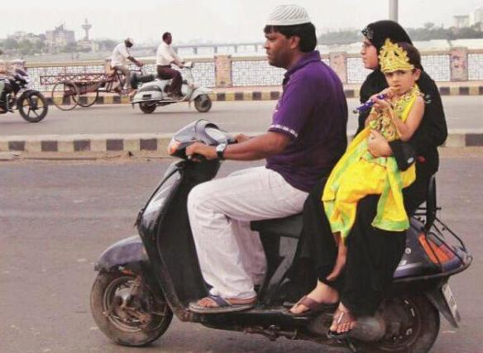
Thank You
Mrunal.org

