Slide 1

SyncCamera
G.Nihar Reddy (1602-16-737-087)
J.Pooja (1602-16-737-089)
N.H.N.S.Pranay (1602-16-737-090)

Slide 2
Problem Statement
Very often people posing for pictures do not know how they’re looking in the frame in the real time.
The person has to check the pictures after they’re taken and make changes in the pose the way they pose.

Slide 3
Solution
Our idea is to build an app that remotely accesses camera of the another phone
Now the subject can use this on their own phone and check how they are looking in the photographer’s phone in the real time.

Slide 4
Use Cases
Login:
Get registered.
Connect:
Connect the devices using bluetooth and wifi-hotspot.
Stream:
Stream in the connected device.
Display in the connected device:
Display the output/ video in other phone.
Disconnect:
Disconnect the connection established earlier.

Slide 5
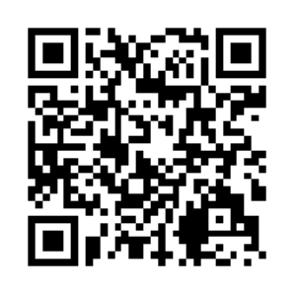
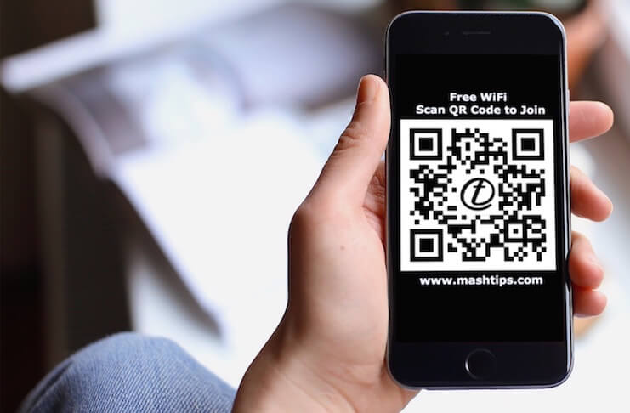
Process:
LOGIN
CONNECT

Slide 6
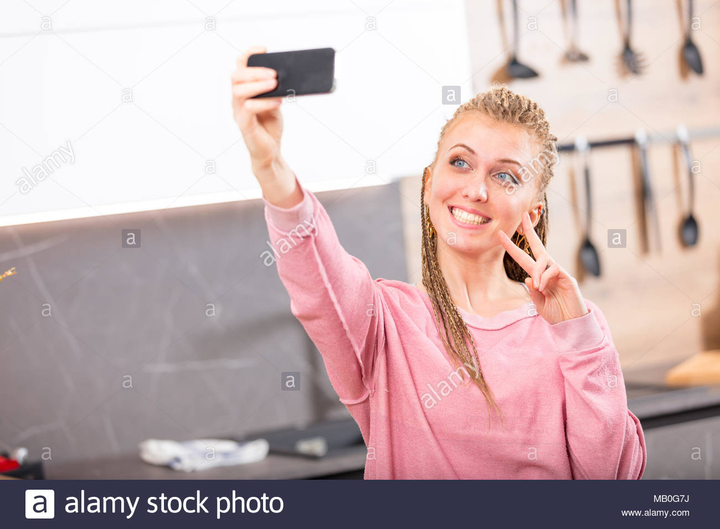
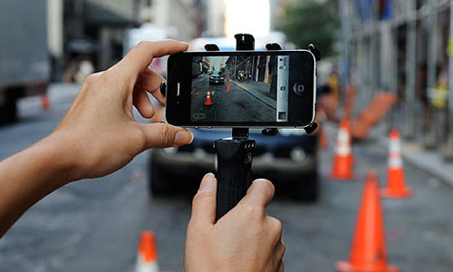
STREAM
DISPLAY IN CONNECTED DEVICE
DISCONNECT

Slide 7

Technology Stack
Android Studio
Network Service
directory
Creating P2P connections with Wifi

Slide 8
Thank you!

