Slide 1
Bluestock Mutual Fund Analysis
Data engineering | Performance & risk | Investor analytics | Interactive dashboard
Final capstone presentation | Built from the supplied project datasets

Slide 2
Problem and project objectives
BLUESTOCK | MUTUAL FUND ANALYSIS
Bring fragmented industry, scheme, NAV, benchmark and transaction data into one analysis workflow.
Compare returns and risk consistently across a 40-scheme sample.
Explore investor transaction patterns and SIP continuity without claiming population representativeness.
Deliver reproducible local analytics and an interactive four-page Streamlit dashboard.

Slide 3
Data sources and coverage
BLUESTOCK | MUTUAL FUND ANALYSIS
10 supplied CSV datasets: fund master, NAV, AUM, SIP, category flows, folios, performance, transactions, holdings and benchmarks.
NAV: 40 schemes across 1,608 observed dates.
Investor transaction sample: 32,778 rows, January 2024 to May 2025.
Latest fund-house AUM snapshot: Dec 2025; INR 62.74 lakh crore.
Additional MFAPI live-NAV utility is opt-in; analytics pipeline runs offline by default.
Coverage windows differ by dataset; category inflows are FY25-only and holdings are a single snapshot.

Slide 4
ETL and analytics architecture
BLUESTOCK | MUTUAL FUND ANALYSIS
RAW DATA
10 source CSVs
>
TRANSFORM
Validate + normalize
>
MODEL
Processed CSV + SQLite
>
ANALYZE
EDA + performance + risk
>
DELIVER
Streamlit + PDF + PPTX
Keys: amfi_code for scheme-level joins; date for aligned snapshots/market series.

Slide 5
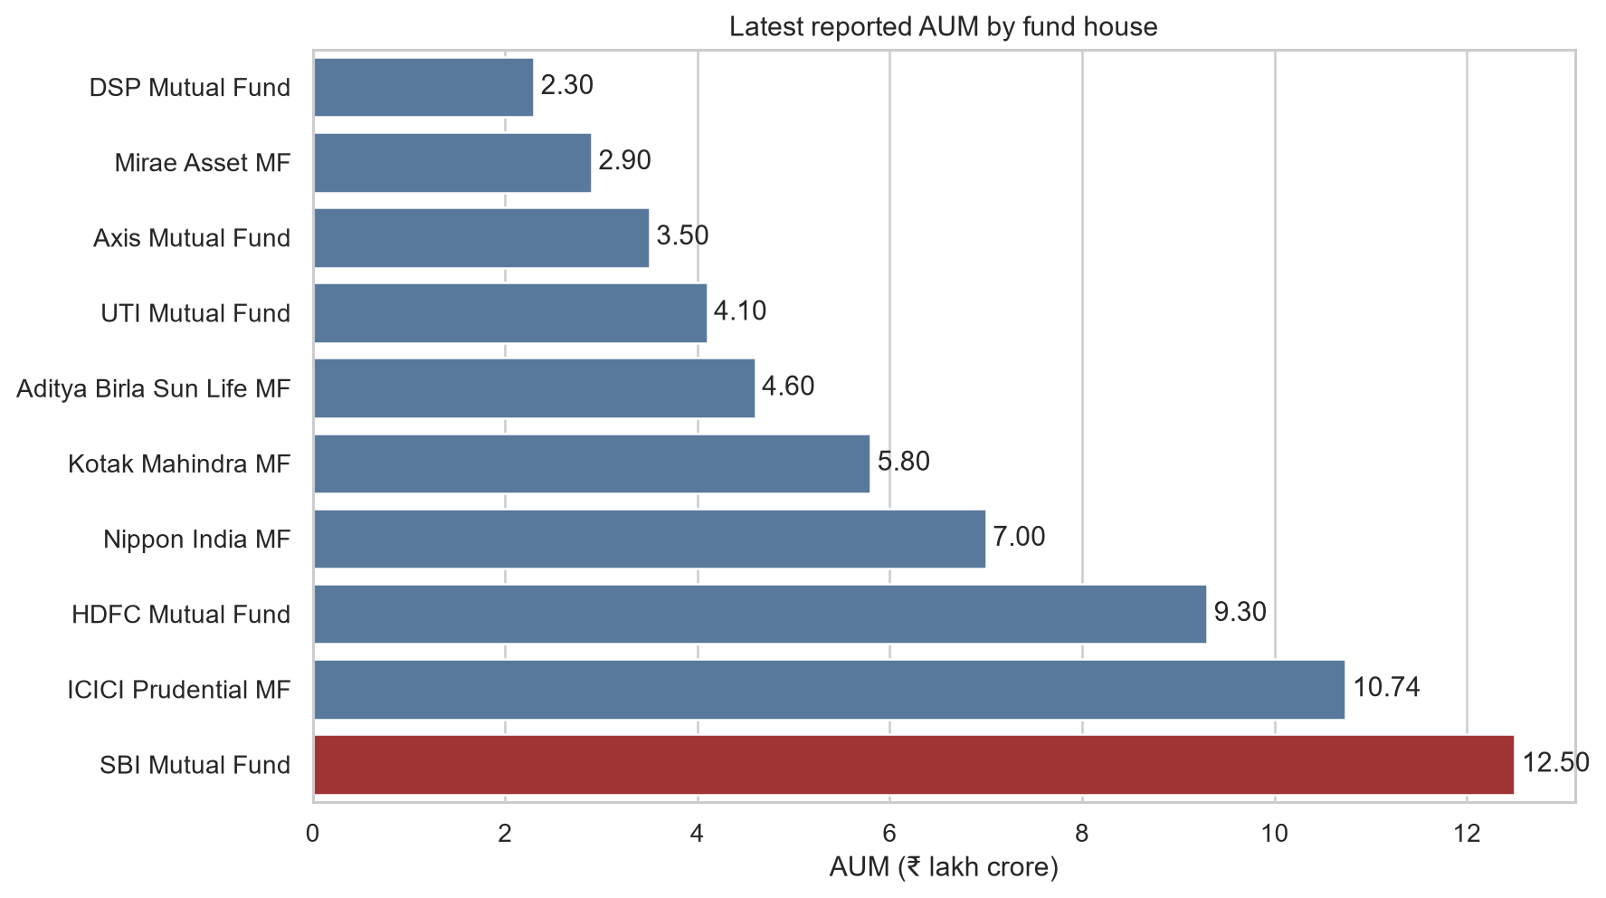
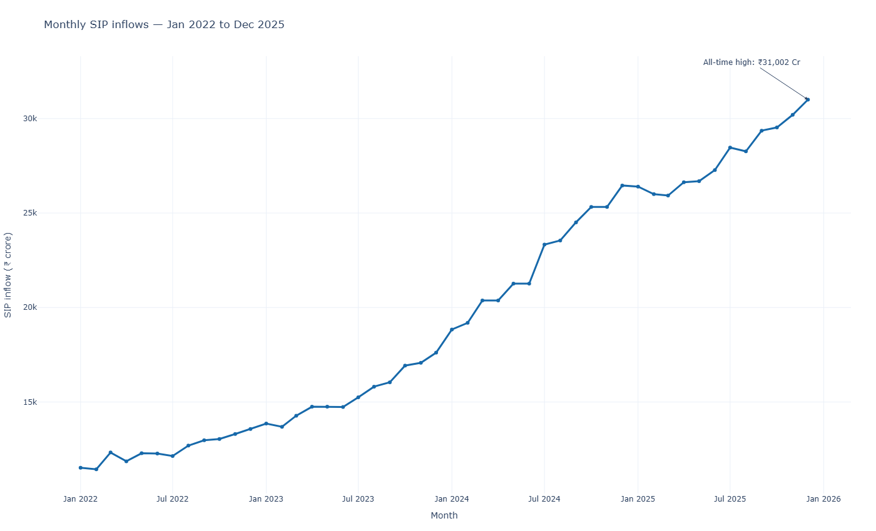
EDA highlight 1 | Industry and flows
BLUESTOCK | MUTUAL FUND ANALYSIS
December 2025 SIP inflow: INR 31,002 crore; supplied AUM snapshots through Dec 2025.

Slide 6
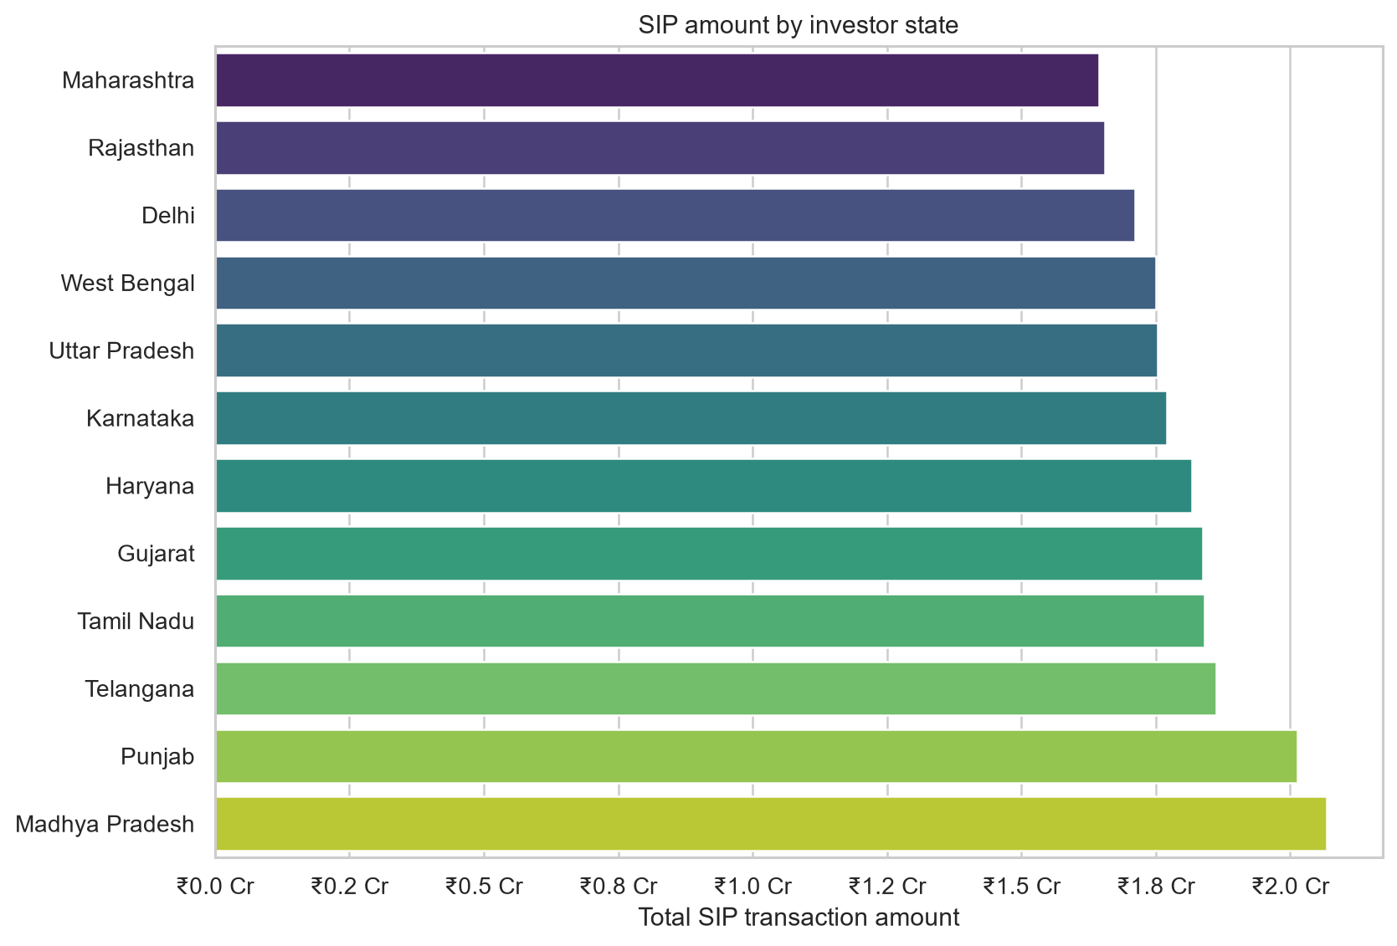
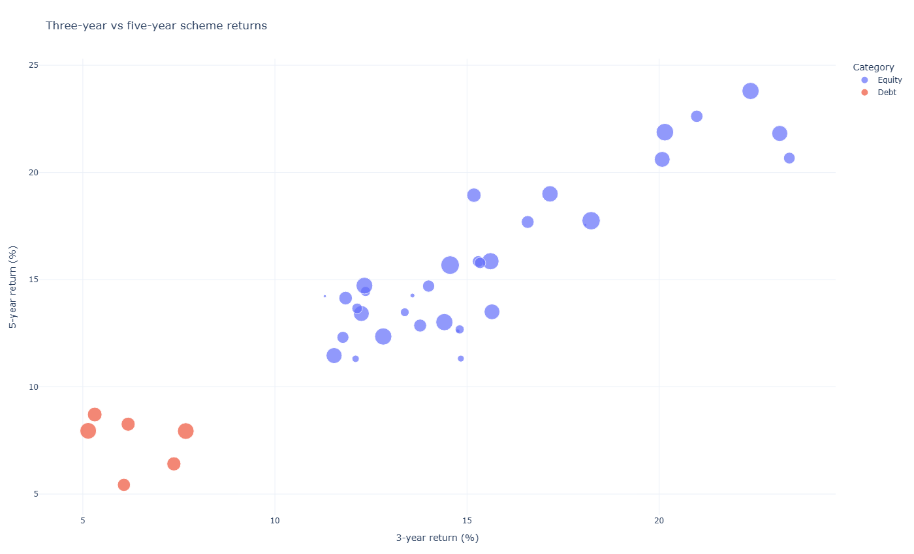
EDA highlight 2 | Investors and schemes
BLUESTOCK | MUTUAL FUND ANALYSIS
Investor summaries describe the supplied sample. Five-year returns are not available for the complete 2022-2026 NAV window.

Slide 7
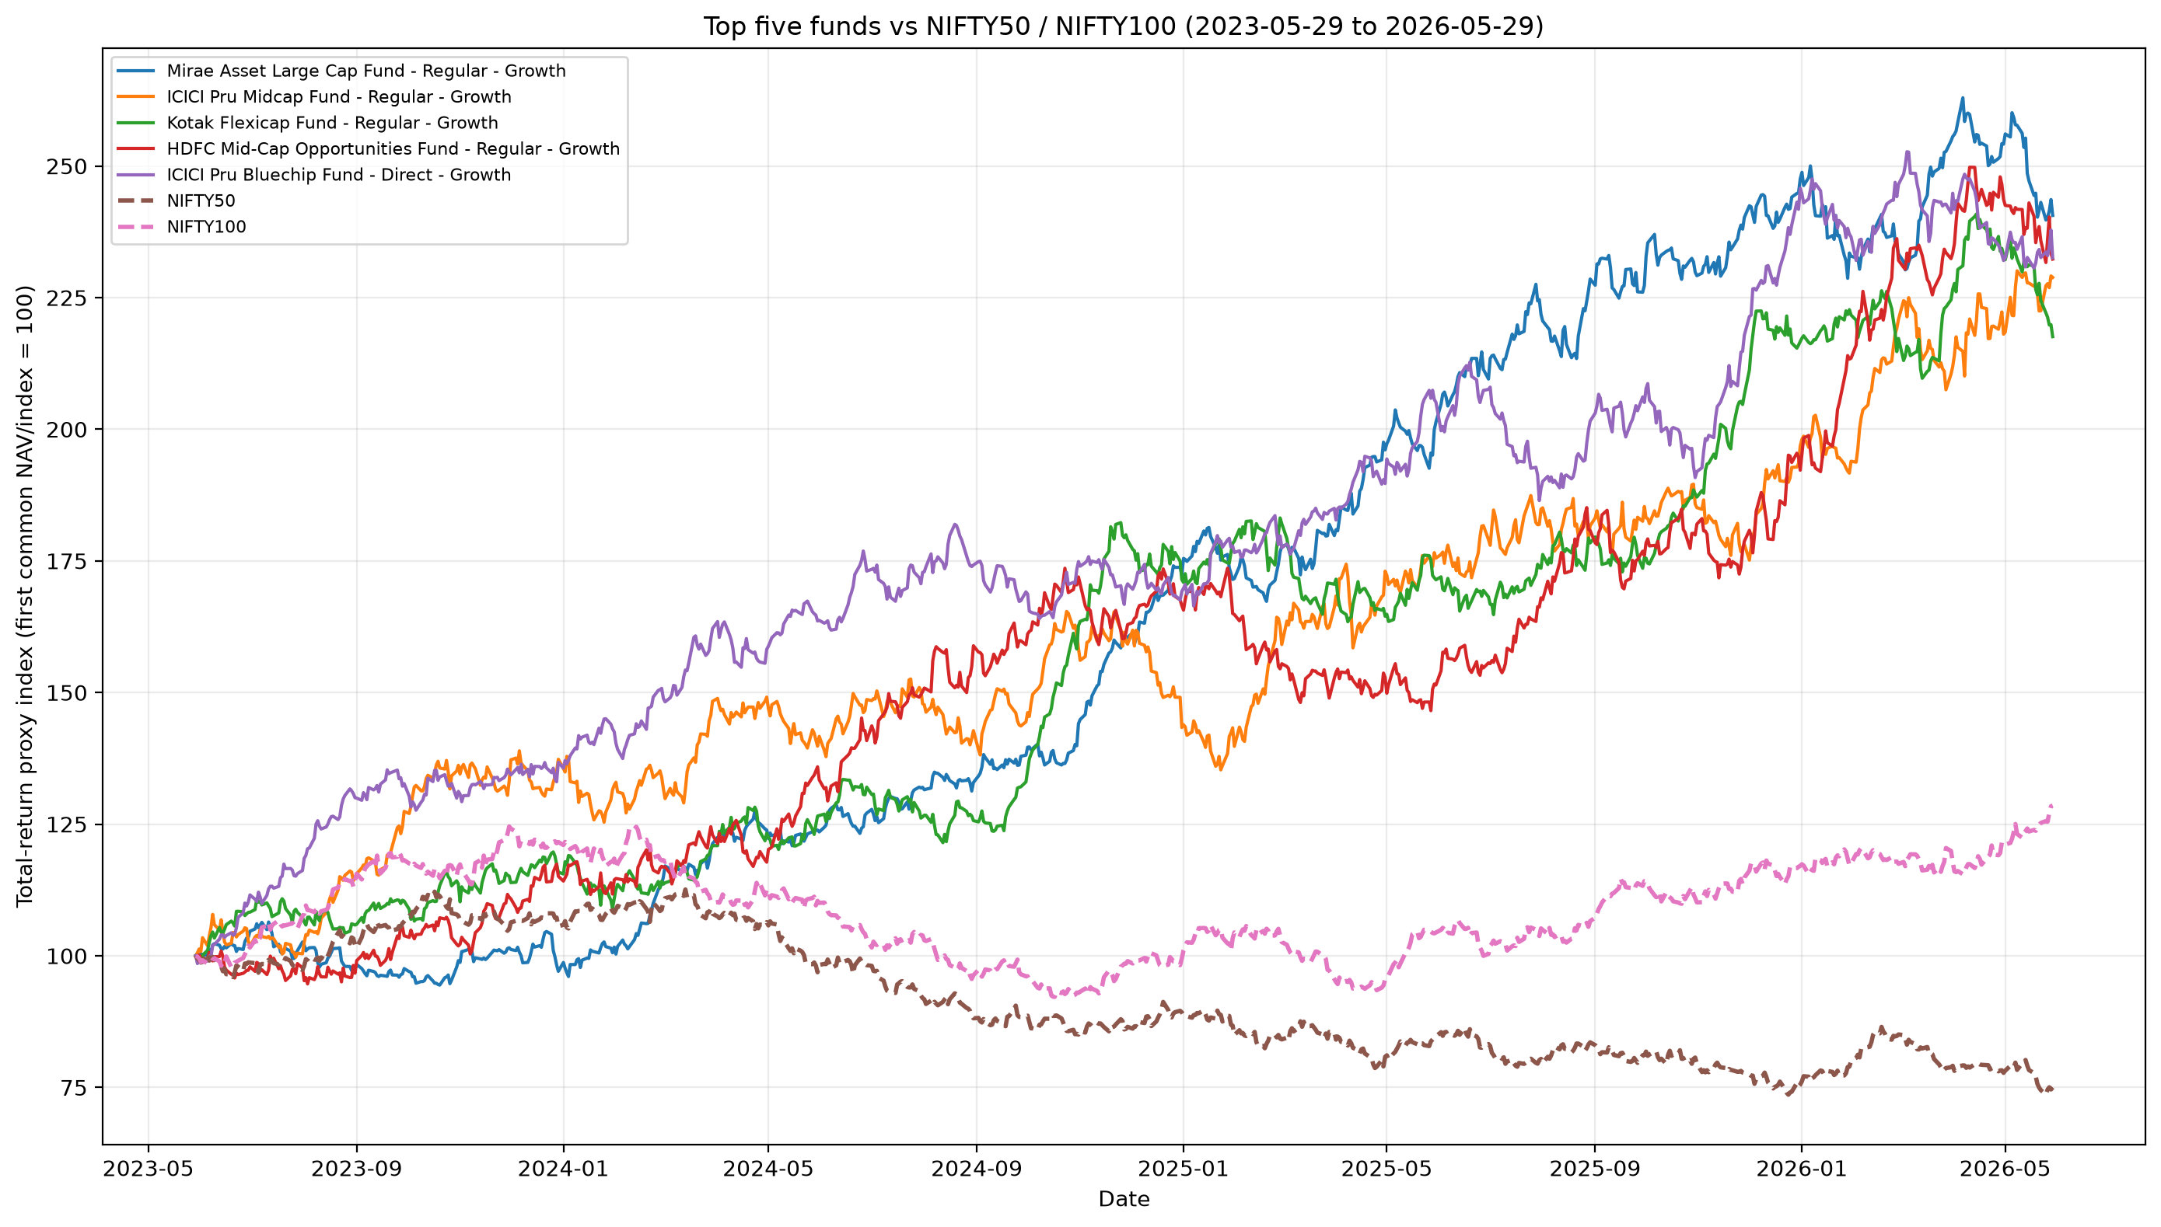
Performance | Composite scorecard
BLUESTOCK | MUTUAL FUND ANALYSIS
Top composite rank: Mirae Asset Large Cap Fund - Regular - Growth
Score 86.25/100 | three-year CAGR 34.0% | Sharpe 1.46
Weights: 30% three-year return, 25% Sharpe, 20% annualized alpha, 15% inverse expense, 10% inverse drawdown.
Five-year CAGR is NA: observed daily NAV begins in January 2022.
Score is a screening heuristic using percentile ranks; not an investment recommendation.

Slide 8
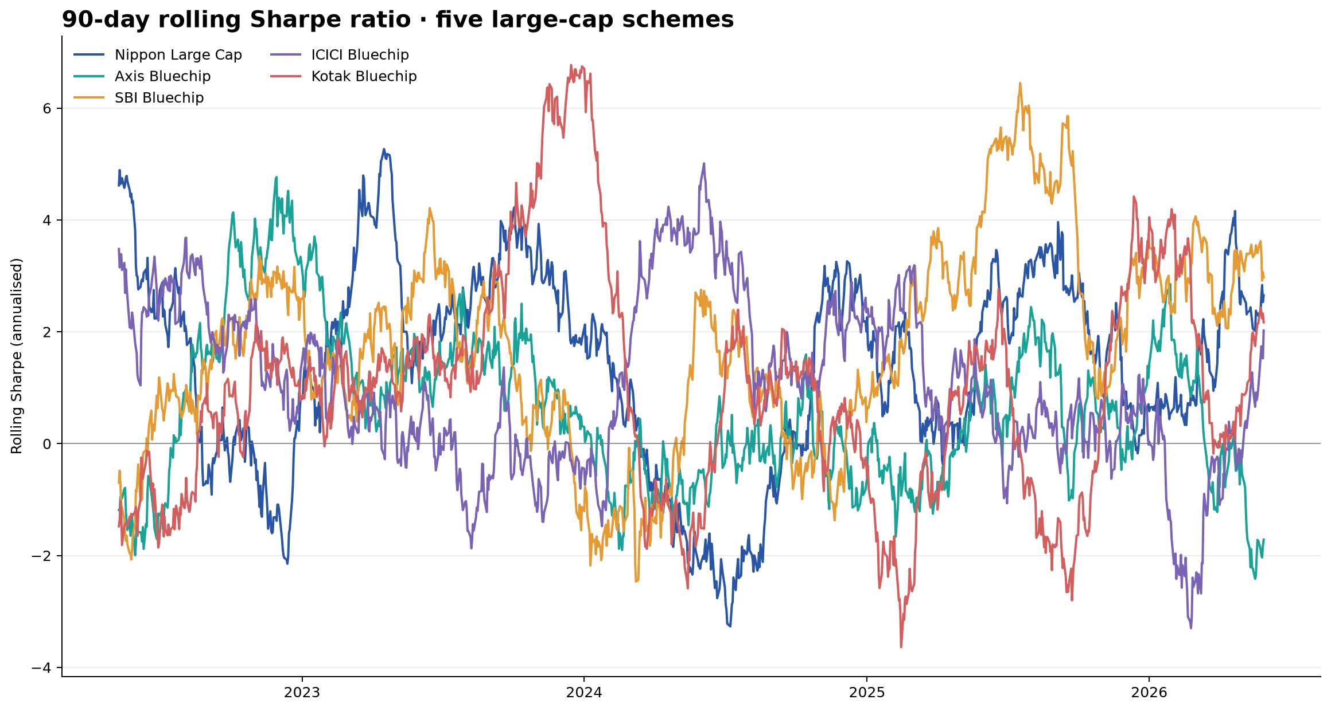
Performance | Risk and benchmark context
BLUESTOCK | MUTUAL FUND ANALYSIS
Most negative historical 95% daily VaR: SBI Small Cap Fund - Direct Plan - Growth (-2.69%).
Tail conditional mean (CVaR): -3.24%.
Daily metrics use 1,149 observed market-date returns per scheme; annualized with 252 trading days.
Risk-free proxy is 6.5% p.a.; alpha/beta use OLS versus NIFTY100 daily returns.
Historical tail estimates describe the sample and do not bound future losses.

Slide 9
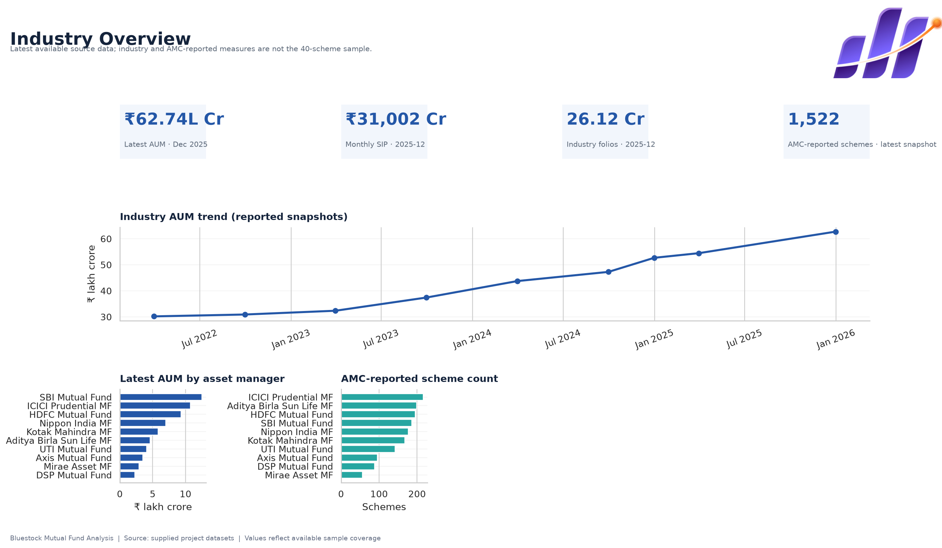
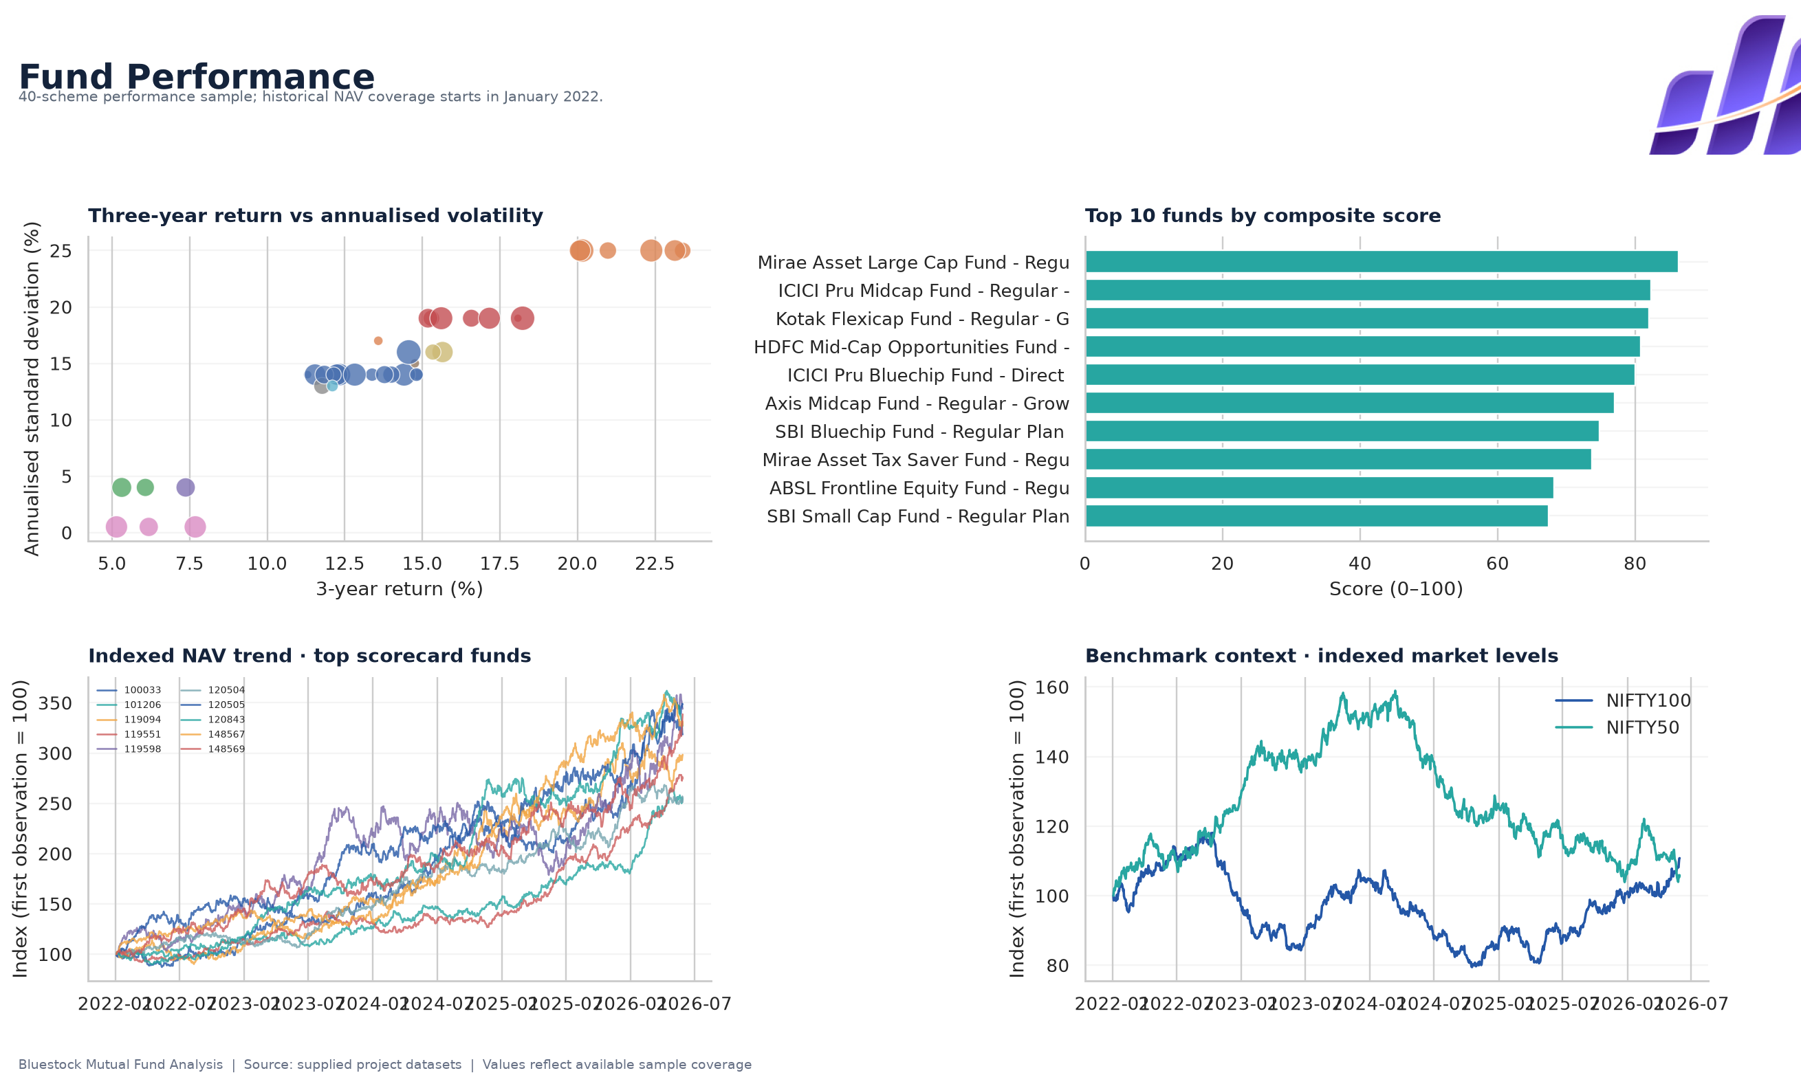
Dashboard | Industry overview and performance
BLUESTOCK | MUTUAL FUND ANALYSIS
Interactive local Streamlit dashboard; screenshots show static page exports.

Slide 10
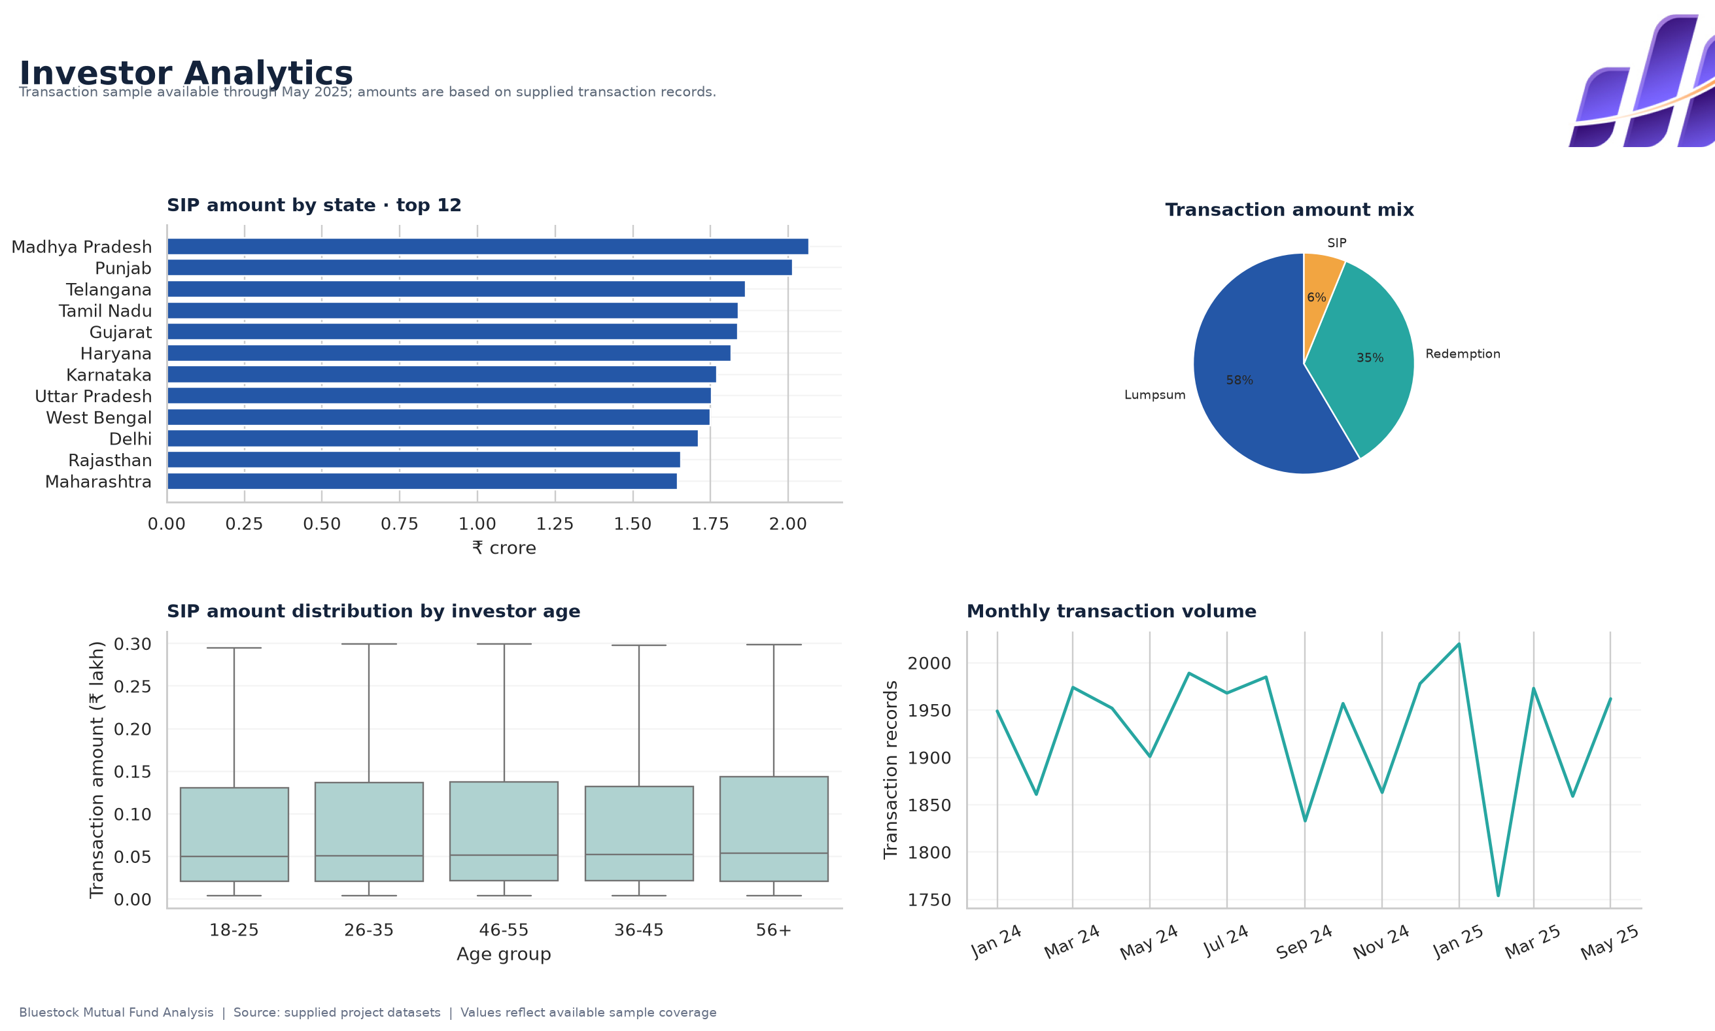
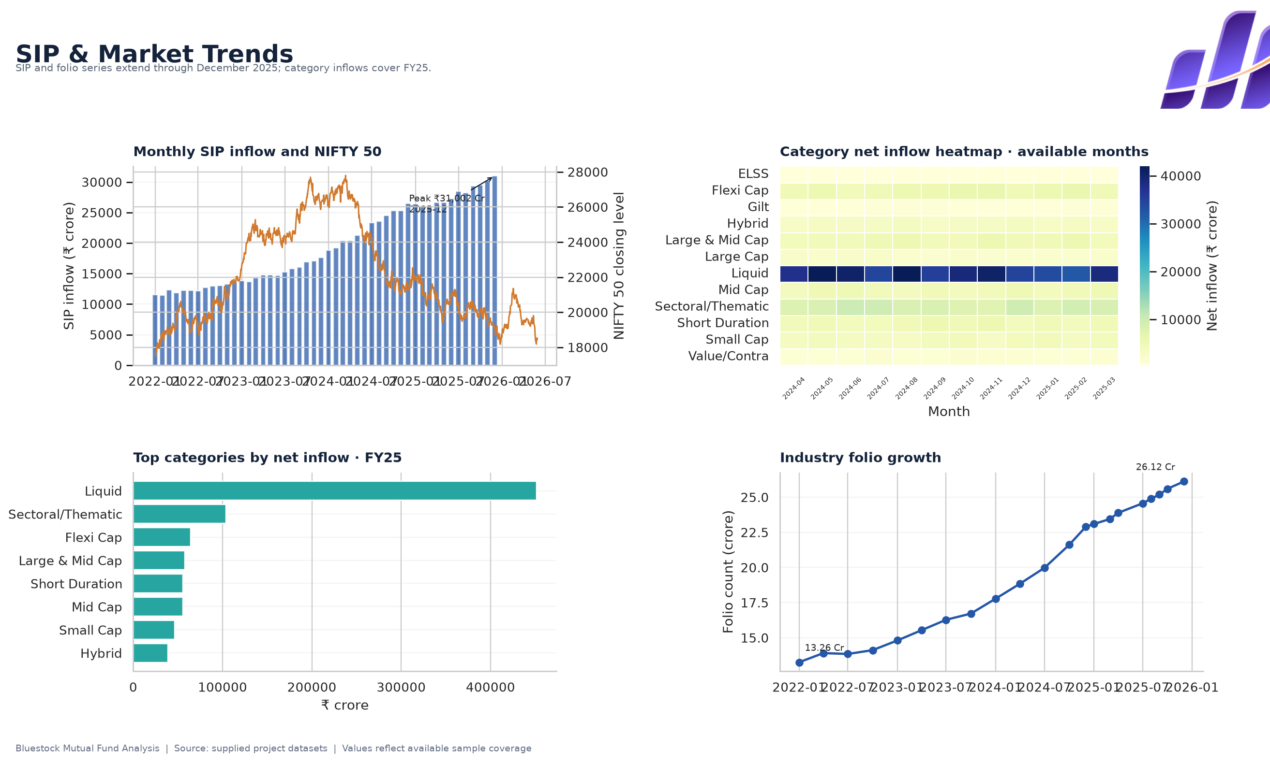
Dashboard | Investor and SIP trends
BLUESTOCK | MUTUAL FUND ANALYSIS
Page outputs are limited to source dataset coverage and are not a published dashboard.

Slide 11
Key findings and recommendations
BLUESTOCK | MUTUAL FUND ANALYSIS
Industry AUM totals INR 62.74 lakh crore in the latest supplied snapshot; monthly SIP series peaks at INR 31,002 crore.
Observed market-date NAV avoids artificial zero returns from forward-filled weekends and holidays.
At-risk SIP flag is a rule-based signal: mean gap >35 days for investors with 6+ SIP rows.
Use scorecard and risk metrics for screening; verify suitability, holdings, fees and benchmark fit.
Extend category flow, holdings and NAV history before stronger claims or long-horizon comparisons.

Slide 12
Thank you
Questions | Local Streamlit dashboard | Reproducible analytics
Limitations: sample coverage, historical metrics, no hosted URL and no validated native PBIX.

