Slide 1
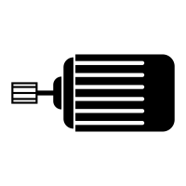
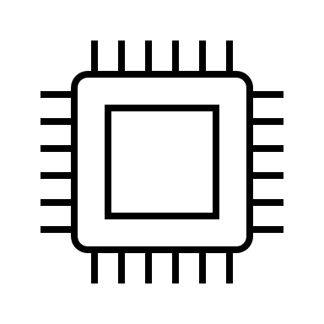




2.4GHz 4-channel transmitter
2.4GHz 4-channel transmitter
Up button
Increase pre-tension
Model TBD
Driver
Motor
Down button
Reduce pre-tension
Tx
Rx
Inputs
Microcontroller
Outputs
Rx
Left button
Shift lower
Right button
Shift higher
Optional
Gearing
5V
3V CR2025 Battery
3V CR2025 Battery
Shifter Controller Module
(5V)
Battery
Model TBD
Cable
Power management
Shifting Module
Stock Derailleur

